Slide 1
Digital Health to Support Family Planning Providers
Improving knowledge, capacity, and service quality
Notes:
Used by appropriately trained health care providers and with supportive processes in place, devices such as mobile phones, tablets, and computers with various software applications are equipping countries to improve health care delivery, strengthen health systems, and support clients.
The recommendations here include interventions in mHealth (medical and public health practice supported by mobile devices) and eHealth (the use of information and communication technologies for health), with the most recent evidence largely focused on mHealth.
Photo Credits: ©2015 Ueli Litscher, Courtesy of Photoshare
REVISED: 5/4/21

Slide 2
Overview
What is a HIP?
HIP Categories
Partnership
Introduction to the High Impact Practices (HIPs)
PART
PART
Background
Theory of Change
How can digital technologies enhance HIPs?
Indicators
Digital Health to Support Family Planning Providers
Priority Research Questions
Implementation Tips
Tools & Resources
Extra Slides
11
Digital Health to Support Family Planning Providers
02
Notes:
Thank you for using this slide deck! This is a product derived from the HIP brief to assist you in presenting to a variety of audiences. Instructions and additional resources are included in the notes of each slide for your convenience. There is a wealth of information and resources in the “Notes” section of each slide.
This presentation is divided in three parts: an Introduction to the High Impact Practices (HIPs) in Family Planning, Digital Health to Support Family Planning Providers, and Extra Slides.
The logo for your organization or ministry may be added to these slides. The web addresses provided in the “Notes” section of each slide can be copied and pasted into your web browser.

Slide 3
High Impact Practices in Family Planning (HIPs) are…
Evidence-based family planning practices
Vetted by experts against specific criteria
Documented in an easy-to-use format
Digital Health to Support Family Planning Providers
03
Notes:
High Impact Practices (HIPs) are a set of evidence-based family planning practices vetted by experts against specific criteria and documented in an easy-to-use format.
The High Impact Practices in Family Planning (HIPs) were first created in 2010 after a survey of FP stakeholders revealed little consensus for “what works” in international FP programming. A small group of leaders in FP were brought together with the task of identifying a short list of HIPs that if implemented at scale would help countries address the unmet need for FP and thereby increase national contraceptive prevalence.
HIPs are identified based on demonstrated magnitude of impact on contraceptive use and potential application in a wide range of settings. Consideration is also given to other relevant outcome measures including unintended pregnancy, fertility, or one of the primary proximate determinants of fertility (delay of marriage, birth spacing, or breast feeding). Evidence of replicability, scalability, sustainability, and cost-effectiveness are also considered.
For more information, please copy and paste this link into your web browser to see this video: https://www.youtube.com/watch?v=N6V0gfl-V3k&ab_channel=KnowledgeSUCCESS
A 2-pager overview of the HIPs is available in an online and a downloadable PDF format here (copy and paste this link into your web browser): https://www.fphighimpactpractices.org/high-impact-practices-in-family-planning-list/

Slide 4
HIPs address the full spectrum of FP programming
Enabling Environment
Service Delivery
Social and Behavioral Change
PART
Address systemic barriers that affect an individual’s ability to access family planning information & services. 6 briefs
Improve the availability, accessibility, acceptability, and quality of family planning services. 8 briefs
Influence knowledge, beliefs, behaviors, and social norms associated with family planning.
3 briefs
Enhancements
Approaches used in conjunction with HIPs to maximize the impact of HIP implementation or increase the reach. 4 briefs
Digital Health to Support Family Planning Providers
04
Notes:
There are three categories of HIPs: Enabling Environment, Service Delivery and Social and Behavioral Change. Digital Health to Support FP Providers is an Enhancement HIP. This information came from the HIP List (copy and paste this link into your web browser): https://www.fphighimpactpractices.org/high-impact-practices-in-family-planning-list/
A HIP Enhancement is a tool or approach that is not a standalone practice, but it is often used in conjunction with HIPs to maximize the impact of HIP implementation or increase the reach and access for specific audiences. The intended purpose and impact of enhancements are focused and, therefore the evidence-based and impact of an enhancement is subjected to different standards than a HIP.
For more information about the HIP Categories and Enhancements, please copy and paste this link into your web browser: https://www.fphighimpactpractices.org/high-impact-practices-in-family-planning-list/
Here are a few examples of HIPs from each category:
Service Delivery:
Immediate Postpartum Family Planning
Mobile Outreach Services
Postabortion Family Planning
Enabling Environment:
Domestic Public Financing
Educating Girls
Supply Chain Management
Social and Behavior Change:
Community Group Engagement
Digital Health for SBC
Mass Media
Enhancements:
Digital Health for Systems
Adolescent-Friendly Contraceptive Services
Family Planning Vouchers
All HIPs are Available in English, Spanish, French, and Portuguese.

Slide 5
HIP Partnership
The Technical Advisory Group (TAG) is made up of 25 experts in family planning, including representatives from the co-sponsors.
The Co-sponsors include the following organizations:
Digital Health to Support Family Planning Providers
05
Notes:
The High Impact Practices in Family Planning (HIPs) are supported by over 65 organizations. These organizations play a vital role in developing, reviewing, disseminating, and implementing HIPs in family planning.
The HIPs partnership includes various structures to ensure HIP products are developed, kept up to date, and disseminated widely. These include:
Co-sponsors – Serve as the secretariat for the HIPs.
Partners – Contribute to key HIP products and endorse the HIPs.
Technical Advisory Group – Ensure high technical quality of key HIP products and approve HIP brief and SPG concepts for development.
P&D Team – Support the production and dissemination (P&D) of HIP products.
Technical Expert Groups – Write new HIP briefs and ensure they are up-to-date.
For more information about the HIP Partnership, please copy and paste this link into your web browser: https://www.fphighimpactpractices.org/partnership-structure/

Slide 6
High Impact Practice
Use digital technologies to support service providers in delivering quality contraceptive services.
Digital Health to Support Family Planning Providers
06
Notes:
Used by appropriately trained health care providers and with supportive processes in place, devices such as mobile phones, tablets, and computers with various software applications are equipping countries to improve health care delivery, strengthen health systems, and support clients.
The recommendations here include interventions in mHealth (medical and public health practice supported by mobile devices) and eHealth (the use of information and communication technologies for health), with the most recent evidence largely focused on mHealth.

Slide 7
Background
A growing body of evidence indicates the use of digital tools by providers supports a range of functions, including registration, health data collection and reporting to improve continuity of care, and improved adherence to treatment approaches.
Use of digital tools by providers promotes consistent and successful adherence to evidence-based delivery protocols.
Digital Health to Support Family Planning Providers
07
Notes:
Frontline health workers in communities and primary care facilities play a vital role in the provision of family planning, as they are uniquely poised to shape health outcomes.
This brief uses the WHO definition of digital health from the draft Global Strategy on Digital Health 2020-2024: “the field of knowledge and practice associated with the development and use of digital technologies to improve health.” Therefore, the recommendations here include interventions in mHealth (medical and public health practice supported by mobile devices) and eHealth (the use of information and communication technologies for health), with the most recent evidence largely focused on mHealth.
Please copy and paste this link into your web browser to download the WHO Global Strategy on Digital Health 2020-2024: https://www.who.int/docs/default-source/documents/gs4dh.pdf?sfvrsn=cd577e23_2
For more information, please copy and paste this link into your web browser to reference the “Background” section on the HIP brief: https://www.fphighimpactpractices.org/briefs/digital-health-systems/

Slide 8
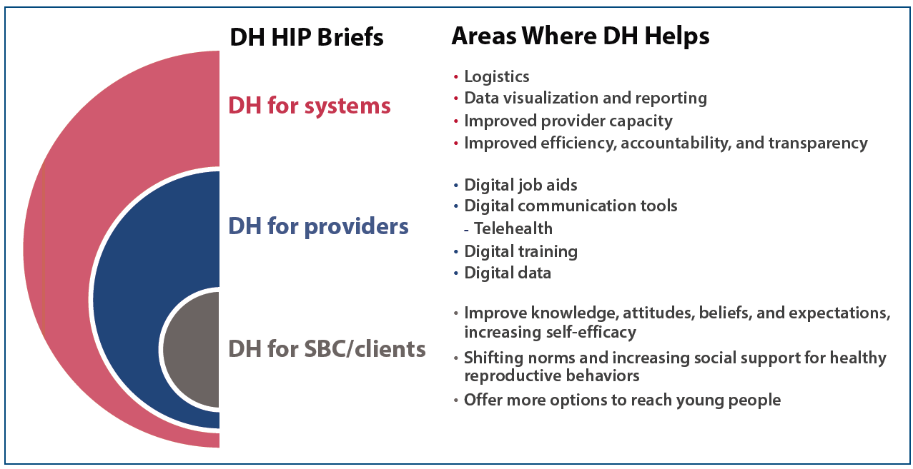
Background
Digital Health (DH) HIP Briefs
Digital Health to Support Family Planning Providers
08
Notes:
Figure 1 summarizes content included in the three digital health HIP briefs.
Of the six building blocks of health systems identified by the WHO, this brief focuses on the first: service delivery. More specifically the focus is on the ways digital health can support service providers to deliver quality contraceptive services. In context of the more recent high-quality health system framework, this brief focuses on two aspects of the framework: competent care and systems (process of care element) and workforce (foundations element). The focus of the brief is specifically on providers because other High Impact Practice (HIP) briefs discuss digital health for social and behavior change and digital health for systems.
View Figure 1 in the HIP brief (copy and paste this link into your web browser): https://www.fphighimpactpractices.org/briefs/digital-health-to-support-family-planning-providers/
For more information about the High-Impact Practices listed in Figure 1, please copy and paste the following links into your web browser to visit the related HIP briefs:
Digital Health for SBC: https://www.fphighimpactpractices.org/briefs/digital-health-sbc/
Digital Health for Systems: https://www.fphighimpactpractices.org/briefs/digital-health-systems/

Slide 9
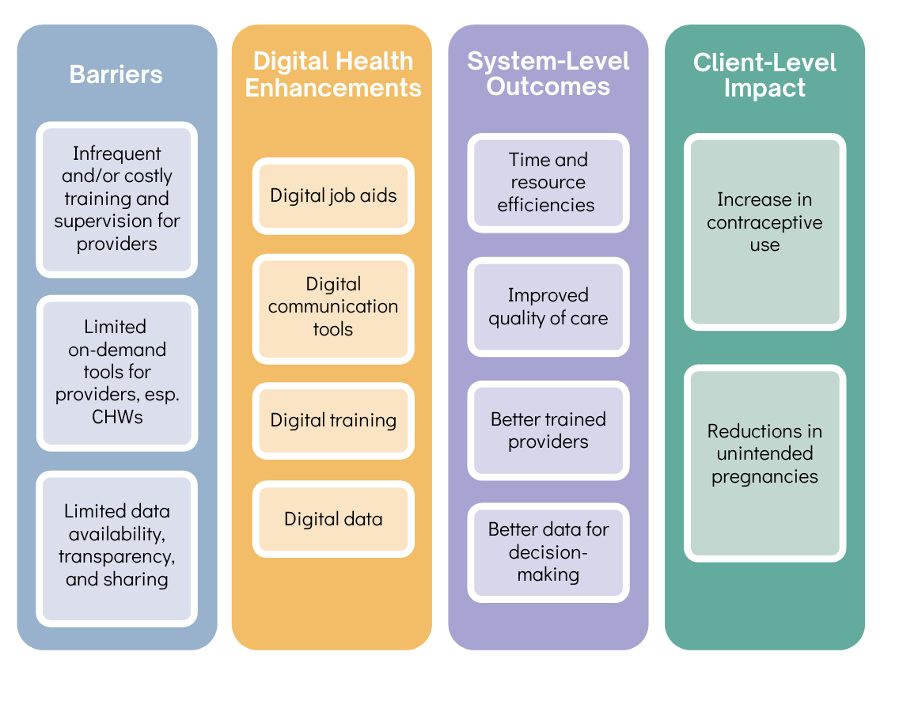
Theory of Change
05
Digital Health to Support Family Planning Providers
09
Notes:
Digital health tools can help FP providers deliver a higher quality of care through job aids, communication tools, training, and data. The Theory of Change (Figure 2) shows systems-level outcomes and client-level impacts when providers use digital health tools to address barriers to quality of service.
View Figure 2 in the HIP brief (copy and paste this link into your web browser): https://www.fphighimpactpractices.org/briefs/digital-health-to-support-family-planning-providers/

Slide 10
How can digital technologies enhance HIPs?
Four digital health enhancements for providers in particular may increase the quality of FP services:
Digital job aids
Digital communication tools
Digital training
Digital data
Digital Health to Support Family Planning Providers
10
Notes:
A review of the literature shows that four digital health enhancements for providers in particular may increase the quality of FP services: 1) digital job aids, 2) digital communication tools, 3) digital training, and 4) digital data. Details on how these digital tools can help FP providers appear below, with examples of each tool provided in Table 1.
Examples from Table 1 are included in the “Notes” Section of the next four slides, organized by type of digital health enhancement: digital job aids, digital communication tools, digital training, and digital data.
View Table 1 in the HIP brief (copy and paste this link into your web browser): https://www.fphighimpactpractices.org/briefs/digital-health-to-support-family-planning-providers/
Digital job aids
Digital job aids can enhance the quality of FP programs by helping to improve service providers’ adherence to clinical protocols through use of digital checklists, counseling and treatment algorithms, and appropriate patient-specific clinical recommendations.
Digital communication tools
Digital applications may enhance FP programs by offering an efficient means to provide supportive supervision remotely and to solicit honest feedback from clients.
Telehealth, which entails providing health care remotely through various communication tools, is another important digital communication tool emerging within FP programs, particularly in light of the 2020 COVID-19 pandemic.
Digital training
As a complement to in-person trainings, digital applications can improve clinical and non-clinical knowledge through refresher trainings and continuous learning opportunities for various cadres of service providers.
Digital data
Real-time collection of client data and appropriate access to client data can aid in continuity of care at the individual level and efficient resource planning at the population level.

Slide 11
How can digital technologies enhance HIPs?
Digital job aids
Digital job aids can enhance the quality of FP programs by helping to improve service providers’ adherence to clinical protocols through use of digital checklists, counseling and treatment algorithms, and appropriate patient-specific clinical recommendations.
Digital Health to Support Family Planning Providers
11
Notes:
Digital job aids
Also called digital clinical decision support systems (CDSS), these can be accessed via mobile phones or tablets.
Mobile phones, for example, can serve as a digital job aid to support providers’ interactions with FP clients. They can also be used to refer FP clients to specific clinical services for provision of contraceptive methods not offered by those providers.
Not only does this facilitate efficient linkage to family planning services, but it can also support longitudinally tracking clients’ completion of referrals and method use. This can allow providers to better support client follow-up.
Examples:
In Benin, a mobile application enabled community health workers (CHWs) to register women as FP clients, provide FP counseling and advice using a combination of images and audio messages in the local language, register clients’ chosen contraceptive method, share information on possible side effects of the method chosen, and record any FP products distributed.
CHWs in India reported that various digital job aids increased their confidence in performing their job.
In Tanzania, an assessment of a FP mobile job aid suggested that CHWs who used the job aid felt they were able to offer improved quality of services and health information and that they experienced improved trust from their clients. Additionally, the assessment of this pilot intervention also highlighted improved supervision of health workers and accountability for their performance, improved communication between supervisors and workers, and improved access to real-time data and reports to support quality improvement.

Slide 12
How can digital technologies enhance HIPs?
Digital communication tools
Digital applications may enhance FP programs by offering an efficient means to provide supportive supervision remotely and to solicit honest feedback from clients.
Telehealth, which entails providing health care remotely through various communication tools, is another important digital communication tool emerging within FP programs, particularly in light of the 2020 COVID-19 pandemic.
Digital Health to Support Family Planning Providers
12
Notes:
Digital communication tools
Facilitate communication between providers and supervisors or providers and clients by using functions such as SMS and interactive voice response (IVR), as well as online communication platforms such as Zoom.
Digital applications may enhance FP programs by offering an efficient means to provide supportive supervision remotely and to solicit honest feedback from clients.
Use of remote communication via SMS and mobile-based modules can promote more frequent and less labor-intensive supervision than in-person consultation.
For client feedback on service quality that can be readily used by FP service providers to enhance service quality, digital tools such as SMS and IVR surveys can be effective approaches for follow-up, but careful assessment of client phone ownership trends and usage patterns is recommended.
Installing tablets in clinic waiting rooms, rather than using paper-based surveys and client exit interviews, is another digital approach which may offer efficiencies on the collection of data on the quality of FP services.
This technology allows for data review in real-time and faster correction of errors, as well as for rapid feedback cycles without the burden of manual data entry. As the information is entered by the clients, software can facilitate transformation of the data into a usable electronic data format.
Furthermore, data interfaces can generate dashboards that give health providers access to easily digestible information rather than raw data. Data collection via tablets can also offer more privacy than a human-administered exit interview.
Telehealth, which entails providing health care remotely through various communication tools, is another important digital communication tool emerging within FP programs, particularly in light of the 2020 COVID-19 pandemic.
While telehealth is primarily understood as benefiting clients by helping them to overcome barriers to accessing health care, client-to-provider telehealth can also benefit providers by allowing providers the flexibility to reach clients separated by distance, including in their own homes.
Provider-to-provider telehealth can facilitate communication between providers for consultations on case management, requesting second opinions, or coordinating care.
Examples:
In Tanzania, SMS feedback from supervisors informed by data collected via a digital reporting system improved timeliness of CHW visits compared with CHWs who did not use the digital tracking system.
In Malawi, a baseline assessment of an mHealth intervention using SMS found that CHWs using SMS to communicate with their supervisors were in more constant contact when compared to counterparts with no access to SMS. CHWs used SMS to request specific technical information on topics such as adverse drug effects, management of contraceptive side effects, and dosage amounts. Furthermore, SMS participants were able to report issues and receive feedback from their supervisors faster and at a cheaper cost than counterparts.

Slide 13
How can digital technologies enhance HIPs?
Digital training
As a complement to in-person trainings, digital applications can improve clinical and non-clinical knowledge through refresher trainings and continuous learning opportunities for various cadres of service providers.
Digital Health to Support Family Planning Providers
13
Notes:
Digital training
Appropriate service provider trainings are one of the cornerstones of a high-quality FP program. As a complement to in-person trainings, digital applications can improve clinical and non-clinical knowledge through refresher trainings and continuous learning opportunities for various cadres of service providers.
Multimedia eLearning courses and IVR facilitate “on demand” training and access to content and technical resources while not requiring providers to leave facilities.
Programmatic experience indicates that a tablet-based system utilized by social franchise networks—including pharmacies and drug shops—can provide performance feedback and coaching information to FP service providers while also monitoring performance over time, thus enhancing service quality.
For more information about Social Franchising, please copy and paste this link into your web browser to visit the related HIP Brief: https://www.fphighimpactpractices.org/briefs/social-franchising/
For more information about Drug Shops and Pharmacies, please copy and paste this link into your web browser to visit the related HIP Brief: https://www.fphighimpactpractices.org/briefs/drug-shops-and-pharmacies/
Examples:
In Bangladesh, field workers providing family planning and maternal and child health information in their communities received netbook computers with eLearning courses and an eToolkit with information on the health areas covered. A pre- and post-assessment indicated improved knowledge in family planning. Additionally, after the interventions the field workers were more likely to counsel couples on all contraceptive options and birth spacing benefits. An earlier study in Bangladesh found that the knowledge a fieldworker gains through a digital health training package can be diffused to clients, positively affecting client knowledge and behaviors, particularly when training is coupled with the use of digital FP counseling resources.
In Senegal, FP service providers received refresher trainings on basic mobile phones through IVR and participants demonstrated significant gains in knowledge up to 10 months after trainings ended.

Slide 14
How can digital technologies enhance HIPs?
Digital data
Real-time collection of client data and appropriate access to client data can aid in continuity of care at the individual level and efficient resource planning at the population level.
Digital Health to Support Family Planning Providers
14
Notes:
Digital data
Real-time collection of client data and appropriate access to client data can aid in continuity of care at the individual level and efficient resource planning at the population level. Digital data may also provide more granular and higher-quality data when compared with analog data, and digital tools can expedite the aggregation of data to “near-instantaneous reporting.”
This can provide FP providers with faster access to data to enhance service quality.
The benefits for service providers include real-time visibility into patient information, including historic and current health data accessible via a dashboard, enabling new insights as well as prompts and reminders for providers.
Finally, timely data about contraceptive supplies can help manage logistics and therefore reduce stockouts.
For more information about Digital Health for Systems, please copy and paste this link into your web browser to visit the related HIP brief: https://www.fphighimpactpractices.org/briefs/digital-health-systems/
Examples:
A forthcoming evaluation of an IVR mobile training resource for frontline health workers in India (Mobile Academy) illustrated possible applications of machine learning for public health practitioners that could be applied to generate evidence on program effectiveness and improve implementation. The evaluation’s protocol highlights that machine learning methodologies can help to improve data collection to assess program effectiveness and can help to inform how the data are used to improve program implementation.
In Malawi, the Martin Preuss Center clinic added FP questions to the electronic medical records (EMR) of HIV patients to prompt providers to assess risks of unintended pregnancies, ask reasons for non-use of contraceptives, and offer them to non-pregnant women. Data collected in the EMR was used retrospectively to determine FP use and reasons for the non-use of contraceptives among women (15-49) living with HIV. The data revealed an increased FP uptake after FP questions were incorporated and found that common reasons for non-use were pregnancy ambivalence and never thinking about taking contraception. The study concluded that incorporating the FP questions into the EMR not only facilitated FP data collection, but it also prompted HIV providers to encourage use of contraceptives

Slide 15
Indicators
Outcome-focused indicators by type of tool:
Decision-support tools and digital provider communication and performance feedback
% of providers with improved adherence to service delivery protocols
Digital/remote training
% of providers with improved knowledge and/or competence
05
Digital Health to Support Family Planning Providers
15
Notes:
Outcome-focused indicators by type of tool:
Decision-support tools and digital provider communication and performance feedback
% of providers with improved adherence to service delivery protocols
Digital/remote training
% of providers with improved knowledge and/or competence

Slide 16
Thank You
Continue to the extra slides or access the HIP brief for more information.
Digital Health to Support Family Planning Providers
16
Notes:
For more information, please copy and paste this link into your web browser to visit the Digital Health to Support FP Providers HIP brief: https://www.fphighimpactpractices.org/briefs/digital-health-to-support-family-planning-providers/

Slide 17
Extra Slides
Priority Research Questions
Implementation Tips
Tools & Resources
Digital Health to Support Family Planning Providers
17
Notes:
We have put together a collection of implementation tips for Digital Health to Support FP Providers, in case you have additional time in your meeting. Further information about these tips can be found in the HIP brief.
References from the literature on this HIP can be found here (copy and paste this link into your web browser): https://www.fphighimpactpractices.org/briefs/digital-health-to-support-family-planning-providers/

Slide 18
Priority Research Questions
Do digital applications that support family planning providers contribute to client-level outcomes such as increase in modern contraceptive prevalence rate?
Which digital health interventions for family planning providers are most cost-effective?
How can governments invest in digital health technology to support health providers’ work in a way that doesn’t exacerbate inequity, with rural communities being denied the full benefits of digital health interventions due to inconsistent coverage and access?
05
Digital Health to Support Family Planning Providers
18
Notes:
These research questions, reviewed by the HIP technical advisory group, reflect the prioritized gaps in the evidence base specific to the topics reviewed in this brief and focus on the HIP criteria.

Slide 19
Implementation Tips
Implementations need to be made appropriate to the local needs, intended users, and overall ecosystem comprised of the information and communications technology (ICT) and enabling environment.
Digital health solutions for providers may require upfront investments on the hardware and software, as well as ongoing maintenance.
Digital Health to Support Family Planning Providers
19
Notes:
Typically, well-resourced urban areas are the first to receive faster, next-generation cellular networks, whereas poorer, rural areas lag behind.
Governments, donors, and program managers should seek to address these issues with upfront investments to support expanded network coverage and other infrastructure.
Digital health solutions for providers may require upfront investments on the hardware (e.g., phones, tablets, servers) and software (e.g. trainings, dashboards), as well as ongoing maintenance.
Successful implementation of digital health solutions will depend upon careful planning for these initial costs.

Slide 20
Implementation Tips
Several resources exist for countries seeking to implement digital health interventions:
Digital Health to Support Family Planning Providers
20
Notes:
Several resources exist for countries seeking to implement digital health interventions:
National eHealth Strategy Toolkit (World Health Organization)
Accelerating the Journey to Self-Reliance Through Strategic Investments in Digital Technologies (USAID)
mHealth Data Security, Privacy, and Confidentiality: Guidelines for Program Implementers and Policymakers (MEASURE Evaluation)

Slide 21
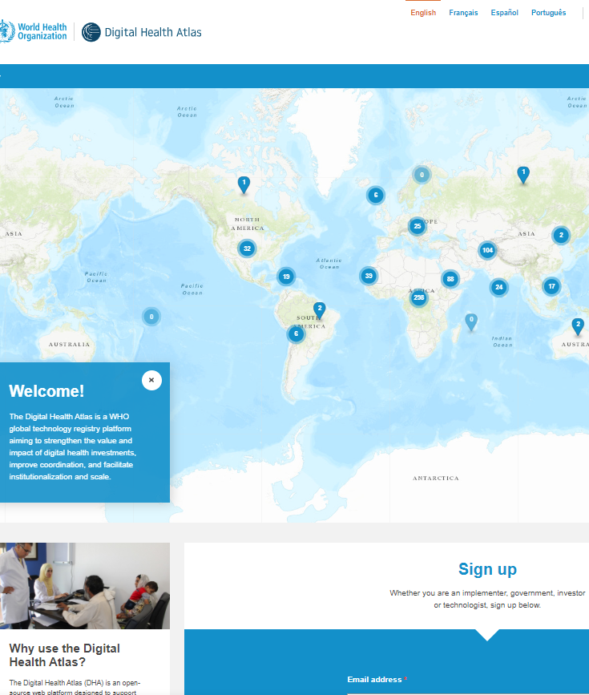
Tools & Resources
Digital Health Atlas
CHW Maturity Model and Toolkit
WHO Digital Accelerator Kits
05
Digital Health to Support Family Planning Providers
21
Notes:
Digital Health Atlas, search for “family planning” or country of interest33: Provides a map summarizing digital health interventions in various countries, facilitating planning, coordination, and use of digital health information systems. https://digitalhealthatlas.org/en/-/
CHW Maturity Model and Toolkit: Allows programs to design a pathway to implement scalable digital health programs to advance community health. https://livinggoods.org/maturity-model/#
WHO Digital Accelerator Kits (Family Planning): They distill WHO guidelines in a digital format to assist providers so that they can more readily use them. https://www.who.int/reproductivehealth/publications/digital-accelerator-kits/en/

Slide 22
fphighimpactpractices.org
Notes:
Subscribe to the HIPs Newsletter here (copy and paste this link into your web browser): https://mailchi.mp/76703a3652c9/hips-newsletter-sign-up
Please visit the five areas of our website to learn more about the HIPs:
HIP Products (copy and paste this link into your web browser): https://www.fphighimpactpractices.org/hip-products/
Resources (copy and paste this link into your web browser): https://www.fphighimpactpractices.org/resources/
Engage (copy and paste this link into your web browser): https://www.fphighimpactpractices.org/engage-with-the-hips/
Overview (copy and paste this link into your web browser): https://www.fphighimpactpractices.org/overview/
About Us (copy and paste this link into your web browser): https://www.fphighimpactpractices.org/partnership-structure/

