Slide 1
Social Marketing
Using marketing principles and techniques to improve contraceptive access, choice, and use.
Notes:
Social marketing seeks to leverage marketing concepts to influence behaviors that benefit individuals and communities for the greater social good. It uses behavior change theory, market research, and consumer insight to inform the delivery of health information, products, and services that are attuned to client’s needs, values, and preferences.
Photo credit: Okwen Patrick Mbah, Photoshare 2012
REVISED: 4/23

Slide 2
Overview
What is a HIP?
HIP Categories
Partnership
Introduction to the High Impact Practices (HIPs)
PART
PART
Background
Theory of Change
What challenges can this HIP help address?
What is the impact?
Recommended Indicators
Social Marketing
Implementation Tips
Priority Research Questions
Tools & Resources
Extra Slides
Notes:
Thank you for using this slide deck! This is a product derived from the HIP brief to assist you in presenting to a variety of audiences. Instructions and additional resources are included in the notes of each slide for your convenience. There is a wealth of information and resources in the “Notes” section of each slide.
This presentation is divided in three parts: an Introduction to the High Impact Practices (HIPs) in Family Planning, Social Marketing, and Extra Slides.
The logo for your organization or ministry may be added to these slides. The web addresses provided in the “Notes” section of each slide can be copied and pasted into your web browser.

Slide 3
High Impact Practices in Family Planning (HIPs) are…
Evidence-based family planning practices
Vetted by experts against specific criteria
Documented in an easy-to-use format
Notes:
High Impact Practices (HIPs) are a set of evidence-based family planning practices vetted by experts against specific criteria and documented in an easy-to-use format.
The High Impact Practices in Family Planning (HIPs) were first created in 2010 after a survey of FP stakeholders revealed little consensus for “what works” in international FP programming. A small group of leaders in FP were brought together with the task of identifying a short list of HIPs that if implemented at scale would help countries address the unmet need for FP and thereby increase national contraceptive prevalence.
HIPs are identified based on demonstrated magnitude of impact on contraceptive use and potential application in a wide range of settings. Consideration is also given to other relevant outcome measures including unintended pregnancy, fertility, or one of the primary proximate determinants of fertility (delay of marriage, birth spacing, or breast feeding). Evidence of replicability, scalability, sustainability, and cost-effectiveness are also considered.
For more information, please copy and paste this link into your web browser to see this video: https://www.youtube.com/watch?v=N6V0gfl-V3k&ab_channel=KnowledgeSUCCESS
A 2-pager overview of the HIPs is available in an online and a downloadable PDF format here (copy and paste this link into your web browser): https://www.fphighimpactpractices.org/high-impact-practices-in-family-planning-list/

Slide 4
HIPs address the full spectrum of FP programming
Enabling Environment
Service Delivery
Social and Behavioral Change
PART
Address systemic barriers that affect an individual’s ability to access family planning information & services. 8 briefs
Improve the availability, accessibility, acceptability, and quality of family planning services. 8 briefs
Influence knowledge, beliefs, behaviors, and social norms associated with family planning.
7 briefs
Enhancements
Approaches used in conjunction with HIPs to maximize the impact of HIP implementation or increase the reach. 4 briefs
Notes:
There are three categories of HIPs: Enabling Environment, Service Delivery and Social and Behavioral Change. Social Marketing is a Service Delivery HIP. This information came from the HIP List (copy and paste this link into your web browser): https://www.fphighimpactpractices.org/high-impact-practices-in-family-planning-list/
A HIP Enhancement is a tool or approach that is not a standalone practice, but it is often used in conjunction with HIPs to maximize the impact of HIP implementation or increase the reach and access for specific audiences. The intended purpose and impact of enhancements are focused and, therefore the evidence-based and impact of an enhancement is subjected to different standards than a HIP.
For more information about the HIP Categories and Enhancements, please copy and paste this link into your web browser: https://www.fphighimpactpractices.org/high-impact-practices-in-family-planning-list/
Here are a few examples of HIPs from each category:
Service Delivery:
Immediate Postpartum Family Planning
Mobile Outreach Services
Postabortion Family Planning
Enabling Environment:
Domestic Public Financing
Educating Girls
Supply Chain Management
Social and Behavior Change:
Community Group Engagement
Digital Health for SBC
Mass Media
Enhancements:
Digital Health for Systems
Adolescent-Responsive Contraceptive Services
Family Planning Vouchers
All HIPs are Available in English, Spanish, French, and Portuguese.

Slide 5
HIP Partnership
The Technical Advisory Group (TAG) is made up of 25 experts in family planning, including representatives from the co-sponsors.
The Co-sponsors include the following organizations:
Notes:
The High Impact Practices in Family Planning (HIPs) are supported by over 65 organizations. These organizations play a vital role in developing, reviewing, disseminating, and implementing HIPs in family planning.
The HIPs partnership includes various structures to ensure HIP products are developed, kept up to date, and disseminated widely. These include:
Co-sponsors – Serve as the secretariat for the HIPs.
Partners – Contribute to key HIP products and endorse the HIPs.
Technical Advisory Group – Ensure high technical quality of key HIP products and approve HIP brief and SPG concepts for development.
P&D Team – Support the production and dissemination (P&D) of HIP products.
Technical Expert Groups – Write new HIP briefs and ensure they are up-to-date.
For more information about the HIP Partnership, please copy and paste this link into your web browser: https://www.fphighimpactpractices.org/partnership-structure/

Slide 6
High Impact Practice
Use marketing principles and techniques to shape the provision of contraceptive services and products to improve access, choice and use, for target populations.
Notes:
Social marketing seeks to leverage marketing concepts to influence behaviors that benefit individuals and communities for the greater social good. It uses behavior change theory, market research, and consumer insight to inform the delivery of health information, products, and services that are attuned to client’s needs, values, and preferences.
For more information about Service Delivery HIPs, please copy and paste this link into your web browser to visit this matrix of tools developed by IBP/WHO: https://www.fphighimpactpractices.org/ibp-who-matrix/
These tools can be used in conjunction with Service Delivery HIPs.
Available in online and downloadable PDF format.
Did you know that we have a webinar recording and downloadable PDF presentation about this HIP? Please copy and paste this link into your web browser to visit: https://www.fphighimpactpractices.org/webinar-social-marketing/
This webinar contains recent implementation successes in several country contexts.
Presenters include:
Martyn Smith, FP2030 (moderator)
Clancy Broxton, USAID
Ram Ganesan, Abt Associates
Jiblal Pokharel, CRS Nepal

Slide 7
Background
Social marketing defines its program objectives and utilizes the following four foundational elements of marketing (i.e., the 4 Ps: product, price, promotion, and place) to develop strategies to achieve them.
What distinguishes social marketing from other behavior change approaches is the notion of value exchange, or the idea that the target audience will adopt or select—a contraceptive method, product, or service—in exchange for perceived benefits.
Notes:
Social marketing seeks to leverage marketing concepts to influence behaviors that benefit individuals and communities for the greater social good.
To do so, social marketing defines its program objectives and utilizes the following four foundational elements of marketing (i.e., the 4 Ps: product, price, promotion, and place) to develop strategies to achieve them.
The 4Ps plus policy can be defined as follows:
Product: a good or service offered to a specific market segment or priority group.
Price: clients’ willingness or ability to pay, considering financial and opportunity costs and competition with other similar products.
Promotion: communication and/or advertising about the product or service targeted to the market segment or priority group.
Place: availability and distribution channels to reach the target market segment, linked to promotion channels.
Policy: policy revision, adoption, and/or guidance to ensure a healthy market.
What distinguishes social marketing from other behavior change approaches is the notion of value exchange, or the idea that the target audience will adopt or select—a contraceptive method, product, or service—in exchange for perceived benefits.
Community Health Workers: https://www.fphighimpactpractices.org/briefs/community-health-workers/
Pharmacies and Drug Shops: https://www.fphighimpactpractices.org/briefs/drug-shops-and-pharmacies/
Social Franchising: https://www.fphighimpactpractices.org/briefs/social-franchising/
For more information, please copy and paste this link into your web browser to reference the “Background” section on the HIP brief: https://www.fphighimpactpractices.org/briefs/social-marketing/

Slide 8
Background
Marketing offers a useful lens through which program designers can leverage the cost/benefit, risk/reward, and incentive/disincentive calculations made by consumers in everyday decision making as they design family planning strategies that create value in the mind of the client and reduce barriers to access.
In addition to promoting behavior change, social marketing programs are also designed to expand the range of contraceptive options available and/or increase when, how, and from whom clients can obtain methods and services.
Notes:
For more information, please copy and paste this link into your web browser to reference the “Background” section on the HIP brief: https://www.fphighimpactpractices.org/briefs/social-marketing/

Slide 9
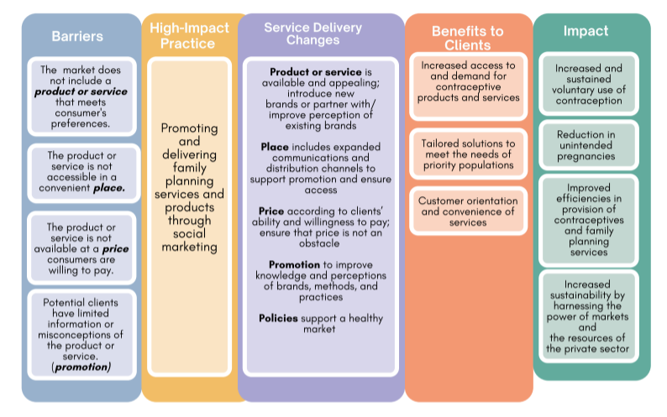
Theory of
Change
BACKGROUND
Notes:
View Figure 1 in the HIP brief (copy and paste this link into your web browser): https://www.fphighimpactpractices.org/briefs/social-marketing/

Slide 10
What challenges can this HIP help address?
Low demand for contraception.
Limited access to high-quality and affordable contraceptive products and services in many markets.
Lack of availability of contraception products and services in public health facilities.
Lack of access to contraception among particular segments of the population.
Lack of a wide range of contraceptives in private sector outlets.
Notes:
Low demand for contraception.
A social marketing program can increase demand for contraceptives by addressing individual knowledge, attitudes, and beliefs, as well as social and community norms.
Limited access to high-quality and affordable contraceptive products and services in many markets.
By marketing high- quality products at affordable prices, social marketing programs can also help reduce the availability, sale, and use of poor-quality products.
Lack of availability of contraception products and services in public health facilities.
Social marketing helps to ensure that family planning products and services are available to users in ways that expand availability and choice, such as being available at different hours or providing more options.
Lack of access to contraception among particular segments of the population.
Social marketing can be a good option to provide family planning services to populations not reached through public sector programs.
Lack of a wide range of contraceptives in private sector outlets.
Social marketing programs can link private facilities to quality-assured products and sensitize providers to offer contraception.

Slide 11
What is the impact?
Social marketing can increase knowledge of, demand for, access to, and use of contraceptive products and services.
Social marketing programs particularly serve the needs of short-acting contraceptive users.
Social marketing programs reach priority populations effectively.
Social marketing programs contribute to building a healthy market.
Notes:
Social marketing can increase knowledge of, demand for, access to, and use of contraceptive products and services.
Social marketing programs particularly serve the needs of short-acting contraceptive users.
There is strong evidence that a large proportion of those who use oral contraceptive pills and condoms rely on social marketing.
Social marketing can specifically adjust the promotion and price of a product to a specific potential user, something that often has a significant impact on the decision to use short-acting contraception like condoms.
Social marketing programs reach priority populations effectively.
While often associated with urban markets, social marketing can also reach rural residents through rural drug shops, mobile outreach, and community-based distribution programs.
Young people can be reached through social marketing accompanied by youth-oriented social media campaigns.
Social marketing programs contribute to building a healthy market.
Social marketing programs that market their own brands and initiatives implemented in partnership with pharmaceutical companies have sustained the increases in contraceptive use even after donor support ended.

Slide 12
Recommended Indicators
Number/percent of pharmacies/drug shops where socially marketed products and/or services are available (disaggregated geographically, product/service)
Percent of cost recovery of social marketing contraceptive products, disaggregated by product and brand (where relevant)
Couple Years of Protection (CYP)
Notes:
Couple Years of Protection (CYP): https://www.usaid.gov/global-health/health-areas/family-planning/couple-years-protection-cyp

Slide 13
Thank You
Continue to the extra slides or access the HIP brief for more information.
Notes:
For more information, please copy and paste this link into your web browser to visit this webpage with a recording of the webinar on Social Marketing and a downloadable PDF version of the presentation: https://www.fphighimpactpractices.org/briefs/social-marketing/

Slide 14
Extra Slides
Implementation Tips
Priority Research Questions
Tools & Resources
Notes:
We have put together a collection of implementation tips for Social Marketing, in case you have additional time in your meeting. Further information about these tips can be found in the HIP brief.
References from the literature on this HIP can be found here (copy and paste this link into your web browser): https://www.fphighimpactpractices.org/briefs/social-marketing/

Slide 15
Implementation Tips
Begin with the end in mind.
Technical, financial, institutional, and market aspects should be considered from the onset of a social marketing program with the goal of providing consistent, reliable support for clients and creating a market that responds to changing needs, values, and preferences over time.

Slide 16
Implementation Tips
Creating sustained behavior change, not just changing knowledge and attitudes.
Clearly identify the audience, segmenting and tailoring interventions accordingly.
Seek to understand audience members’ lives, behaviors, motivations, and constraints using relevant theories.
Seek to understand competing behaviors.
Notes:
Creating sustained behavior change, not just changing knowledge and attitudes.
Clearly identify the audience, segmenting and tailoring interventions accordingly.
Seek to understand audience members’ lives, behaviors, motivations, and constraints using relevant theories.
Seek to understand competing behaviors.
Maximize the benefits and minimize the costs of adopting a new behavior to create an attractive exchange.
Use a mix of methods to facilitate behavior change based on the factors influencing the practice.

Slide 17
Implementation Tips
Conduct audience research.
Review and analysis of data (e.g., DHS, formative research, participatory action research, and human-centered design) helps social marketing programs gain insight into and segment the target audience.

Slide 18
Implementation Tips
Invest in multi-year social and behavior change.
Campaigns and local promotional activities need to be rooted in audience research, continually monitored, and adjusted over time.

Slide 19
Implementation Tips
Support coordination among government, private sector, and social marketing programs.
Coordination among different sectors will help ensure that free and heavily subsidized social marketing products are targeted to those who need them the most.
All sectors need to share data, communicate regularly, and have a common understanding of the marketplace to ensure that products are available and clients receive uninterrupted services.

Slide 20
Implementation Tips
Where possible leverage existing infrastructure.
If there are quality-assured commercial brands already present in the market or manufacturers with capacity and interest in investing in a new market, social marketing programs should collaborate with and support commercial suppliers to build a market for their products.

Slide 21
Implementation Tips
Ensure subsidized social marketing products are targeted and priced appropriately.
When donor-supported programs are not targeted to a specific population segment, social marketing efforts may crowd out commercially viable contraceptives from those individuals who can afford to pay, perpetuating reliance on donor support for sustaining supplies.

Slide 22
Implementation Tips
Increase cost recovery and support a fair marketplace.
Social marketing programs can not only increase their cost recovery but also create a marketplace that allows commercial manufacturers to enter the market.
Social marketing can and should be implemented to avoid crowding out the for-profit private sector, particularly in countries that are more advanced economically and have higher overall contraceptive prevalence rates.
Notes:
Increase cost recovery and support a fair marketplace.
By adjusting to the market conditions, social marketing programs can not only increase their cost recovery but also create a marketplace that allows commercial manufacturers to enter the market.
Social marketing can and should be implemented to avoid crowding out the for-profit private sector, particularly in countries that are more advanced economically and have higher overall contraceptive prevalence rates.

Slide 23
Implementation Tips
Balance branded and generic promotion.
Many successful social marketing programs benefit from an “umbrella” branding strategy, through which many related products are marketed and sold under a single brand name.
Generic promotion, or unbranded campaigns, are best suited for promoting the benefits of family planning; addressing misconceptions about family planning; and delaying, spacing, or limiting future pregnancies per fertility intentions.
Notes:
Balance branded and generic promotion.
Many successful social marketing programs benefit from an “umbrella” branding strategy, through which many related products are marketed and sold under a single brand name.
Generic promotion, or unbranded campaigns, are best suited for promoting the benefits of family planning; addressing misconceptions about family planning (either specific methods or in general); and delaying, spacing, or limiting future pregnancies per fertility intentions.

Slide 24
Priority Research Questions
How do social marketing program models evolve over time to sustain or optimize their efficiency?
How does long-term, sustained use of socially marketed products and services improve overall market growth and access to family planning products and services?
How does social marketing measurably close equity gaps in contraceptive access?
Notes:
These research questions, reviewed by the HIP technical advisory group, reflect the prioritized gaps in the evidence base specific to the topics reviewed in this brief and focus on the HIP criteria.

Slide 25
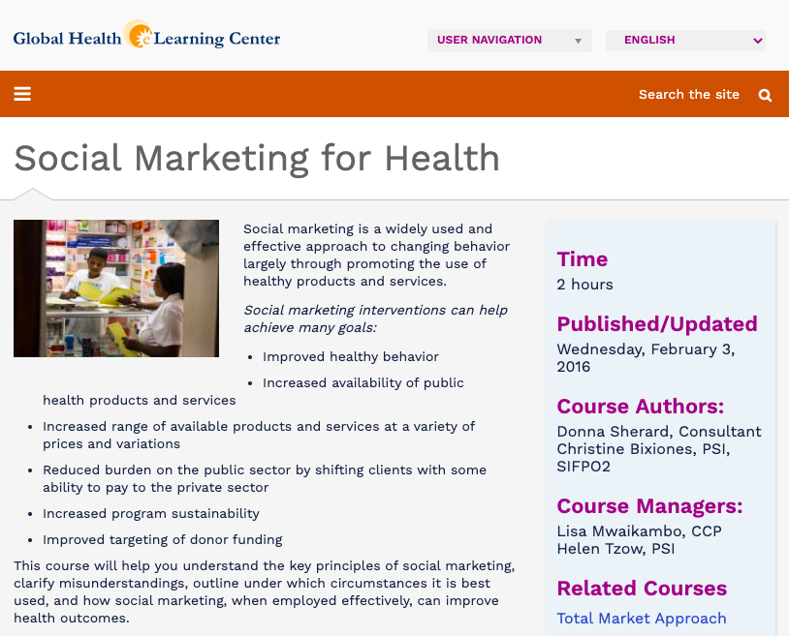
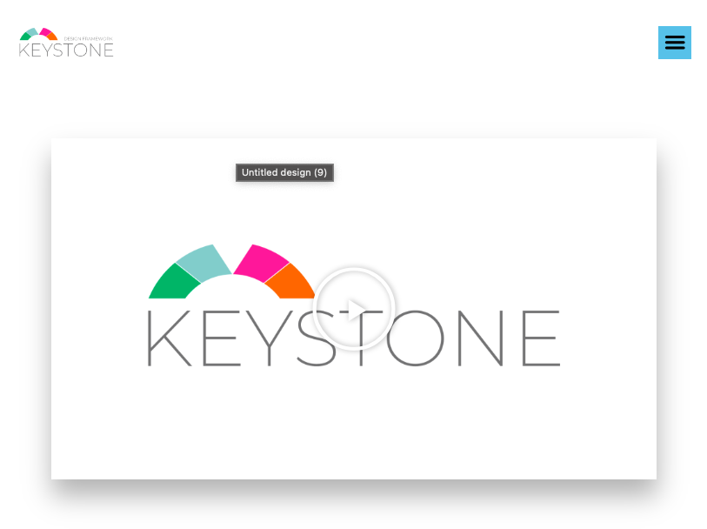
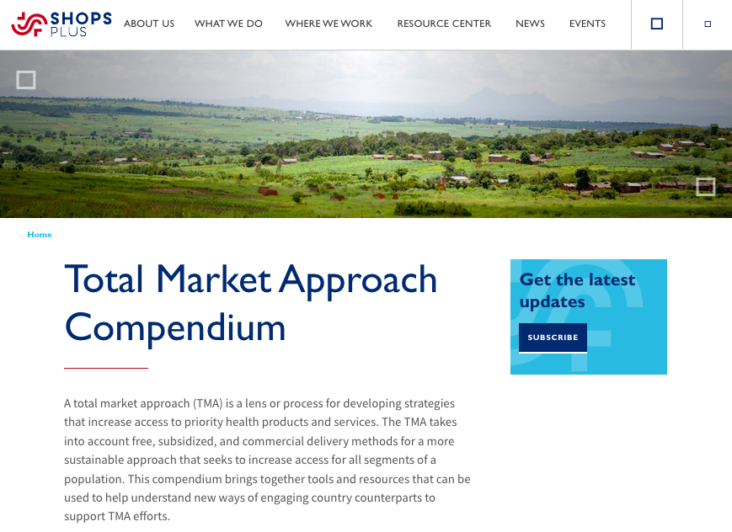
Tools & Resources
Social Marketing for Health: Global
Keystone Design Framework
Total Market Approach (TMA) Compendium
Phases of Social Marketing. Building the Sustainability of Donor-Supported Programs
Notes:
Social Marketing for Health: Global Health eLearning Center is a course that provides an overview of social marketing and how it can be applied to improve health. Available from: https://globalhealthlearning.org/course/social-marketing-health
International Social Marketing Association (ISMA) provides resources to advance social marketing practice, research, and teaching through collaborative networks of professionals, supporters, and enthusiasts. Available from: https://isocialmarketing.org/
Keystone Design Framework is a collection of best practices and tools to assist the application of social marketing principles and practices to development programming. Available from: https://www.psi.org/keystone/
Total Market Approach (TMA) Compendium is a compendium bringing together tools and resources that can be used to help understand new ways of engaging country counterparts to support TMA efforts. Available from: https://www.shopsplusproject.org/tmacompendium
Phases of Social Marketing. Building the Sustainability of Donor-Supported Programs describes strategies to design and support appropriate and sustainable social marketing programs from start-up to graduation. Available from: https://www.shopsplusproject.org/sites/default/files/2017-05/Phases%20of%20Social%20Marketing.pdf

Slide 26
fphighimpactpractices.org
Notes:
Subscribe to the HIPs Newsletter here (copy and paste this link into your web browser): https://mailchi.mp/76703a3652c9/hips-newsletter-sign-up
Please visit the five areas of our website to learn more about the HIPs:
HIP Products (copy and paste this link into your web browser): https://www.fphighimpactpractices.org/hip-products/
Resources (copy and paste this link into your web browser): https://www.fphighimpactpractices.org/resources/
Engage (copy and paste this link into your web browser): https://www.fphighimpactpractices.org/engage-with-the-hips/
Overview (copy and paste this link into your web browser): https://www.fphighimpactpractices.org/overview/
About Us (copy and paste this link into your web browser): https://www.fphighimpactpractices.org/partnership-structure/

