Slide 1
Adolescent-Responsive Contraceptive Services
Institutionalizing adolescent-responsive elements to expand access and choice
Notes:
This brief focuses on service delivery aspects of adolescent-responsive contraceptive services (ARCS) and does not discuss other investments that support adolescents’ use of contraception or that reduce adolescent births, such as girls’ education, community engagement, engaging men and boys, or social marketing, which are addressed in other HIP briefs.
For more information about these topics, please copy and paste the following links into your web browser to see the related HIP products:
Educating Girls: https://www.fphighimpactpractices.org/briefs/educating-girls/
Community Group Engagement: https://www.fphighimpactpractices.org/briefs/community-group-engagement/
Engaging Men and Boys in Family Planning: https://www.fphighimpactpractices.org/guides/engaging-men-and-boys-in-family-planning/
Social Marketing: https://www.fphighimpactpractices.org/briefs/social-marketing/
© 2013 Arturo Sanabria, Courtesy of Photoshare
REVISED: 5/4/21

Slide 2
Overview
What is a HIP?
HIP Categories
Partnership
Introduction to the High Impact Practices (HIPs)
PART
PART
Background
A systems-approach to ARCS
Evidence of Impact
Measurement and Indicators
Adolescent-Responsive Contraceptive Services (ARCS)
Priority Research Questions
Implementation Tips
Extra Slides
11
Adolescent-Responsive Contraceptive Services
02
Notes:
Thank you for using this slide deck! This is a product derived from the HIP brief to assist you in presenting to a variety of audiences. Instructions and additional resources are included in the notes of each slide for your convenience. There is a wealth of information and resources in the “Notes” section of each slide.
This presentation is divided in three parts: an Introduction to the High Impact Practices (HIPs) in Family Planning, Adolescent-Responsive Contraceptive Services (ARCS), and Extra Slides.
The logo for your organization or ministry may be added to these slides. The web addresses provided in the “Notes” section of each slide can be copied and pasted into your web browser.

Slide 3
High Impact Practices in Family Planning (HIPs) are…
Evidence-based family planning practices
Vetted by experts against specific criteria
Documented in an easy-to-use format
Adolescent-Responsive Contraceptive Services
03
Notes:
High Impact Practices (HIPs) are a set of evidence-based family planning practices vetted by experts against specific criteria and documented in an easy-to-use format.
The High Impact Practices in Family Planning (HIPs) were first created in 2010 after a survey of FP stakeholders revealed little consensus for “what works” in international FP programming. A small group of leaders in FP were brought together with the task of identifying a short list of HIPs that if implemented at scale would help countries address the unmet need for FP and thereby increase national contraceptive prevalence.
HIPs are identified based on demonstrated magnitude of impact on contraceptive use and potential application in a wide range of settings. Consideration is also given to other relevant outcome measures including unintended pregnancy, fertility, or one of the primary proximate determinants of fertility (delay of marriage, birth spacing, or breast feeding). Evidence of replicability, scalability, sustainability, and cost-effectiveness are also considered.
For more information, please copy and paste this link into your web browser to see this video: https://www.youtube.com/watch?v=N6V0gfl-V3k&ab_channel=KnowledgeSUCCESS
A 2-pager overview of the HIPs is available in an online and a downloadable PDF format here (copy and paste this link into your web browser): https://www.fphighimpactpractices.org/high-impact-practices-in-family-planning-list/

Slide 4
HIPs address the full spectrum of FP programming
Enabling Environment
Service Delivery
Social and Behavioral Change
PART
Address systemic barriers that affect an individual’s ability to access family planning information & services. 6 briefs
Improve the availability, accessibility, acceptability, and quality of family planning services. 8 briefs
Influence knowledge, beliefs, behaviors, and social norms associated with family planning.
3 briefs
Enhancements
Approaches used in conjunction with HIPs to maximize the impact of HIP implementation or increase the reach. 4 briefs
Adolescent-Responsive Contraceptive Services
04
Notes:
There are three categories of HIPs: Enabling Environment, Service Delivery and Social and Behavioral Change. Adolescent-Responsive Contraceptive Services is an Enhancement HIP. This information came from the HIP List (copy and paste this link into your web browser): https://www.fphighimpactpractices.org/high-impact-practices-in-family-planning-list/
A HIP Enhancement is a tool or approach that is not a standalone practice, but it is often used in conjunction with HIPs to maximize the impact of HIP implementation or increase the reach and access for specific audiences. The intended purpose and impact of enhancements are focused and, therefore the evidence-based and impact of an enhancement is subjected to different standards than a HIP.
For more information about the HIP Categories and Enhancements, please copy and paste this link into your web browser: https://www.fphighimpactpractices.org/high-impact-practices-in-family-planning-list/
Here are a few examples of HIPs from each category:
Service Delivery:
Immediate Postpartum Family Planning
Mobile Outreach Services
Postabortion Family Planning
Enabling Environment:
Domestic Public Financing
Educating Girls
Supply Chain Management
Social and Behavior Change:
Community Group Engagement
Digital Health for SBC
Mass Media
Enhancements:
Digital Health for Systems
Adolescent-Friendly Contraceptive Services
Family Planning Vouchers
All HIPs are Available in English, Spanish, French, and Portuguese.

Slide 5
HIP Partnership
The Technical Advisory Group (TAG) is made up of 25 experts in family planning, including representatives from the co-sponsors.
The Co-sponsors include the following organizations:
Adolescent-Responsive Contraceptive Services
05
Notes:
The High Impact Practices in Family Planning (HIPs) are supported by over 65 organizations. These organizations play a vital role in developing, reviewing, disseminating, and implementing HIPs in family planning.
The HIPs partnership includes various structures to ensure HIP products are developed, kept up to date, and disseminated widely. These include:
Co-sponsors – Serve as the secretariat for the HIPs.
Partners – Contribute to key HIP products and endorse the HIPs.
Technical Advisory Group – Ensure high technical quality of key HIP products and approve HIP brief and SPG concepts for development.
P&D Team – Support the production and dissemination (P&D) of HIP products.
Technical Expert Groups – Write new HIP briefs and ensure they are up-to-date.
For more information about the HIP Partnership, please copy and paste this link into your web browser: https://www.fphighimpactpractices.org/partnership-structure/

Slide 6
High Impact Practice
Apply a systems approach to make existing contraceptive services adolescent-responsive.
Adolescent-Responsive Contraceptive Services
06
Notes:
This brief focuses on service delivery aspects of adolescent-responsive contraceptive services (ARCS) and does not discuss other investments that support adolescents’ use of contraception or that reduce adolescent births, such as girls’ education, community engagement, engaging men and boys, or social marketing, which are addressed in other HIP briefs.
For more information about these topics, please copy and paste the following links into your web browser to see the related HIP products:
Educating Girls: https://www.fphighimpactpractices.org/briefs/educating-girls/
Community Group Engagement: https://www.fphighimpactpractices.org/briefs/community-group-engagement/
Engaging Men and Boys in Family Planning: https://www.fphighimpactpractices.org/guides/engaging-men-and-boys-in-family-planning/
Social Marketing: https://www.fphighimpactpractices.org/briefs/social-marketing/
A systems approach refers to incorporating evidence-based elements throughout all components of the health system, rather than implementing isolated interventions. For example, an adolescent-responsive systems approach would include job descriptions, core competencies for providing technically sound nonjudgmental and confidential services to adolescents in pre-service and in-service training, and performance reviews, rather than solely running trainings with service providers.

Slide 7
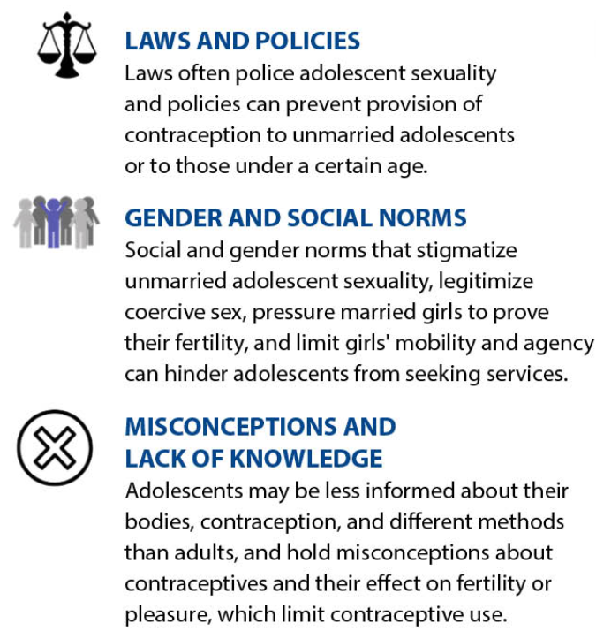
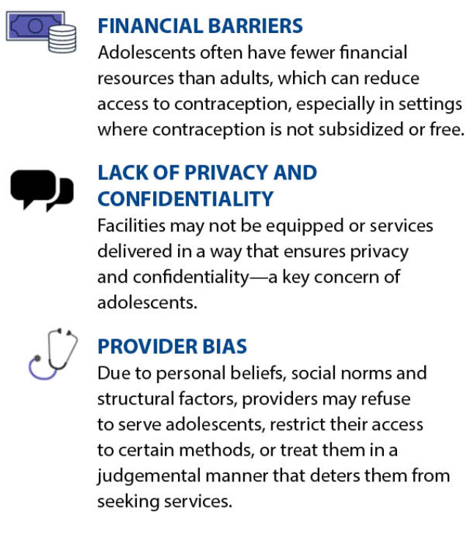
Background
Barriers to access and use of contraceptive services for adolescents
Health systems must institutionalize service delivery that:
Acknowledges adolescents as distinct from other age groups
Addresses the barriers that limit adolescents’ access to and use of contraception.
Adolescent-Responsive Contraceptive Services
07
Notes:
Adolescents need a range of supports to remain well, to transition safely into adulthood, and to adopt lifelong healthy behaviors; a key support is access to contraceptive information and services. However, many countries continue to invest in interventions that are ineffective at increasing contraceptive use. This contributes to poor sexual and reproductive health outcomes.
With 1.25 billion adolescents, increasing to 1.35 billion in 2050, and countries striving to achieve universal health coverage, health systems must go beyond piecemeal approaches to institutionalize service delivery that acknowledges adolescents as distinct from other age groups and addresses the barriers that limit adolescents’ access to and use of contraception (Figure 1)
View Figure 1 in the HIP brief (copy and paste this link into your web browser): https://www.fphighimpactpractices.org/briefs/adolescent-responsive-contraceptive-services/
For more information, please copy and paste this link into your web browser to reference the “Background” section on the HIP brief: https://www.fphighimpactpractices.org/briefs/adolescent-responsive-contraceptive-services/

Slide 8
Background
Adolescent-friendly services, when well-designed and well-implemented, can help increase access to and use of contraception.
Establishing adolescent-responsive contraceptive services (ARCS) is emerging as a more scalable and sustainable way to meet adolescents’ needs for contraceptive information and services.
Adolescent-Responsive Contraceptive Services
08
Notes:
There is evidence that adolescent-friendly services, when well-designed and well-implemented, can help increase access to and use of contraception. However, traditional models of specialized service delivery for adolescents have proven difficult to sustain and scale (Box 1).
Box 1: Separate space models have proven difficult to sustain and scale
In an attempt to respond to adolescents’ concerns around stigma, privacy, and confidentiality, many programs and/or countries have implemented adolescent friendly services using separate space models (e.g., offering adolescent friendly services in a separate room within an existing health facility). However, separate space models have proven difficult to sustain and scale, due to staff and resource shortages and low utilization of available specialized services, among many other constraints.
For more information, please copy and paste this link into your web browser to reference the “Background” section on the HIP brief: https://www.fphighimpactpractices.org/briefs/adolescent-responsive-contraceptive-services/

Slide 9
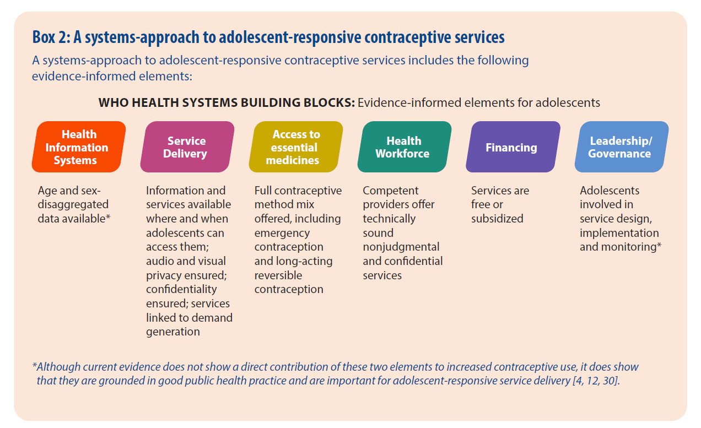
A systems-approach to ARCS
A systems approach implies that policies, procedures, and programs across the entire health system are adapted to respond to the diverse needs and preferences of adolescents.
Adolescent-Responsive Contraceptive Services
09
Notes:
Establishing adolescent-responsive contraceptive services (ARCS) is emerging as a more scalable and sustainable way to meet adolescents’ needs for contraceptive information and services. The term adolescent-responsive contraceptive services signals an evolution from traditional stand-alone models of adolescent-friendly services towards a systems approach to making existing contraceptive services adolescent-responsive by incorporating elements with demonstrated effectiveness for increasing adolescent contraceptive use (Box 2). A systems approach implies that policies, procedures, and programs across the entire health system are adapted to respond to the diverse needs and preferences of adolescents.
View Box 2 in the HIP brief (copy and paste this link into your web browser): https://www.fphighimpactpractices.org/briefs/adolescent-responsive-contraceptive-services/

Slide 10
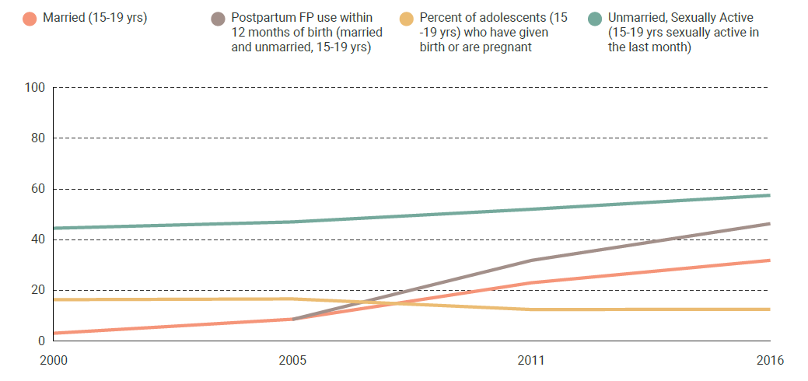
Evidence of Impact:
Ethiopia
Modern contraceptive use among adolescent girls aged 15-19, Ethiopia, by study year, percent
Ethiopia has reported consistent increases in contraceptive uptake among all sexually active adolescents and fewer adolescent births.
Source: Ethiopia DHS 2005, Ethiopia DHS 2011, Ethiopia DHS 2016
05
Adolescent-Responsive Contraceptive Services
10
Notes:
Evidence is accruing that investing in ARCS can improve adolescent contraceptive use, and Ethiopia and Chile are showing promising results.
Specific actions taken by the government of Ethiopia included:
The development of policies that supported adolescent access to contraceptive information and services, regardless of age, parity, or marital status;
Changing health management information systems (HMIS) to collect age- disaggregated data for key indicators;
Training and supervising health service providers;
Using a variety of service delivery models and/or providers (health extension workers) to reach adolescents;
Offering free contraceptive services;
Providing a broad range of methods;
Refurbishing health facilities; and
Institutionalizing administrative decision making at the local level and linking service provision with community engagement and women’s empowerment activities
An adaptive management style and involvement of key stakeholders, including non-governmental organizations (NGOs) and professional associations, facilitated the adoption of these actions and policies.
Ethiopia has reported consistent increases in contraceptive uptake among all sexually active adolescents and fewer adolescent births (Figure 2).
View Figure 2 in the HIP brief (copy and paste this link into your web browser): https://www.fphighimpactpractices.org/briefs/adolescent-responsive-contraceptive-services/

Slide 11
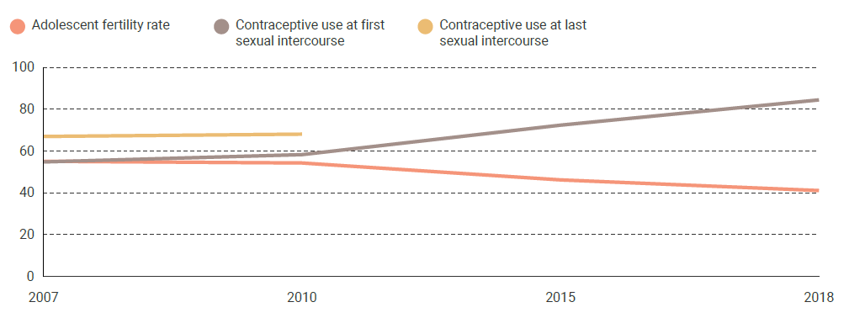
Evidence of Impact:
Chile
Modern contraceptive use among all adolescents aged 15-19, Chile, 2007-2018, percent
Positive outcomes included a decrease in the birth rate among adolescents aged 15-19.
Sources: [1]INJUV. Quinta Encuesta Nacional de Juventud. Santiago, Chile: Instituto Nacional de la Juventud; 2007. [2]INJUV. Sexta. Encuesta Nacional de Juventud. Santiago, Chile: Instituto Nacional de la Juventud; 2010. [3]Dides C, Fernández C. (Ed.). Salud Sexual Salud Reproductiva y Derechos Humanos en Chile. Estado de Situación 2016. Santiago de Chile: Corporaci Miles; 2016. [4]INJUV. Novena Encuesta Nacional de Juventud. Santiago, Chile: Instituto Nacional de la Juventud; 2019.
Note: The estimates for contraceptive use at first and last sexual intercourse are for all adolescents and not disaggregated by sex (sex-disaggregated data for this age group was not available in the National Youth Surveys for the respective years).
05
Adolescent-Responsive Contraceptive Services
11
Notes:
The Chilean government’s 10-year strategy (2011–2020) implemented a five-pronged systems-approach that:
Trained health service providers;
Created adolescent-friendly spaces in primary health centers;
Offered the full method mix;
Improved outreach and referrals; and
Created a legal framework that articulated stakeholder responsibilities.
A monthly register gathered adolescent-specific data. Human and financial resources were sustained throughout the 10-year period and coordination mechanisms were maintained. Advocacy and publicity highlighted the strategy’s positive outcomes, which helped to alleviate public resistance to providing contraception to adolescents.
Positive outcomes included a decrease in the birth rate among adolescents aged 15-19:
From 55.1 births per 1,000 women in 2007 to 41.1 births per 1,000 women in 2018;
A 51% reduction in the proportion of births to mothers under the age of 19 between 2000-2017; and
A 30% increase in reported contraceptive use at first sexual intercourse between 2007 and 2018 (Figure 3)
Sources: [1]INJUV. Quinta Encuesta Nacional de Juventud. Santiago, Chile: Instituto Nacional de la Juventud; 2007. [2]INJUV. Sexta. Encuesta Nacional de Juventud. Santiago, Chile: Instituto Nacional de la Juventud; 2010. [3]Dides C, Fernández C. (Ed.). Salud Sexual Salud Reproductiva y Derechos Humanos en Chile. Estado de Situación 2016. Santiago de Chile: Corporaci Miles; 2016. [4]INJUV. Novena Encuesta Nacional de Juventud. Santiago, Chile: Instituto Nacional de la Juventud; 2019.
Note: The estimates for contraceptive use at first and last sexual intercourse are for all adolescents and not disaggregated by sex (sex-disaggregated data for this age group was not available in the National Youth Surveys for the respective years).
View Figure 3 in the HIP brief (copy and paste this link into your web browser): https://www.fphighimpactpractices.org/briefs/adolescent-responsive-contraceptive-services/

Slide 12
Evidence of Impact:
Chile, Ethiopia,
Uruguay
Box 3. Lessons from Chile, Ethiopia, and Uruguay
Dedicated advocates created momentum for scale-up
Supportive policies enabled the development and implementation of evidence-informed interventions
Communication around scale-up was clear and directive
Adequate resources were allocated
The scale up effort was effectively managed Scale-up execution was systematic and pragmatic
Relevant stakeholders were actively engaged and contributed to sustainability
Assessments and periodic reviews enabled the adaptive management of programs, and effectively communicated successes
Ongoing advocacy ensured sustained integration across policies, programs, strategies, services, and indicators
Each country developed its own approach to scale up, and the following points were commonalities in their efforts:
05
Adolescent-Responsive Contraceptive Services
12
Notes:
Although Ethiopia and Chile have not fully addressed the complete list of elements listed in Box 2, their results illustrate how a systems approach to providing ARCS can contribute to improving contraceptive uptake. When an adolescent-responsive lens is intentionally and systematically applied across the health system, the resulting system is stronger and is better able to sustain quality services at scale (Box 3).
View Box 3 in the HIP brief (copy and paste this link into your web browser): https://www.fphighimpactpractices.org/briefs/adolescent-responsive-contraceptive-services/

Slide 13
Measurement and Indicators
1a. Number and percent of health facilities that currently provide adolescent contraceptive services
Measured by the percent of facilities that provided contraceptive services to at least one adolescent under the age of 20 years
1b. Total number of contraceptive visits by clients under the age of 20 years
Proportion of districts (or other geographic area) in which adolescents aged 15-19 years have a designated place in community accountability mechanisms on access to and quality of health services
The denominator is the number of districts with a community accountability mechanism in place, and the numerator is the number of them in which adolescents have a designated place.
05
Adolescent-Responsive Contraceptive Services
13
Notes:
The following indicators can be used to measure and monitor countries’ progress towards offering ARCS. Indicators 1a and 1b should be measured and analyzed together to give a more complete picture of contraceptive service delivery to adolescents.
1a. Number and percent of health facilities that currently provide adolescent contraceptive services
Measured by the percent of facilities that provided contraceptive services to at least one adolescent under the age of 20 years
Performance Indicator Reference Sheet forthcoming
1b. Total number of contraceptive visits by clients under the age of 20 years
For countries collecting family planning data for 10-14 yrs. and 15-19 yrs., this indicator should be calculated by taking the sum of visits to 15-19 yrs.
2. Proportion of districts (or other geographic areas) in which adolescents aged 15-19 years
have a designated place in community accountability mechanisms on access to and quality of
health services
The denominator is the number of districts with a community accountability mechanism in place, and the numerator is the number of them in which adolescents have a designated place.
Illustrative examples of community accountability mechanisms include: community score cards, monitoring citizen charters, public hearings, health committees at the district/sub-district/health facility levels, financial monitoring committees, public expenditure tracking surveys, school health management committees, and participatory research and evaluation.
This indicator is adapted from a forthcoming handbook on universal health coverage being developed by WHO and draws from evidence on social accountability, including Hurd et al. (2020).

Slide 14
Thank You
Continue to the extra slides or access the HIP brief for more information.
Adolescent-Responsive Contraceptive Services
14
Notes:
For more information, please copy and paste this link into your web browser to visit the ARCS HIP brief: https://www.fphighimpactpractices.org/briefs/adolescent-responsive-contraceptive-services/

Slide 15
Extra Slides
Priority Research Questions
Implementation Tips
Adolescent-Responsive Contraceptive Services
15
Notes:
We have put together a collection of implementation tips for ARCS, in case you have additional time in your meeting. Further information about these tips can be found in the HIP brief.
References from the literature on this HIP can be found here (copy and paste this link into your web browser): https://www.fphighimpactpractices.org/briefs/adolescent-responsive-contraceptive-services/

Slide 16
Priority Research Questions
What are the factors and system conditions that allow for adolescent-responsive contraceptive services to be scaled and sustained?
What actions have governments taken to integrate ARCS into universal health care (UHC), and what were the results?
What social accountability mechanisms—including those that are led by adolescents—could increase contraceptive services’ responsiveness to adolescents?
05
Adolescent-Responsive Contraceptive Services
16
Notes:
These research questions, reviewed by the HIP technical advisory group, reflect the prioritized gaps in the evidence base specific to the topics reviewed in this brief and focus on the HIP criteria.

Slide 17
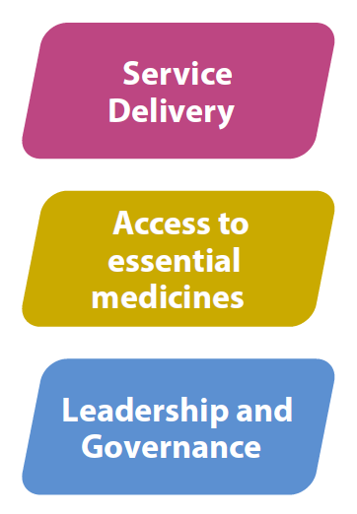
Implementation Tips
Ensure an enabling policy and legal environment for contraception provision to adolescents.
Support the development, revision, and implementation of laws, policies, and service delivery guidelines that clearly state that all adolescents can obtain accurate, comprehensive sexual and reproductive health information, support in decision-making from a qualified health professional, respectful treatment, and voluntary choice of a full range of contraceptive methods regardless of age, marital status or parity.
Ensure copies of relevant laws, policies, guidelines, and adolescent-friendly service standards where they exist are widely available.
Adolescent-Responsive Contraceptive Services
17
Notes:
This is a non-exhaustive list of tips for implementing ARCS. The tips are associated with WHO’s Health Systems Building Blocks to illustrate how to apply a systems approach to ARCS. A systems-approach will involve the implementation of these actions and will analyze and coordinate the relationships between them. Because this brief addresses contraceptive service delivery for adolescents, most tips are supply side related. Demand side tips can be found in other HIP briefs.
Ensure an enabling policy and legal environment for contraception provision to adolescents.
Support the development, revision, and implementation of laws, policies, and service delivery guidelines that clearly state that all adolescents can obtain accurate, comprehensive sexual and reproductive health information, support in decision-making from a qualified health professional, respectful treatment, and voluntary choice of a full range of contraceptive methods, regardless of age, martial status or parity.
For more information about policy, please copy and paste this link into your web browser to visit the Policy HIP Brief: https://www.fphighimpactpractices.org/briefs/policy/
Ensure copies of relevant laws, policies, guidelines, and adolescent-friendly service standards where they exist are widely available.
Provider trainings and follow up support at facility level should reflect these legal rights, policies, guidelines, and standards.
For more information about policy, please copy and paste this link into your web browser to visit the Policy HIP Brief: https://www.fphighimpactpractices.org/briefs/policy/

Slide 18
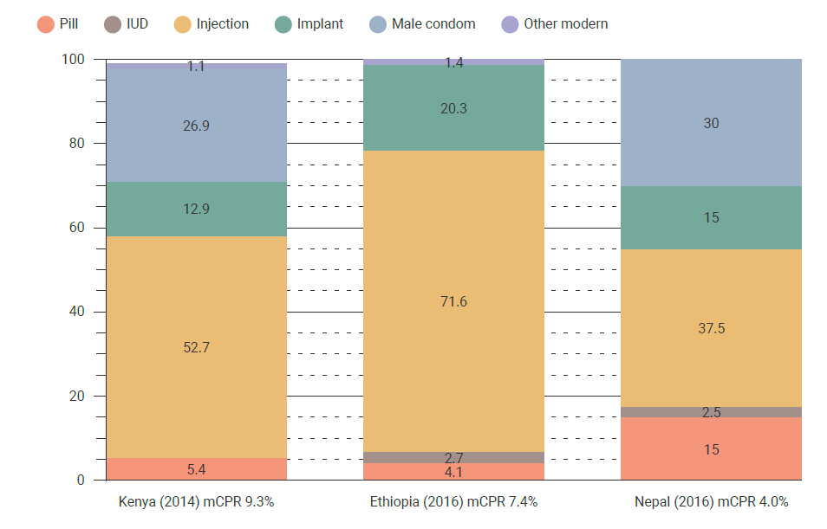
Implementation Tips
Modern method mix among all women ages 15-19 from recent DHS surveys, percent
Ensure an enabling policy and legal environment for contraception provision to adolescents.
Adolescents will use a variety of methods, including long-acting reversible contraception (LARCs), when offered a full range of contraceptive methods.
*Note: other methods include female condoms, LAM, IUD.
Adolescent-Responsive Contraceptive Services
18
Notes:
Figure 4 shows method mix data from Kenya, Ethiopia, and Nepal highlighting that adolescents will use a variety of methods, including long-acting reversible contraception (LARCs), when offered a full range of contraceptive methods.
View Figure 4 in the HIP brief (copy and paste this link into your web browser): https://www.fphighimpactpractices.org/briefs/adolescent-responsive-contraceptive-services/

Slide 19
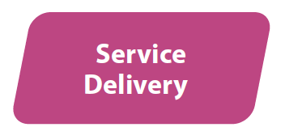
Implementation Tips
Employ a variety of sectors and channels, to reach different adolescent segments.
Use different channels to reach a wider range of adolescents, taking into consideration adolescents’ needs and preferences.
Integrate contraceptive products and services into other health services, especially services that adolescents readily seek.
Consider promising new modalities, especially relevant in the context of COVID-19, such as self-care models and direct-to-consumer models.
Adolescent-Responsive Contraceptive Services
19
Notes:
Employ a variety of sectors and channels, to reach different adolescent segments.
Integrate contraceptive products and services into other health services, especially services that adolescents readily seek (e.g., HIV and MNCH) – this can be especially important from an equity perspective to reach certain adolescent segments (e.g., first-time parents, adolescent boys, etc.).
For more information about engaging men and boys in family planning, please copy and paste this link into your web browser to visit the related HIP strategic planning guide: https://www.fphighimpactpractices.org/guides/engaging-men-and-boys-in-family-planning/
Consider promising new modalities, especially relevant in the context of COVID-19, such as self-care models (e.g., self-injection of DMPA-SC) and direct-to-consumer models (e.g., digital platforms to provide counseling and home delivery of methods).
Also, provide over the counter access to emergency contraception and oral contraceptive pills.
For more information about Digital Health for social and behavior change: https://www.fphighimpactpractices.org/briefs/digital-health-sbc/

Slide 20
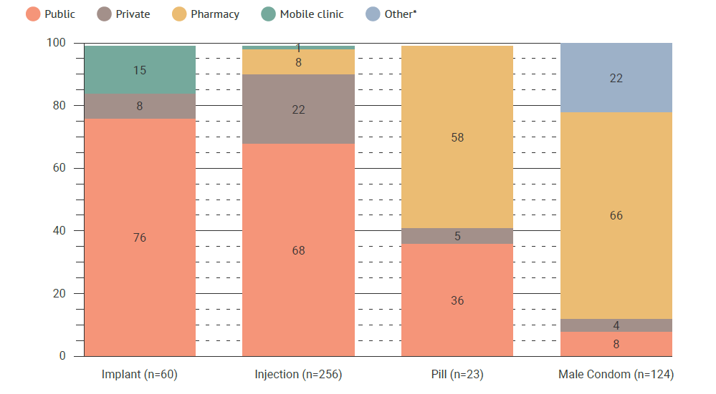
Implementation Tips
Method source by current method, all users ages 15-19 years, Kenya DHS, percent
Employ a variety of sectors and channels, to reach different adolescent segments.
An example from Kenya shows the importance of offering a range of channels to obtain contraception.
*Other methods include female condoms, LAM, IUD.
Total sample size of all users ages 15-19 is 463, and n=the number of users for the method.
Adolescent-Responsive Contraceptive Services
20
Notes:
Figure 5 shows an example from Kenya on the importance of offering adolescents a range of channels to obtain contraception.
Use different channels to reach a wider range of adolescents, taking into consideration adolescents’ needs and preferences, as well as the types of methods that can be provided through each channel. These include public and private-sector facilities, community-based distribution, mobile outreach services, pharmacies and drug shops, and school- or workplace-based services.
For more information about Community Health Workers, please copy and paste this link into your web browser to visit the related HIP Brief: https://www.fphighimpactpractices.org/briefs/community-health-workers/
For more information about Mobile Outreach Services, please copy and paste this link into your web browser to visit the related HIP Brief: https://www.fphighimpactpractices.org/briefs/mobile-outreach-services/
For more information about Drug Shops and Pharmacies, please copy and paste this link into your web browser to visit the related HIP Brief: https://www.fphighimpactpractices.org/briefs/drug-shops-and-pharmacies/
View Figure 5 in the HIP brief (copy and paste this link into your web browser): https://www.fphighimpactpractices.org/briefs/adolescent-responsive-contraceptive-services/

Slide 21
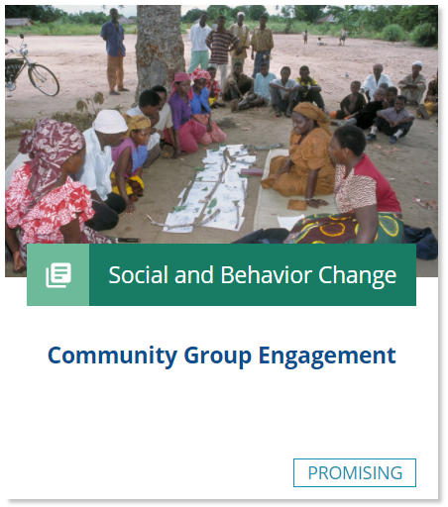
Implementation Tips
Link ARCS with social and behavior change interventions that address adolescent-specific cognitive, cultural, and social challenges and barriers.
Link multi-sectoral demand side and gender-transformative community-engagement efforts to ARCS, including through strong referral networks.
Adolescent-Responsive Contraceptive Services
21
Notes:
Link ARCS with social and behavior change interventions that address adolescent-specific cognitive, cultural, and social challenges and barriers.
Link multi-sectoral demand side and gender-transformative community-engagement efforts to ARCS, including through strong referral networks.
For more information about Community Group Engagement, please copy and paste this link into your web browser to visit the related HIP Brief: https://www.fphighimpactpractices.org/briefs/community-group-engagement/

Slide 22
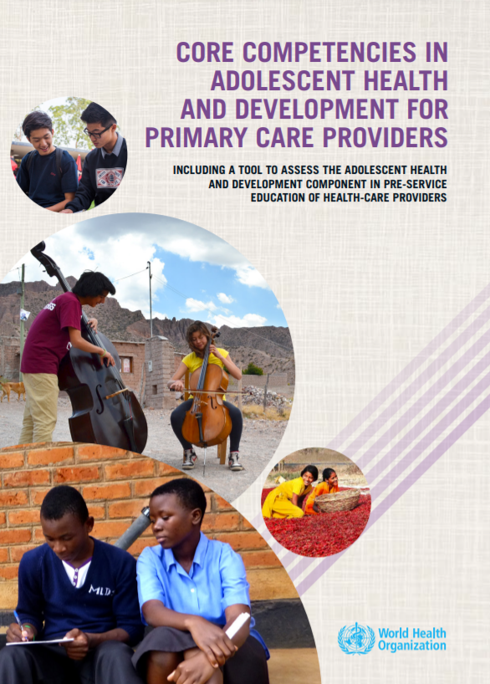
Implementation Tips
Improve providers’ competency in providing ARCS.
Use whole clinic training that equips all providers and staff with the competencies necessary to offer respectful care.
Train small groups using low dose, high frequency training methodologies.
Adolescent-Responsive Contraceptive Services
22
Notes:
Improve providers’ competency in providing ARCS.
Use whole clinic training that equips all providers and staff, including support staff, with the competencies necessary to offer respectful care, including contraceptive information, counseling, and products to adolescents.
This can build shared commitment to serving adolescents and complementary responsibilities for delivering ARCS.
Train small groups using low dose, high frequency training methodologies that incorporate WHO’s Core Competencies in Adolescent Health and Development for Primary Care Providers.
Please copy and paste this link into your web browser to view these core competencies: https://www.who.int/maternal_child_adolescent/documents/core_competencies/en/

Slide 23
Implementation Tips
Improve providers’ competency in providing ARCS.
Reinforce training through job descriptions that reference quality standards, job aids, refresher training, mentorship, and supportive supervision.
Complement trainings with interventions that address the individual, situational and social factors contributing to provider bias.
Adolescent-Responsive Contraceptive Services
23
Notes:
Improve providers’ competency in providing ARCS.
Reinforce training through job descriptions that reference quality standards, job aids, refresher training, mentorship, and supportive supervision, as training alone is insufficient in changing provider behavior.
Complement trainings with interventions that address the individual, situational and social factors contributing to provider bias.
This can include values clarifications exercises and creating a supportive environment for change without placing blame on providers, in addition to the dissemination of guidelines and mentoring mentioned earlier.

Slide 24
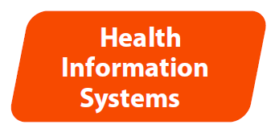
Implementation Tips
Collect and use data to design, improve, and track ARCS implementation.
Use quantitative and qualitative data to determine the specific needs and preferences of different adolescent groups.
Review existing health information systems to collect, compile, and analyze age- and sex-disaggregated data.
Adolescent-Responsive Contraceptive Services
24
Notes:
Collect and use data to design, improve, and track ARCS implementation.
Use quantitative and qualitative data to determine the specific needs and preferences of different adolescent groups; identify who is not being reached with contraceptive services; and use a strategic approach to draw on evidence-based interventions that ensure adolescent clients are offered appropriate contraceptive services.
For more information, please copy and paste this link into your web browser to visit the related HIP strategic planning guide: https://www.fphighimpactpractices.org/guides/improving-sexual-and-reproductive-health-of-young-people/
Review existing health information systems to collect, compile, and analyze age- and sex-disaggregated data.

Slide 25
Implementation Tips
Collect and use data to design, improve, and track ARCS implementation.
Collect adolescent feedback.
Include adolescent-focused indicators in quality improvement frameworks.
Review data at the facility, district, and national level to ensure that corrective action is taken, and resources are appropriately allocated.
Adolescent-Responsive Contraceptive Services
25
Notes:
Collect and use data to design, improve, and track ARCS implementation.
Collect adolescent feedback.
This can be done through exit interviews, self-administered questionnaires, digital platforms, mystery clients, or other approaches.
Include adolescent-focused indicators in quality improvement frameworks.
Review data at the facility, district, and national level to ensure that corrective action is taken, and resources are appropriately allocated.

Slide 26
Implementation Tips
Address financial barriers to adolescent contraceptive use.
Include ARCS in universal health care and national insurance schemes and/or use other approaches such as offering vouchers or offering subsidized services.
Finance ARCS through national and sub-national budget allocations and distributions.
Adolescent-Responsive Contraceptive Services
26
Notes:
Address financial barriers to adolescent contraceptive use.
Include ARCS in universal health care and national insurance schemes and/or use other approaches such as offering vouchers or offering subsidized services through social marketing, social franchising, and cost-recovery schemes.
For more information about Vouchers for Family Planning, please copy and paste this link into your web browser to visit the related HIP Brief: https://www.fphighimpactpractices.org/briefs/family-planning-vouchers/
For more information about Social Marketing, please copy and paste this link into your web browser to visit the related HIP Brief: https://www.fphighimpactpractices.org/briefs/social-marketing/
For more information about Social Franchising, please copy and paste this link into your web browser to visit the related HIP Brief: https://www.fphighimpactpractices.org/briefs/social-franchising/
Finance ARCS through national and sub-national budget allocations and distributions.
For more information about Domestic Public Financing, please copy and paste this link into your web browser to visit the related HIP Brief: https://www.fphighimpactpractices.org/briefs/domestic-public-financing/

Slide 27
Implementation Tips
Support meaningful participation and leadership of adolescents.
Ensure that national policies are designed and implemented to acknowledge adolescents’ rights to meaningful engagement and establish mechanism that facilitate adolescents’ meaningful participation in the design, implementation, and monitoring of ARCS.
Support adolescents to effectively contribute to advocacy, governance and accountability efforts.
Adolescent-Responsive Contraceptive Services
27
Notes:
Support meaningful participation and leadership of adolescents.
Ensure that national policies are designed and implemented to acknowledge adolescents’ rights to meaningful engagement and establish mechanism that facilitate adolescents’ meaningful participation in the design, implementation, and monitoring of ARCS.
Support adolescents to effectively contribute to advocacy, governance and accountability efforts.

Slide 28
fphighimpactpractices.org
Notes:
Subscribe to the HIPs Newsletter here (copy and paste this link into your web browser): https://mailchi.mp/76703a3652c9/hips-newsletter-sign-up
Please visit the five areas of our website to learn more about the HIPs:
HIP Products (copy and paste this link into your web browser): https://www.fphighimpactpractices.org/hip-products/
Resources (copy and paste this link into your web browser): https://www.fphighimpactpractices.org/resources/
Engage (copy and paste this link into your web browser): https://www.fphighimpactpractices.org/engage-with-the-hips/
Overview (copy and paste this link into your web browser): https://www.fphighimpactpractices.org/overview/
About Us (copy and paste this link into your web browser): https://www.fphighimpactpractices.org/partnership-structure/

