Slide 1




Digital Health for Systems
Strengthening Family Planning Systems Through Time and Resource Efficiencies
Notes:
This brief summarizes the experience and evidence for the most commonly used digital health technologies aimed at supporting health systems and providers. A companion brief will address applications aimed at supporting consumers.
©2015 Ueli Litscher, Courtesy of Photoshare
REVISED: 5/4/21

Slide 2
Overview
What is a HIP?
HIP Categories
Partnership
Introduction to the High Impact Practices (HIPs)
PART
PART
Background
Key Messages
How can digital technologies enhance HIPs?
Digital Health for Systems
Priority Research Questions
Implementation Tips
Tools & Resources
Extra Slides
11
Digital Health for Systems
02
Notes:
Thank you for using this slide deck! This is a product derived from the HIP brief to assist you in presenting to a variety of audiences. Instructions and additional resources are included in the notes of each slide for your convenience. There is a wealth of information and resources in the “Notes” section of each slide.
This presentation is divided in three parts: an Introduction to the High Impact Practices (HIPs) in Family Planning, Digital Health for Systems, and Extra Slides.
The logo for your organization or ministry may be added to these slides. The web addresses provided in the “Notes” section of each slide can be copied and pasted into your web browser.

Slide 3



High Impact Practices in Family Planning (HIPs) are…
Evidence-based family planning practices
Vetted by experts against specific criteria
Documented in an easy-to-use format
Digital Health for Systems
03
Notes:
High Impact Practices (HIPs) are a set of evidence-based family planning practices vetted by experts against specific criteria and documented in an easy-to-use format.
The High Impact Practices in Family Planning (HIPs) were first created in 2010 after a survey of FP stakeholders revealed little consensus for “what works” in international FP programming. A small group of leaders in FP were brought together with the task of identifying a short list of HIPs that if implemented at scale would help countries address the unmet need for FP and thereby increase national contraceptive prevalence.
HIPs are identified based on demonstrated magnitude of impact on contraceptive use and potential application in a wide range of settings. Consideration is also given to other relevant outcome measures including unintended pregnancy, fertility, or one of the primary proximate determinants of fertility (delay of marriage, birth spacing, or breast feeding). Evidence of replicability, scalability, sustainability, and cost-effectiveness are also considered.
For more information, please copy and paste this link into your web browser to see this video: https://www.youtube.com/watch?v=N6V0gfl-V3k&ab_channel=KnowledgeSUCCESS
A 2-pager overview of the HIPs is available in an online and a downloadable PDF format here (copy and paste this link into your web browser): https://www.fphighimpactpractices.org/high-impact-practices-in-family-planning-list/

Slide 4
HIPs address the full spectrum of FP programming
Enabling Environment
Service Delivery
Social and Behavioral Change
PART
Address systemic barriers that affect an individual’s ability to access family planning information & services. 6 briefs
Improve the availability, accessibility, acceptability, and quality of family planning services. 8 briefs
Influence knowledge, beliefs, behaviors, and social norms associated with family planning.
3 briefs
Enhancements
Approaches used in conjunction with HIPs to maximize the impact of HIP implementation or increase the reach. 4 briefs
Digital Health for Systems
04
Notes:
There are three categories of HIPs: Enabling Environment, Service Delivery and Social and Behavioral Change. Digital Health for Systems is an Enhancement HIP. This information came from the HIP List (copy and paste this link into your web browser): https://www.fphighimpactpractices.org/high-impact-practices-in-family-planning-list/
A HIP Enhancement is a tool or approach that is not a standalone practice, but it is often used in conjunction with HIPs to maximize the impact of HIP implementation or increase the reach and access for specific audiences. The intended purpose and impact of enhancements are focused and, therefore the evidence-based and impact of an enhancement is subjected to different standards than a HIP.
For more information about the HIP Categories and Enhancements, please copy and paste this link into your web browser: https://www.fphighimpactpractices.org/high-impact-practices-in-family-planning-list/
Here are a few examples of HIPs from each category:
Service Delivery:
Immediate Postpartum Family Planning
Mobile Outreach Services
Postabortion Family Planning
Enabling Environment:
Domestic Public Financing
Educating Girls
Supply Chain Management
Social and Behavior Change:
Community Group Engagement
Digital Health for SBC
Mass Media
Enhancements:
Digital Health for Systems
Adolescent-Friendly Contraceptive Services
Family Planning Vouchers
All HIPs are Available in English, Spanish, French, and Portuguese.

Slide 5





HIP Partnership
The Technical Advisory Group (TAG) is made up of 25 experts in family planning, including representatives from the co-sponsors.
The Co-sponsors include the following organizations:
Digital Health for Systems
05
Notes:
The High Impact Practices in Family Planning (HIPs) are supported by over 65 organizations. These organizations play a vital role in developing, reviewing, disseminating, and implementing HIPs in family planning.
The HIPs partnership includes various structures to ensure HIP products are developed, kept up to date, and disseminated widely. These include:
Co-sponsors – Serve as the secretariat for the HIPs.
Partners – Contribute to key HIP products and endorse the HIPs.
Technical Advisory Group – Ensure high technical quality of key HIP products and approve HIP brief and SPG concepts for development.
P&D Team – Support the production and dissemination (P&D) of HIP products.
Technical Expert Groups – Write new HIP briefs and ensure they are up-to-date.
For more information about the HIP Partnership, please copy and paste this link into your web browser: https://www.fphighimpactpractices.org/partnership-structure/

Slide 6
High Impact Practice
Use digital technologies to support health systems and service delivery for family planning.
Digital Health for Systems
06
Notes:
This brief summarizes the experience and evidence for the most commonly used digital health technologies aimed at supporting health systems and providers. A companion brief will address applications aimed at supporting consumers.

Slide 7
Background
Digital health applications for health systems and providers can support implementation of HIPs by offering:
Better data for decision making with virtually real-time reporting of services and commodities
Improved provider capacity through continuous learning, digital provider tools, and mobile supervision
Increased transparency, efficiency, and accountability through digital financial services
Digital Health for Systems
07
Notes:
With the rapid expansion of mobile and electronic platforms across the globe, including in low- and middle-income countries, there is potential for even greater use of digital health technologies to strengthen health systems and family planning service delivery.
For more information, please copy and paste this link into your web browser to reference the “Background” section on the HIP brief: https://www.fphighimpactpractices.org/briefs/digital-health-systems/

Slide 8
Key Messages
Family planning indicators should be incorporated into new and existing digital health and logistics management information systems.
More research is needed about when and how digital applications for provider support are most effective, efficient, and scalable.
Mobile money and electronic financial transactions have the potential to provide efficiency and transparency of health care financing and transactions.
Digital Health for Systems
08

Slide 9

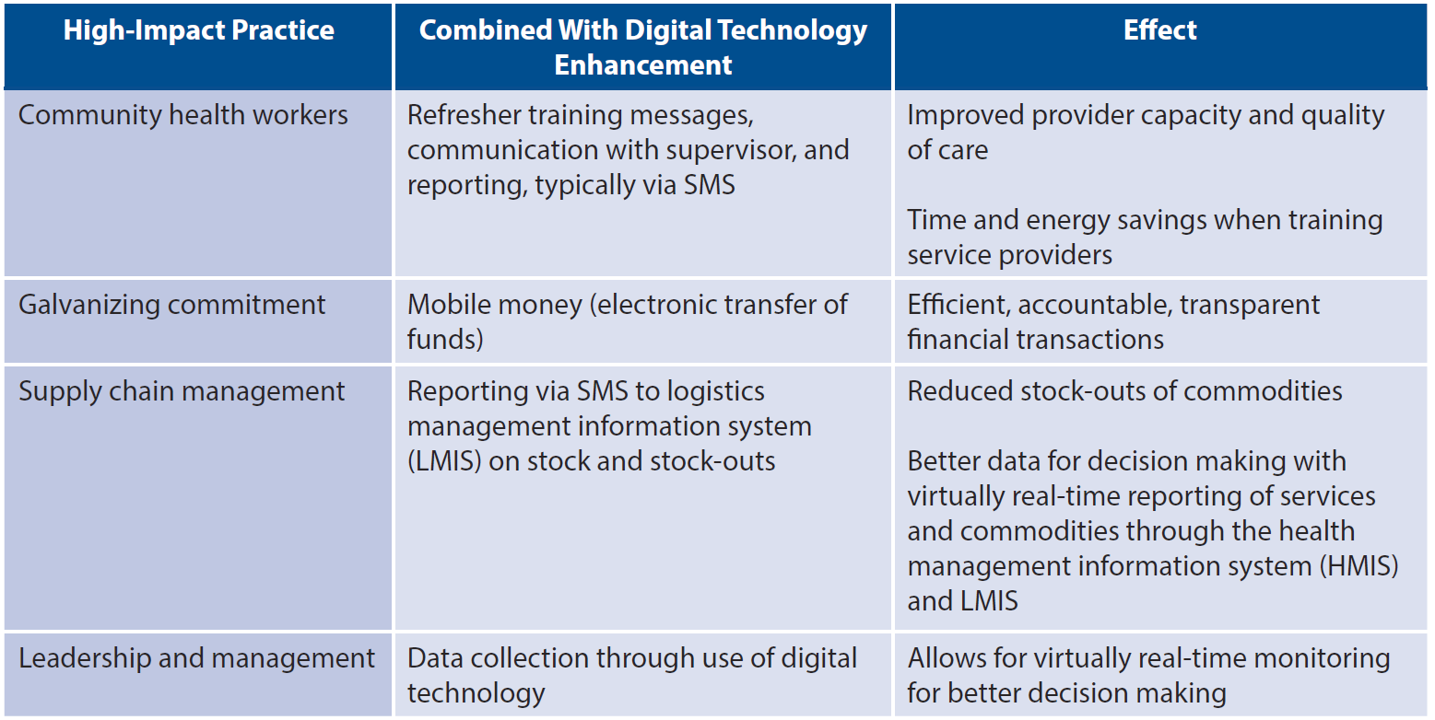
How can digital technologies enhance HIPs?
Illustrative Examples of How Digital Technologies Can Enhance HIPs
05
Digital Health for Systems
09
Notes:
Table 1 provides some illustrative examples of how digital technologies can be used to support implementation of HIPs.
Evidence demonstrating the value of digital health approaches has increased over the past decade.
Systematic reviews of digital applications in HIV care and treatment, maternal and child health service delivery, and non-communicable disease treatment have documented evidence that digital health tools increase efficiency of data collection, improve quality of care, and increase communication between health workers and their managers and supervisors.
It is likely that these results are generalizable to family planning programming as well.
View Table 1 in the HIP brief (copy and paste this link into your web browser): https://www.fphighimpactpractices.org/briefs/digital-health-systems/
For more information about the High-Impact Practices listed in Table 1, please copy and paste the following links into your web browser to visit the related HIP briefs:
Community Health Workers: https://www.fphighimpactpractices.org/briefs/community-health-workers/
Galvanizing Commitment: https://www.fphighimpactpractices.org/briefs/galvanizing-commitment/
Supply Chain Management: https://www.fphighimpactpractices.org/briefs/supply-chain-management/
Leaders and Managers: https://www.fphighimpactpractices.org/briefs/leaders-and-managers/

Slide 10


How can digital technologies enhance HIPs?
Better Data for Decision Making
Digital applications can be used to manage logistics and reduce contraceptive stock-outs.
Digital Health for Systems
10
Notes:
Digital applications can be used to manage logistics and reduce contraceptive stock-outs.
A common aim of digital technologies for family planning is to reduce contraceptive stock-outs.
For more information about Supply Chain Management, please copy and paste this link into your web browser to visit the related HIP brief: https://www.fphighimpactpractices.org/briefs/supply-chain-management/
For more information about Community Health Workers (CHWs), please copy and paste this link into your web browser to visit the related HIP brief: https://www.fphighimpactpractices.org/briefs/community-health-workers/
Examples
In Malawi, community health workers (CHWs) use their personal phones to submit stock information via SMS to the LMIS. The system automatically calculates the resupply needs for a CHW based on reported stock levels, calculates how much stock was consumed and how much is needed for resupply, and transmits this need via SMS to the corresponding health center, enabling staff to prepackage orders in advance of the CHW pickup. This digital technology improved rates of reporting on stock levels and reduced the time required for drug resupply by half.
Similar gains were reported in Bangladesh where an electronic logistics management information system (LMIS) collects data on consumption and availability of family planning commodities, sends SMS and email alerts for reporting reminders, tracks reports against set timelines, and sends warnings of potential stock imbalances for contraceptive commodities. Participant districts nearly eliminated stock-outs; for instance, facilities reporting stock-out rates for Implanon implants dropped from 69% to 1% among facilities using the digital system.
Senegal is expanding use of the Informed Push Model, which allows logistics professionals to enter commodity stock information on tablets at the time of delivery. The program automatically calculates quantities based on previous consumption.

Slide 11

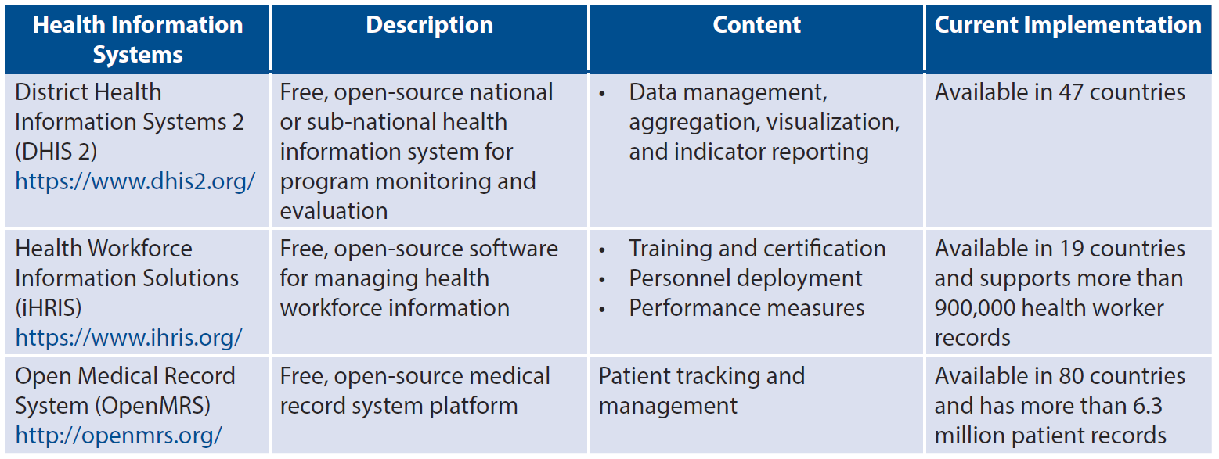
How can digital technologies enhance HIPs?
Illustrative Examples of Digital Health Information Systems
Digital national health management information systems allow for timely analysis, data visualization, and reporting.
05
Digital Health for Systems
11
Notes:
Digital national health management information systems allow for timely analysis, data visualization, and reporting.
Many countries are investing in large digital HMISs, such as the District Health Information Systems 2 (DHIS 2), and in digital human resource information systems such as Health Workforce Information Solutions (iHRIS) (see Table 2). These digital health information systems, often complemented by interactive data dashboards with GIS mapping, enable timely access to nationwide data that can be used to inform more granular decisions about how to allocate resources, where to target interventions, and whether to adjust performance objectives. Although DHIS 2 and iHRIS can and should include family planning indicators and data, not all countries are currently fully leveraging these platforms to capture this information.
View Table 2 in the HIP brief (copy and paste this link into your web browser): https://www.fphighimpactpractices.org/briefs/digital-health-systems/

Slide 12
How can digital technologies enhance HIPs?
Improved Provider Capacity
As a complement to in-person trainings, digital applications can improve clinical knowledge through refresher trainings and continuous learning opportunities for remote service providers.
Digital applications may improve client-provider interactions by offering on-demand, comprehensive, and accurate information and referrals.
Digital Health for Systems
12
Notes:
As a complement to in-person trainings, digital applications can improve clinical knowledge through refresher trainings and continuous learning opportunities for remote service providers.
While the evidence base suggests that digital technologies can contribute to improved knowledge retention among providers, experts believe that these approaches can also provide time and resource efficiencies by reducing the need to travel for trainings, thereby additionally reducing disruptions to service delivery.
Examples
In Senegal, family planning service providers received refresher trainings on basic mobile phones through interactive voice response (IVR). Participants demonstrated significant gains in knowledge up to 10 months after trainings ended.
In Nigeria, a program used Android-based smartphones or tablets to provide entertaining and instructional videos using footage of midwives providing family planning services. Qualitative interviews revealed that the video content raised awareness among midwives of how provider bias negatively affects clients.
Digital applications may improve client-provider interactions by offering on-demand, comprehensive, and accurate information and referrals.
Digital health is commonly used to enhance client-provider interactions and adherence to recommended protocols, particularly among CHWs.
In addition to supporting CHWs’ interactions with their clients, mobile phones are also used to link clients to clinical services, including provision of methods not offered by CHWs. Mobile-phone referrals, often made via SMS, have the potential to provide efficient links to clinical services and to support provider tracking.
Examples
In Benin, a mobile application enables CHWs to register women as family planning clients, provide family planning counseling and advice using a combination of images and audio messages in the local language, register clients’ chosen contraceptive method, share information on possible side effects of the method chosen, and record any family planning products distributed.
CHWs in India reported that similar tools increased their confidence in performing their job.
In Tanzania, CHWs reported that a mobile job aid with forms for client and service data and text-message reporting and reminders allowed them to provide timelier and more convenient care; offer better quality of information on a range of contraceptive methods; and improve privacy, confidentiality, and trust with clients. Over time, the Tanzania pilot evolved and scaled to include additional functionalities to support a pay-for-performance initiative and allow clients to rate service quality. The expanded program demonstrated a 522% increase in the number of monthly registrations of users who had received family planning counseling, and a 15-fold increase in the number of follow-up visits when comparing mobile to paper-based systems.

Slide 13
How can digital technologies enhance HIPs?
Improved Provider Capacity
Digital applications may provide a cost-effective option for remote supportive supervision.
Improved Efficiency, Accountability, and Transparency of Financial Transactions
Mobile money can be leveraged to increase efficiency and transparency of financial transactions.
Digital Health for Systems
13
Notes:
Digital applications may provide a cost-effective option for remote supportive supervision.
Using digital technologies to track provider activities may improve performance.
Examples
In Kenya, CHWs used a popular instant messaging technology to enact virtual one-to-one, group, and peer-to-peer forms of supervision and support.
In Tanzania, SMS feedback from supervisors informed by data collected via a digital reporting system improved timeliness of CHW visits compared with CHWs who did not use the digital tracking system.
Providers in India who used a digital self-tracking tool made 20% more visits than providers who did not use the tool.
Improved Efficiency, Accountability, and Transparency of Financial Transactions
Digital financial services use mobile technology to store, send, or receive funds and are increasingly being applied across the health sector to replace cash-based transactions.
Applications include bulk payments, such as salaries and per diems, as well as delivery of timely incentive payments for service referrals through results-based financing schemes.
Examples
In Madagascar, a mobile money program used to facilitate payments to family planning service providers significantly reduced the time delay for reimbursement. The rapid claims reimbursements also increased service provider motivation to offer quality services and expand their client base.
In Bangladesh, a program uses mobile money to reimburse providers for delivering maternal and child health services. The switch from cash to digital transfers resulted in an annual cost savings of approximately US$60,000 and an annual time savings of roughly 41,333 work hours.
Resource-tracking heat maps are an innovation that allows stakeholders to visually follow the flow of money through the health system. The system can be designed to identify funding bottlenecks, assess the timeliness of disbursements, and expose leakage in the system.

Slide 14
Thank You
Continue to the extra slides or access the HIP brief for more information.
Digital Health for Systems
14
Notes:
For more information, please copy and paste this link into your web browser to visit the Digital Health for Systems HIP brief: https://www.fphighimpactpractices.org/briefs/digital-health-systems/

Slide 15
Extra Slides
Priority Research Questions
Implementation Tips
Tools & Resources
Digital Health for Systems
15
Notes:
We have put together a collection of implementation tips for Digital Health for Systems, in case you have additional time in your meeting. Further information about these tips can be found in the HIP brief.
References from the literature on this HIP can be found here (copy and paste this link into your web browser): https://www.fphighimpactpractices.org/wp-content/uploads/2017/09/DigitalHealthForSystems_references.pdf

Slide 16
Priority Research Questions
In what circumstances is the use of digital health interventions in family planning most cost-effective for offering training, training follow-up, or continuing education to providers?
In what circumstances are digital health interventions most cost-effective for use in contraceptive counseling and screening?
In what circumstances are digital health interventions in family planning cost-effective compared with non-digital interventions?
Do digital applications that support family planning systems contribute to client-level outcomes such as the modern contraceptive prevalence rate?
05
Digital Health for Systems
16
Notes:
These research questions, reviewed by the HIP technical advisory group, reflect the prioritized gaps in the evidence base specific to the topics reviewed in this brief and focus on the HIP criteria.

Slide 17

Implementation Tips
Gather information about and from the intended users of the digital intervention.
Understand the overall technology landscape, including available infrastructure, existing programs, opportunities for interoperability, and potential technology partners.
Determine the potential scale for the project and the resources necessary for its long-term operation.
Digital Health for Systems
17
Notes:
Gather information about and from the intended users of the digital interventions.
This includes questions related to how stakeholders currently understand and use technology (including the types of technology they use and prefer and how they pay for technology use), as well as the barriers they face that a digital solution might address.
Segmenting users into sub-categories (e.g., men/women, educated/non-educated) can provide insight into important differences that could influence the design of the digital health intervention.
Once it has been established that a digital solution is appropriate for solving a given problem, engage users, as well as other key stakeholders, in the design and testing of the tool. Doing so can help create more appropriate and user-friendly interventions that are more likely to be adopted, while failing to do so can mean costly and timely revisions later down the line.
Understand the overall technology landscape, including available infrastructure, existing programs, opportunities for interoperability, and potential technology partners.
It is important to collect information about the technology landscape, including cell phone and Internet coverage, to make decisions about what type of technology will be most appropriate.
In addition, time and resources can be saved when building upon existing digital services to add new functionalities (especially when the intervention is built on open-source software) and when ensuring that digital health interventions are interoperable, meaning they can “talk” to each other to exchange information. Increasingly, decision makers and implementers are seeking to create links among different digital health systems and services to further achieve systems-level outcomes and impact.
Determine the potential scale for the project and the resources necessary for its long-term operation.
As the field of digital health matures, more interventions are reaching scale—used by large numbers of individuals or at national or near-national levels of coverage, and institutionalized into existing systems and processes with high levels of engagement and ownership by local stakeholders.
Successful projects have engaged local stakeholders from the beginning in a deliberate, systematic, and continuous process.

Slide 18
Implementation Tips
Consider realistic options for sustainable financing.
Monitor the implementation and performance of your digital health service.
Digital Health for Systems
18
Notes:
Consider realistic options for sustainable financing.
Digital health interventions need to be developed in a way that is appropriate to the local context while at the same time considering cost implications should the project be scaled nationally.
Costs can include program design, equipment procurement, hosting fees, short-code fees, data packages, and server maintenance.
Different approaches are associated with different financial and technical support implications, whether using smartphone applications, SMS, or voice. For example, interventions that use SMS can become costly as they scale—the more SMS sent and received, the higher the cost. While some services have succeeded in obtaining reduced or free SMS, voice, and/or data rates through public-private partnerships, most do not, and governments may not be in a position to assume the costs as projects transition to national scale. Furthermore, programs may want to explore other less costly platforms such as Facebook and WhatsApp.
Regardless of the technology, if digital health interventions are proven to be more cost-effective than non-digital alternatives, or to bring cost-efficiencies, then governments may successfully advocate for internal or external funding assistance.
Monitor the implementation and performance of your digital health service.
Like all health interventions, monitoring and evaluation should be planned for from the start as part of program design and should be linked to the program’s logic model.
What is unique to digital health technologies is the ability to rapidly collect monitoring and evaluation data through various techniques, including through routine system data as well as through other quantitative and qualitative approaches such as surveys deployed via the digital platform. The ability to garner near real-time process monitoring information enables rapid design and implementation improvements.
In addition, if designed well, evaluations of digital health interventions can determine their effectiveness, including value for money, as well as impact, though these evaluations may or may not be conducted using only digital data collection methodologies.
Once ready to document and disseminate results from monitoring and evaluation, implementers may find the mHealth Evidence Reporting and Assessment (mERA) Checklist, developed by the mHealth Technical Evidence Review Group at the World Health Organization, to be a useful resource.
Please copy and paste this link into your web browser to access this resource: https://www.bmj.com/content/352/bmj.i1174

Slide 19


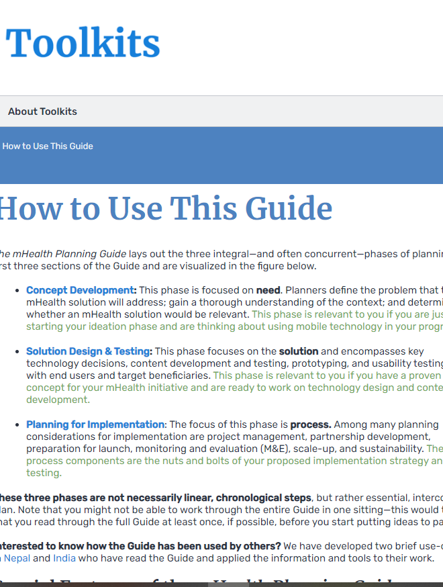


Tools & Resources
Principles for Digital Development
mHealth Planning Guide
mHealth Assessment and Planning for Scale (MAPS) Toolkit
Global Digital Health Network
05
Digital Health for Systems
19
Notes:
Principles for Digital Development: A set of nine principles based on lessons learned in implementing digital technologies in development. https://digitalprinciples.org/
mHealth Planning Guide: A thorough orientation to the mHealth planning process for anyone looking to learn more about integrating mobile technology into health programs in low- and middle-income countries. https://toolkits.knowledgesuccess.org/toolkits/mhealth-planning-guide/how-use-guide
mHealth Assessment and Planning for Scale (MAPS) Toolkit: A self-assessment tool that guides project teams to sustainably scale up their mHealth innovations. https://www.who.int/life-course/publications/mhealth-toolkit/en/
Global Digital Health Network: A networking forum for thousands of members from 94 countries to share information, engage with the broader community, and provide leadership in digital health for global public health. https://www.mhealthworkinggroup.org/

Slide 20

fphighimpactpractices.org
Notes:
Subscribe to the HIPs Newsletter here (copy and paste this link into your web browser): https://mailchi.mp/76703a3652c9/hips-newsletter-sign-up
Please visit the five areas of our website to learn more about the HIPs:
HIP Products (copy and paste this link into your web browser): https://www.fphighimpactpractices.org/hip-products/
Resources (copy and paste this link into your web browser): https://www.fphighimpactpractices.org/resources/
Engage (copy and paste this link into your web browser): https://www.fphighimpactpractices.org/engage-with-the-hips/
Overview (copy and paste this link into your web browser): https://www.fphighimpactpractices.org/overview/
About Us (copy and paste this link into your web browser): https://www.fphighimpactpractices.org/partnership-structure/

