Slide 1




Domestic Public Financing
Building a sustainable future for family planning programs
Notes:
In order for voluntary family planning programs to be successful and sustainable, there needs to be strong national capacity to implement and manage programs, including capacity to mobilize and spend the necessary financial resources for family planning commodities, service delivery, demand creation, and training.
This brief focuses primarily on public financing from general tax revenues, which are typically the primary source of domestic financing for health.
Photo Credit: Russell Watkins/Department for International Development
REVISED: 5/4/21

Slide 2
Overview
What is a HIP?
HIP Categories
Partnership
Introduction to the High Impact Practices (HIPs)
PART
PART
Domestic Public
Financing
Background
Why is this practice important?
Theory of Change
Evidence of Impact
Implementation Tips
Tools & Resources
Extra Slides
11
Domestic Public Financing
02
Notes:
Thank you for using this slide deck! This is a product derived from the HIP brief to assist you in presenting to a variety of audiences. Instructions and additional resources are included in the notes of each slide for your convenience. There is a wealth of information and resources in the “Notes” section of each slide.
This presentation is divided in three parts: an Introduction to the High Impact Practices (HIPs) in Family Planning, Domestic Public Financing, and Extra Slides.
The logo for your organization or ministry may be added to these slides. The web addresses provided in the “Notes” section of each slide can be copied and pasted into your web browser.

Slide 3



High Impact Practices in Family Planning (HIPs) are…
Evidence-based family planning practices
Vetted by experts against specific criteria
Documented in an easy-to-use format
Domestic Public Financing
03
Notes:
High Impact Practices (HIPs) are a set of evidence-based family planning practices vetted by experts against specific criteria and documented in an easy-to-use format.
The High Impact Practices in Family Planning (HIPs) were first created in 2010 after a survey of FP stakeholders revealed little consensus for “what works” in international FP programming. A small group of leaders in FP were brought together with the task of identifying a short list of HIPs that if implemented at scale would help countries address the unmet need for FP and thereby increase national contraceptive prevalence.
HIPs are identified based on demonstrated magnitude of impact on contraceptive use and potential application in a wide range of settings. Consideration is also given to other relevant outcome measures including unintended pregnancy, fertility, or one of the primary proximate determinants of fertility (delay of marriage, birth spacing, or breast feeding). Evidence of replicability, scalability, sustainability, and cost-effectiveness are also considered.
For more information, please copy and paste this link into your web browser to see this video: https://www.youtube.com/watch?v=N6V0gfl-V3k&ab_channel=KnowledgeSUCCESS
A 2-pager overview of the HIPs is available in an online and a downloadable PDF format here (copy and paste this link into your web browser): https://www.fphighimpactpractices.org/high-impact-practices-in-family-planning-list/

Slide 4
HIPs address the full spectrum of FP programming
Enabling Environment
Service Delivery
Social and Behavioral Change
PART
Address systemic barriers that affect an individual’s ability to access family planning information & services. 6 briefs
Improve the availability, accessibility, acceptability, and quality of family planning services. 8 briefs
Influence knowledge, beliefs, behaviors, and social norms associated with family planning.
3 briefs
Enhancements
Approaches used in conjunction with HIPs to maximize the impact of HIP implementation or increase the reach. 4 briefs
Domestic Public Financing
04
Notes:
There are three categories of HIPs: Enabling Environment, Service Delivery and Social and Behavioral Change. Domestic Public Financing is an Enabling Environment HIP. This information came from the HIP List (copy and paste this link into your web browser): https://www.fphighimpactpractices.org/high-impact-practices-in-family-planning-list/
A HIP Enhancement is a tool or approach that is not a standalone practice, but it is often used in conjunction with HIPs to maximize the impact of HIP implementation or increase the reach and access for specific audiences. The intended purpose and impact of enhancements are focused and, therefore the evidence-based and impact of an enhancement is subjected to different standards than a HIP.
For more information about the HIP Categories and Enhancements, please copy and paste this link into your web browser: https://www.fphighimpactpractices.org/high-impact-practices-in-family-planning-list/
Here are a few examples of HIPs from each category:
Service Delivery:
Immediate Postpartum Family Planning
Mobile Outreach Services
Postabortion Family Planning
Enabling Environment:
Domestic Public Financing
Educating Girls
Supply Chain Management
Social and Behavior Change:
Community Group Engagement
Digital Health for SBC
Mass Media
Enhancements:
Digital Health for Systems
Adolescent-Friendly Contraceptive Services
Family Planning Vouchers
All HIPs are Available in English, Spanish, French, and Portuguese.

Slide 5
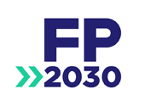




HIP Partnership
The Technical Advisory Group (TAG) is made up of 25 experts in family planning, including representatives from the co-sponsors.
The Co-sponsors include the following organizations:
Domestic Public Financing
05
Notes:
The High Impact Practices in Family Planning (HIPs) are supported by over 65 organizations. These organizations play a vital role in developing, reviewing, disseminating, and implementing HIPs in family planning.
The HIPs partnership includes various structures to ensure HIP products are developed, kept up to date, and disseminated widely. These include:
Co-sponsors – Serve as the secretariat for the HIPs.
Partners – Contribute to key HIP products and endorse the HIPs.
Technical Advisory Group – Ensure high technical quality of key HIP products and approve HIP brief and SPG concepts for development.
P&D Team – Support the production and dissemination (P&D) of HIP products.
Technical Expert Groups – Write new HIP briefs and ensure they are up-to-date.
For more information about the HIP Partnership, please copy and paste this link into your web browser: https://www.fphighimpactpractices.org/partnership-structure/

Slide 6
High Impact Practice
Increase allocation and efficient use of domestic public financing for voluntary family planning at national and sub-national levels.
Domestic Public Financing
06
Notes:
In order for voluntary family planning programs to be successful and sustainable, there needs to be strong national capacity to implement and manage programs, including capacity to mobilize and spend the necessary financial resources for family planning commodities, service delivery, demand creation, and training.
This brief focuses primarily on public financing from general tax revenues, which are typically the primary source of domestic financing for health.

Slide 7
Background
Increase the value of public expenditure by improving:
Budget allocation
Budget execution
Efficiency
This brief focuses primarily on public financing from general tax revenues, which are typically the primary source of domestic financing for health.
Domestic Public Financing
07
Notes:
Budget allocation: securing sufficient resources in national and sub-national budgets to purchase family planning commodities and supplies, service delivery, social and behavior change activities, and other core components of the family planning program
Budget execution: ensuring the approved budget is fully spent in line with stated priorities and within appropriate timelines
Efficiency: using available resources in the most cost-effective way to maximize their impact
Family planning has been shown to be a “best buy” for governments: for each additional dollar spent on contraceptive services in developing countries, the cost of maternal and newborn health care could be reduced by $2.20.
A mix of financing from a variety of sources, including funds from dedicated revenue sources (e.g., earmarked taxes) and prepayment schemes (i.e., contributory insurance), loans for health, and the private sector, is required to achieve predictable, adequate, and sustainable financing for family planning.
This brief focuses primarily on public financing from general tax revenues, which are typically the primary source of domestic financing for health in low- and lower-middle-income countries.
For more information, please copy and paste this link into your web browser to reference the “Background” section on the HIP brief: https://www.fphighimpactpractices.org/briefs/domestic-public-financing/

Slide 8
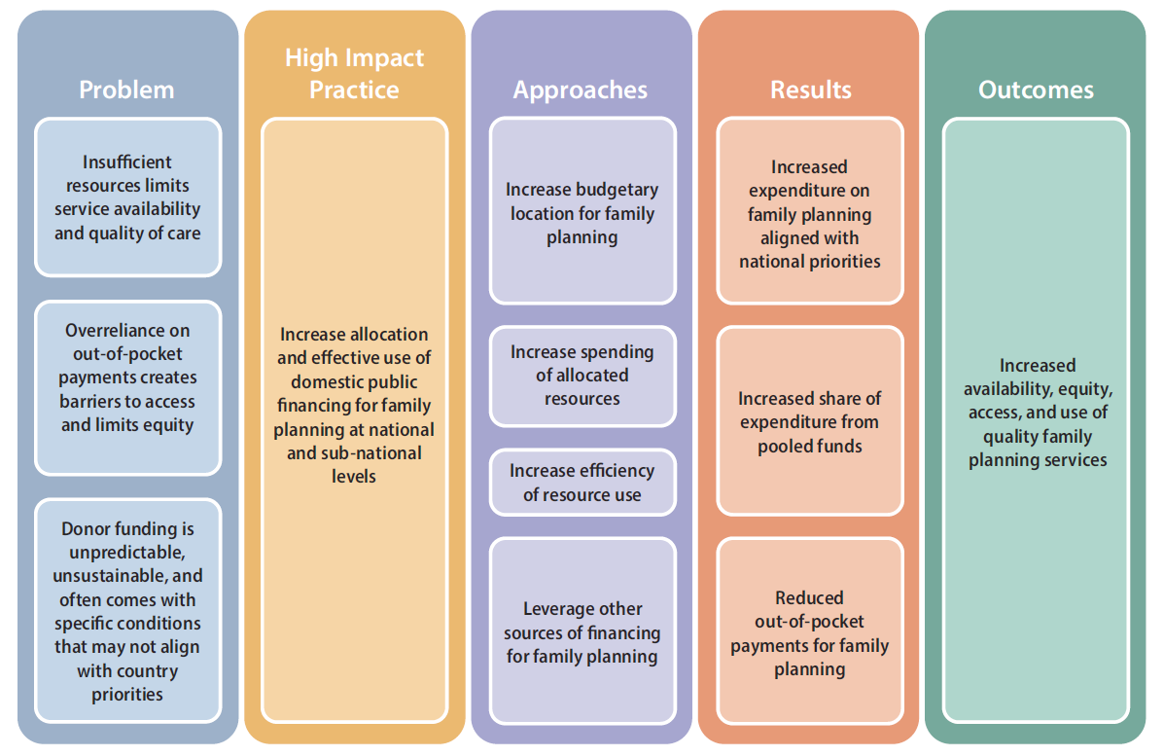
Theory of Change
BACKGROUND
Domestic Public Financing
08
Notes:
Figure 1: Improved Domestic Public Financing: Theory of Change
Assumption: Family planning services are heavily dependent on donor and/or out-of-pocket expenditures.
The purpose of this brief is to aid ministries of health and family planning programmers, including implementers and advocates, in these countries to increase the value of public expenditure by improving budget allocation, budget execution, and efficiency.
View Figure 1 in the HIP brief (copy and paste this link into your web browser): https://www.fphighimpactpractices.org/briefs/domestic-public-financing/

Slide 9
Why is this practice important?
The growing demand for voluntary family planning will require a substantial increase in financial resources.
The lack of public financing for family planning and limited coverage of prepayment mechanisms means that individuals often rely on out-of-pocket (OOP) expenditure to pay for contraceptives and services.
Inadequate public financing contributes to inequities in access to voluntary family planning services and financial hardship for the poor.
Domestic Public Financing
09
Notes:
Current domestic allocations and expenditure in many low- and middle-income countries are insufficient and the growing demand for voluntary family planning will require a substantial increase in financial resources.
Many low- and middle-income countries continue to rely heavily on donor financing for family planning and other health areas. Domestic financial commitments, including those made as part of the Family Planning 2020 (FP2020) initiative, have not always translated to increased spending on family planning.
Growing populations coupled with higher rates of modern contraceptive use will greatly increase the number of contraceptive users supported by national health systems.
If current trends in increased contraceptive use in 135 low- and middle-income countries continue, the funding gap for commodities alone will be $290 million in 2020 and a cumulative $793 million for 2018–2020, which reflects only a portion of the total cost of providing family planning services.
Inadequate public financing contributes to inequities in access to voluntary family planning services and financial hardship for the poor.
The lack of public financing for family planning and limited coverage of prepayment mechanisms means that individuals often rely on out-of-pocket (OOP) expenditure to pay for contraceptives and services.
The need to pay OOP for contraception can propose a particularly significant barrier for adolescents and women who lack financial autonomy.
Even in countries where family planning is theoretically free, there is an overreliance on OOP expenditure.
Research indicates that OOP expenditure on health in general can have impoverishing effects on individuals regardless of the country where they live or their income levels.

Slide 10
Evidence of Impact
Summary
There are encouraging examples of countries that have been able to increase the share of domestic public financing for family planning through:
  Increased allocation of public revenues to family planning.
  Increased execution of funds allocated to family planning.
  Improved efficiency in the use of funds.
  Additional financing mechanisms leveraged.
05
Domestic Public Financing
10
Notes:
Increased allocation of public revenues to family planning.
At the national and local levels, governments have committed budgetary resources to family planning, most commonly for the purchase of contraceptive commodities and supplies.
Increased execution of funds allocated to family planning.
While advocacy is often targeted at increasing budget allocation, it is critical to also ensure that the allocated budgets are spent fully and on time.
There are a wide variety of reasons why execution rates of family planning budgets may be low, including that funds are not released or they are released too late; funds are redirected to other uses; or cumbersome procurement processes cause delays.
Improved efficiency in the use of funds.
Regardless of the size of the family planning budget, it is essential to scrutinize how funds are used to deliver the best results for the cost.
Many countries have made significant strides in ensuring that the best price is received for commodities and that service delivery is provided efficiently.
Additional financing mechanisms leveraged.
Other non-budgetary mechanisms may be used to fund health services, particularly in countries with more developed health financing systems.
In these countries, family planning advocates should ensure that family planning has a dedicated financing stream or that contraceptive commodities and services are included within health benefit packages.

Slide 11
Evidence of Impact
Increased allocation
Increased allocation of public revenues to family planning, in millions of USD
At the national and local levels, governments have committed budgetary resources to family planning, most commonly for the purchase of contraceptive commodities and supplies.
(2005-2013) (2014-2016) (2016-2017)
Source: Family Planning 2020 (FP2020). (2017); Advance Family Planning (AFP). (2018)
05
Domestic Public Financing
11
Notes:
Increased allocation of public revenues to family planning.
At the national and local levels, governments have committed budgetary resources to family planning, most commonly for the purchase of contraceptive commodities and supplies.
While it is recognized that investments in family planning need to go beyond commodities and supplies to include all core components of an effective program, the examples below reflect the fact that other elements of family planning programs are often not explicitly stated in line-item budgets.
Examples
Kenya increased its allocation for family planning commodities from $2.5 million in fiscal year 2005/2006 to $6.6 million in 2012/2013, and national government commitments to family planning overall grew to $8.0 million. As of 2017, all 47 counties in the country have committed to having a budget line for family planning by 2020.
In 2016, Tanzania increased its national family planning budget from $1.1 million to $2.3 million.
Five districts in Indonesia increased their family planning budget allocations by an average of 76% to a total of $3.6 million between 2014 and 2016. In addition, the Government of Indonesia announced significant additional funding assistance for health programs, including family planning, to local governments in its renewed FP2020 commitment in July 2017.
In Lagos State in Nigeria, contraceptive methods are provided free in public facilities, but user fees for consumables such as syringes and gloves were found to be a barrier to family planning uptake. Through engagement in the budget preparation process, civil society successfully advocated for the inclusion of a budget line for family planning consumables in the 2017 budget

Slide 12
Evidence of Impact
Increased execution
Guatemala increased its allocation of public-sector funds for contraceptive procurement from $0.43 million in 2006 to $3.5 million in 2016.
In eSwatini, the Ministry of Health has succeeded in increasing budget execution through routine budget performance monitoring, improving budget utilization from 92% to 98%.
Budget underspending in the health sector is common. This represents a missed opportunity to deliver priority programs such as family planning.
05
Domestic Public Financing
12
Notes:
Increased execution of funds allocated to family planning.
While advocacy is often targeted at increasing budget allocation, it is critical to also ensure that the allocated budgets are spent fully and on time.
There are a wide variety of reasons why execution rates of family planning budgets may be low, including that funds are not released or they are released too late; funds are redirected to other uses; or cumbersome procurement processes cause delays.
Examples
Guatemala increased its allocation of public-sector funds for contraceptive procurement from $0.43 million in 2006 to $3.5 million in 2016. Despite an earmarked tax on alcohol to pay for family planning and reproductive health, which raised $4.3 million in 2006 and increased to $7.3 million in 2016, use of these funds was difficult to track and they were often used for general programming by the Ministry of Health. The creation of a family planning and reproductive health line item and a specific allocation for contraceptives, as well as the creation of the National Commission for Contraceptive Security tasked with tracking the use of family planning spending, increased accountability in the use of these funds.
In eSwatini, the Ministry of Health has succeeded in increasing budget execution through routine budget performance monitoring. Through the use of understandable dashboards drawn from routine budget execution information, senior management proactively identify and address underspending. This process informed the reprogramming of funds at the end of the fiscal year 2014/2015 for the purchase of antiretroviral drugs, improving budget utilization from 92% to 98%. A similar process could be implemented to address underspending on family planning line items.

Slide 13
Evidence of Impact
Improved efficiency
Improved efficiency in the use of funds
Investing in evidence-based programming
Implementing strategic purchasing reforms
Procuring in bulk
Using pooled or coordinated buying
Organizing service delivery to optimize the health workforce
Adopting a total market approach
Regardless of the size of the family planning budget, it is essential to scrutinize how funds are used to deliver the best results for the cost.
05
Domestic Public Financing
13
Notes:
Improved efficiency in the use of funds.
The following examples highlight some of the ways in which countries have achieved cost savings through improved efficiency:
Investing in evidence-based programming by prioritizing high-impact, cost-effective interventions, drawing on evidence of programs that have cost-effectiveness assessments.
Implementing strategic purchasing reforms, including promoting a payer-provider split by contracting out services to private or nongovernmental organizations or implementing performance- or results-based financing programs in the public sector.
Procuring in bulk across delivery sites and programs at the national or sub-national level to reduce commodity prices.
Using pooled or coordinated buying across countries, as has been done in West Africa through the West African Health Organization, enabling countries to negotiate reduced prices with manufacturers.
Organizing service delivery to optimize the health workforce, such as through (1) task shifting, which may reduce the cost of family planning services, and (2) integration, or offering family planning services as part of standard care for other related health services, such as delivery care, childhood immunization, and postabortion care, which may reduce the marginal cost of family planning services by reducing health worker time required and achieving economies of scale in training and supervision.
Adopting a total market approach to family planning by (1) targeting government expenditure/subsidies to the poor or, in more mature health financing systems, pro-poor insurance programs, and (2) engaging the private sector to expand access to services and leverage OOP expenditure from those with ability to pay.

Slide 14
Evidence of Impact
Additional financing
Other non-budgetary mechanisms may be used to fund health services, particularly in countries with more developed health financing systems.
Additional financing mechanisms leveraged
Integration of family planning into national and social health insurance
New government loans
Earmarking
05
Domestic Public Financing
14
Notes:
Additional financing mechanisms leveraged.
Other non-budgetary mechanisms may be used to fund health services, particularly in countries with more developed health financing systems.
In these countries, family planning advocates should ensure that family planning has a dedicated financing stream or that contraceptive commodities and services are included within health benefit packages.
Strategies:
Integration of family planning into national and social health insurance can provide a reliable and substantial source of funding for family planning and promote long-term sustainability of family planning financing. In a study of 16 countries with social health insurance, 14 included some modern contraceptive options in their benefits package. Civil society has played an important role in advocating for the inclusion of contraceptive methods in such schemes.
New government loans have been used to increase investment in family planning. For example, the GFF was launched in 2015 as a mechanism to catalyze access to new international and domestic sources of financing for reproductive, maternal, neonatal, and child health (RMNCH), through the provision of modest grants. So far, a number of governments have accessed these loans alongside their GFF grant, including Kenya, which allocated $20 million for RMNCH strategic commodities, especially family planning commodities.
Earmarking a percentage of tax revenues to family planning can increase the share of domestic funding for family planning. For example, in Guatemala 15% of alcohol tax revenues are earmarked for family planning and reproductive health, of which 30% is specifically designated for contraceptive procurement, thereby increasing the share of contraceptive funding from domestic sources from 5% in 2002 to 100% in 2011.

Slide 15
Thank You
Continue to the extra slides or access the HIP brief for more information.
Domestic Public Financing
15
Notes:
For more information, please copy and paste this link into your web browser to visit the HIP brief for Domestic Public Financing: https://www.fphighimpactpractices.org/briefs/domestic-public-financing/

Slide 16
Extra Slides
Implementation Tips
Tools & Resources
Domestic Public Financing
16
Notes:
We have put together a collection of implementation tips for Domestic Public Financing, in case you have additional time in your meeting. Further information about these tips can be found in the HIP brief.
References from the literature on this HIP can be found here (copy and paste this link into your web browser): https://www.fphighimpactpractices.org/wp-content/uploads/2018/09/DomesticPublicFinancing_references.pdf

Slide 17

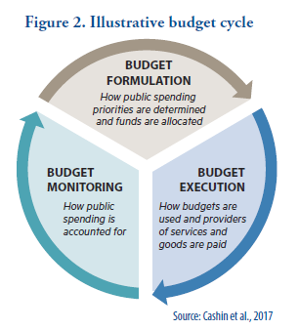
Implementation Tips
  Include family planning in key strategic documents at the national and sub-national levels.
  Set a realistic number of goals with cost estimates.
  Develop a clear understanding of the annual budget cycle.
Domestic Public Financing
17
Notes:
Include family planning in key strategic documents at the national and sub-national levels.
The first step to ensuring that family planning is prioritized in the national budget is to clearly articulate family planning priorities and targets in government policies and strategies, including those focusing on reproductive, maternal, neonatal, and child health (RMNCH).
In decentralized health systems, strategies developed at the sub-national level may be more relevant for influencing budget allocations.
Set a realistic number of goals with cost estimates.
Plans that clearly set out program objectives in a measurable way provide a road map for program implementation.
These plans should prioritize high impact interventions and should include a detailed assessment of the funding needed for their implementation and any gaps.
The more detailed the costing, the more useful the plan will be to inform domestic financing needs. Costed Implementation Plans (CIPs) are one approach to develop such a plan.
Develop a clear understanding of the annual budget cycle.
It is important to have a good understanding of each stage of the budget process to be able to identify points in the process at which to most effectively engage with decision makers at national and sub-national levels.
At the beginning of the financial year, a budget calendar should be issued outlining the intended timing of each step (see Figure 2).

Slide 18

Implementation Tips
  Invest in advocacy to galvanize commitment to family planning.
  Use past spending to build an evidence base.
  Increase budget transparency and public participation.
  Strengthen public financial management capacity in the health sector.
Domestic Public Financing
18
Notes:
Invest in advocacy to galvanize commitment to family planning.
In some contexts, family planning does not appear in the budget and is instead subsumed under one of the other budget line items for health. In such cases, the first step is to advocate for the inclusion of a separate budget line item for contraceptive commodities as this is the easiest way to identify and track family planning investments.
Advocacy efforts may focus at the national or sub-national level, depending on the extent of fiscal decentralization in the country.
In Nigeria, for example, an analysis of the approved budget for 2017 found that family planning was omitted from the federal budget despite the government’s ambitious FP2020 commitments to invest $11.35 million annually in contraceptive commodities.
Using these commitments as the focus of messaging, civil society successfully advocated for the reinstatement of this budget line item by participating in the budget hearing and engaging directly with the parliamentary budget committee for health (personal communication, Evidence for Action, 2017).
Once the budget line item is included, advocacy efforts can focus on ensuring that the amount allocated is in line with needs and stated priorities.
For more information about galvanizing commitment, please copy and paste this link into your web browser to visit the related HIP brief: https://www.fphighimpactpractices.org/briefs/galvanizing-commitment/
Use past spending to build an evidence base.
As part of National Health Accounts, some countries have produced reproductive health subaccounts, which include an assessment of expenditure on family planning.
Where these expenditure data exist, they can provide a useful source of evidence to support advocacy and accountability.
In Rwanda, for example, the 2002 reproductive health subaccount found that 80% of reproductive health expenditure was funded by donors. The Ministry of Health used this information to advocate for greater domestic financing for family planning.
Increase budget transparency and public participation.
Only when there is free exchange of public information and citizens have the opportunity to effectively engage in the budget process can the government be held accountable for its budget.
In Malawi, a self-assessment tool was used to sensitize district health authorities and local politicians on the budget system, including processes for public participation and information sharing, as outlined in the Public Financial Management Act, 2003. The assessment results were used to develop biannual district scorecards, which helped facilitate dialogue among district stakeholders and track progress relating to transparency and participation over time.
Strengthen public financial management capacity in the health sector.
The public financial management (PFM) system refers to the institutions, policies, and processes that govern the use of public funds. Within ministries of health, there is often limited awareness of how PFM processes and reforms can be used to improve program expenditures.
PFM reforms such as the move from input- to program-based budgeting (i.e., moving from input line items to budgets based on programs), as well as the establishment of multiyear revenue and expenditure frameworks (i.e., a government-wide spending plan that links policy priorities to macroeconomic and revenue forecasts over a 3–5-year period), if well implemented, can build capacity of health officials beyond the finance unit and gain buy-in for productive engagement in PFM processes.
This understanding can help to address some of the blockages in the disbursement of funds.

Slide 19
Implementation Tips
  Strengthen dialogue between ministries of health and finance.
  Track budgets to assess whether the budget for family planning is being implemented per the approved budget and timelines.
  Advocate for inclusion of family planning in formal health insurance schemes, including social, national, and private health insurance schemes.
Domestic Public Financing
19
Notes:
Strengthen dialogue between ministries of health and finance.
Establishing more productive engagement between the two government authorities will enable the ministry of health to better take advantage of PFM reforms and to better communicate about sector needs (See Box on Tips for Advocacy).
The ministry of health can gain the confidence of the ministry of finance by demonstrating that family planning programs are planned and budgeted for based on evidence, that there are systems for monitoring and accountability, and that family planning investments are linked to the government’s midterm expenditure framework.
This can help to combat perceptions that the ministry of health is ineffective and inefficient, which often leads to reluctance by the ministry of finance to increase investment in the health sector.
Track budgets to assess whether the budget for family planning is being implemented per the approved budget and timelines.
Tracking exercises can take on various forms, with the simplest being an annual comparison of the approved/enacted budget to the total spending during the fiscal year.
Where actual spending information is available during implementation, through quarterly expenditure reports for example, tracking exercises can be carried out more regularly, allowing discrepancies to be identified as they arise.
More extensive tracking exercises, such as a Public Expenditure Tracking Survey (PETS), can be used to track the flow of funds from each level of government in order to identify the bottlenecks in the system.
These exercises require primary data collection and a greater understanding of the national PFM system.
Advocate for inclusion of family planning in formal health insurance schemes, including social, national, and private health insurance schemes.
Civil society organizations, in collaboration with ministries of health, play an important role in engaging with politicians and decision makers, participating in technical working groups, and developing targeted position papers to raise awareness about the importance and value of family planning.

Slide 20




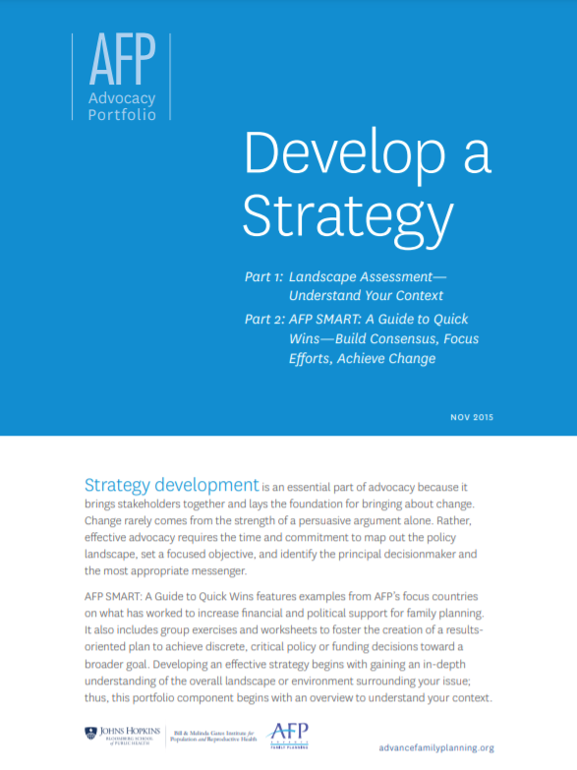
Tools & Resources
A Toolkit for Ministries of Health to Work More Effectively with Ministries of Finance
Family Planning Financing Roadmap
Budgeting for Health
Develop a Strategy
05
Domestic Public Financing
20
Notes:
Family Planning Financing Roadmap: An interactive tool that provides country specific financing options based on context. http://www.fpfinancingroadmap.org/
A Toolkit for Ministries of Health to Work More Effectively with Ministries of Finance: presents a set of strategies, self-assessment methodologies, and performance management processes to help MOHs better manage their own resources and effectively communicate with MOFs. https://www.hfgproject.org/toolkit-ministries-health-work-effectively-ministries-finance/
Budgeting for Health: outlines the role of the MoH and other stakeholders in providing timely inputs into the national budgeting process. http://who.int/healthsystems/publications/nhpsp-handbook-ch8/en/
Develop a Strategy: features a tool to understand your context and assess the likelihood of influencing policy development; and a 9-step approach to developing an advocacy strategy. https://www.advancefamilyplanning.org/sites/default/files/2017-07/2%20Develop%20a%20Strategy_Nov%202015_ALL_EN.pdf

Slide 21

fphighimpactpractices.org
Notes:
Subscribe to the HIPs Newsletter here (copy and paste this link into your web browser): https://mailchi.mp/76703a3652c9/hips-newsletter-sign-up
Please visit the five areas of our website to learn more about the HIPs:
HIP Products (copy and paste this link into your web browser): https://www.fphighimpactpractices.org/hip-products/
Resources (copy and paste this link into your web browser): https://www.fphighimpactpractices.org/resources/
Engage (copy and paste this link into your web browser): https://www.fphighimpactpractices.org/engage-with-the-hips/
Overview (copy and paste this link into your web browser): https://www.fphighimpactpractices.org/overview/
About Us (copy and paste this link into your web browser): https://www.fphighimpactpractices.org/partnership-structure/

