Slide 1
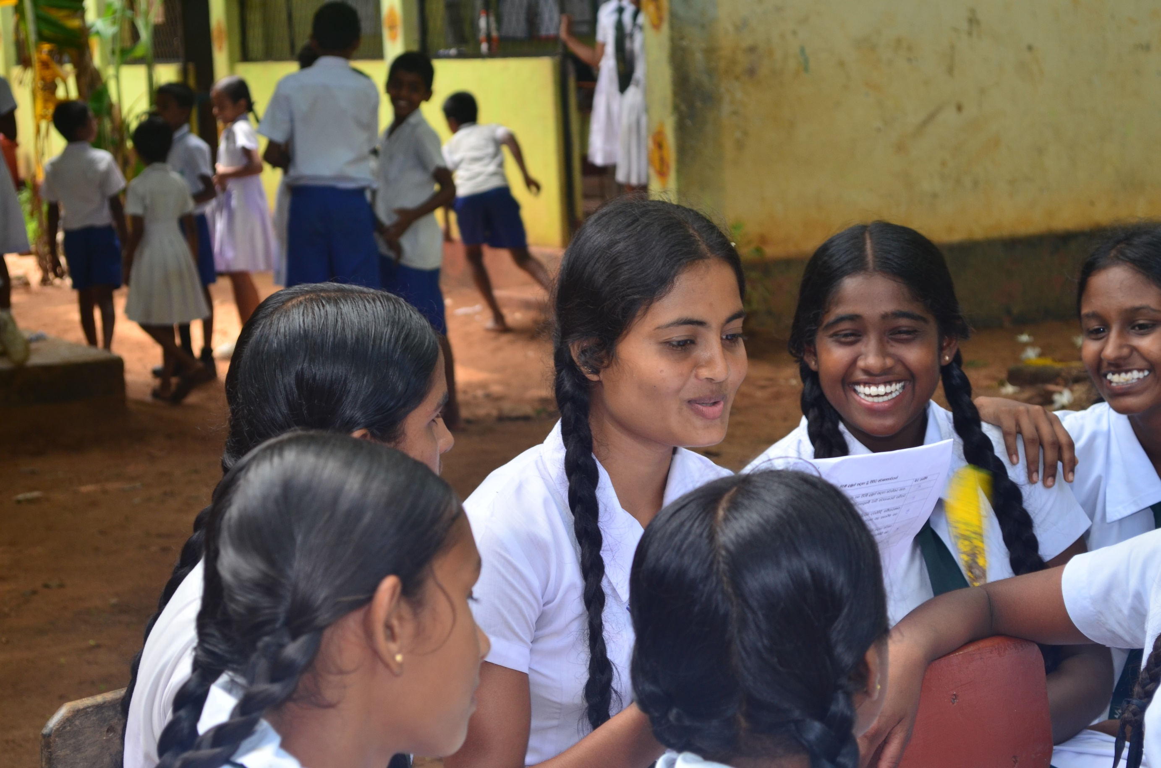
Educating Girls
Creating a foundation for positive sexual and reproductive health behaviors
Notes:
Investments that promote keeping girls in school, particularly in secondary school, have far-reaching and long-term health and development benefits for individuals, families, and communities.
The purpose of this brief is to describe the relationship of girls’ education on family planning and reproductive health and behaviors; highlight evidence-based practices that increase girls’ enrollment, retention, and participation in school; and provide recommendations for how the health sector can help support keeping girls in school.
Photo credits: © Plan Sri Lanka
REVISED: 5/4/21

Slide 2
Overview
What is a HIP?
HIP Categories
Partnership
Introduction to the High Impact Practices (HIPs)
PART
Background
Impact of Girls’ Education on Reproductive Behavior
What Works to Keep Girls in School?
Illustrative Examples
PART
Educating Girls
How Can the Health Sector Support Keeping Girls in School?
Tools & Resources
Extra Slides
11
Educating Girls
02
Notes:
Thank you for using this slide deck! This is a product derived from the HIP brief to assist you in presenting to a variety of audiences. Instructions and additional resources are included in the notes of each slide for your convenience. There is a wealth of information and resources in the “Notes” section of each slide.
This presentation is divided in three parts: an Introduction to the High Impact Practices (HIPs) in Family Planning, Educating Girls, and Extra Slides.
The logo for your organization or ministry may be added to these slides. The web addresses provided in the “Notes” section of each slide can be copied and pasted into your web browser.

Slide 3
High Impact Practices in Family Planning (HIPs) are…
Evidence-based family planning practices
Vetted by experts against specific criteria
Documented in an easy-to-use format
Educating Girls
03
Notes:
High Impact Practices (HIPs) are a set of evidence-based family planning practices vetted by experts against specific criteria and documented in an easy-to-use format.
The High Impact Practices in Family Planning (HIPs) were first created in 2010 after a survey of FP stakeholders revealed little consensus for “what works” in international FP programming. A small group of leaders in FP were brought together with the task of identifying a short list of HIPs that if implemented at scale would help countries address the unmet need for FP and thereby increase national contraceptive prevalence.
HIPs are identified based on demonstrated magnitude of impact on contraceptive use and potential application in a wide range of settings. Consideration is also given to other relevant outcome measures including unintended pregnancy, fertility, or one of the primary proximate determinants of fertility (delay of marriage, birth spacing, or breast feeding). Evidence of replicability, scalability, sustainability, and cost-effectiveness are also considered.
For more information, please copy and paste this link into your web browser to see this video: https://www.youtube.com/watch?v=N6V0gfl-V3k&ab_channel=KnowledgeSUCCESS
A 2-pager overview of the HIPs is available in an online and a downloadable PDF format here (copy and paste this link into your web browser): https://www.fphighimpactpractices.org/high-impact-practices-in-family-planning-list/

Slide 4
HIPs address the full spectrum of FP programming
Enabling Environment
Service Delivery
Social and Behavioral Change
PART
Address systemic barriers that affect an individual’s ability to access family planning information & services. 6 briefs
Improve the availability, accessibility, acceptability, and quality of family planning services. 8 briefs
Influence knowledge, beliefs, behaviors, and social norms associated with family planning.
3 briefs
Enhancements
Approaches used in conjunction with HIPs to maximize the impact of HIP implementation or increase the reach. 4 briefs
Educating Girls
04
Notes:
There are three categories of HIPs: Enabling Environment, Service Delivery and Social and Behavioral Change. Educating Girls is an Enabling Environment HIP. This information came from the HIP List (copy and paste this link into your web browser): https://www.fphighimpactpractices.org/high-impact-practices-in-family-planning-list/
A HIP Enhancement is a tool or approach that is not a standalone practice, but it is often used in conjunction with HIPs to maximize the impact of HIP implementation or increase the reach and access for specific audiences. The intended purpose and impact of enhancements are focused and, therefore the evidence-based and impact of an enhancement is subjected to different standards than a HIP.
For more information about the HIP Categories and Enhancements, please copy and paste this link into your web browser: https://www.fphighimpactpractices.org/high-impact-practices-in-family-planning-list/
Here are a few examples of HIPs from each category:
Service Delivery:
Immediate Postpartum Family Planning
Mobile Outreach Services
Postabortion Family Planning
Enabling Environment:
Domestic Public Financing
Educating Girls
Supply Chain Management
Social and Behavior Change:
Community Group Engagement
Digital Health for SBC
Mass Media
Enhancements:
Digital Health for Systems
Adolescent-Friendly Contraceptive Services
Family Planning Vouchers
All HIPs are Available in English, Spanish, French, and Portuguese.

Slide 5
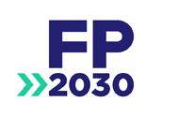
HIP Partnership
The Technical Advisory Group (TAG) is made up of 25 experts in family planning, including representatives from the co-sponsors.
The Co-sponsors include the following organizations:
Educating Girls
05
Notes:
The High Impact Practices in Family Planning (HIPs) are supported by over 65 organizations. These organizations play a vital role in developing, reviewing, disseminating, and implementing HIPs in family planning.
The HIPs partnership includes various structures to ensure HIP products are developed, kept up to date, and disseminated widely. These include:
Co-sponsors – Serve as the secretariat for the HIPs.
Partners – Contribute to key HIP products and endorse the HIPs.
Technical Advisory Group – Ensure high technical quality of key HIP products and approve HIP brief and SPG concepts for development.
P&D Team – Support the production and dissemination (P&D) of HIP products.
Technical Expert Groups – Write new HIP briefs and ensure they are up-to-date.
For more information about the HIP Partnership, please copy and paste this link into your web browser: https://www.fphighimpactpractices.org/partnership-structure/

Slide 6
High Impact Practice
Keep girls in school to improve health and development.
Educating Girls
06
Notes:
Investments that promote keeping girls in school, particularly in secondary school, have far-reaching and long-term health and development benefits for individuals, families, and communities.
The purpose of this brief is to describe the relationship of girls’ education on family planning and reproductive health and behaviors; highlight evidence-based practices that increase girls’ enrollment, retention, and participation in school; and provide recommendations for how the health sector can help support keeping girls in school.

Slide 7
Background
Data consistently demonstrate a strong and positive relationship between increased formal educational attainment among girls and healthier sexual and reproductive behaviors, including contraceptive use.
Governments and their partners can invest in structural changes that facilitate access to formal education, such as equitable gender norms, economic empowerment, and promoting healthy behaviors.
Educating Girls
07
Notes:
Educating girls helps improve gender equity by increasing agency and empowering girls to engage in decision-making that affects their families and the development of their communities.
Access to high-quality contraceptive services for young people plays a key role in helping girls avoid an unintended pregnancy in order to pursue their educational goals.
In 2011, 57 million children globally were not in school. More than one-half of the world’s out-of-school children live in sub-Saharan Africa (EFA Global Monitoring Report team, 2014).
Although gender disparities in education are narrowing, UNESCO estimates that only 29% of primary-school-age children live in countries that have achieved gender parity (that is, equal participation for girls and boys in school) at the secondary level, and only 15% live in countries with gender parity at the upper secondary level (Fiske, 2012).
For more information, please copy and paste this link into your web browser to reference the “Background” section on the HIP brief: https://www.fphighimpactpractices.org/briefs/educating-girls/

Slide 8
Impact of Girls’ Education on Reproductive
Behavior
Educated women are more likely to delay marriage and first births as well as engage in other protective health behaviors.
Women’s education is associated with a wide range of positive child health outcomes.
Complementary investments in education and family planning can accelerate the fertility transition and facilitate development.
BACKGROUND
Educating Girls
08
Notes:
Strong associations between education and reproductive behavior are observed consistently across a wide variety of social and economic settings and over time.
Educated women are more likely to delay marriage and first births as well as engage in other protective health behaviors.
Research in developing countries shows that girls who attend formal school delay sexual initiation, marry and start childbearing at older ages, and have lower rates of HIV and other reproductive morbidities (Lloyd, 2005).
Women’s education is associated with a wide range of positive child health outcomes.
Each additional year of mothers’ education increases the chance of mothers using prenatal care (Currie and Moretti, 2003).
Children of educated mothers are more likely than children of uneducated mothers to have higher birth weights, less likely to die in infancy, and more likely to be immunized (Muula et al., 2011; Chou et al., 2007).
These relationships are observed among mothers with primary-level education and become stronger with secondary-level education (Chou et al., 2007).
Complementary investments in education and family planning can accelerate the fertility transition and facilitate development.
“On average, countries with a higher level of education tended to be more advanced and to have earlier emergence of modern contraceptive use … and therefore to have an earlier fertility decline” (Garenne, 2012).
A demographic projection model using data from India predicted that investments in both education and family planning programs will have the largest impacts on slowing population growth compared with investing in only one aspect, and that together these investments will have far-reaching effects on gender equity and economic growth (Jiang and Hardee, 2014).
Based on data from 105 countries, researchers concluded that investments in universal primary and secondary education played a “decisive role” in bringing countries out of poverty and reducing fertility rates (Crespo et al., 2013).

Slide 9
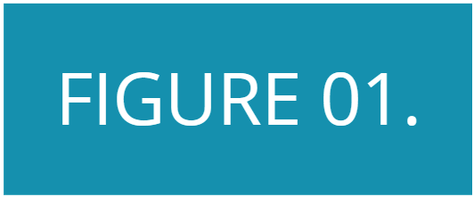
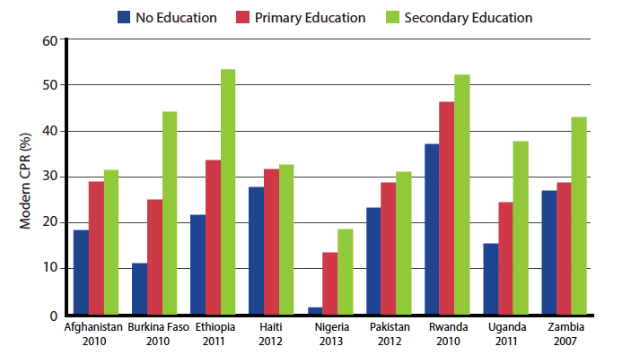
Impact of Girls’ Education on Reproductive
Behavior
Modern Contraceptive Prevalence Rate (CPR) Among Married Women of Reproductive Age by Education Level in Selected Low-Income Countries
Educated women are more likely to have fewer children and use modern contraception.
BACKGROUND
Source: DHS Program, 2012
Educating Girls
09
Notes:
Educated women are more likely to have fewer children and use modern contraception.
Research consistently shows a strong correlation between women’s higher educational attainment and increased contraceptive use and reduced childbearing.
In countries with large differences in educational attainment, women with no education will bear, on average, up to 3 children more in their lifetime than women with secondary or higher levels of education (Asiimwe et al., 2013; DHS Program, 2012; Mboup and Saha, 1998).
Similarly, in these countries, levels of modern contraceptive use are 30% to 700% higher among women with primary or secondary education than among women with no education (see Figure).
View this figure in the HIP brief (copy and paste this link into your web browser):
https://www.fphighimpactpractices.org/briefs/educating-girls/

Slide 10
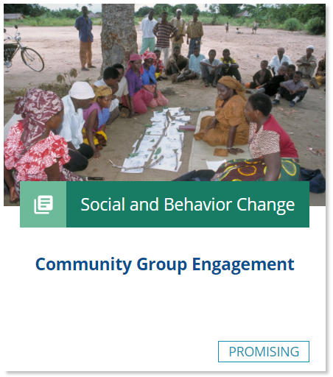
What works to keep girls in school?
Engage communities to change social norms that devalue girls and their education.
Improve the quality of the school environment.
Provide economic incentives to enroll and keep girls in school.
Link health programs to schools.
Educating Girls
10
Notes:
Engage communities to change social norms that devalue girls and their education.
Lack of social support discourages girls from attending school, such as staff providing more support to boys than girls; teachers believing that subjects such as math are less important for girls than boys; harassment by boys; and boys not recognizing that girls are not treated equitably (Lloyd et al., 2000).
Community engagement approaches can address these barriers by emphasizing the value of girls and the benefits of girls’ education; promoting a gender-equitable distribution of household work; engaging parents, girls, and communities to ensure girls’ safety; and providing a support structure for girls to pursue education.
For more information, please copy and paste this link into your web browser to visit the HIP brief on Community Group Engagement: https://www.fphighimpactpractices.org/briefs/community-group-engagement/
Improve the quality of the school environment.
In many countries, children do not attend school because they fear an environment of abuse and sexual exploitation.
Teacher training, engaging in collaborative learning styles and extracurricular activities, employing women as teachers, appointing women to local positions of leadership, and community engagement approaches can help improve the quality of schools (Unterhalter et al., 2014).
Provide economic incentives to enroll and keep girls in school.
Much of the rigorous evidence on keeping girls in school comes from interventions that involve economic incentives, such as such as conditional and unconditional cash transfers or non-cash transfers to cover expenses such as school fees, books, uniforms, and transportation (Unterhalter et al., 2014).
Data show that conditional cash transfers based upon school attendance are effective at increasing school enrollment and attendance among girls in secondary school (Baird et al., 2010).
Link health programs to schools.
High levels of poverty affect both boys’ and girls’ health status and nutrition and have significant impact on school attendance (Fancy et al., 2012).
By addressing the underlying health issues that affect school attendance school-feeding programs, such as the BESO II, Community-School Partnership Program for Education and Health in Ethiopia (Tate et al., 2011), the World Food Program in Pakistan (WFP, [2014]) and school deworming programs in Kenya (Miguel and Kremer, 2004) have been effective at reducing absenteeism and increasing primary school enrollment.

Slide 11
What works to keep girls in school?
Interventions with insufficient evidence to assess impact on keeping girls in school:
Separate toilets for girls at schools
Menstrual hygiene management
Provision of sanitary pads and puberty education
Educating Girls
11
Notes:
Interventions with insufficient evidence to assess impact on keeping girls in school:
Separate toilets for girls at schools (Birdthistle et al., 2011; Unterhalter et al., 2014).
Menstrual hygiene management (Sumpter et al., 2014; Unterhalter et al., 2014).
Provision of sanitary pads and puberty education (Montgomery et al., 2012; Unterhalter et al., 2014)
For more information about the evidence base for these interventions, please copy and paste this link into your web browser to visit the references for this HIP brief: https://www.fphighimpactpractices.org/wp-content/uploads/2018/08/EducatingGirls_references.pdf

Slide 12
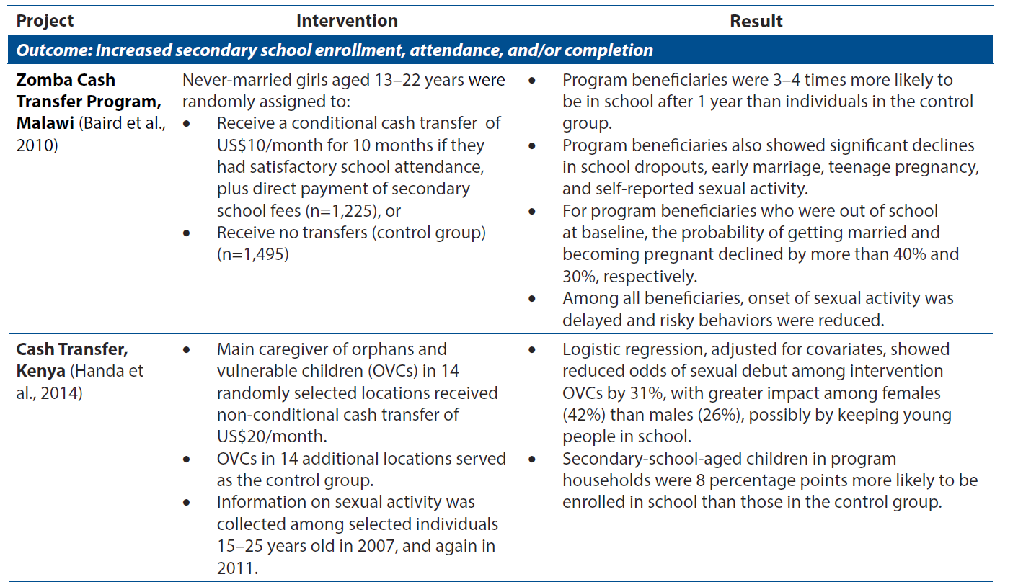
Illustrative Examples
Educating Girls
12
Notes:
This Table provides illustrative examples of programs in Africa that have successfully enrolled and retained girls in school.
Table. Illustrative Examples of Investments to Keep Girls in School, by Outcome
View the full table in the HIP brief (copy and paste this link into your web browser): https://www.fphighimpactpractices.org/briefs/educating-girls/

Slide 13
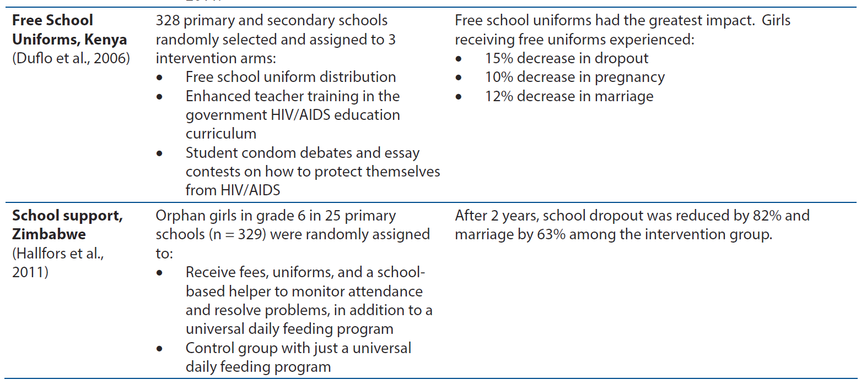
Illustrative Examples
Educating Girls
13
Notes:
This Table provides illustrative examples of programs in Africa that have successfully enrolled and retained girls in school.
Table. Illustrative Examples of Investments to Keep Girls in School, by Outcome
View the full table in the HIP brief (copy and paste this link into your web browser): https://www.fphighimpactpractices.org/briefs/educating-girls/

Slide 14
Thank You
Continue to the extra slides or access the HIP brief for more information.
Educating Girls
14
Notes:
For more information, please copy and paste this link into your web browser to visit the HIP brief for Educating Girls: https://www.fphighimpactpractices.org/briefs/educating-girls/

Slide 15
Extra Slides
What works to keep girls in school?
Tools & Resources
Educating Girls
15
Notes:
We have put together a collection of implementation tips for Educating Girls, in case you have additional time in your meeting. Further information about these tips can be found in the HIP brief.
References from the literature on this HIP can be found here (copy and paste this link into your web browser): https://www.fphighimpactpractices.org/wp-content/uploads/2018/08/EducatingGirls_references.pdf

Slide 16
How can the health sector support keeping girls in school?
Many of the following considerations include cross-sectoral approaches between the health, education, and other sectors:
Cross-Sectoral Monitoring and Evaluation
Community Engagement
Policy Environment
School Environment
Economic Incentives
Linking Health and Education
Educating Girls
16
Notes:
Cross-Sectoral Monitoring and Evaluation
Collaborative efforts to keep girls in school should collect key information on inputs, outcomes, and cost-effectiveness for both education and sexual and reproductive health.
Community Engagement
These interventions were the most effective when they engaged a wide range of stakeholders, including teachers, supervisors, students, ministry officials, and parents/guardians (Clarke, 2011; Tate et al., 2011; Herz and Sperling, 2004).
Many health sector programs have existing community structures such as community-based distribution agents and community health workers. The health sector can use these structures to strengthen social and behavior change communication strategies in order to address community perceptions of school quality and safety as well as gender roles.
These strategies should coordinate messaging and link messages on the mutual benefits of education on health, including sexual and reproductive health, and vice versa.
For more information about community health workers, please copy and paste this link into your web browser to visit the related HIP brief: https://www.fphighimpactpractices.org/briefs/community-health-workers/
For more information about community group engagement, please copy and paste this link into your web browser to visit the related HIP brief: https://www.fphighimpactpractices.org/briefs/community-group-engagement/
Policy Environment
The health sector also has an important role to play in creating a policy environment that is supportive of girls’ education. Examples of areas in which the health sector can contribute include:
Advocating gender-equitable universal education policies
Advocating with the Ministries of Education, Gender, and Youth to remove policy barriers that prevent girls from returning to school after dropout, marriage, or pregnancy
Working with the Ministries of Education and Health to implement policies to eliminate the practice of child marriage, which is a barrier to girls’ education; encourage development of such policies; and support programs that prevent child marriage or address the needs of married adolescents
For more information about policy, please copy and paste this link into your web browser to visit the Policy HIP Brief: https://www.fphighimpactpractices.org/briefs/policy/
School Environment
Efforts to improve the quality of the educational environment fall mainly outside the purview of the health sector. Areas in which the health sector may contribute to an improved learning environment in collaboration with the education sector include:
Reducing gender-based violence in schools to help create supportive learning environments for girls
Training teachers in gender-equitable teaching methods
Supporting programs that promote teachers and women as mentors for girls in communities
Economic Incentives
Targeted resources to parents and/or students, in the form of stipends and cash transfers, improve girls’ access to school as well as their retention and progression in school.
In poor settings, even small amounts of cash may be sufficient to significantly increase participation of girls in school (Unterhalter et al., 2014).
The health sector can partner with the education and other sectors to support such cash and non-cash transfers.
Identifying the appropriate beneficiaries is a critical factor in the effectiveness of these interventions. Resources should be directed to the populations most in need and to students at grade levels where dropouts are most likely to occur.
Another important aspect of targeting the resources is to ensure eligibility criteria are transparent, objective, well-understood by communities, and perceived to be fair (Unterhalter et al., 2014).
Linking Health and Education
Coupling health interventions with school-based programs may help improve girls’ attendance and participation in schools.
Cross-sectoral programs need to provide more robust evidence that these programs contribute to improved health outcomes as well as health knowledge and behaviors (Doyle et al., 2010; Plummer et al., 2007). Examples of health interventions in schools include:
School-based feeding programs or take-home food rations for girls
Linking community-based health care activities and workers to schools
Linking health services such as counseling, contraception, and testing and treatment for sexually transmitted infections and HIV
Ensuring boys and girls have information about sexual and reproductive health issues

Slide 17
How can the health sector support keeping girls in school?
Cross-Sectoral Monitoring and Evaluation
Collaborative efforts to keep girls in school should collect key information on inputs, outcomes, and cost-effectiveness for both education and sexual and reproductive health.
Educating Girls
17
Notes:
Cross-Sectoral Monitoring and Evaluation
The impact of education interventions on sexual and reproductive health behaviors remains complex and the mechanisms of action unclear.
Collaborative efforts to keep girls in school should collect key information on inputs, outcomes, and cost-effectiveness for both education and sexual and reproductive health.

Slide 18
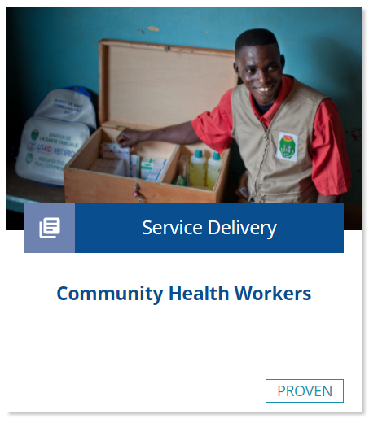
How can the health sector support keeping girls in school?
Community Engagement
Strengthen social and behavior change communication strategies in order to address community perceptions of school quality and safety as well as gender roles.
Link messages on the mutual benefits of education on health, including sexual and reproductive health, and vice versa.
Educating Girls
18
Notes:
Community Engagement
These interventions were the most effective when they engaged a wide range of stakeholders, including teachers, supervisors, students, ministry officials, and parents/guardians (Clarke, 2011; Tate et al., 2011; Herz and Sperling, 2004).
Many health sector programs have existing community structures such as community-based distribution agents and community health workers. The health sector can use these structures to strengthen social and behavior change communication strategies in order to address community perceptions of school quality and safety as well as gender roles.
These strategies should coordinate messaging and link messages on the mutual benefits of education on health, including sexual and reproductive health, and vice versa.
For more information about community health workers, please copy and paste this link into your web browser to visit the related HIP brief: https://www.fphighimpactpractices.org/briefs/community-health-workers/
For more information about community group engagement, please copy and paste this link into your web browser to visit the related HIP brief: https://www.fphighimpactpractices.org/briefs/community-group-engagement/

Slide 19
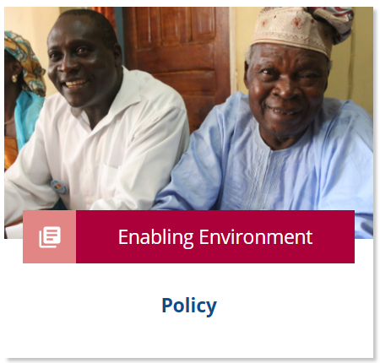
How can the health sector support keeping girls in school?
Policy Environment
Advocating gender-equitable universal education policies
Advocating with the Ministries of Education, Gender, and Youth to remove policy barriers that prevent girls from returning to school after dropout, marriage, or pregnancy
Educating Girls
19
Notes:
Policy Environment
The health sector also has an important role to play in creating a policy environment that is supportive of girls’ education. Examples of areas in which the health sector can contribute include:
Advocating gender-equitable universal education policies
Advocating with the Ministries of Education, Gender, and Youth to remove policy barriers that prevent girls from returning to school after dropout, marriage, or pregnancy
Working with the Ministries of Education and Health to implement policies to eliminate the practice of child marriage, which is a barrier to girls’ education; encourage development of such policies; and support programs that prevent child marriage or address the needs of married adolescents
For more information about policy, please copy and paste this link into your web browser to visit the Policy HIP Brief: https://www.fphighimpactpractices.org/briefs/policy/

Slide 20
How can the health sector support keeping girls in school?
School Environment
Reducing gender-based violence in schools to help create supportive learning environments for girls
Training teachers in gender-equitable teaching methods
Supporting programs that promote teachers and women as mentors for girls in communities
Educating Girls
20
Notes:
School Environment
Efforts to improve the quality of the educational environment fall mainly outside the purview of the health sector. Areas in which the health sector may contribute to an improved learning environment in collaboration with the education sector include:
Reducing gender-based violence in schools to help create supportive learning environments for girls
Training teachers in gender-equitable teaching methods
Supporting programs that promote teachers and women as mentors for girls in communities

Slide 21
How can the health sector support keeping girls in school?
Conditional Cash Transfers
Conditionality enhances impact on school attendance but increases cost.
Impact is greatest if focused on girls at points of transition in the education system.
Gains are greatest in the poorest settings and among the poorest girls.
School accessibility can constrain impact.
Enrollment and attendance gains do not necessarily translate into improvements in learning outcomes.
Cost-benefit ratio should be included in any analysis of conditional cash transfers.
Safety to and from school should be addressed.
Source: Arnold et al., 2011
Economic Incentives
Targeted resources to parents and/or students, in the form of stipends and cash transfers, improve girls’ access to school as well as their retention and progression in school.
Educating Girls
21
Notes:
Economic Incentives
Targeted resources to parents and/or students, in the form of stipends and cash transfers, improve girls’ access to school as well as their retention and progression in school.
In poor settings, even small amounts of cash may be sufficient to significantly increase participation of girls in school (Unterhalter et al., 2014).
The health sector can partner with the education and other sectors to support such cash and non-cash transfers.
Identifying the appropriate beneficiaries is a critical factor in the effectiveness of these interventions. Resources should be directed to the populations most in need and to students at grade levels where dropouts are most likely to occur.
Another important aspect of targeting the resources is to ensure eligibility criteria are transparent, objective, well-understood by communities, and perceived to be fair (Unterhalter et al., 2014).

Slide 22
How can the health sector support keeping girls in school?
Linking Health and Education
School-based feeding programs or take-home food rations for girls
Linking community-based health care activities and workers to schools
Ensuring boys and girls have information about sexual and reproductive health issues
Educating Girls
22
Notes:
Linking Health and Education
Coupling health interventions with school-based programs may help improve girls’ attendance and participation in schools.
Cross-sectoral programs need to provide more robust evidence that these programs contribute to improved health outcomes as well as health knowledge and behaviors (Doyle et al., 2010; Plummer et al., 2007). Examples of health interventions in schools include:
School-based feeding programs or take-home food rations for girls
Linking community-based health care activities and workers to schools
Linking health services such as counseling, contraception, and testing and treatment for sexually transmitted infections and HIV
Ensuring boys and girls have information about sexual and reproductive health issues

Slide 23
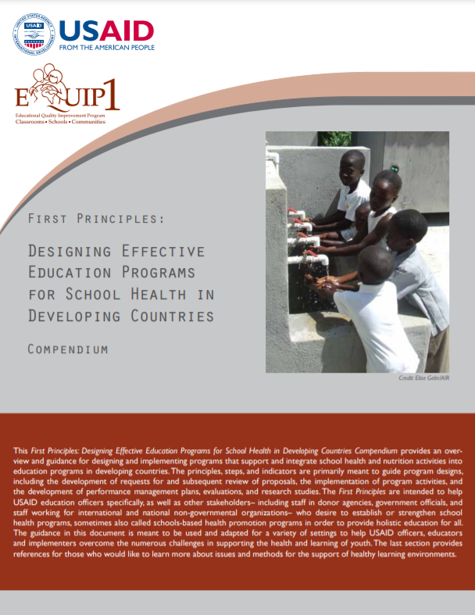
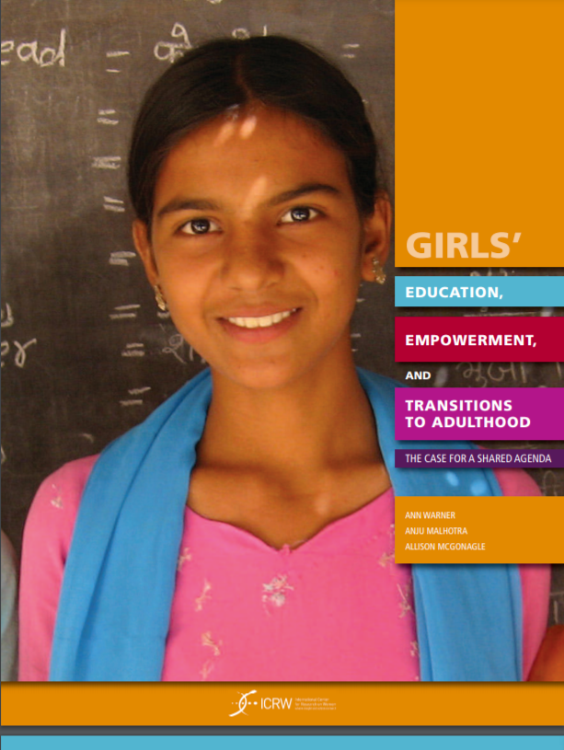
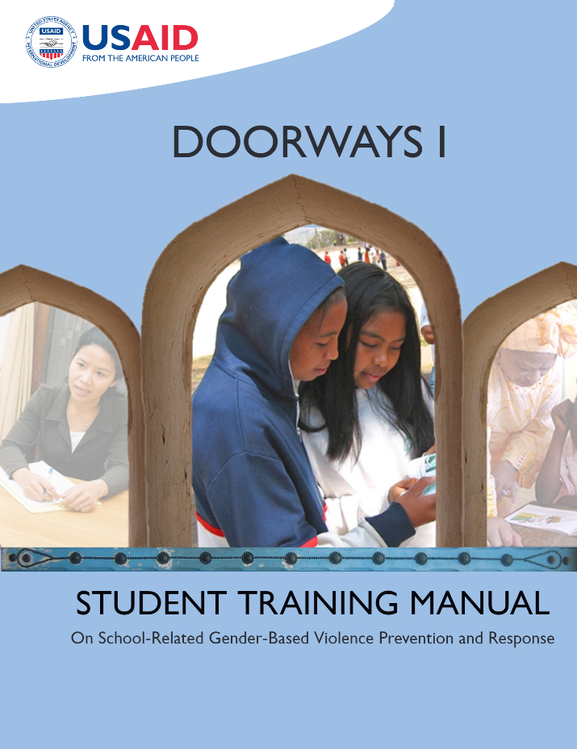
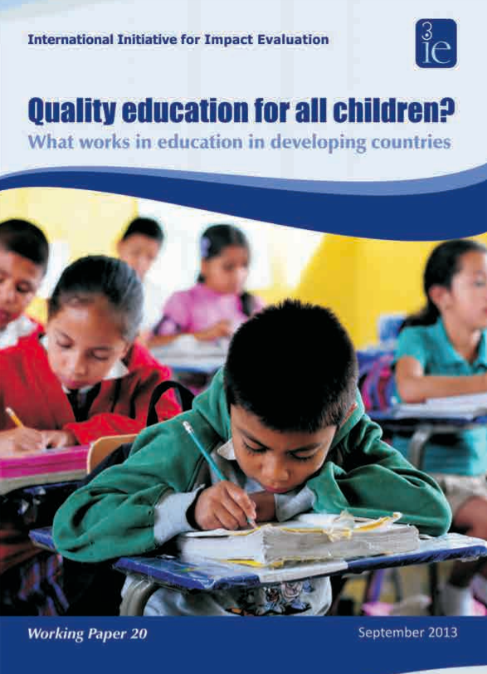
Tools & Resources
First Principles: Designing Effective Education Programs for School
Girls Education, Empowerment, and Transitions to Adulthood: The Case for a Shared Agenda
Safe Schools Program (Doorways)
Quality Education for All Children? What Works in Education in Developing Countries
05
Educating Girls
23
Notes:
First Principles: Designing Effective Education Programs for School Health in Developing Countries Compendium provides an overview and guidance for designing and implementing programs that support and integrate school health and nutrition and education programs in developing countries. Available at: https://www.edu-links.org/resources/first-principles-designing-effective-education-programs-5
Girls Education, Empowerment, and Transitions to Adulthood: The Case for a Shared Agenda makes a case for why leveraging education to facilitate girls’ transitions to healthy, safe, and productive adulthood is the single most important development investment that can be made. Available at: http://www.icrw.org/publications/girls-education-empowerment-and-transitions-adulthood
Safe Schools Program (Doorways): Replication Phase is a training program to enable teachers, community members, and students to prevent and respond to school-related gender-based violence. Available at: https://www.ungei.org/publication/doorways-i-student-training-manual-school-related-gender-based-violence-prevention-and
Quality Education for All Children? What Works in Education in Developing Countries includes analysis of a range of school interventions from 75 studies. Available at: https://www.3ieimpact.org/evidence-hub/publications/working-papers/quality-education-all-children-what-works-education

Slide 24
fphighimpactpractices.org
Notes:
Subscribe to the HIPs Newsletter here (copy and paste this link into your web browser): https://mailchi.mp/76703a3652c9/hips-newsletter-sign-up
Please visit the five areas of our website to learn more about the HIPs:
HIP Products (copy and paste this link into your web browser): https://www.fphighimpactpractices.org/hip-products/
Resources (copy and paste this link into your web browser): https://www.fphighimpactpractices.org/resources/
Engage (copy and paste this link into your web browser): https://www.fphighimpactpractices.org/engage-with-the-hips/
Overview (copy and paste this link into your web browser): https://www.fphighimpactpractices.org/overview/
About Us (copy and paste this link into your web browser): https://www.fphighimpactpractices.org/partnership-structure/

