Slide 1
Galvanizing Commitment
Creating a supportive environment for family planning programs
Notes:
Demonstrable commitment to family planning strengthens the enabling environment in which programs and policies are implemented. Regardless of past performance, countries can experience stagnation as their commitment to family planning lags over time (Putjuk, 2014).
This brief considers why galvanizing support for family planning is important, presents examples of different types of commitment and how they advance the enabling environment, and offers experiential learning from experts in the field.
Photo Credit: UN Photo Mark Garten
REVISED: 5/4/21

Slide 2
Overview
Introduction to the High Impact Practices (HIPs)
What is a HIP?
HIP Categories
Partnership
PART
PART
Galvanizing Commitment
Background
Evidence of Impact
Extra Slides
Implementation Tips
Tools & Resources
11
Galvanizing Commitment
02
Notes:
Thank you for using this slide deck! This is a product derived from the HIP brief to assist you in presenting to a variety of audiences. Instructions and additional resources are included in the notes of each slide for your convenience. There is a wealth of information and resources in the “Notes” section of each slide.
This presentation is divided in three parts: an Introduction to the High Impact Practices (HIPs) in Family Planning, Galvanizing Commitment, and Extra Slides.
The logo for your organization or ministry may be added to these slides. The web addresses provided in the “Notes” section of each slide can be copied and pasted into your web browser.

Slide 3
High Impact Practices in Family Planning (HIPs) are…
Evidence-based family planning practices
Vetted by experts against specific criteria
Documented in an easy-to-use format
Galvanizing Commitment
03
Notes:
High Impact Practices (HIPs) are a set of evidence-based family planning practices vetted by experts against specific criteria and documented in an easy-to-use format.
The High Impact Practices in Family Planning (HIPs) were first created in 2010 after a survey of FP stakeholders revealed little consensus for “what works” in international FP programming. A small group of leaders in FP were brought together with the task of identifying a short list of HIPs that if implemented at scale would help countries address the unmet need for FP and thereby increase national contraceptive prevalence.
HIPs are identified based on demonstrated magnitude of impact on contraceptive use and potential application in a wide range of settings. Consideration is also given to other relevant outcome measures including unintended pregnancy, fertility, or one of the primary proximate determinants of fertility (delay of marriage, birth spacing, or breast feeding). Evidence of replicability, scalability, sustainability, and cost-effectiveness are also considered.
For more information, please copy and paste this link into your web browser to see this video: https://www.youtube.com/watch?v=N6V0gfl-V3k&ab_channel=KnowledgeSUCCESS
A 2-pager overview of the HIPs is available in an online and a downloadable PDF format here (copy and paste this link into your web browser): https://www.fphighimpactpractices.org/high-impact-practices-in-family-planning-list/

Slide 4
HIPs address the full spectrum of FP programming
Enabling Environment
Service Delivery
Social and Behavioral Change
PART
Address systemic barriers that affect an individual’s ability to access family planning information & services. 6 briefs
Improve the availability, accessibility, acceptability, and quality of family planning services. 8 briefs
Influence knowledge, beliefs, behaviors, and social norms associated with family planning.
3 briefs
Enhancements
Approaches used in conjunction with HIPs to maximize the impact of HIP implementation or increase the reach. 4 briefs
Galvanizing Commitment
04
Notes:
There are three categories of HIPs: Enabling Environment, Service Delivery and Social and Behavioral Change. Galvanizing Commitment is an Enabling Environment HIP. This information came from the HIP List (copy and paste this link into your web browser): https://www.fphighimpactpractices.org/high-impact-practices-in-family-planning-list/
A HIP Enhancement is a tool or approach that is not a standalone practice, but it is often used in conjunction with HIPs to maximize the impact of HIP implementation or increase the reach and access for specific audiences. The intended purpose and impact of enhancements are focused and, therefore the evidence-based and impact of an enhancement is subjected to different standards than a HIP.
For more information about the HIP Categories and Enhancements, please copy and paste this link into your web browser: https://www.fphighimpactpractices.org/high-impact-practices-in-family-planning-list/
Here are a few examples of HIPs from each category:
Service Delivery:
Immediate Postpartum Family Planning
Mobile Outreach Services
Postabortion Family Planning
Enabling Environment:
Domestic Public Financing
Educating Girls
Supply Chain Management
Social and Behavior Change:
Community Group Engagement
Digital Health for SBC
Mass Media
Enhancements:
Digital Health for Systems
Adolescent-Friendly Contraceptive Services
Family Planning Vouchers
All HIPs are Available in English, Spanish, French, and Portuguese.

Slide 5
HIP Partnership
The Technical Advisory Group (TAG) is made up of 25 experts in family planning, including representatives from the co-sponsors.
The Co-sponsors include the following organizations:
Galvanizing Commitment
05
Notes:
The High Impact Practices in Family Planning (HIPs) are supported by over 65 organizations. These organizations play a vital role in developing, reviewing, disseminating, and implementing HIPs in family planning.
The HIPs partnership includes various structures to ensure HIP products are developed, kept up to date, and disseminated widely. These include:
Co-sponsors – Serve as the secretariat for the HIPs.
Partners – Contribute to key HIP products and endorse the HIPs.
Technical Advisory Group – Ensure high technical quality of key HIP products and approve HIP brief and SPG concepts for development.
P&D Team – Support the production and dissemination (P&D) of HIP products.
Technical Expert Groups – Write new HIP briefs and ensure they are up-to-date.
For more information about the HIP Partnership, please copy and paste this link into your web browser: https://www.fphighimpactpractices.org/partnership-structure/

Slide 6
High Impact Practice
Galvanize commitment to support family planning programs.
Galvanizing Commitment
06
Notes:
Demonstrable commitment to family planning strengthens the enabling environment in which programs and policies are implemented. Regardless of past performance, countries can experience stagnation as their commitment to family planning lags over time (Putjuk, 2014).
This brief considers why galvanizing support for family planning is important, presents examples of different types of commitment and how they advance the enabling environment, and offers experiential learning from experts in the field.

Slide 7
Background
Countries and their development partners have recommitted to meeting the reproductive needs of their constituents. Sustained advocacy and accountability mechanisms are needed to ensure these commitments come to fruition.
There are three forms of commitment — expressed, institutional, and financial — at the global, regional, country, and subnational levels.
Galvanizing Commitment
07
Notes:
Advocacy plays a key role in moving toward establishing commitment as stakeholders link the problem and evidence with the specific investment needed. Once made, stakeholders monitor implementation of the commitment to ensure that it leads to improvements in the underlying issue.
For more information, please copy and paste this link into your web browser to reference the “Background” section on the HIP brief: https://www.fphighimpactpractices.org/briefs/galvanizing-commitment/

Slide 8
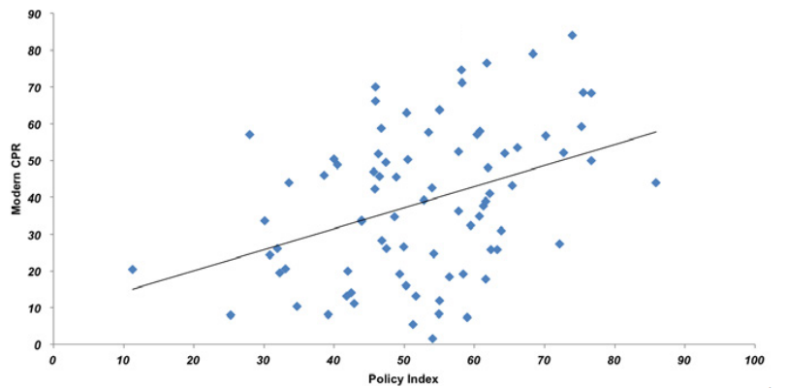
Evidence of Impact
Figure 1. Correlation Between Family Planning Policy Index and Modern CPR
The presence of different types of commitments is tied to a strong policy environment for family planning, which, in turn, is associated with a higher modern contraceptive prevalence rate (mCPR).
Source: Kuang et al., 2015
05
Galvanizing Commitment
08
Notes:
Figure 1 shows the relationship between the strength of the policy environment for family planning as assessed in the Family Planning Effort Score (FPES) and the country’s modern contraceptive prevalence rate (mCPR).
The presence of different types of commitments is tied to a strong policy environment for family planning, which, in turn, is associated with a higher modern contraceptive prevalence rate (mCPR), as illustrated by evidence from the most recent round of the Family Planning Effort Score (FPES). The FPES captures different aspects of national program inputs based on expert observers’ judgments on 30 program features, which are converted to scores in four program effort areas: policy, services, evaluation, and method availability. While the experience of the 90 countries included in the 2015 FPES shows broad distribution, the overall trend indicates a correlation between a strong policy environment and higher mCPR (Kuang et al, 2015).
View Figure 1 in the HIP brief (copy and paste this link into your web browser): https://www.fphighimpactpractices.org/briefs/galvanizing-commitment/

Slide 9
Evidence of Impact:
Expressed commitments
Expressed commitment can be in the form of a constitutional amendment, law, or policy that guarantees:
Access to health and family planning;
Development of family planning strategies and costed implementation plans; or
Incorporation of family planning in national development plans.
05
Galvanizing Commitment
09
Notes:
From the private sector, commitments can include policies and programs that support employees’ access to family planning.
Expressed commitments are often the first step toward more substantial ownership and investment in family planning programming.
The following examples illustrate how expressed commitment can lead to additional commitments and desired outcomes.
In 2005, the effects of rapid population growth on development and poverty were presented to the Rwandan cabinet using the “Resources for the Awareness of Population Impacts on Development” (RAPID) model projections. (RAPID projects the social and economic consequences of high fertility and rapid population growth for such sectors as labor, education, health, urbanization, and agriculture [Health Policy Initiative, 2009].)
By 2006, the MOH had produced a National Family Planning Policy and five-year strategy (2006–2010), and the government had included a budget line item for contraceptives (Solo, 2008).
Use of modern contraceptives among married women increased dramatically in the intervening years—from 10% in 2005 to 45% in 2010 (INSR, 2006; NISR, 2012).
Funding for contraceptives showed a commensurate increase, too: from US$491,231 in 2004 to $5,742,112 in 2008—with the MOH beginning to use its own funds for contraceptive procurement in 2008 (MOH [Rwanda], 2009).
At the 2011 International Conference on Family Planning in Dakar, Senegal’s President Abdoulaye Wade stated his commitment to family planning, which was renewed at the 2012 London Summit on Family Planning.
As a result of his expressed commitment, the MOH is employing more staff to provide family planning services, expanding method mix to better meet clients’ needs, and fostering an environment to expand the role of the private sector (Stratton, 2015).
Since 2010, Senegal has experienced a rapid increase in modern contraceptive use, from 10% in 2010–11 to 20% in 2014 (ANSD [Senegal], 2014; UN, Population Division, 2011).

Slide 10
Evidence of Impact:
Institutional commitments
Institutional commitments involve greater investment than an expressed commitment, such as creating or upgrading a public agency or a permanent standing committee. Examples include:
Jharkhand State’s (India) Family Planning Task Force
Kenya’s National Council for Population and Development (NCPD)
05
Galvanizing Commitment
10
Notes:
The following examples illustrate different forms of institutional commitment that contribute to a more favorable enabling environment for family planning.
India’s Jharkhand State recognized the need for an institution to address the state’s high fertility rates. It first established the Family Planning Task Force, which was charged to assess services and training needs. The Task Force created a state family planning strategy and created a family planning cell within the State Reproductive and Child Health Office to serve as a sustainable institution to promote family planning in the state (Chokshi et al., 2014).
Kenya’s National Council for Population and Development (NCPD) is charged with providing leadership and mobilizing support for population programs, as well as creating public awareness on population and development issues. As Kenya’s process of devolution moves forward, the NCPD is collaborating with stakeholders to support advocacy efforts for line items for family planning in county budgets (Health Policy Project, 2015).

Slide 11
Evidence of Impact:
Financial commitments
Financial commitments reflect a willingness of governments and the private sector to invest resources to advance access to family planning. Examples include:
Bolivia’s Maternal and Infant Health Insurance Program (SUMI)
Guatemala’s Healthy Motherhood Law
05
Galvanizing Commitment
11
Notes:
The following examples illustrate the extent to which countries are increasing financial commitments to family planning—at both the central and the decentralized level.
Bolivia’s maternal and infant health insurance program (Seguro Universal Materno Infantil, or SUMI) was expanded in 1999 to include reproductive health and family planning services (Beith et al., 2006).
However, because contraceptives were still donated centrally, municipalities were not reimbursed for providing these services. In anticipation of donor phase-out, advocates lobbied to expand SUMI to include reproductive health supplies.
As a result, in 2006, SUMI was expanded to cover all its beneficiaries’ reproductive health needs, including contraceptives (USAID | DELIVER PROJECT, 2012).
Guatemala provides financial support for reproductive health programs through an alcohol tax. As part of the 2010 Healthy Motherhood Law, 15% of the alcohol tax revenue is required to be allotted to reproductive health programming, of which 30% must be used to purchase contraceptive commodities.
A budget tracking exercise indicates that moneys have been allocated and disbursed as mandated from the Ministry of Finance (MOF) to the MOH.
Between 2006 and 2012, the tax contributed an estimated $24.3 million to reproductive health programming (Reyes et al., 2013).
Malawian parliamentarians committed to create a new budget line for family planning commodities in 2012. In the 2013/14 budget year, the MOF allocated approximately $80,000 for the budget line (Health Policy Project, 2013).
In subsequent years, the MOF increased the allocation to $165,000 and then to $190,000. These increases are largely attributed to the engagement of the parliamentarians in oversight and negotiation with the MOF (personal communication with Patrick Mugirwa, Programme Officer, Partners in Population and Development-African Regional Office, June 4, 2015).
Leaders from 364 Indonesian villages began committing funds to family planning, which are expected to cover data recording and reporting, community mobilization, and transportation costs for users of clinical methods who must travel to access services (AFP, 2015).
The Global Fund to Fight AIDS, Tuberculosis and Malaria provides resources for purchasing contraceptives, yet relatively few countries have used this alternative mechanism for contraceptive procurement. Rwanda is among the few that included contraceptives in its Round 7 application, taking advantage of this unique opportunity to galvanize additional financial support for family planning (USAID | DELIVER PROJECT, [2008]).

Slide 12
Evidence of Impact:
Civil Society & Private Sector
Civil society and the private sector can also make financial commitments to family planning, reinforcing the idea that reproductive health goes beyond the responsibility of governments. Examples include:
Merck’s Merck for Mothers
Levi Strauss Foundation’s Improving Worker Well-Being Innovation Fund
Lotus Garment Group’s on-site health clinic
05
Galvanizing Commitment
12
Notes:
The following examples illustrate commitments made by the private sector to increase use of family planning.
Merck for Mothers is a 10-year, $500 million private-sector initiative to reduce preventable maternal deaths globally. In Senegal, Merck for Mothers is supporting the expansion of a supply chain innovation to ensure that health facilities maintain adequate stocks of a range of contraceptive options by working with private suppliers (Merck for Mothers, [2013]).
The Levi Strauss Foundation has created an Improving Worker Well-Being Innovation Fund in which suppliers can co-fund grants to community-based NGOs to help factory owners meet their workers’ health and well-being goals, including sexual and reproductive health.
Lotus High Tech/Lotus High Fashion is an apparel manufacturing company with more than 8,000 workers located in Port Said, Egypt. After receiving technical assistance from a number of international NGOs, the company implemented structural changes to the on-site health clinic, including expanding the role of nurses, integrating management and clinical functions, and defining clinical quality standards.

Slide 13
Thank You
Continue to the extra slides or access the HIP brief for more information.
Galvanizing Commitment
13
Notes:
For more information, please copy and paste this link into your web browser to visit the Galvanizing Commitment HIP brief: https://www.fphighimpactpractices.org/briefs/galvanizing-commitment/

Slide 14
Extra Slides
Implementation Tips
Tools & Resources
Galvanizing Commitment
14
Notes:
We have put together a collection of implementation tips for Galvanizing Commitment, in case you have additional time in your meeting. Further information about these tips can be found in the HIP brief.
References from the literature on this HIP can be found here (copy and paste this link into your web browser): https://www.fphighimpactpractices.org/wp-content/uploads/2018/08/GalvanizingCommitment_references.pdf

Slide 15
Implementation Tips
Advocate Increased Commitment and Follow Through
Timing is everything.
Involve civil society organizations, professional associations, and the media in advocacy.
Coordinate advocacy efforts.
Support policy champions.
Galvanizing Commitment
15
Notes:
Advocacy, evidence, and accountability are three interrelated components needed to affirm commitment to family planning programs. Because commitments to family planning can waver in both the public and the private sectors, it is important to invest in systems and processes that support family planning over the long term while strengthening capacity in advocacy and accountability—especially for those times when commitments waver.
Advocate Increased Commitment and Follow Through
Timing is everything.
Family planning advocates must engage early in strategy development so that decision-makers understand the contribution that family planning makes to the development agenda.
As governments develop their budgets and expenditure frameworks, it is critical to mobilize advocacy efforts at the right moment in the annual cycle to influence the process. Entering the process too late will not lead to successful results.
Involve civil society organizations, professional associations, and the media in advocacy.
While civil society and professional associations often play a vital role in advocacy, an informed media is also important—not as advocates but as unbiased communicators of the underlying problems, their consequences to the public, and the need for commitments to address the situation.
Coordinate advocacy efforts.
Whether as part of a reproductive health technical working group, contraceptive security committee, or other coordinating board, fostering communication among all sectors helps build trust and confidence.
Support policy champions.
Policy champions are central to reaching decision-makers to plant and nurture ideas of commitment and to follow through with accountability approaches.
Cultivate and support champions wherever possible—within different parts of government, the private sector, and academia, as well as within individuals whose work focuses on maternal and child health, HIV, or other health issues.
Selecting opinion leaders as champions can be an effective way to achieve advocacy goals, but the champions need to understand what they are being asked to do and may need support to carry out the advocacy effort (FHI 360, 2010).

Slide 16
Implementation Tips
Use Evidence to Inform Advocacy Efforts and Reinforce Accountability
Support collection and analysis of financial data.
Estimate the true resource needs of family planning programs.
Ensure program impacts are measured and evaluated.
Galvanizing Commitment
16
Notes:
Use Evidence to Inform Advocacy Efforts and Reinforce Accountability
Support collection and analysis of financial data.
Financial data help decision-makers understand how funds flow between national and international accounts and out-of-pocket expenditures, while also providing information that can be used to hold governments and partners accountable for following through on commitments.
Support the collection and use of information on cost, cost-effectiveness, and cost savings, including National Health Accounts and reproductive health subaccounts.
The Public Expenditure Tracking Survey (PETS), supported by the World Bank, is another example of a tracking system, which documents use and abuse of public money and provides insights into cost efficiency, decentralization, and accountability.
Estimate the true resource needs of family planning programs beyond the cost of supplies and equipment.
Costed implementation plans should address all aspect of family planning and be realistic in estimating activity costs, as well as the total cost of the plan.
Ensure program impacts are measured and evaluated.
With this evidence, advocates can confirm that resources are used efficiently, effectively, and equitably.

Slide 17
Implementation Tips
Monitor Progress Toward Meeting Commitments
Use UNFPA’s Global Programme to Enhance Reproductive Health Commodity Security (GPRHCS) annual report to monitor program performance.
Foster accountability through FP2030.
Use social accountability to apply pressure to follow through on commitments.
Galvanizing Commitment
17
Notes:
Monitor Progress Toward Meeting Commitments
Use UNFPA’s Global Programme to Enhance Reproductive Health Commodity Security (GPRHCS) annual report to monitor program performance.
This report includes information for 46 countries on financial and expressed commitment for making contraceptive supplies available; existence of rights-based and youth-focused policies for access to family planning being implemented through costed plans along with guidelines and tools; effective national coordinating mechanisms for reproductive health supplies; and national institutions integrating family planning supply chain and procurement issues into training curricula.
Please copy and paste this link into your web browser to view the report: https://www.unfpa.org/sites/default/files/pub-pdf/GPRHCS%20Annual%20Report%202013_web.pdf
Foster accountability through FP2030.
The annual FP2020 report includes key indicators of country progress toward commitments. Track20 and the Performance Monitoring and Accountability (PMA2020) projects also track key measures at the country level (FP2020, 2015).
Use social accountability to apply pressure to follow through on commitments.
Civil society can play a crucial role in holding governments accountable. Social accountability offers a variety of approaches—from periodic community assessments to ongoing budget tracking.
Civil society organizations can work together to identify the most effective approach for tracking the commitment they are monitoring. In addition, they can learn from other coalitions about how to carry out these approaches most effectively (Hecht et al., 2014).

Slide 18
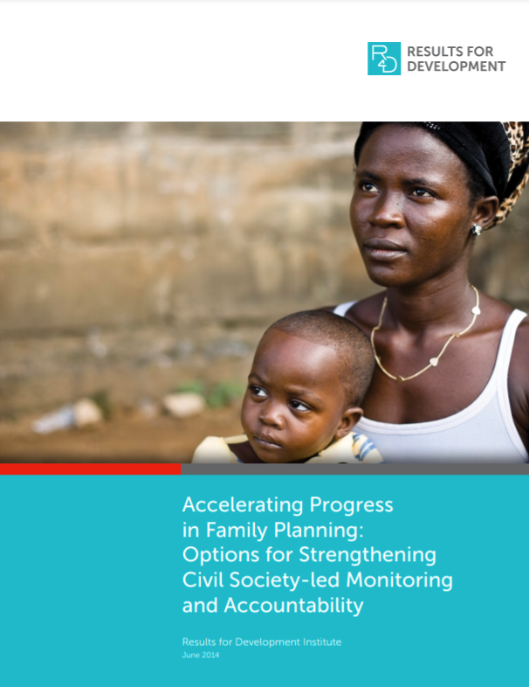
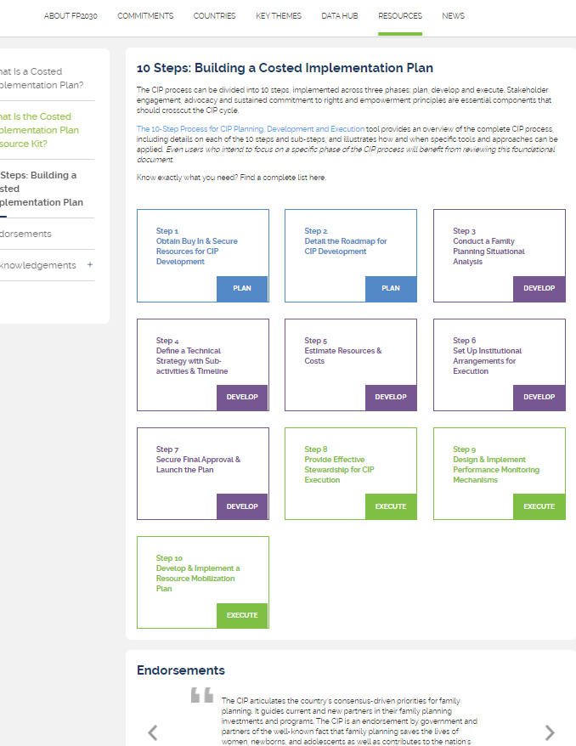
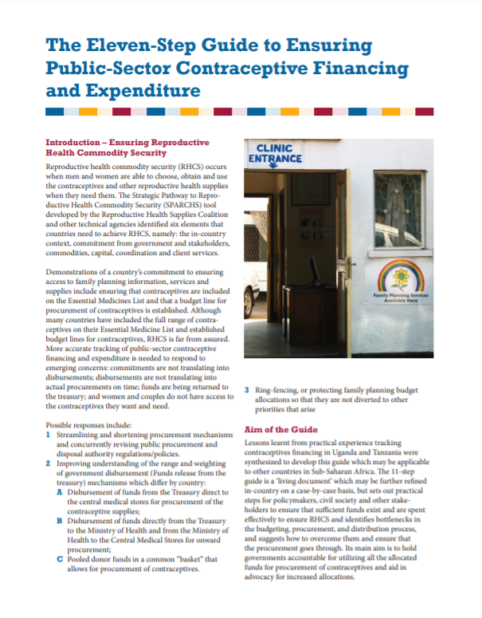
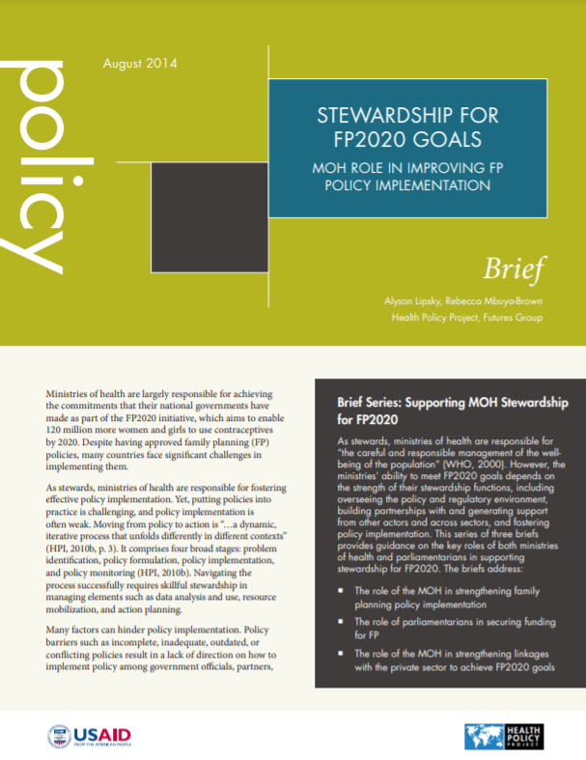
Tools & Resources
Accelerating Progress in Family Planning: Options for Strengthening Civil Society-Led Monitoring and Accountability
Stewardship for FP2020 Goals: MOH Role in Improving FP Policy Implementation
Costed Implementation Plan Resource Kit
Eleven-Step Guide to Ensuring Public-Sector Contraceptive Financing and Expenditure
05
Galvanizing Commitment
18
Notes:
Accelerating Progress in Family Planning: Options for Strengthening Civil Society-Led Monitoring and Accountability identifies options to support stronger monitoring and accountability, particularly social accountability, around family planning. Available from: https://r4d.org/resources/accelerating-progress-family-planning-options-strengthening-civil-society-led-monitoring-accountability/
Costed Implementation Plan Resource Kit features tools for developing and executing a robust, actionable, and resourced family planning strategy. Available from: http://www.familyplanning2020.org/microsite/cip
Eleven-Step Guide to Ensuring Public-Sector Contraceptive Financing and Expenditure sets out practical steps for policy makers, civil society, and other stakeholders to ensure sufficient funds exist and are spent effectively to ensure reproductive health commodity security. Available from: http://pai.org/wp-content/uploads/2014/03/11-Step-Guide.pdf
Stewardship for FP2020 Goals: MOH Role in Improving FP Policy Implementation identifies three ways for ministries of health to address barriers to policy implementation and strengthen their role as stewards of national FP2020 efforts. Available from: http://www.healthpolicyproject.com/index.cfm?ID=publications&get=pubID&pubID=347

Slide 19
fphighimpactpractices.org
Notes:
Subscribe to the HIPs Newsletter here (copy and paste this link into your web browser): https://mailchi.mp/76703a3652c9/hips-newsletter-sign-up
Please visit the five areas of our website to learn more about the HIPs:
HIP Products (copy and paste this link into your web browser): https://www.fphighimpactpractices.org/hip-products/
Resources (copy and paste this link into your web browser): https://www.fphighimpactpractices.org/resources/
Engage (copy and paste this link into your web browser): https://www.fphighimpactpractices.org/engage-with-the-hips/
Overview (copy and paste this link into your web browser): https://www.fphighimpactpractices.org/overview/
About Us (copy and paste this link into your web browser): https://www.fphighimpactpractices.org/partnership-structure/

