Slide 1
Immediate Postpartum
Family Planning
A key component of childbirth care
Notes:
This High Impact Practices in Family Planning (HIP) brief summarizes the evidence and provides implementation tips for proactively offering family planning as part of care during and immediately after childbirth, often referred to as the immediate postpartum period.
Photo credit: © Bill & Melinda Gates Foundation/Ryan Lobo
REVISED 5/4/2021.

Slide 2
Overview
What is a HIP?
HIP Categories
Partnership
Introduction to the High Impact Practices (HIPs)
PART
PART
Background
Theory of Change
Why Immediate PPFP?
Recommended Indicators
Evidence of Impact
Immediate Postpartum Family Planning
Implementation Tips
Tools & Resources
Extra Slides
11
Immediate Postpartum Family Planning
02
Notes:
Thank you for using this slide deck! This is a product derived from the HIP brief to assist you in presenting to a variety of audiences. Instructions and additional resources are included in the notes of each slide for your convenience. There is a wealth of information and resources in the “Notes” section of each slide.
This presentation is divided in three parts: an Introduction to the High Impact Practices (HIPs) in Family Planning, Immediate Postpartum Family Planning (PPFP), and Extra Slides.
The logo for your organization or ministry may be added to these slides. The web addresses provided in the “Notes” section of each slide can be copied and pasted into your web browser.

Slide 3
High Impact Practices in Family Planning (HIPs) are…
Evidence-based family planning practices
Vetted by experts against specific criteria
Documented in an easy-to-use format
Immediate Postpartum Family Planning
03
Notes:
High Impact Practices (HIPs) are a set of evidence-based family planning practices vetted by experts against specific criteria and documented in an easy-to-use format.
The High Impact Practices in Family Planning (HIPs) were first created in 2010 after a survey of FP stakeholders revealed little consensus for “what works” in international FP programming. A small group of leaders in FP were brought together with the task of identifying a short list of HIPs that if implemented at scale would help countries address the unmet need for FP and thereby increase national contraceptive prevalence.
HIPs are identified based on demonstrated magnitude of impact on contraceptive use and potential application in a wide range of settings. Consideration is also given to other relevant outcome measures including unintended pregnancy, fertility, or one of the primary proximate determinants of fertility (delay of marriage, birth spacing, or breast feeding). Evidence of replicability, scalability, sustainability, and cost-effectiveness are also considered.
For more information, please copy and paste this link into your web browser to see this video: https://www.youtube.com/watch?v=N6V0gfl-V3k&ab_channel=KnowledgeSUCCESS
A 2-pager overview of the HIPs is available in an online and a downloadable PDF format here (copy and paste this link into your web browser): https://www.fphighimpactpractices.org/high-impact-practices-in-family-planning-list/

Slide 4
HIPs address the full spectrum of FP programming
Enabling Environment
Service Delivery
Social and Behavioral Change
PART
Address systemic barriers that affect an individual’s ability to access family planning information & services. 6 briefs
Improve the availability, accessibility, acceptability, and quality of family planning services. 8 briefs
Influence knowledge, beliefs, behaviors, and social norms associated with family planning.
3 briefs
Enhancements
Approaches used in conjunction with HIPs to maximize the impact of HIP implementation or increase the reach. 4 briefs
Immediate Postpartum Family Planning
04
Notes:
There are three categories of HIPs: Enabling Environment, Service Delivery and Social and Behavioral Change. Immediate PPFP is a service delivery HIP. This information came from the HIP List (copy and paste this link into your web browser): https://www.fphighimpactpractices.org/high-impact-practices-in-family-planning-list/
A HIP Enhancement is a tool or approach that is not a standalone practice, but it is often used in conjunction with HIPs to maximize the impact of HIP implementation or increase the reach and access for specific audiences. The intended purpose and impact of enhancements are focused and, therefore the evidence-based and impact of an enhancement is subjected to different standards than a HIP.
For more information about the HIP Categories and Enhancements, please copy and paste this link into your web browser: https://www.fphighimpactpractices.org/high-impact-practices-in-family-planning-list/
Here are a few examples of HIPs from each category:
Service Delivery:
Immediate Postpartum Family Planning
Mobile Outreach Services
Postabortion Family Planning
Enabling Environment:
Domestic Public Financing
Educating Girls
Supply Chain Management
Social and Behavior Change:
Community Group Engagement
Digital Health for SBC
Mass Media
Enhancements:
Digital Health for Systems
Adolescent-Friendly Contraceptive Services
Family Planning Vouchers
All HIPs are Available in English, Spanish, French, and Portuguese.

Slide 5
HIP Partnership
The Technical Advisory Group (TAG) is made up of 25 experts in family planning, including representatives from the co-sponsors.
The Co-sponsors include the following organizations:
Immediate Postpartum Family Planning
05
Notes:
The High Impact Practices in Family Planning (HIPs) are supported by over 65 organizations. These organizations play a vital role in developing, reviewing, disseminating, and implementing HIPs in family planning.
The HIPs partnership includes various structures to ensure HIP products are developed, kept up to date, and disseminated widely. These include:
Co-sponsors – Serve as the secretariat for the HIPs.
Partners – Contribute to key HIP products and endorse the HIPs.
Technical Advisory Group – Ensure high technical quality of key HIP products and approve HIP brief and SPG concepts for development.
P&D Team – Support the production and dissemination (P&D) of HIP products.
Technical Expert Groups – Write new HIP briefs and ensure they are up-to-date.
For more information about the HIP Partnership, please copy and paste this link into your web browser: https://www.fphighimpactpractices.org/partnership-structure/

Slide 6
High Impact Practice
Offer contraceptive counseling and services as part of facility-based childbirth care prior to discharge from the health facility.
Immediate Postpartum Family Planning
06
Notes:
This High Impact Practices in Family Planning (HIP) brief summarizes the evidence and provides implementation tips for proactively offering family planning as part of care during and immediately after childbirth, often referred to as the immediate postpartum period.
For more information about Service Delivery HIPs, please copy and paste this link into your web browser to visit this matrix of tools developed by IBP/WHO: https://www.fphighimpactpractices.org/ibp-who-matrix/
These tools can be used in conjunction with Service Delivery HIPs.
Available in online and downloadable PDF format.
Did you know that we have a webinar recording and downloadable PDF presentation about this HIP? Please copy and paste this link into your web browser to visit: https://www.fphighimpactpractices.org/immediate-postpartum-family-planning-a-key-component-of-childbirth-care-webinar/
This webinar contains recent implementation successes in several country contexts.
Presenters include:
Michael Mwiti, Jhpiego Kenya
Saswati Das, Jhpiego India
Mario Festin, WHO
Riaz Mobaracaly, Pathfinder International, Mozambique
Laura Raney, Senior Advisor, FP2030 (Moderator)

Slide 7
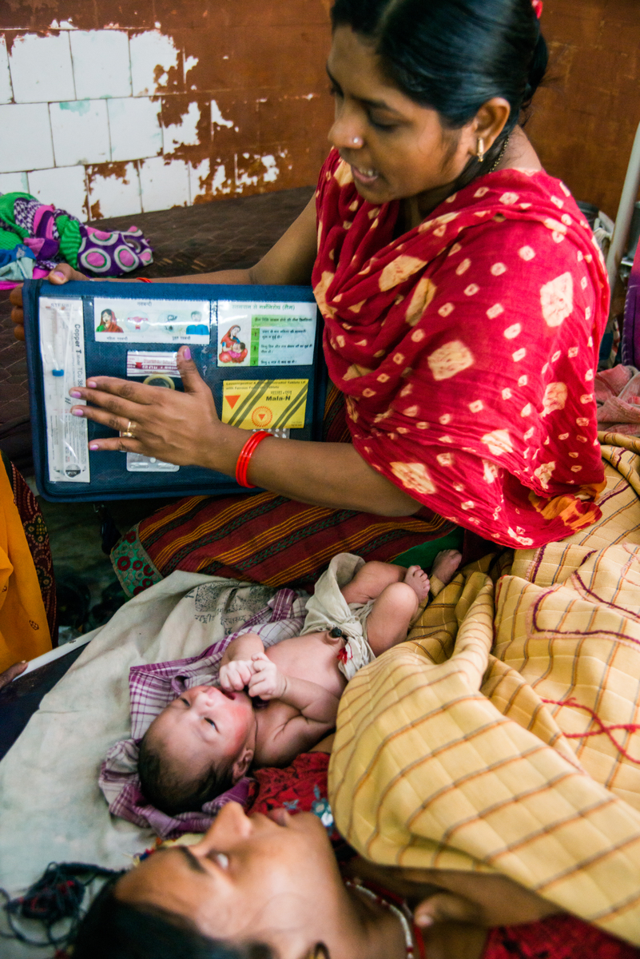
Background
Offering modern contraception services as part of care provided during childbirth:
Increases postpartum contraceptive use
Reduces the risk of adverse maternal, perinatal and infant outcomes
Likely reduces both unintended pregnancies and pregnancies that are too closely spaced
Immediate Postpartum Family Planning
07
Notes:
For more information, please copy and paste this link into your web browser to reference the “Background” section on the HIP brief: https://www.fphighimpactpractices.org/briefs/immediate-postpartum-family-planning/
After a live birth, the recommended interval before attempting the next pregnancy is at least 24 months.
Despite this evidence, 61% of women are not using effective contraception within 24 months postpartum to avoid an unintended pregnancy.
Photo Credit: ©Bill & Melinda Gates Foundation/Ryan Lobo

Slide 8
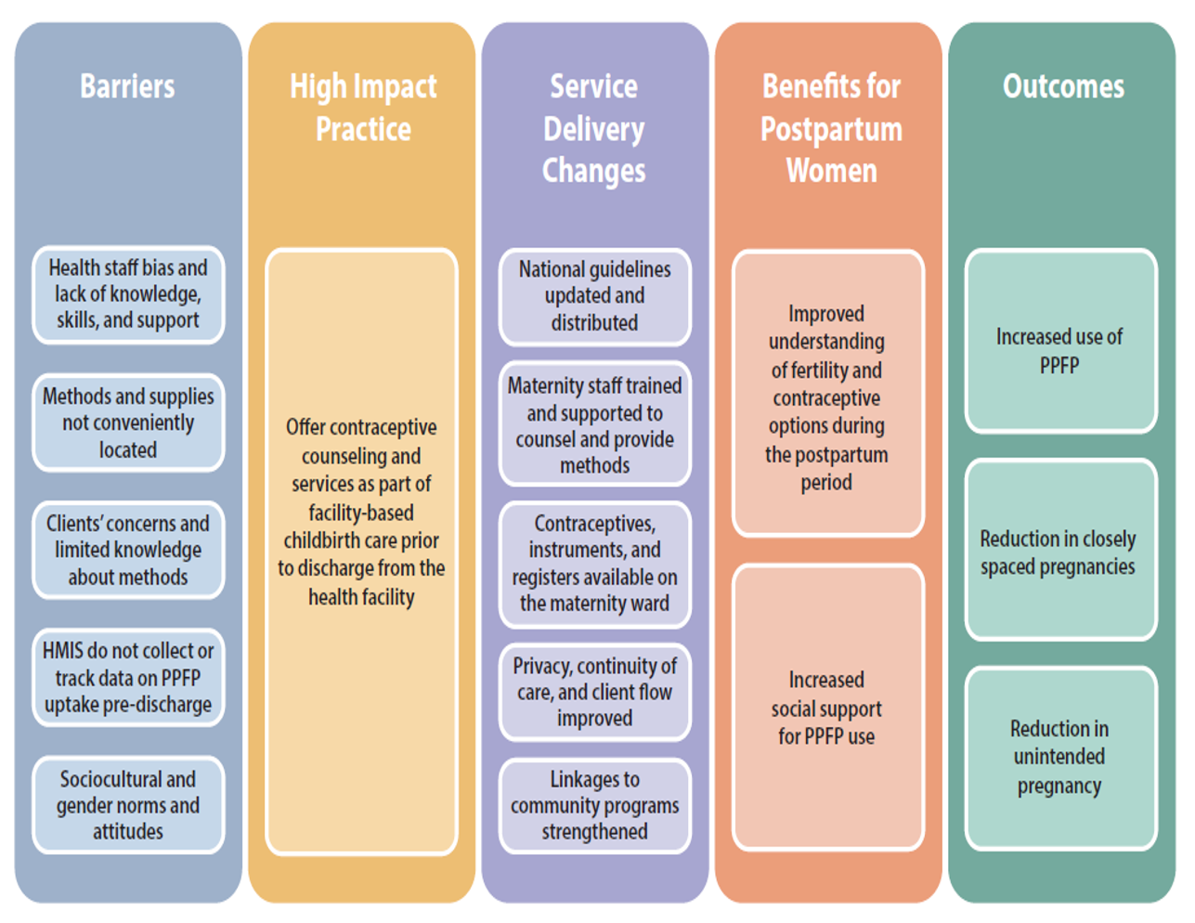
Theory of
Change
BACKGROUND
Immediate Postpartum Family Planning
08
Notes:
Assumption: There are high levels of facility-based births among the target population.
HMIS: health management information system; PPFP: postpartum family planning
Offering services during the postpartum period is a common approach to addressing gaps in access to services
For more information, please copy and paste this link into your web browser to visit the related HIP brief about Family Planning and Immunization: https://www.fphighimpactpractices.org/briefs/family-planning-and-immunization-integration/
Facility-based childbirth services offer an ideal platform to reach women and their partners with family planning information and services.
View Figure 1 in the HIP brief (copy and paste this link into your web browser): https://www.fphighimpactpractices.org/briefs/immediate-postpartum-family-planning/

Slide 9
Why is this practice important?
Providing family planning counseling as part of childbirth care raises awareness of the importance of birth spacing and postpartum contraceptive options.
An increasing number of women and their partners can be reached through facility-based childbirth services.
Immediately after birth, women may choose from a wide variety of contraceptives.
Immediate Postpartum Family Planning
09
Notes:
Providing family planning counseling as part of childbirth care raises awareness of the importance of birth spacing and postpartum contraceptive options
Providing information at this time can improve knowledge and attitudes regarding the use of postpartum contraception.
An increasing number of women and their partners can be reached through facility-based childbirth services
Globally, 4 of 5 births take place with the assistance of a skilled birth attendant, and increasingly these births are taking place in health facilities.
As countries continue to strengthen facility-based childbirth care, this will be an increasingly important platform to reach women and their partners with family planning services.
Immediately after birth, women may choose from a wide variety of contraceptives
Including hormonal and non-hormonal, long-and short-acting, and permanent methods (See Box 1 in Immediate PPFP brief and below for a full list).
Based on a consultation convened by WHO, women can safely use contraceptive implants during the immediate postpartum period, in addition to many other types of contraceptives.
Box 1: Contraceptive Options During the Immediate Postpartum Period
For breastfeeding women:
• Female sterilization
• Male sterilization
• Intrauterine device (IUD)
• Implants
• Progestogen-only pills
• Lactational amenorrhea method (LAM)
• Condoms
For non-breastfeeding women*:
• Female sterilization
• Male sterilization
• IUD
• Implants
• Injectables
• Condoms
• Emergency contraception

Slide 10
Recommended Indicators
Number/percent of women who delivered in a facility and received counseling on family planning prior to discharge
Disaggregated by age group, <20 years vs. >20 years
Number/percent of women who deliver in a facility and initiate or leave with a modern contraceptive method prior to discharge
Disaggregated by type of method and age group, <20 years vs. >20 years
05
Immediate Postpartum Family Planning
10
Notes:
It is recommended that programs implementing postpartum family planning include these following indicators:
For more information about the first indicator, please copy and paste this link into your web browser: https://www.measureevaluation.org/prh/rh_indicators/family-planning/family-planning-and-maternal-and-child-health/number-or-percent-of-women-who-delivered-in-a-facility-and-received-counseling-on-family-planning-prior-to-discharge
For more information about the second indicator, please copy and paste this link into your web browser: https://www.measureevaluation.org/prh/rh_indicators/family-planning/family-planning-and-maternal-and-child-health/number-percent-of-women-who-delivered-in-a-facility-and-initiated-a-modern-contraceptive-method-prior-to-discharge

Slide 11
Evidence of Impact
Percentage of Women Giving Birth Leaving the Facility With a Modern Contraceptive Method, Before and After Introduction of Contraceptive Counseling and Services During Childbirth Care
If women are provided comprehensive counseling and are proactively offered contraception from a range of choices as part of childbirth care, between 20% and 50% of women will leave the facility with a method.
* Hospital Escuela, the government-run hospital
† Hospital Materno-Infantil, Tegucigalpa, the Honduran Social Security System
05
Immediate Postpartum Family Planning
11
Notes:
This figure is an adaptation of Table 1 in the HIP brief (copy and paste this link into your web browser): https://www.fphighimpactpractices.org/briefs/immediate-postpartum-family-planning/
More recent experiences consistently demonstrate the potential impact of this practice. Table 1 summarizes experience from 5 country programs, 3 of which are based on unpublished data. The timeframe examined in all the studies was the immediate postpartum period prior to women leaving the facility. Studies were considered if multiple contraceptive methods were offered. Taken together, old and new, these findings show that if women are provided comprehensive counseling and are proactively offered contraception from a range of choices as part of childbirth care, between 20% and 50% of women will leave the facility with a method.
What is the impact?
Offering modern contraception as part of childbirth services increases postpartum contraceptive use. Immediate postpartum family planning is not a new concept.
The International Postpartum Program, implemented from 1966 to 1973 in 138 institutions across 21 countries and reaching 3.5 million women, demonstrated the feasibility of providing family planning services in the context of hospital-based obstetric care.
In 1971, at the height of implementation, approximately 21% of obstetric patients in participating facilities obtained contraception during the immediate postpartum period, proving that family planning services could be incorporated into obstetric wards quickly and at low cost.

Slide 12
Thank You
Continue to the extra slides or access the HIP brief for more information.
Immediate Postpartum Family Planning
12
Notes:
For more information, please copy and paste this link into your web browser to visit this webpage with a recording of the webinar on Immediate PPFP and a downloadable PDF version of the presentation: https://www.fphighimpactpractices.org/immediate-postpartum-family-planning-a-key-component-of-childbirth-care-webinar/

Slide 13
Extra Slides
Implementation Tips
Tools & Resources
Immediate Postpartum Family Planning
13
Notes:
We have put together a collection of implementation tips for immediate PPFP, in case you have additional time in your meeting. Further information about these tips can be found in the HIP brief.
References from the literature on this HIP can be found here (copy and paste this link into your web browser): https://www.fphighimpactpractices.org/wp-content/uploads/2017/10/ImmediatePPFP_references.pdf

Slide 14
Implementation Tips
Invest in good documentation and monitoring to help ensure voluntarism and informed choice
Update national service delivery guidelines and clarify the role of service providers
Conduct formative assessments to guide social and behavior change strategies
Immediate Postpartum Family Planning
14
Notes:
Invest in good documentation and monitoring to help ensure voluntarism and informed choice.
Can help programs assess progress while ensuring clients’ rights are protected
Facilitates communication across providers who are caring for the same client and ensures continuity of care.
Update national service delivery guidelines and clarify the role of service providers.
Particularly critical if existing guidelines reflect delayed start of progestin-only methods, like implants.
Should clearly articulate that all antenatal and maternity care providers have a role in PPFP.
Conduct formative assessments to guide social and behavior change strategies
Understanding barriers to PPFP uptake and tailoring programmatic approaches to address those barriers can improve uptake.
When first starting PPFP services, providers can identify interested clients through counseling during antenatal care services and birth.
As services become established, and programs seek to increase uptake on a sustained basis, demand creation at the community level is needed.

Slide 15
Implementation Tips
Consider home visits if targeting immediate PPFP adoption among first-time, young parents
Offer the broadest range of contraceptive methods possible and make them available prior to maternity discharge
Consider leveraging antenatal care visits to educate clients on contraception
Immediate Postpartum Family Planning
15
Notes:
Consider home visits if targeting PPFP adoption among first-time, young parents.
Programs targeting young married women and adolescents have found value in using home visits or community group engagement.
Need to carefully test strategies for approaching and counseling young married women, as well as their parents and senior women in the household.
Offer the broadest range of contraceptive methods possible and make them available prior to maternity discharge.
Institutions that demonstrate marked improvements in postpartum contraceptive uptake did so by expanding the method mix and by focusing on method adoption during the pre-discharge period.
Consider leveraging antenatal care visits to educate clients on contraception.
Allows women to fully explore their intentions and to make an informed decision about contraception before delivery.
May be particularly helpful if introducing IUD or sterilization as women often need more time to consider and discuss these options with their partners.

Slide 16
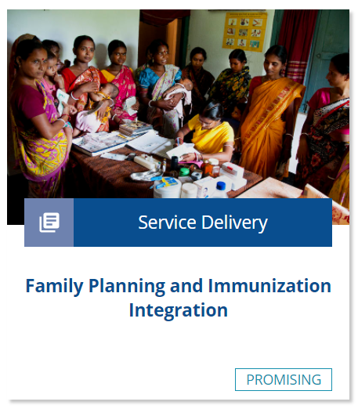
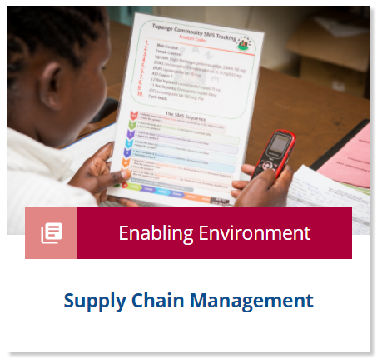
Implementation Tips
Plan for contraceptive uptake later during the postpartum period
Ensure adequate staff, equipment, and supplies, and if possible, ensure their availability 24 hours a day, 7 days a week
Immediate Postpartum Family Planning
16
Notes:
Plan for contraceptive uptake later during the postpartum period.
The PPFP counseling session is an opportunity to make a plan for returning to a facility for postnatal care and immunization.
Immunization services tend to reach high coverage and provide a possible platform for linking or integrating family planning services
For more information, please copy and paste this link into your web browser to visit the related HIP brief about Family Planning and Immunization: https://www.fphighimpactpractices.org/briefs/family-planning-and-immunization-integration/
Ensure adequate staff, equipment, and supplies, and if possible, ensure their availability 24 hours a day, 7 days a week.
May entail making PPFP-trained providers available on call at nights or on weekends.
Conducting whole-site orientations helps ensure that even staff who have not been trained or do not possess a clinical background can support PPFP.
Pre-position supplies and organize client flow to identify appropriate space for counseling.
For more information, please copy and paste this link into your web browser to visit the related HIP brief about Supply Chain Management: https://www.fphighimpactpractices.org/briefs/supply-chain-management/

Slide 17
Implementation Tips
Do not forget men
Encourage facility leadership and adjust management practices based on facility size
Immediate Postpartum Family Planning
17
Notes:
Do not forget men.
Can reduce the occurrence of postpartum depression and improve use of maternal health services.
Inequitable gender norms have a powerful effect on women’s ability to make and act on decisions about birth spacing and limiting.
Providing men and women the opportunity to engage in family planning discussions as part of maternity care – together or separately – can directly address these inequitable norms and create space for joint decision-making for effective use of family planning.
For more information, please copy and paste this link into your web browser to visit the HIP strategic planning guide on Engaging Men and Boys in Family Planning: https://www.fphighimpactpractices.org/guides/engaging-men-and-boys-in-family-planning/
Encourage facility leadership and adjust management practices based on facility size.
Larger facilities may require more intensive engagement of staff than smaller facilities to achieve similar output.
In the International Postpartum Family Planning Program, small facilities with motivated providers demonstrated the highest rate of postpartum contraceptive uptake.
For more information, please copy and paste this link into your web browser to visit the HIP brief on Leaders and Managers: https://www.fphighimpactpractices.org/briefs/leaders-and-managers/

Slide 18
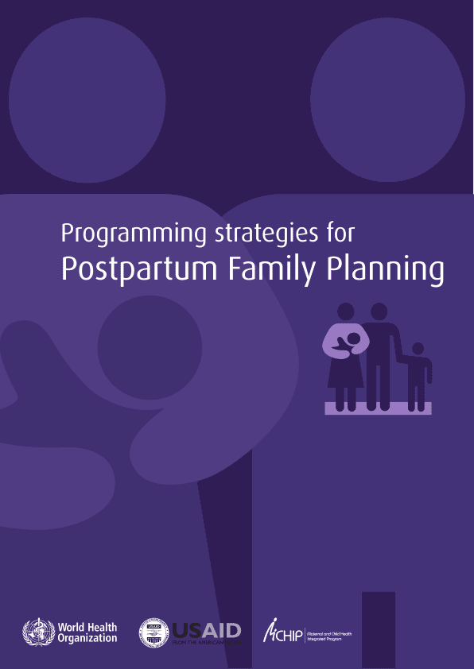
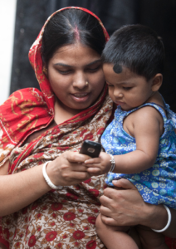
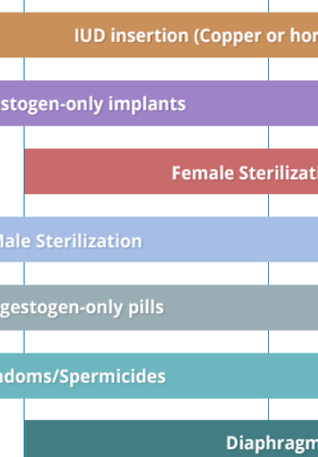
Tools & Resources
Case Study: Bangladesh: Behavioral Maintenance and Follow-Up
Compendium of WHO Recommendations for Postpartum Family Planning
K4Health Postpartum Family Planning (PPFP) Toolkit
Programming Strategies for Postpartum Family Planning
05
Immediate Postpartum Family Planning
18
Notes:
Compendium of WHO Recommendations for Postpartum Family Planning is a web-based tool that integrates core WHO guidance to guide women through their family planning decision-making during the first year postpartum.
K4Health Postpartum Family Planning (PPFP) Toolkit provides a comprehensive collection of best practices and evidence-based tools and documents on PPFP.
Programming Strategies for Postpartum Family Planning is a resource for program planners and managers when designing interventions to integrate PPFP into national and subnational strategies.
Service Communication Case Study: Bangladesh: Behavioral Maintenance and Follow-Up is an example of a project that has successfully used social and behavior change communication via mHealth to communicate important information about pregnancy and the first year of a child’s life, including PPFP, to expecting and new mothers and their families.
Bonus resource: Use of the WHO Guidelines & Tools alongside service delivery High Impact Practices in family planning. The tool focuses on Service Delivery HIPs and selected WHO Guidelines related to family planning service delivery. The tool is intended to be a quick reference for program managers designing or implementing family planning programs. The tool can be used to help improve implementation of HIPs by illustrating how to incorporate WHO evidence-based guidelines and/or can be used to support advocacy efforts for HIPs by linking them with globally recognized and credible WHO Guidelines. Please copy and paste this link into your web browser to visit:
https://www.fphighimpactpractices.org/ibp-who-matrix/

Slide 19
fphighimpactpractices.org
Notes:
Subscribe to the HIPs Newsletter here (copy and paste this link into your web browser): https://mailchi.mp/76703a3652c9/hips-newsletter-sign-up
Please visit the five areas of our website to learn more about the HIPs:
HIP Products (copy and paste this link into your web browser): https://www.fphighimpactpractices.org/hip-products/
Resources (copy and paste this link into your web browser): https://www.fphighimpactpractices.org/resources/
Engage (copy and paste this link into your web browser): https://www.fphighimpactpractices.org/engage-with-the-hips/
Overview (copy and paste this link into your web browser): https://www.fphighimpactpractices.org/overview/
About Us (copy and paste this link into your web browser): https://www.fphighimpactpractices.org/partnership-structure/

