Slide 1
Leaders and Managers
Making family planning programs work
Notes:
Leadership and management are both essential elements of developing successful family planning programs and can help ensure resources are used effectively to achieve results.
Photo Credit: © 2013 SC4CCM/JSI, Courtesy of Photoshare
REVISED: 5/4/21

Slide 2
Overview
What is a HIP?
HIP Categories
Partnership
Introduction to the High Impact Practices (HIPs)
PART
PART
Background
Leadership and Management at All Levels of the Health System
What challenges can this HIP help address?
Evidence of Impact
Leaders and Managers
Implementation Tips
Tools & Resources
Extra Slides
11
Leaders and Managers
02
Notes:
Thank you for using this slide deck! This is a product derived from the HIP brief to assist you in presenting to a variety of audiences. Instructions and additional resources are included in the notes of each slide for your convenience. There is a wealth of information and resources in the “Notes” section of each slide.
This presentation is divided in three parts: an Introduction to the High Impact Practices (HIPs) in Family Planning, Leaders and Managers, and Extra Slides.
The logo for your organization or ministry may be added to these slides. The web addresses provided in the “Notes” section of each slide can be copied and pasted into your web browser.

Slide 3
High Impact Practices in Family Planning (HIPs) are…
Evidence-based family planning practices
Vetted by experts against specific criteria
Documented in an easy-to-use format
Leaders and Managers
03
Notes:
High Impact Practices (HIPs) are a set of evidence-based family planning practices vetted by experts against specific criteria and documented in an easy-to-use format.
The High Impact Practices in Family Planning (HIPs) were first created in 2010 after a survey of FP stakeholders revealed little consensus for “what works” in international FP programming. A small group of leaders in FP were brought together with the task of identifying a short list of HIPs that if implemented at scale would help countries address the unmet need for FP and thereby increase national contraceptive prevalence.
HIPs are identified based on demonstrated magnitude of impact on contraceptive use and potential application in a wide range of settings. Consideration is also given to other relevant outcome measures including unintended pregnancy, fertility, or one of the primary proximate determinants of fertility (delay of marriage, birth spacing, or breast feeding). Evidence of replicability, scalability, sustainability, and cost-effectiveness are also considered.
For more information, please copy and paste this link into your web browser to see this video: https://www.youtube.com/watch?v=N6V0gfl-V3k&ab_channel=KnowledgeSUCCESS
A 2-pager overview of the HIPs is available in an online and a downloadable PDF format here (copy and paste this link into your web browser): https://www.fphighimpactpractices.org/high-impact-practices-in-family-planning-list/

Slide 4
HIPs address the full spectrum of FP programming
Enabling Environment
Service Delivery
Social and Behavioral Change
PART
Address systemic barriers that affect an individual’s ability to access family planning information & services. 6 briefs
Improve the availability, accessibility, acceptability, and quality of family planning services. 8 briefs
Influence knowledge, beliefs, behaviors, and social norms associated with family planning.
3 briefs
Enhancements
Approaches used in conjunction with HIPs to maximize the impact of HIP implementation or increase the reach. 4 briefs
Leaders and Managers
04
Notes:
There are three categories of HIPs: Enabling Environment, Service Delivery and Social and Behavioral Change. Leaders and Managers is an Enabling Environment HIP. This information came from the HIP List (copy and paste this link into your web browser): https://www.fphighimpactpractices.org/high-impact-practices-in-family-planning-list/
A HIP Enhancement is a tool or approach that is not a standalone practice, but it is often used in conjunction with HIPs to maximize the impact of HIP implementation or increase the reach and access for specific audiences. The intended purpose and impact of enhancements are focused and, therefore the evidence-based and impact of an enhancement is subjected to different standards than a HIP.
For more information about the HIP Categories and Enhancements, please copy and paste this link into your web browser: https://www.fphighimpactpractices.org/high-impact-practices-in-family-planning-list/
Here are a few examples of HIPs from each category:
Service Delivery:
Immediate Postpartum Family Planning
Mobile Outreach Services
Postabortion Family Planning
Enabling Environment:
Domestic Public Financing
Educating Girls
Supply Chain Management
Social and Behavior Change:
Community Group Engagement
Digital Health for SBC
Mass Media
Enhancements:
Digital Health for Systems
Adolescent-Friendly Contraceptive Services
Family Planning Vouchers
All HIPs are Available in English, Spanish, French, and Portuguese.

Slide 5
HIP Partnership
The Technical Advisory Group (TAG) is made up of 25 experts in family planning, including representatives from the co-sponsors.
The Co-sponsors include the following organizations:
Leaders and Managers
05
Notes:
The High Impact Practices in Family Planning (HIPs) are supported by over 65 organizations. These organizations play a vital role in developing, reviewing, disseminating, and implementing HIPs in family planning.
The HIPs partnership includes various structures to ensure HIP products are developed, kept up to date, and disseminated widely. These include:
Co-sponsors – Serve as the secretariat for the HIPs.
Partners – Contribute to key HIP products and endorse the HIPs.
Technical Advisory Group – Ensure high technical quality of key HIP products and approve HIP brief and SPG concepts for development.
P&D Team – Support the production and dissemination (P&D) of HIP products.
Technical Expert Groups – Write new HIP briefs and ensure they are up-to-date.
For more information about the HIP Partnership, please copy and paste this link into your web browser: https://www.fphighimpactpractices.org/partnership-structure/

Slide 6
High Impact Practice
Develop and support capacity to lead and manage family planning programs.
Leaders and Managers
06
Notes:
Leadership and management are both essential elements of developing successful family planning programs and can help ensure resources are used effectively to achieve results.

Slide 7
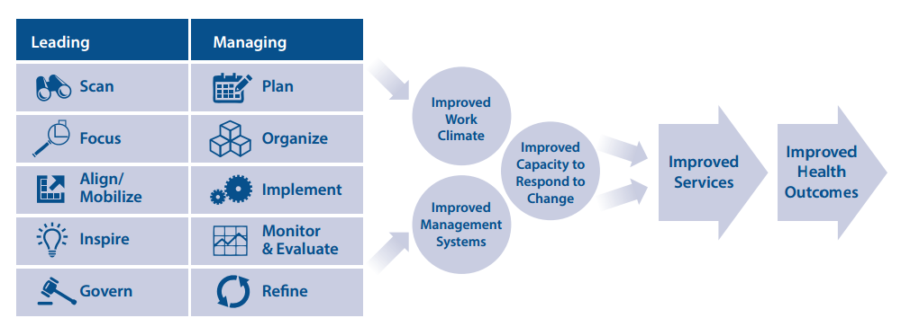
Background
Leading and Managing for Results Model
Leaders and managers must work in tandem to effect positive change.
Leadership and management are most effective when practiced together.
Source: Adapted from Management Sciences for Health’s Leading & Managing for Results Model.
Leaders and Managers
07
Notes:
Leadership and management approaches are multifaceted and thus identifying direct or causal links between such approaches and improved reproductive health outcomes is challenging. Illustrative models, however, demonstrate the relationship between strong leadership and management and improved health outcomes (WHO, 2007a) while reflecting common skills and qualities (Peterson et al., 2011; WHO, 2007b; Galer et al., 2005) (see Figure 1).
Leadership practices comprise:
Scanning for opportunities: seeking out and identifying alternatives and options
Setting direction to focus efforts: envisioning purpose, aspiration, and goals
Aligning partners and mobilizing community: engaging community into program activities
Inspiring staff to improve work climate: investing in various opportunities and approaches to improve quality of employees’ output
Governing responsibly: exercising control for mutual benefit
Management practices encompass:
Planning: deciding in advance what is to be done
Organizing structures: acquiring, maintaining, and retaining human resources and developing intentional patterns of relationships among people and other resources
Implementing activities through coordinated systems: designing and using systems to identify, capture, structure, value, leverage, and share information/knowledge/intellectual assets
Monitoring and evaluation: setting up processes to track activities against plans and to assess performance of those activities
Refining the program: using assessment results to refine program activities
View Figure 1 in the HIP brief (copy and paste this link into your web browser): https://www.fphighimpactpractices.org/briefs/leaders-and-managers/

Slide 8
Leadership and Management at All Levels of the Health System
HEALTH SYSTEM LEVEL | LEADERSHIP PRACTICES | MANAGEMENT PRACTICES | COUNTRY EXAMPLE
Global Regions | Identify economies of scale. | Standardize curricula for health workers and develop regional protocols for research. | West Africa Health Organization (WAHO), the health arm of the Economic Community of West African States, implemented a coordinated informed buying system for contraceptive commodities to ensure orders and prices were standardized across the region. WAHO also supported the standardization of medical and nursing school curricula to ensure standard quality of service provision when health workers migrated across borders (Clemmons & Thatte, 2011).
National | Articulate a country’s family planning goals and priorities. | Set minimum standards of quality, outline roles and responsibilities, facilitate coordination, guide resource mobilization, and determine timelines for program rollout (HIPs, 2013). | Bangladesh’s 2011 Health Policy is based on the country’s constitutional obligations to the right to health. The policy includes objectives to strengthen and expedite the family planning program, both to attain replacement fertility and to make the program more acceptable, easily available, and effective among extremely poor and low-income communities (HIPs, 2013; Khuda, 2010).
District | Make certain health service decisions with political and budgetary autonomy at the local level. | Develop systems to strengthen reporting and management of commodities to ensure accurate forecasting and prevent stockouts at district and sub-district levels. | In 2006 the government of Rwanda decentralized health service delivery including family planning. Ensuring adequate human resources and commodities at the district level was critical to maintaining quality service delivery. Decentralization enabled greater community involvement which helped increase support of family planning, particularly among certain populations such as young people and men (Muhoza, 2013).
Community/ Service | Support task sharing policies. | Ensure adequate management and supervision of community health workers (CHWs). | Between 2012 and 2013, CHWs in Senegal began providing injectable contraceptives (DMPA). Leadership from the Ministry of Health (MOH), robust training, and supervision resulted in safe and effective implementation (FHI 360, 2013).
Leaders and Managers
08
Notes:
Decentralization is a critical component of health reform in many developing countries, affecting the way services are structured, resourced, and staffed (Kolehmainen-Aitken, 2004).
As the lowest levels of the health systems increasingly manage services, the need for leadership and management at all levels of the health system is even more crucial.
A review of Indonesia’s experience with decentralization concluded, “Decentralization … resulted in less emphasis on family planning in many districts/municipalities and so has aggravated these adverse trends. … Decentralization … does impact on the political instruments and operational strategies available to the central government agencies to revitalize the family planning program when these departments and agencies no longer have line authority, staff or budgets to direct field operations” (Hull & Mosley, 2009).
Different approaches may be needed at various levels of the health system (see Table 1).
View Table 1 in the HIP brief (copy and paste this link into your web browser): https://www.fphighimpactpractices.org/briefs/leaders-and-managers/

Slide 9
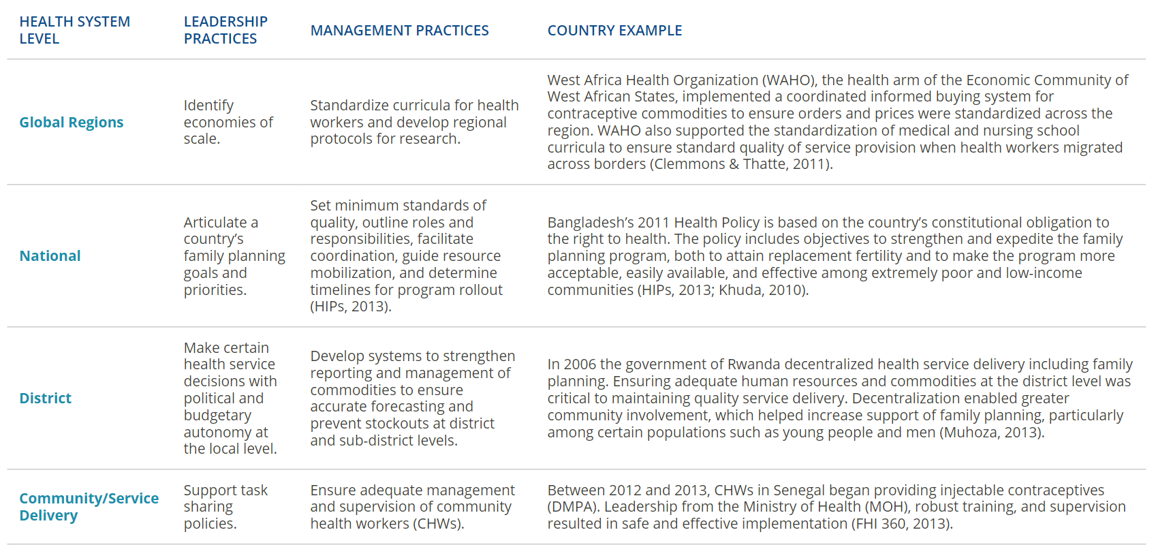
Leadership and Management at All Levels of the Health System
Illustrative Examples of Leadership and Management Practices Throughout the Health System
Leaders and Managers
08
Notes:
Decentralization is a critical component of health reform in many developing countries, affecting the way services are structured, resourced, and staffed (Kolehmainen-Aitken, 2004).
As the lowest levels of the health systems increasingly manage services, the need for leadership and management at all levels of the health system is even more crucial.
A review of Indonesia’s experience with decentralization concluded, “Decentralization … resulted in less emphasis on family planning in many districts/municipalities and so has aggravated these adverse trends. … Decentralization … does impact on the political instruments and operational strategies available to the central government agencies to revitalize the family planning program when these departments and agencies no longer have line authority, staff or budgets to direct field operations” (Hull & Mosley, 2009).
Different approaches may be needed at various levels of the health system (see Table 1).
View Table 1 in the HIP brief (copy and paste this link into your web browser): https://www.fphighimpactpractices.org/briefs/leaders-and-managers/

Slide 10
What challenges can this HIP help countries address?
Improve work climate
Improve organizational and management systems
Improve the capacity to respond to change and to scale-up effective practices
Leaders and Managers
10
Notes:
Improve work climate
In family planning programs, provider-level barriers to positive health outcomes include a lack of knowledge and skills among providers about contraceptive methods, low health worker motivation to provide family planning, long wait times for clients to receive services, and disrespectful treatment of clients (Tumlinson et al., 2013).
Many of these issues can be addressed with adequate leadership and management practices to help motivate staff and improve the quality of services, such as recognizing the need for additional staff training, supportive supervision of providers, staff recognition, job aids, and improving logistic systems (GHSP, 2013; Tumlinson et al., 2013; Smith et al., 2012).
Other analyses have demonstrated the importance of management practices such as having job descriptions for clinical staff as key to providing quality family planning services (Thatte & Choi, 2015; Bennett et al., 2000).
Health workers repeatedly report poor leadership and management by their managers or supervisors as a key factor in their lack of motivation, found a systematic review of health worker motivation (Willis-Shattuck et al., 2008).
Hospital or clinical management was reported in 80% of the reviewed studies as an important factor for health worker motivation.
Other themes directly related to management issues included financial incentives (90%), career development (85%), work appreciation/recognition (70%), and ensuring the availability of resources (75%). Having a strong organizational mission is another motivating factor for health workers (Franco et al., 2002; Grindle, 1997), which can be achieved with strong leadership and vision.
Improve organizational and management systems
While there is growing acknowledgment of the need to increase the numbers and quality of clinical providers (WHO, 2006), a recent report also highlighted the need for these professionals to be equipped with leadership and management skills to carry out the “efficient handling of scarce resources in conditions of uncertainty”(Frenk et al., 2010).
A family planning and health worker analysis of 10 African countries concluded that leadership and management functions such as the way “health workers are trained, distributed, and supported may be as important as how many health workers are available” (Pacque-Margolis et al., 2013).
Specialized health manager cadres are rare. Physicians and nurses are often put into positions to lead and manage health facilities without the skills to do so. These individuals are often tasked with stretching scarce resources for programming (Gillespie, 2004). While trained clinically, they often lack skills around human resource distribution, resource allocation, and recruitment (Kabene et al., 2006; Mathauer & Imhoff, 2006; Rowe et al., 2005), resulting in poorly managed health facilities.
In addition, shortages of drugs and supplies, weak logistics systems, poor supervisory support, and unclear roles and responsibilities contribute to poor performance, low staff morale, and high staff turnover (Willis-Shattuck et al., 2008; Dieleman & Harnmeijer, 2006; Egger et al., 2005; Chen et al., 2004; Kolehmainen-Aitken, 2004; Dussault & Dubois, 2003).
In Kenya, over 70% of clinical staff with management responsibility surveyed reported they had either “no preparation” or “very inadequate preparation” for this part of their work (MSH, 2008).
Improve the capacity to respond to change and to scale-up effective practices
Country experience has demonstrated that leadership and management skills are necessary to move from small-scale pilot studies to full-scale country implementation.
In Ethiopia, key informants cited “leadership by the government” and improvement in health systems including logistics and supervision as major factors for successful scale-up of family planning (USAID, 2011).
In Ghana, the scale-up efforts of the Community-based Health Planning and Services (CHPS) program documented that weak leadership and supervision in many districts contributed to a “lack of focus and clarity” about the program (Awoonor-Williams et al., 2013).
Leadership and management training around prioritization, planning, and identifying a shared vision among implementers and the community later contributed to successful scale-up of the program in key regions (Awoonor-Williams et al., 2013).
A review of successful scale-up of health programs documented strong leadership and management as being a critical factor for success (Levine, 2007). Political leadership can help facilitate resources and commitment, but leadership and management at the implementation level through the providers or the health system is equally critical and will ultimately drive the successful scale-up of health interventions (Levine, 2007).

Slide 11
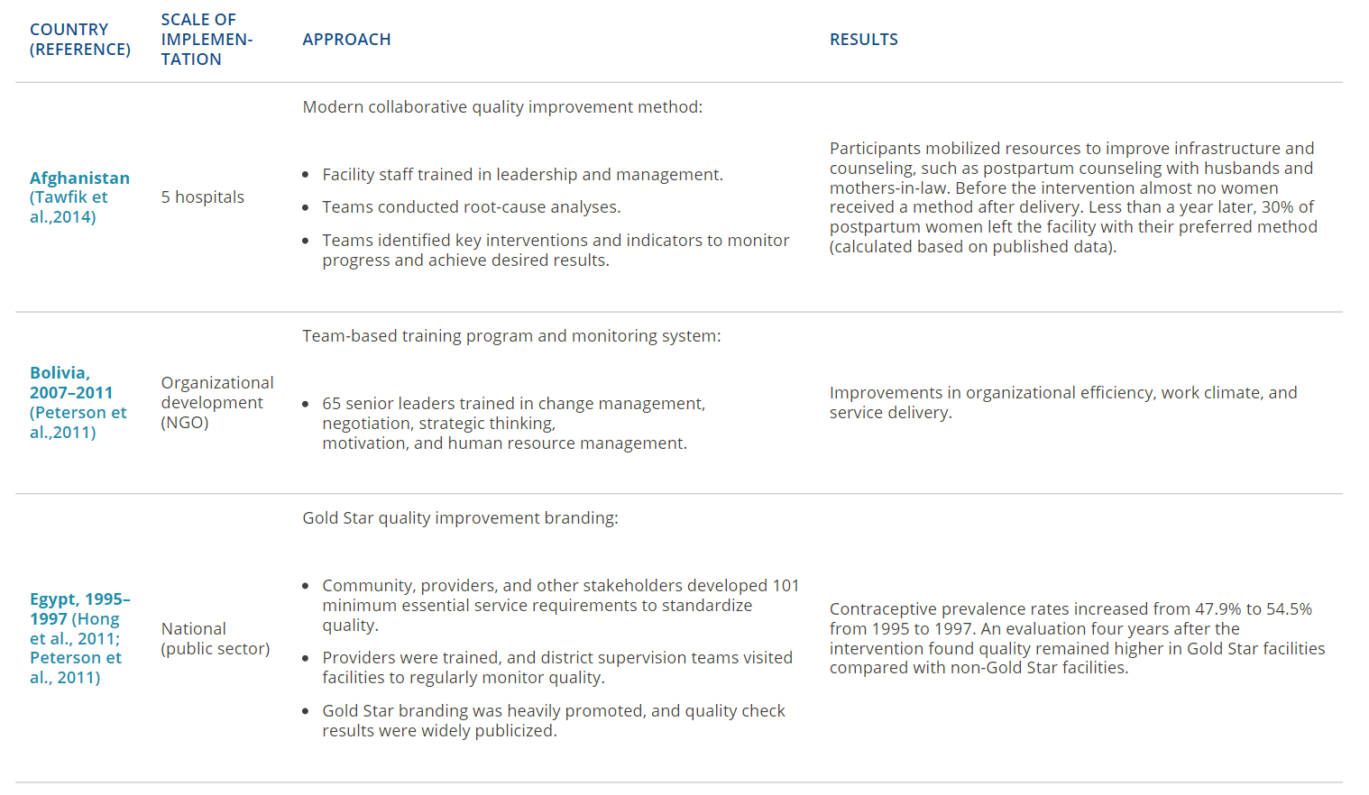
Evidence of Impact
Approaches using multiple interventions result in more comprehensive outcomes than a single-intervention strategy
Illustrative Results of Selected Leadership and Management Interventions
05
Leaders and Managers
11
Notes:
A systematic review of leadership, management, and governance strategies concluded that approaches using multiple interventions result in more comprehensive outcomes than a single-intervention strategy (Edward et al., 2013).
See Table 2 for illustrative examples from Afghanistan, Bolivia, and Egypt of results achieved with improved leadership and management interventions.
View Table 2 in the HIP brief (copy and paste this link into your web browser): https://www.fphighimpactpractices.org/briefs/leaders-and-managers/

Slide 12
Evidence of Impact
Illustrative Results of Selected Leadership and Management Interventions
 | SCALE OF IMPLEMENTATION | APPROACH | RESULTS
Afghanistan (Tawfik et al., 2014) | 5 hospitals | Modern collaborative quality improvement method: Facility staff trained in leadership and management. Teams conducted root-cause analyses. Teams identified key interventions and indicators to monitor progress and achieve desired results. | Participants mobilized resources to improve infrastructure and counseling, such as postpartum counseling with husbands and mothers-in-law. Before the intervention almost no women received a method after delivery. Less than a year later, 30% of postpartum women left the facility with their preferred method (calculated based on published data).
Bolivia, 2007-2011 (Peterson et al., 2011) | Organizational development (NGO) | Team-based training program and monitoring system: 65 senior leaders trained in change management, negotiation, strategic thinking, motivation, and human resource management. | Improvements in organizational efficiency, work climate, and service delivery.
Egypt, 1995-1997 (Hong et al., 2011; Peterson et al, 2011) | National (public sector) | Gold Star quality improvement branding: Community, providers, and other stakeholders developed 101 minimum essential service requirements to standardize quality. Providers were trained, and district supervision teams visited facilities to regularly monitor quality. Gold Star branding was heavily promoted, and quality check results were widely publicized. | Contraceptive prevalence rates increased from 47.9% to 54.5% from 1995 to 1997. An evaluation four years after the intervention found quality remained higher in Gold Star facilities compared with non-Gold Star facilities.
05
Leaders and Managers
11
Notes:
A systematic review of leadership, management, and governance strategies concluded that approaches using multiple interventions result in more comprehensive outcomes than a single-intervention strategy (Edward et al., 2013).
See Table 2 for illustrative examples from Afghanistan, Bolivia, and Egypt of results achieved with improved leadership and management interventions.
View Table 2 in the HIP brief (copy and paste this link into your web browser): https://www.fphighimpactpractices.org/briefs/leaders-and-managers/

Slide 13
Thank You
Continue to the extra slides or access the HIP brief for more information.
Leaders and Managers
12
Notes:
For more information, please copy and paste this link into your web browser to visit the Leaders and Managers HIP brief: https://www.fphighimpactpractices.org/briefs/leaders-and-managers/

Slide 14
Extra Slides
Implementation Tips
Tools & Resources
Leaders and Managers
13
Notes:
We have put together a collection of implementation tips for Leaders and Managers, in case you have additional time in your meeting. Further information about these tips can be found in the HIP brief.
References from the literature on this HIP can be found here (copy and paste this link into your web browser): https://www.fphighimpactpractices.org/wp-content/uploads/2018/08/LeadersAndManagers_references.pdf

Slide 15
Implementation Tips
Support leaders and managers.
Professionalize leadership and management roles.
Train teams that work together through applied learning.
Include leadership and management skills in pre-service training.
Connect with a community of practice.
Leaders and Managers
20
Notes:
A range of leadership and management improvement approaches have been implemented across regions. Some are embedded in quality improvement or quality assurance interventions while others are stand-alone programs focused exclusively on improving leadership and management skills. While there is no one way to build leadership and management capacity, below are a few key issues to consider:
Support leaders and managers.
Developing strong leaders and managers requires support in a variety of areas, including financial resources, commodities, mentorship, clear processes, information, technology, equipment, facilities, and knowledge.
Support also includes intangibles such as ideas, encouragement, feedback, and time to engage in various communities of practice. Mentorship and coaching is especially important to developing new leaders (Nzinga et al., 2013).
This support should be reinforced by country-specific policies, legislation, relationships and work culture.
For information on other enabling environment and infrastructural issues, see the HIP brief on Policy: https://www.fphighimpactpractices.org/briefs/policy/
Professionalize leadership and management roles.
Standards related to leadership and management competencies are unfortunately rare, and there is no reporting or certifications for those who lead and manage family planning programs (MSH, 2013). However, the climate is changing.
Recently the MOH in Kenya committed to professionalizing leadership and management by creating the Kenya Institute for Health Systems Management to train cadres of workers in health management and health systems strengthening (MSH, 2013).
Train teams that work together through applied learning.
Applied learning is the most effective way to gain practical skills in leadership and management, yielding skill retention rates of up to 75% compared with 5–10% from only reading or lectures (NTL, 2011).
In addition, using applied-learning approaches with teams working together in real workplace settings has more positive results than sending individuals to off-site leadership and management trainings in which the curriculum is not necessarily directly applicable to their work.
Experience from Ghana found stand-alone workshops to be an ineffective tool for leadership training (Awoonor-Williams et al., 2013), and most quality improvement approaches center around a team-based approach (APHA, 2011).
Management training of district health officials in Latin America had the most effect when the organizational and team structure participated in the leadership and management training together (Dorros, 2006).
Include leadership and management skills in pre-service training.
To build and sustain capacity for leadership and management, such skills should be incorporated into pre-service training for health care providers.
In Uganda, leadership and management training has been incorporated into medical and nursing school curricula, in collaboration with Makarere University. In addition to receiving clinical training, students are trained on human resources management, finance, logistics, and leadership.
In Kenya, leadership and management training has been incorporated into pre-service training for physicians and nurses at the University of Nairobi and the Kenya Medical training college. Efforts to add this type of training into other university curricula are underway (MSH, 2013).
Connect with a community of practice.
Connect leaders and managers to a larger community that shares common visions or goals for family planning (Wheatley, 2002). Establishing or connecting with a community of practice enables leaders and managers to develop a shared repertoire of resources: experiences, stories, tools, and ways of addressing recurring problems (Wenger-Trayner & Wenger-Trayner, 2015).
At national, regional, district, sub-district, or facility levels, communities of practice could be established through mechanisms such as Technical Working Groups (TWGs) or a Stakeholder Leadership Group (Gormley & McCaffery, 2011) or through the use of technology to establish communication arenas such as listservs and websites.
Such groups can also serve as advocacy groups for strengthening leadership and galvanizing commitment around family planning investments, another important high-impact practice for family planning programs.
For more information about galvanizing commitment, please copy and paste this link into your web browser to visit the related HIP brief: https://www.fphighimpactpractices.org/briefs/galvanizing-commitment/

Slide 16
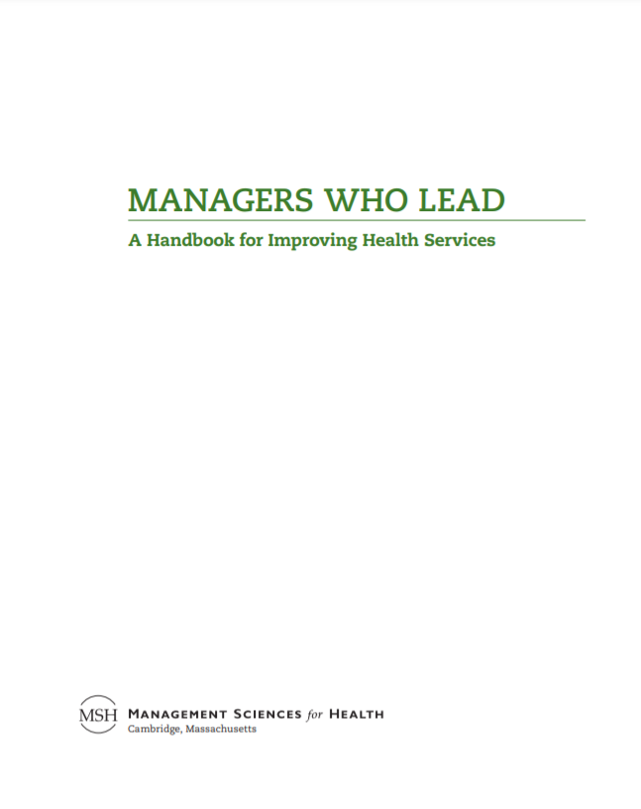
Tools & Resources
Health Care Improvement Project (HCI) Standard Evaluation System
Managers Who Lead
Human Resources Management Assessment Approach
Leadership Development Program
05
Leaders and Managers
17
Notes:
The following resources provide an illustrative range of materials, including training manuals, quality improvement techniques, and tools to monitor leadership and management processes, to help facilitate leadership and management practices throughout the health system.
Managers Who Lead: A Handbook for Improving Health Services. Provides managers with practical guidelines and approaches for leading teams to identify and find solutions for their challenges. Staff at any level of the health system can use these concepts to improve their ability to lead and manage well. Available from: https://www.msh.org/resources/managers-who-lead-a-handbook-for-improving-health-services
Human Resources Management Assessment Approach. Guides policy makers, managers, and human resources practitioners to understand and respond to human resource management challenges. Available from: http://www.capacityplus.org/files/resources/hrm-assessment-approach.pdf
Leadership Development Program. A team-based approach to leadership training focused on the basic practices of leading and managing, creating an enabling work environment, and creating sustainable teams that are committed to continuously improving services. More information available from: https://www.msh.org/our-work/health-systems/leadership-management-governance/leadership
Health Care Improvement Project (HCI) Standard Evaluation System. A tool to strengthen documentation, analysis, and synthesis of learning by quality improvement teams. Available from: https://www.usaidassist.org/resources/learning-and-improvement-system-strengthening-documentation-analysis-and-synthesis

Slide 17
fphighimpactpractices.org
Notes:
Subscribe to the HIPs Newsletter here (copy and paste this link into your web browser): https://mailchi.mp/76703a3652c9/hips-newsletter-sign-up
Please visit the five areas of our website to learn more about the HIPs:
HIP Products (copy and paste this link into your web browser): https://www.fphighimpactpractices.org/hip-products/
Resources (copy and paste this link into your web browser): https://www.fphighimpactpractices.org/resources/
Engage (copy and paste this link into your web browser): https://www.fphighimpactpractices.org/engage-with-the-hips/
Overview (copy and paste this link into your web browser): https://www.fphighimpactpractices.org/overview/
About Us (copy and paste this link into your web browser): https://www.fphighimpactpractices.org/partnership-structure/

