Slide 1




Supply Chain Management
Investing in the supply chain is critical to achieving family planning goals
Notes:
Establishing and maintaining effective supply chain management is essential to making modern contraceptives available and thus helping individuals achieve their reproductive goals.
This brief focuses on key practices to strengthen the management of each step of the supply chain from the manufacturer to the service delivery point.
Photo credit: © 2014 John Kihoro/Tupange(Jhpiego Kenya), Courtesy of Photoshare
REVISED: 5/4/21

Slide 2
Overview
What is a HIP?
HIP Categories
Partnership
Introduction to the High Impact Practices (HIPs)
PART
Background
End to end supply chain processes
What challenges can this HIP help address?
Evidence of Impact
Recommended Indicator
PART
Supply Chain
Management
Implementation Tips
Tools & Resources
Extra Slides
11
Supply Chain Management
02
Notes:
Thank you for using this slide deck! This is a product derived from the HIP brief to assist you in presenting to a variety of audiences. Instructions and additional resources are included in the notes of each slide for your convenience. There is a wealth of information and resources in the “Notes” section of each slide.
This presentation is divided in three parts: an Introduction to the High Impact Practices (HIPs) in Family Planning, Supply Chain Management, and Extra Slides.
The logo for your organization or ministry may be added to these slides. The web addresses provided in the “Notes” section of each slide can be copied and pasted into your web browser.

Slide 3



High Impact Practices in Family Planning (HIPs) are…
Evidence-based family planning practices
Vetted by experts against specific criteria
Documented in an easy-to-use format
Supply Chain Management
03
Notes:
High Impact Practices (HIPs) are a set of evidence-based family planning practices vetted by experts against specific criteria and documented in an easy-to-use format.
The High Impact Practices in Family Planning (HIPs) were first created in 2010 after a survey of FP stakeholders revealed little consensus for “what works” in international FP programming. A small group of leaders in FP were brought together with the task of identifying a short list of HIPs that if implemented at scale would help countries address the unmet need for FP and thereby increase national contraceptive prevalence.
HIPs are identified based on demonstrated magnitude of impact on contraceptive use and potential application in a wide range of settings. Consideration is also given to other relevant outcome measures including unintended pregnancy, fertility, or one of the primary proximate determinants of fertility (delay of marriage, birth spacing, or breast feeding). Evidence of replicability, scalability, sustainability, and cost-effectiveness are also considered.
For more information, please copy and paste this link into your web browser to see this video: https://www.youtube.com/watch?v=N6V0gfl-V3k&ab_channel=KnowledgeSUCCESS
A 2-pager overview of the HIPs is available in an online and a downloadable PDF format here (copy and paste this link into your web browser): https://www.fphighimpactpractices.org/high-impact-practices-in-family-planning-list/

Slide 4
HIPs address the full spectrum of FP programming
Enabling Environment
Service Delivery
Social and Behavioral Change
PART
Address systemic barriers that affect an individual’s ability to access family planning information & services. 6 briefs
Improve the availability, accessibility, acceptability, and quality of family planning services. 8 briefs
Influence knowledge, beliefs, behaviors, and social norms associated with family planning.
3 briefs
Enhancements
Approaches used in conjunction with HIPs to maximize the impact of HIP implementation or increase the reach. 4 briefs
Supply Chain Management
04
Notes:
There are three categories of HIPs: Enabling Environment, Service Delivery and Social and Behavioral Change. Supply Chain Management is an Enabling Environment HIP. This information came from the HIP List (copy and paste this link into your web browser): https://www.fphighimpactpractices.org/high-impact-practices-in-family-planning-list/
A HIP Enhancement is a tool or approach that is not a standalone practice, but it is often used in conjunction with HIPs to maximize the impact of HIP implementation or increase the reach and access for specific audiences. The intended purpose and impact of enhancements are focused and, therefore the evidence-based and impact of an enhancement is subjected to different standards than a HIP.
For more information about the HIP Categories and Enhancements, please copy and paste this link into your web browser: https://www.fphighimpactpractices.org/high-impact-practices-in-family-planning-list/
Here are a few examples of HIPs from each category:
Service Delivery:
Immediate Postpartum Family Planning
Mobile Outreach Services
Postabortion Family Planning
Enabling Environment:
Domestic Public Financing
Educating Girls
Supply Chain Management
Social and Behavior Change:
Community Group Engagement
Digital Health for SBC
Mass Media
Enhancements:
Digital Health for Systems
Adolescent-Friendly Contraceptive Services
Family Planning Vouchers
All HIPs are Available in English, Spanish, French, and Portuguese.

Slide 5





HIP Partnership
The Technical Advisory Group (TAG) is made up of 25 experts in family planning, including representatives from the co-sponsors.
The Co-sponsors include the following organizations:
Supply Chain Management
05
Notes:
The High Impact Practices in Family Planning (HIPs) are supported by over 65 organizations. These organizations play a vital role in developing, reviewing, disseminating, and implementing HIPs in family planning.
The HIPs partnership includes various structures to ensure HIP products are developed, kept up to date, and disseminated widely. These include:
Co-sponsors – Serve as the secretariat for the HIPs.
Partners – Contribute to key HIP products and endorse the HIPs.
Technical Advisory Group – Ensure high technical quality of key HIP products and approve HIP brief and SPG concepts for development.
P&D Team – Support the production and dissemination (P&D) of HIP products.
Technical Expert Groups – Write new HIP briefs and ensure they are up-to-date.
For more information about the HIP Partnership, please copy and paste this link into your web browser: https://www.fphighimpactpractices.org/partnership-structure/

Slide 6
High Impact Practice
Invest in supply chain management by increasing data visibility and use, accelerating product flow, professionalizing the supply chain workforce, and capitalizing on private sector capacity.
Supply Chain Management
06
Notes:
Establishing and maintaining effective supply chain management is essential to making modern contraceptives available and thus helping individuals achieve their reproductive goals.
This brief focuses on key practices to strengthen the management of each step of the supply chain from the manufacturer to the service delivery point.
Did you know that we have a webinar recording and downloadable PDF presentation about this HIP? Please copy and paste this link into your web browser to visit: https://www.fphighimpactpractices.org/supply-chain-management-webinar/
This webinar contains recent implementation successes in several country contexts.
Presenters:
Claudette Diogo, Ghana Health Service
Julia White, RHSC, Global FP VAN
Martyn Smith, Family Planning 2020
Prashant Yadav, Harvard Medical School/Global Health and Social Medicine

Slide 7
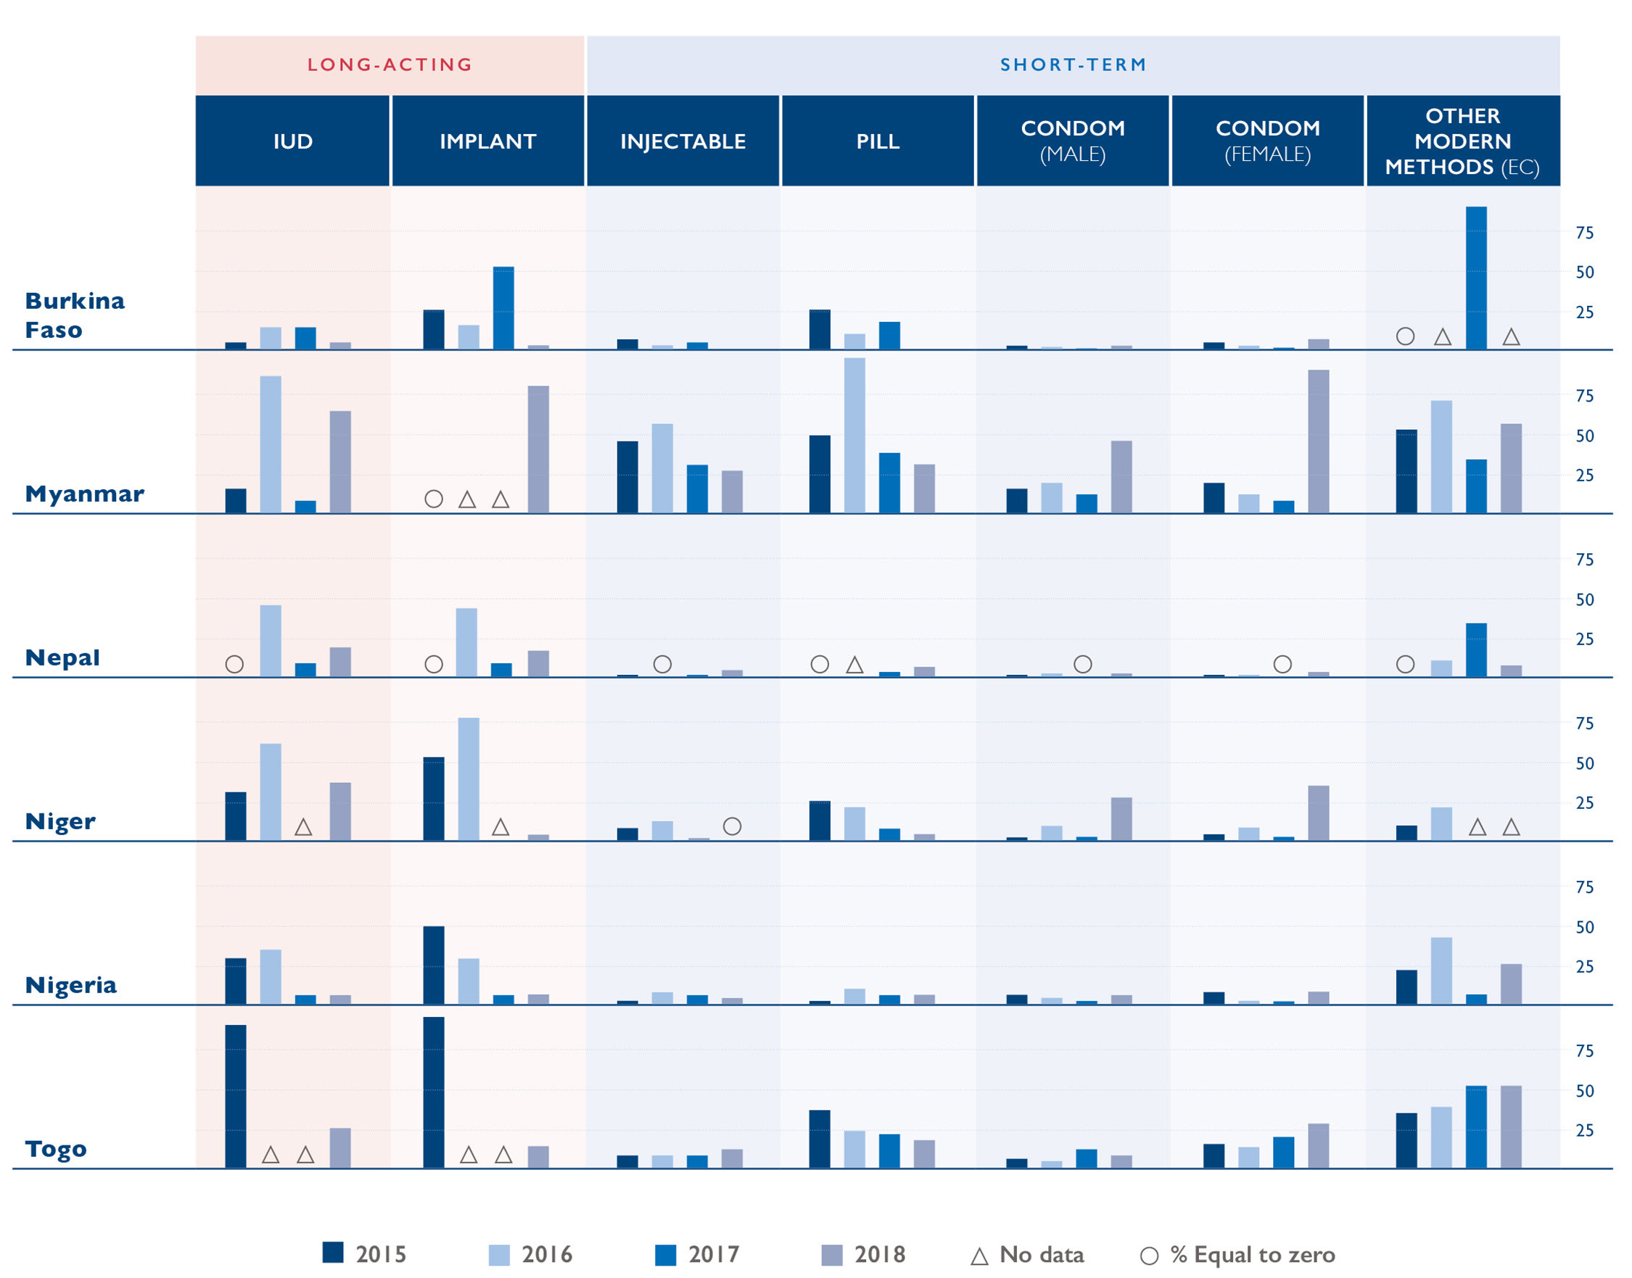

Background
Stockouts of popular contraceptive products are common and persistent across many countries.
Percentage of facilities stocked out, by method offered, on the day of assessment
Source: FP2020 Core Indicator 10.
Supply Chain Management
07
Notes:
Supply chain management organizes the vast network of supply chain players in a system to ensure timely delivery of products.
An effective supply chain works when these players collaborate to make decisions on moving products.
Various inefficiencies and bottlenecks across the supply chain contribute significantly to high stockout rates for modern contraceptives.
To improve supply chain performance and increase product access, these players need data visibility – information allowing them to jointly understand where products are in the system and which processes are blocking their movement.
For more information, please copy and paste this link into your web browser to reference the “Background” section on the HIP brief: https://www.fphighimpactpractices.org/briefs/supply-chain-management/

Slide 8
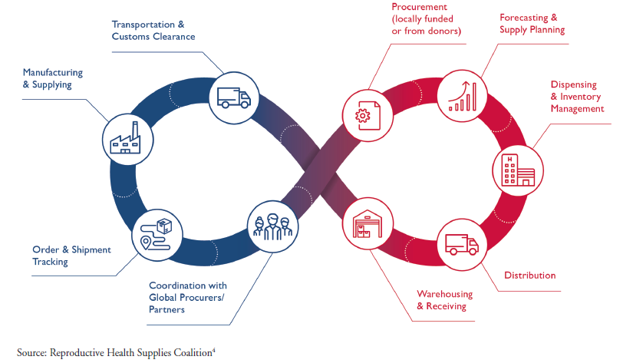

End to End Supply
Chain Processes
The various processes in the supply chain, from the service delivery point to warehouses to manufacturers, are linked in the “end to end” supply chain.
BACKGROUND
Supply Chain Management
08
Notes:
Figure 2: The various processes in the supply chain, from the service delivery point to warehouses to manufacturers, are linked in the “end to end” supply chain.
Figure 2 illustrates the interconnectedness between supply chain processes (i.e., forecasting and quantification, procurement, production, transportation, delivery) in the “end to end” supply chain, where a disruption at any point in the supply chain can result in lack of availability to the individual users at the service delivery point.
View Figure 2 in the HIP brief (copy and paste this link into your web browser): https://www.fphighimpactpractices.org/briefs/supply-chain-management/

Slide 9
What challenges can this HIP help countries address?
Continuous availability of a wide range of contraceptive methods is a key factor in supporting an individual’s ability to plan and space pregnancies.
A reliable stock of contraceptives supports voluntary choice—an important element in user satisfaction and method continuation.
Supply Chain Management
09
Notes:
Continuous availability of a wide range of contraceptive methods is a key factor in supporting an individual’s ability to plan and space pregnancies.
Inadequate supplies of family planning commodities are estimated to account for up to one-third of the unmet need for family planning in LMICs.
Lack of access and supply failures are among the most cited reasons in LMICs for unmet demand, non-use, and discontinuing contraception.
A reliable stock of contraceptives supports voluntary choice—an important element in user satisfaction and method continuation.
Contraceptive use is higher in contexts with a consistent supply of contraceptive method options.
Data from East Africa indicate that a woman living in a region with one additional contraceptive method available in her region was 50% more likely to report using contraception than a woman living in a region with less choice.
Similar findings have been documented in Haiti, Malawi, and Ethiopia.

Slide 10

What challenges can this HIP help countries address?
Effective supply chains support women’s choice of modern contraception and have the potential to meet latent demand for previously unavailable methods.
Supply Chain Management
10
Notes:
Effective supply chains support women’s choice of modern contraception and have the potential to meet latent demand for previously unavailable methods.
This effect stems, in part, from improving quality of care and by reducing stockouts of needed contraceptive methods, as well as the ancillary supplies and equipment required for some clinical methods.
It was exemplified by Senegal’s use of the informed push model (IPM) where nationwide consumption of modern contraception rose in one year by 48% due to the reliable availability off commodities.
Photo credit: Reproductive Health Supplies Coalition

Slide 11

Recommended Indicator
Percentage of facilities stocked out, by family planning product or method offered, on the day of the assessment
  (Reporting day or day of visit)
05
Supply Chain Management
11
Notes:
It is recommended that programs implementing supply chain management include the following indicator:
For more information about this indicator, please copy and paste this link into your web browser: https://www.rhsupplies.org/uploads/tx_rhscpublications/Harmonized_Suite_of_Indicators.pdf

Slide 12
Evidence of Impact
Summary
Increase data visibility and use for continuous improvement
Speed up product flow through the supply chain
Build and support a competent, professional supply chain workforce
Capitalize on private sector supply chain capacity, where appropriate
05
Supply Chain Management
12
Notes:
The following four intervention areas will be key components to strengthening supply chain performance and meeting the product needs for family planning and other health programs:

Slide 13
Evidence of Impact
Data Visibility and Use
Contraceptive Stockouts in Kaduna State, Nigeria, Before and After Intervention
The Kaduna State Health Supply Chain Transformation Project (Nigeria) addressed fragmented logistics data collection systems, duplication of efforts, wastages and losses.
Source: Nigeria, Kaduna State Government, et al. (2017)
Increase data visibility and use for continuous improvement
05
Supply Chain Management
13
Notes:
Collecting and analyzing the right data can offer the needed visibility to help governments, country partners, manufacturers, and global procurers make effective decisions related to estimating supply needs, procuring and distributing product, and advocating for adequate funding.
In situations where global supply is scarce, systematic collection and sharing of supply chain data becomes even more critical to balance stock and coordinate shipments within and among countries.
Conducting routine supply chain assessments offers insights to identify and respond to process bottlenecks and is one of the fastest, most effective paths to improved supply chain performance.
Routine data collection from service delivery point stock and consumption is also important in order to help managers understand how much product is sitting in inventory versus being regularly consumed.

Slide 14
Evidence of Impact
Speed up product flow
Number of warehouses and storerooms, Mozambique, Before and After Optimization
A network optimization exercise conducted in Mozambique indicated that consolidating two layers of the distribution system into a single intermediate level would save $6.7 million per year.
Source: Peffer (2019)
Speed up product flow through the supply chain
05
Supply Chain Management
14
Notes:
Commercial distribution systems have streamlined their supply chains and increased the pace of distribution runs, significantly reducing stockouts at the point of consumption.
Supply chains with fewer levels between the central agency and the service delivery points improve availability and in many cases also reduce costs. Streamlined supply chains lead to better information sharing between the levels in the distribution system, and improve accountability compared to supply chains with too many layers
Mozambique and Zambia both revised and streamlined their reporting systems to allow demand and order data to flow directly from health facilities to the central distribution centers (as opposed to through districts and other layers in the system). Reducing the number of tiers involved in the information flow improves the speed at which information moves and establishes clearer responsibilities for reporting and action.

Slide 15
Evidence of Impact
Professional workforce
Contraceptive Stockouts in Nepal, Before and After Intervention
Strategic outsourcing and institutionalized development of staff capacity led to a reduction in contraceptive stockouts in Nepal.
Source: USAID | DELIVER PROJECT, Task Order 4. (2014)
Build and support a competent, professional supply chain workforce
05
Supply Chain Management
15
Notes:
Many government organizations find it difficult to recruit and retain qualified supply chain staff, and ministries of health often have insufficient human resources dedicated to the medicine supply chain.
The global health community recommends supply chain workers be recognized and included within existing human resources systems, including appropriate recruitment, support, motivation, and professional development and retention plans.
Supply chain leaders within the health system need to be elevated to strategic roles, and empowered within those roles to successfully advocate for supply chain needs and proactively address supply chain challenges.
Initial evidence from Nepal indicates that supply chain improvement efforts, including strategic outsourcing and institutionalized development of staff capacity, led to a reduction in contraceptive stockouts from 8% to less than 2%.

Slide 16
Evidence of Impact
Private sector capacity
Proportion of Health Facilities Experiencing Stockouts, Senegal, Before and After Intervention
A distribution outsourcing arrangement in Senegal reduced the proportion of health facilities experiencing stockouts, while reducing annual distribution costs.
Source: Hasselback et al (2017)
Capitalize on private sector supply chain capacity, where appropriate
05
Supply Chain Management
16
Notes:
The commercial sector brings unique supply chain capabilities and can play an important role in strengthening supply chains for health products.
While the exact role varies depending on a country’s specific supply chain, contracting transport and distribution to private companies has yielded benefits in many countries.
Success of private sector engagement and contracting models has depended on a clear policy framework; strong government understanding and commitment, including contract management capacity in government; and a competitive local market for high-quality private supply chain service providers.
Even in instances where the private sector cannot be leveraged for transportation, distribution, or other supply chain services, it can act as a source of technical best practices in designing and operating supply chains and their corresponding performance management systems.
Opportunities may exist for expanding use of private sector pharmacies and drug shops as an integral part of the public sector family planning services to expand access in both rural and urban areas, possibly leveraging vouchers or subsidies.

Slide 17
Thank You
Continue to the extra slides or access the HIP brief for more information.
Supply Chain Management
17
Notes:
For more information, please copy and paste this link into your web browser to visit this webpage with a recording of the webinar on Supply Chain Management and a downloadable PDF version of the presentation: https://www.fphighimpactpractices.org/supply-chain-management-webinar/

Slide 18
Extra Slides
Implementation Tips
Tools & Resources
Supply Chain Management
18
Notes:
We have put together a collection of implementation tips for Supply Chain Management, in case you have additional time in your meeting. Further information about these tips can be found in the HIP brief.
References from the literature on this HIP can be found here (copy and paste this link into your web browser): https://www.fphighimpactpractices.org/wp-content/uploads/2017/05/SupplyChainMgmt_References.pdf

Slide 19

Implementation Tips
  Increase data visibility and use for continuous improvement.
  Conduct regular and systematic assessments to identify supply chain bottlenecks and solutions.
  Strengthen existing data collection while working toward electronic systems.
Supply Chain Management
19
Notes:
Increase data visibility and use for continuous improvement.
Conduct regular and systematic assessments to identify supply chain bottlenecks and solutions.
There are a number of tools available that can work separately or in conjunction. These tools can identify short-term “quick win” improvements, medium-term strategic level resource planning, and long-term comprehensive supply chain changes.
Regardless of the tools chosen for assessment, ultimately, the government and other key stakeholders should lead a process to distill the findings into one agreed vision for supply chain strengthening.
The Technical Review of Public Health Supply Chain Assessment Tools can be used in selecting the most relevant assessment approaches.
Please copy and paste this link into your web browser to access this review: https://isghealth.org/wp-content/uploads/2020/12/Technical-Review-of-Public-Health-Supply-Chain-Assessment-Tools.pdf
Strengthen existing data collection while working toward electronic systems.
It is not necessary to wait for the perfect electronic data system to benefit from data visibility. Existing data, such as service delivery point stock, months of stock, and average monthly consumption, can and should be analyzed to inform decision-making.
Review of existing data collection tools and processes should be part of the supply chain assessments outlined above to identify opportunities to improve data quality and use.
Once existing data collection processes are proven, and as the supply chain matures, data collection and use should evolve to automated, more advanced electronic processes that allow faster analysis.
For more information about electronic data collection and systems, please copy and paste this link into your web browser to visit the Digital Health HIP brief: https://www.fphighimpactpractices.org/briefs/digital-health-systems/

Slide 20
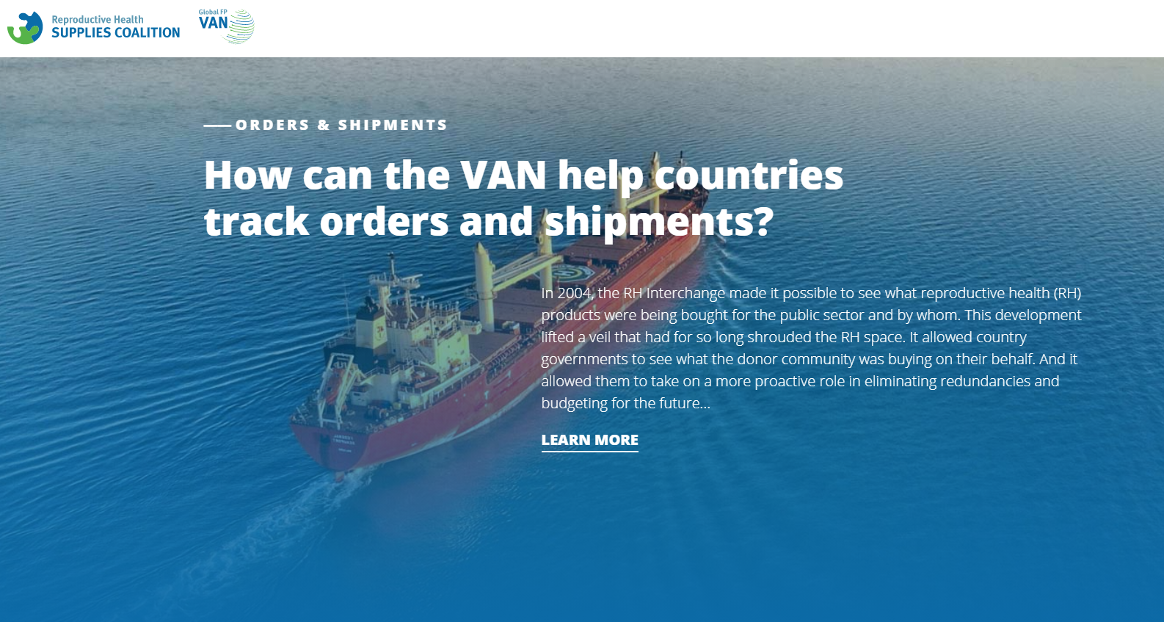

Implementation Tips
  Increase data visibility and use for continuous improvement.
  Adopt an electronic logistics management information system to work toward visibility across the whole supply chain, from manufacturers to service delivery points.
Supply Chain Management
20
Notes:
Increase data visibility and use for continuous improvement.
Adopt an electronic logistics management information system to work toward visibility across the whole supply chain, from manufacturers to service delivery points.
Electronic data collection and systems allow frequent sharing of updates related to purchase orders, stock inventory, product consumption, and shipment and delivery statuses across a complex network of supply chain players.
In situations where global supply is scarce, electronic systems make it easier to balance stock and coordinate shipments.
Countries can look to early adopters like Nigeria and Malawi for advice on connecting to global visibility networks, and to countries like Tanzania to set up national electronic logistics management systems.
Governments that put in place national electronic logistics management information systems, like the Tanzania example described above, can connect to electronic networks (e.g., the Global FP Visibility and Analytics Network) linking them to their global manufacturers and shippers.
For more information about VAN, please copy and paste this link into your web browser to access the network: https://www.rhsupplies.org/microsites/gfpvan/
For more information about electronic data collection and systems, please copy and paste this link into your web browser to visit the Digital Health HIP brief: https://www.fphighimpactpractices.org/briefs/digital-health-systems/

Slide 21
Implementation Tips
  Speed up product flow through the supply chain.
  Map current supply chain processes to understand where duplication or wastage is happening.
  Utilize network optimization tools to understand the optimal infrastructure for a given supply chain in a specific context.
Supply Chain Management
21
Notes:
Speed up product flow through the supply chain.
Map current supply chain processes to understand where duplication or wastage is happening.
Process mapping provides insight into the systems and processes involved in product movement through the supply chain, who is doing what and when, and the time spent.
It is a first step to understand duplication in efforts, wastage in time and resources, as well as key bottlenecks, and is seen as useful in health care quality improvement projects.
Subsequently, once the bottlenecks in the current processes are identified, the next step is to redesign the supply chain processes to address these inefficiencies.
Utilize network optimization tools to understand the optimal infrastructure for a given supply chain in a specific context.
Whilst infrastructure changes can be expensive, in the longer term they should drive down costs and improve the experience for all those involved in the process, including most importantly the user.
Network optimization is often coupled with redesigning the inventory and distribution rules of the system to further maximize benefits.
Such design can carefully balance the needs of service, efficiency, and resilience in the supply chain.

Slide 22

Implementation Tips
  Build and support a competent, professional supply chain workforce.
  Use a systematic, sustainable approach to strengthen supply chain human resources in-country.
  Foster and build strong leadership for supply chain management.
Supply Chain Management
22
Notes:
Build and support a competent, professional supply chain workforce.
Use a systematic, sustainable approach to strengthen supply chain human resources in-country.
Countries should instead strive to develop national systems and programs that can sustainably prepare and engage (through employment or outsourcing) the required supply chain workforce.
This means understanding what competencies are required to manage and operate their supply chain, planning how these will be developed in the educational system, and ensuring the supply chain workers are explicitly considered throughout all aspects of the human resources cycle.
The People that Deliver Initiative has recently developed a theory of change to support countries in this approach. For more information, copy and paste this link into your web browser: https://peoplethatdeliver.org/resources/building-human-resources-supply-chain-management-theory-change
Foster and build strong leadership for supply chain management.
Strong supply chain performance requires health sector leaders who understand the importance of the supply chain to achieving health outcomes, and supply chain leaders who can envision and drive transformational change.
For more information, please copy and paste this link into your web browser to visit the HIP brief on Leaders and Managers: https://www.fphighimpactpractices.org/briefs/leaders-and-managers/

Slide 23

Implementation Tips
Capitalize on private sector supply chain capacity, where appropriate.
Supply chain operations are labor- and asset-intensive, require specialized technical expertise, and provide economies of scale through consolidation.
Supply Chain Management
23
Notes:
Capitalize on private sector supply chain capacity, where appropriate.
Supply chain operations are labor- and asset-intensive, require specialized technical expertise, and provide economies of scale through consolidation.
In most countries, supply chain management is not a core business or comparative strength of governments or ministries of health. A policy that supports private sector engagement in the supply chain and leverages private sector capacities can increase performance while decreasing cost per unit delivered.
For more information about policy, please copy and paste this link into your web browser to visit the Policy HIP Brief: https://www.fphighimpactpractices.org/briefs/policy/
Third-party logistics providers can be contracted to provide specific supply chain services, such as procurement, customs clearance, warehousing, or distribution.
In addition, “fourth party logistics providers” can be used to manage an array of third-party providers and services to provide comprehensive supply chain solutions.
Contract management and oversight are both critical prerequisites for private-sector run transport and distribution.
Many countries lack sufficient mechanisms and capacities in these areas. It is important to start by assessing capacity in the government for contract management and for defining and enforcing contract provisions and performance expectations, as well as other mechanisms for effective private sector engagement.
Seeking support and building capacity where gaps exist will be a key first step.
Conduct an in-depth, cost-risk benefit and private-sector capability analysis.
This should include a thorough costing analysis of the existing government-owned transport and distribution system, taking into account hidden costs such as asset depreciation and staff time, and understanding the private sector operators’ geographical reach and costs.
Where it makes sense to engage the private sector (either in selected regions or nationally), getting top-level ownership of the process within the government, including the finance ministry, is critical to ensure analysis is utilized and the solutions move forward.
Photo credit: 2012, Humphleah’s International Limited

Slide 24


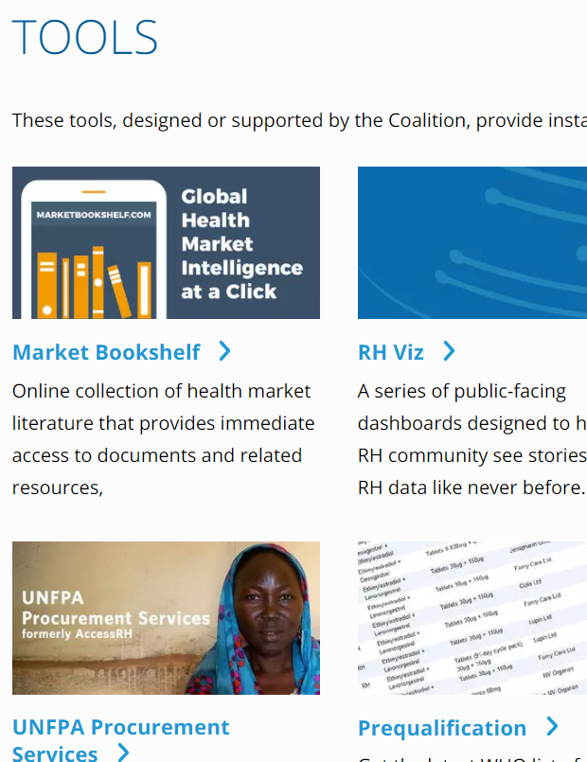
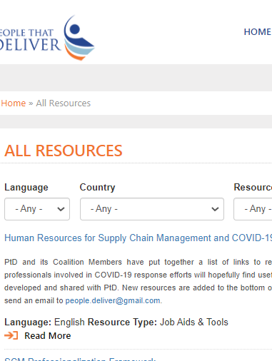

Tools & Resources
MDS-3: Managing Access to Medicines and Health Technologies
Reproductive Health Supply Coalition Tools Page
Private Sector Engagement: A Guidance Document for Supply Chains in the Modern Context
People that Deliver Resource Page
05
Supply Chain Management
18
Notes:
General Supply Chain Management Guidance: MDS-3: Managing Access to Medicines and Health Technologies. 2012. Management Sciences for Health. https://www.msh.org/resources/mds-3-managing-access-to-medicines-and-health-technologies
Reproductive Health Commodity Security and Data Visibility: Reproductive Health Supply Coalition tools page: https://www.rhsupplies.org/activities-resources/tools/
Human Resources for Health Supply Chains: People that Deliver resource page: https://peoplethatdeliver.org/resources-chronologically
Outsourcing and Engaging Private Sector: Private Sector Engagement: A Guidance Document for Supply Chains in the Modern Context. 2014. United Nations Commission on Life-Saving Commodities, Technical Reference Team on Private Sector Engagement.
https://toolkits.knowledgesuccess.org/toolkits/fp-logistics/private-sector-engagement-guidance-document-supply-chains-modern-context

Slide 25

fphighimpactpractices.org
Notes:
Subscribe to the HIPs Newsletter here (copy and paste this link into your web browser): https://mailchi.mp/76703a3652c9/hips-newsletter-sign-up
Please visit the five areas of our website to learn more about the HIPs:
HIP Products (copy and paste this link into your web browser): https://www.fphighimpactpractices.org/hip-products/
Resources (copy and paste this link into your web browser): https://www.fphighimpactpractices.org/resources/
Engage (copy and paste this link into your web browser): https://www.fphighimpactpractices.org/engage-with-the-hips/
Overview (copy and paste this link into your web browser): https://www.fphighimpactpractices.org/overview/
About Us (copy and paste this link into your web browser): https://www.fphighimpactpractices.org/partnership-structure/

