Slide 1



Social Norms
Promoting community support for family planning.
Notes:
This HIP brief together with the other two HIP briefs focusing on family planning social and behavior change (SBC) programs (couples’ communication and knowledge, attitudes, and beliefs) recognizes that factors influencing health behaviors exist on multiple levels, are interrelated, and extend beyond the individual. Interventions that address social norms typically do one or more of the following: 1) identify the social norms and reference groups relevant to the behaviors of interest; 2) seek change at the community rather than individual level; 3) confront power imbalances such as those related to gender and age; and/or 4) create or reinforce positive norms to support healthy behaviors.
Couples’ Communication: https://www.fphighimpactpractices.org/briefs/couple-communication/
Knowledge, Beliefs, Attitudes, and Self-Efficacy Brief: https://www.fphighimpactpractices.org/briefs/knowledge-attitudes-and-beliefs/
Photo credit: Images of Empowerment
REVISED: 3/23

Slide 2
Overview
What is a HIP?
HIP Categories
Partnership
Introduction to the High Impact Practices (HIPs)
PART
PART
Background
Theory of Change
Why is this practice important?
Interventions to address social norms
Implementation Measurement
Social Norms
Implementation Tips
Priority Research Questions
Tools & Resources
Extra Slides
Notes:
Thank you for using this slide deck! This is a product derived from the HIP brief to assist you in presenting to a variety of audiences. Instructions and additional resources are included in the notes of each slide for your convenience. There is a wealth of information and resources in the “Notes” section of each slide.
This presentation is divided in three parts: an Introduction to the High Impact Practices (HIPs) in Family Planning, Social Norms, and Extra Slides.
The logo for your organization or ministry may be added to these slides. The web addresses provided in the “Notes” section of each slide can be copied and pasted into your web browser.

Slide 3



High Impact Practices in Family Planning (HIPs) are…
Evidence-based family planning practices
Vetted by experts against specific criteria
Documented in an easy-to-use format
Notes:
High Impact Practices (HIPs) are a set of evidence-based family planning practices vetted by experts against specific criteria and documented in an easy-to-use format.
The High Impact Practices in Family Planning (HIPs) were first created in 2010 after a survey of FP stakeholders revealed little consensus for “what works” in international FP programming. A small group of leaders in FP were brought together with the task of identifying a short list of HIPs that if implemented at scale would help countries address the unmet need for FP and thereby increase national contraceptive prevalence.
HIPs are identified based on demonstrated magnitude of impact on contraceptive use and potential application in a wide range of settings. Consideration is also given to other relevant outcome measures including unintended pregnancy, fertility, or one of the primary proximate determinants of fertility (delay of marriage, birth spacing, or breast feeding). Evidence of replicability, scalability, sustainability, and cost-effectiveness are also considered.
For more information, please copy and paste this link into your web browser to see this video: https://www.youtube.com/watch?v=N6V0gfl-V3k&ab_channel=KnowledgeSUCCESS
A 2-pager overview of the HIPs is available in an online and a downloadable PDF format here (copy and paste this link into your web browser): https://www.fphighimpactpractices.org/high-impact-practices-in-family-planning-list/

Slide 4
HIPs address the full spectrum of FP programming
Enabling Environment
Service Delivery
Social and Behavioral Change
PART
Address systemic barriers that affect an individual’s ability to access family planning information & services. 8 briefs
Improve the availability, accessibility, acceptability, and quality of family planning services. 8 briefs
Influence knowledge, beliefs, behaviors, and social norms associated with family planning.
6 briefs
Enhancements
Approaches used in conjunction with HIPs to maximize the impact of HIP implementation or increase the reach. 4 briefs
Notes:
There are three categories of HIPs: Enabling Environment, Service Delivery and Social and Behavioral Change. Social Norms is a Social and Behavior Change HIP. This information came from the HIP List (copy and paste this link into your web browser): https://www.fphighimpactpractices.org/high-impact-practices-in-family-planning-list/
A HIP Enhancement is a tool or approach that is not a standalone practice, but it is often used in conjunction with HIPs to maximize the impact of HIP implementation or increase the reach and access for specific audiences. The intended purpose and impact of enhancements are focused and, therefore the evidence-based and impact of an enhancement is subjected to different standards than a HIP.
For more information about the HIP Categories and Enhancements, please copy and paste this link into your web browser: https://www.fphighimpactpractices.org/high-impact-practices-in-family-planning-list/
Here are a few examples of HIPs from each category:
Service Delivery:
Immediate Postpartum Family Planning
Mobile Outreach Services
Postabortion Family Planning
Enabling Environment:
Domestic Public Financing
Educating Girls
Supply Chain Management
Social and Behavior Change:
Community Group Engagement
Digital Health for SBC
Mass Media
Enhancements:
Digital Health for Systems
Adolescent-Responsive Contraceptive Services
Family Planning Vouchers
All HIPs are Available in English, Spanish, French, and Portuguese.

Slide 5
HIP Partnership
The Technical Advisory Group (TAG) is made up of 25 experts in family planning, including representatives from the co-sponsors.
The Co-sponsors include the following organizations:
Notes:
The High Impact Practices in Family Planning (HIPs) are supported by over 65 organizations. These organizations play a vital role in developing, reviewing, disseminating, and implementing HIPs in family planning.
The HIPs partnership includes various structures to ensure HIP products are developed, kept up to date, and disseminated widely. These include:
Co-sponsors – Serve as the secretariat for the HIPs.
Partners – Contribute to key HIP products and endorse the HIPs.
Technical Advisory Group – Ensure high technical quality of key HIP products and approve HIP brief and SPG concepts for development.
P&D Team – Support the production and dissemination (P&D) of HIP products.
Technical Expert Groups – Write new HIP briefs and ensure they are up-to-date.
For more information about the HIP Partnership, please copy and paste this link into your web browser: https://www.fphighimpactpractices.org/partnership-structure/

Slide 6
High Impact Practice
Implement interventions that address social norms to support an individual’s or couple’s decision-making power to meet their reproductive intentions.
Notes:
This HIP brief together with the other two HIP briefs focusing on family planning social and behavior change (SBC) programs (couples’ communication and knowledge, attitudes, and beliefs) recognizes that factors influencing health behaviors exist on multiple levels, are interrelated, and extend beyond the individual. Interventions that address social norms typically do one or more of the following: 1) identify the social norms and reference groups relevant to the behaviors of interest; 2) seek change at the community rather than individual level; 3) confront power imbalances such as those related to gender and age; and/or 4) create or reinforce positive norms to support healthy behaviors.
Couples’ Communication: https://www.fphighimpactpractices.org/briefs/couple-communication/
Knowledge, Beliefs, Attitudes, and Self-Efficacy Brief: https://www.fphighimpactpractices.org/briefs/knowledge-attitudes-and-beliefs/

Slide 7
Background
Social norms define acceptable and appropriate actions within a given community or group.
They are sustained and enforced by people whose opinions or behaviors matter to an individual (e.g., sexual partners, friends, peers, family members, religious or community leaders).
Individuals who do not act in accordance with social norms may face sanctions, such as ostracism or lowering of status.
Notes:
An individual’s or couple’s decisions and behaviors around contraception and reproductive health are influenced not only by their individual knowledge, beliefs, and attitudes but also by informal and mostly unwritten rules of the communities where they live known as “social norms.”
Social norms define acceptable and appropriate actions within a given community or group.
They are sustained and enforced by people whose opinions or behaviors matter to an individual (e.g., sexual partners, friends, peers, family members, religious or community leaders).
Individuals who do not act in accordance with social norms may face sanctions, such as ostracism or lowering of status.
Couples’ Communication: https://www.fphighimpactpractices.org/briefs/couple-communication/
Knowledge, Beliefs, Attitudes, and Self-Efficacy Brief: https://www.fphighimpactpractices.org/briefs/knowledge-attitudes-and-beliefs/
Mass Media: https://www.fphighimpactpractices.org/briefs/mass-media/
Community Group Engagement: https://www.fphighimpactpractices.org/briefs/community-group-engagement/
Digital Health for SBC: https://www.fphighimpactpractices.org/briefs/digital-health-sbc/
For more information, please copy and paste this link into your web browser to reference the “Background” section on the HIP brief: https://www.fphighimpactpractices.org/briefs/social-norms/

Slide 8
Background
Interventions that address social norms typically do one or more of the following:
Identify the social norms and reference groups relevant to the behaviors of interest.
Seek change at the community rather than individual level.
Confront power imbalances such as those related to gender and age.
Create or reinforce positive norms to support healthy behaviors.
Notes:
For more information, please copy and paste this link into your web browser to reference the “Background” section on the HIP brief: https://www.fphighimpactpractices.org/briefs/social-norms/

Slide 9
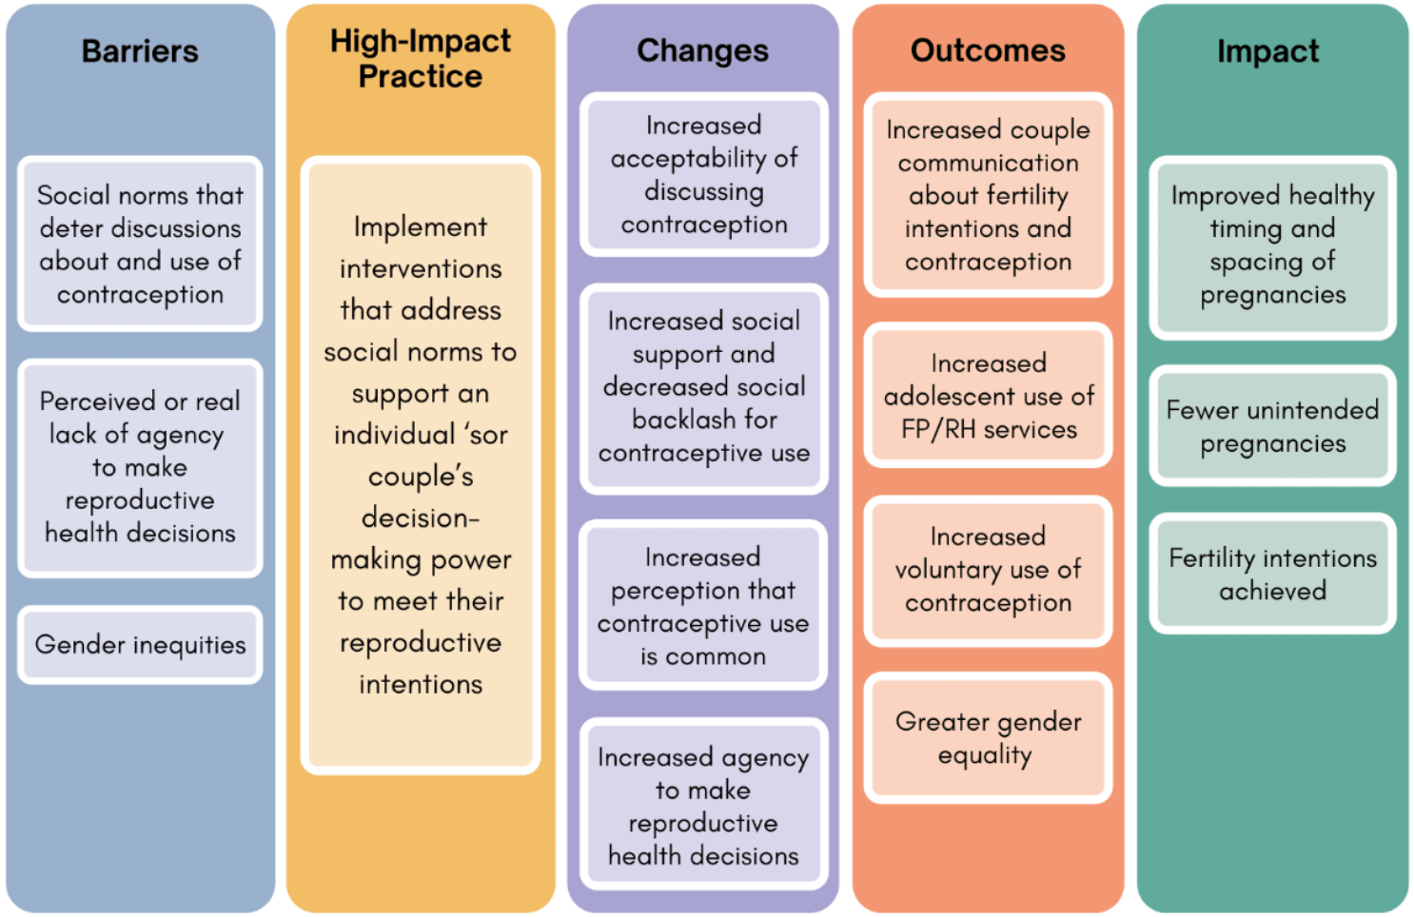
Theory of
Change
BACKGROUND
Notes:
View Theory of Change in the HIP brief (copy and paste this link into your web browser): https://www.fphighimpactpractices.org/briefs/social-norms/

Slide 10
Why is this practice important?
Social norms can inhibit an individual’s ability to act on their reproductive intentions.
Social norms can influence couples’ communication about family planning, which in turn influences contraceptive use.
Social norms affect individuals’ and couples’ decisions about when to have children.
Notes:
Social norms can inhibit an individual’s ability to act on their reproductive intentions.
Social norms can overpower an individual’s preferences.
Social norms can influence couples’ communication about family planning, which in turn influences contraceptive use.
People who believe that other couples discuss family planning or who are encouraged by their networks to discuss family planning with their partners are more likely to report that they discuss family planning with their partner.
Social norms affect individuals’ and couples’ decisions about when to have children.
Social norms that encourage parents to space their children for their health and strength affect contraceptive use, sexual activity, and childbearing decisions.
Social norms around couples having as many children as possible may be juxtaposed with established norms “which make spacing of pregnancies socially desirable, and from emerging norms on what entails taking good care of one’s children.”

Slide 11
Why is this practice important?
Social norms influence contraceptive use.
Social norms can facilitate or hinder efforts to access good quality sexual and reproductive health care.
Notes:
Social norms influence contraceptive use.
In several research studies, participants who reported social norms in their communities were favorable towards family planning were between two and four times as likely to use contraception.
Social norms can facilitate or hinder efforts to access good quality sexual and reproductive health care.
In Liberian communities with social norms that encourage child spacing by means of postpartum abstinence, postpartum women did not use the available family planning services because of a lack of privacy.

Slide 12
What interventions address social norms?
Example: In Benin, social network mapping identified key influencers who were engaged in reflective dialogues about family planning-related norms. Community radio broadcasted the reflective dialogues. Referrals to health providers were offered. This led to:
Men who heard the radio broadcasts were more likely to believe their peers use contraception (descriptive norm).
The percentage of women who were using a contraceptive method increased.
Notes:
The Social Norms HIP brief contains highlights from intervention studies in Benin, Niger, Zambia, Kenya, Nigeria, and Palestine. For more information, please copy and paste this link into your web browser: https://www.fphighimpactpractices.org/briefs/social-norms/
Benin: Social network mapping identified key influencers who were engaged in reflective dialogues about family planning-related norms. Community radio broadcasted the reflective dialogues. Influencers were encouraged to discuss new ideas and behaviors with their networks. Referrals to health providers were offered.
Intervention impact on social norms:
Men who heard the radio broadcasts were more likely to believe their peers use contraception (descriptive norm).
Men and women who had participated in a reflective dialogue were more likely to believe their peers approved of family planning (injunctive norm).
Intervention impact on contraceptive use:
The percentage of women who were using a contraceptive method increased.
Community members exposed to select package components were more likely to use a contraceptive method and to meet their family planning needs.
Measurement challenges are a factor in the limited evidence available to demonstrate how interventions can successfully address family planning-related social norms.
A lack of agreement on how to measure social norms, as well as the time and resources required to do so, are potential reasons for studies to not include social norm measures.

Slide 13

Implementation Measurement
Descriptive norm
  Percent of intended audience who report that people in their reference group use a contraceptive method. (What others do)
Injunctive norm
  Percent of intended audience who report that their reference group would approve of them using contraception. (What others think I should do)
Diffusion
  Percent of intended audience who have discussed new family planning-related ideas or behaviors with others in their community.
Notes:
Note: As written, these indicators would be measured through surveys, but could be adapted for use with qualitative methods such as focus group discussions

Slide 14
Thank You
Continue to the extra slides or access the HIP brief for more information.

Slide 15
Extra Slides
Implementation Tips
Priority Research Questions
Tools & Resources
Notes:
We have put together a collection of implementation tips for Social Norms, in case you have additional time in your meeting. Further information about these tips can be found in the HIP brief.

Slide 16

Implementation Tips
Identify the norms and the power dynamics underlying norms and behaviors.
Program staff should work with communities to determine which norms influence the behavior/s of interest, who influences norms and behaviors and who enforces them.
Careful attention also should be paid to power dynamics, including across genders, age groups, and individuals or groups with differing roles and status within the community.
Notes:
Identify the norms and the power dynamics underlying norms and behaviors.
Program staff should work with communities to determine which norms influence the behavior/s of interest, who influences norms and behaviors (i.e., reference groups), and who enforces them.
Careful attention also should be paid to power dynamics, including across genders, age groups, and individuals or groups with differing roles and status within the community.

Slide 17
Implementation Tips
Ensure staff and facilitators have the training and skills to support community-led social norm processes.
To ensure that facilitator beliefs and unconscious biases do not unintentionally limit the ability of the community to set their own values or cause harm, staff and facilitators should engage in separate reflective dialogues and/or values clarification activities to explore their own beliefs.

Slide 18
Implementation Tips
Create or reinforce positive social norms by modeling desired behavior(s).
Modeling demonstrates the process of accepting and acting on the desired behavior, conveys the benefits of practicing the behavior, and provides examples of how to resist norms and strengthen individual agency.
Notes:
Create or reinforce positive social norms by modeling desired behavior(s).
Modeling demonstrates the process of accepting and acting on the desired behavior, conveys the benefits of practicing the behavior, and provides examples of how to resist norms and strengthen individual agency.
The perception that other people, particularly others like them, are doing the same thing and/or approve of it, can increase positive norms and self-efficacy.

Slide 19
Implementation Tips
Anticipate, plan for, monitor, and mitigate pushback and unanticipated harmful effects.
Programs must maintain strong “do no harm” principles. This requires careful consideration of the complex sensitivities around social norms, as well as planning for ways to lessen risks for all involved, especially marginalized groups.

Slide 20
Priority Research Questions
Capturing evidence on how SBC interventions can address social norms and thus change family planning behaviors can be challenging, time-consuming, and costly. How do we best evaluate the effectiveness of interventions that address social norms?
Notes:
These research questions, reviewed by the HIP technical advisory group, reflect the prioritized gaps in the evidence base specific to the topics reviewed in this brief and focus on the HIP criteria.

Slide 21
Priority Research Questions
Most interventions with evidence showing that norms were successfully shifted included reflective dialogues. What other types of interventions (e.g., mass and digital media, advocacy for policy change) and what combinations of interventions can effectively address family planning-related social norms?
Notes:
These research questions, reviewed by the HIP technical advisory group, reflect the prioritized gaps in the evidence base specific to the topics reviewed in this brief and focus on the HIP criteria.

Slide 22
Priority Research Questions
Do interventions that address social norms lead to sustained changes in family planning behaviors by creating an environment in which contraceptive use is considered normal and approved of? And if so, how can programs accelerate diffusion of positive social norms to more quickly reach that “tipping point”?
Notes:
These research questions, reviewed by the HIP technical advisory group, reflect the prioritized gaps in the evidence base specific to the topics reviewed in this brief and focus on the HIP criteria.

Slide 23


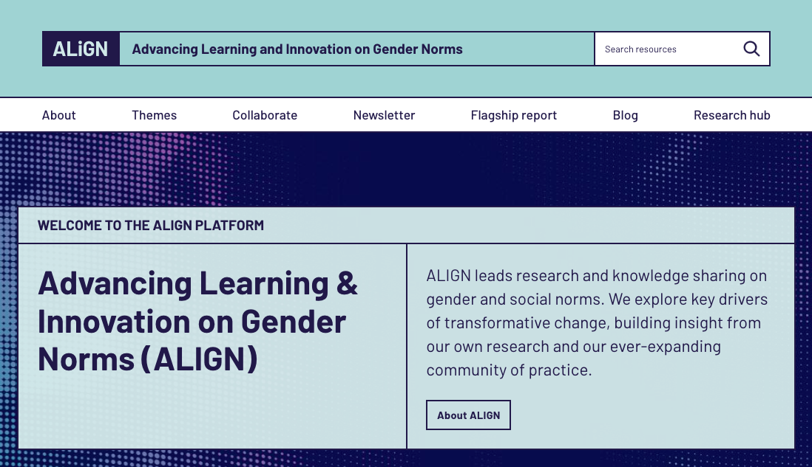
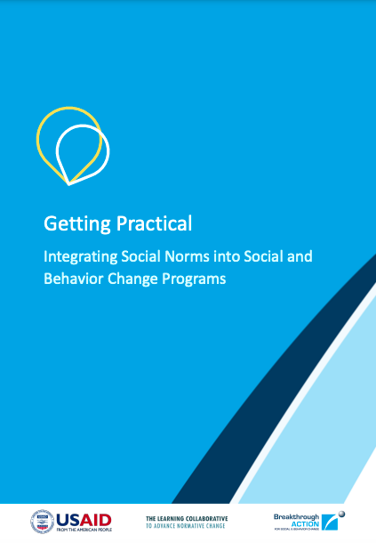


Tools & Resources
The Advancing Learning and Innovation on Gender Norms (ALIGN) Platform
Getting Practical: Integrating Social Norms into Social and Behavior Change Programs
A Taxonomy for Social Norms that Influence Family Planning in Ouagadougou Partnership Countries
Social Analysis and Action Global Implementation Guide
20 Essential Resources on Social Norms and Family Planning
Notes:
20 Essential Resources on Social Norms and Family Planning is a collection of resources is for program planners, designers, and implementers who want to understand and measure social norms and incorporate social norm interventions into their work. Available from: https://my.knowledgesuccess.org/20-essential-resources-social-norms-family-planning/p/1
The Advancing Learning and Innovation on Gender Norms (ALIGN) Platform is a website brings together resources on gender norms and creates a related community of practice; it includes many resources for family planning-related social norms. Available from: https://www.alignplatform.org/
Getting Practical: Integrating Social Norms into Social and Behavior Change Programs is a tool for program planners, designers, and evaluators to address the gap between formative social norms research and the other phases of the program design cycle. Available from: https://breakthroughactionandresearch.org/getting-practical-tool/
A Taxonomy for Social Norms that Influence Family Planning in Ouagadougou Partnership Countries is a tool that offers a simple classification system for social norms related to family planning. It can be used to help those who are new to social norms to quickly understand what norms in their community may look like. Available from: https://breakthroughactionandresearch.org/wp-content/uploads/2020/10/Taxonomy-for-Social-Norms-OP-Countries.pdf
Social Analysis and Action (SAA) Global Implementation Guide is a facilitated process through which individuals explore and challenge the social norms and practices that shape their lives and health. Available from: https://www.care.org/wp-content/uploads/2020/08/saatoolkit_final_rights_reserved.pdf

Slide 24
fphighimpactpractices.org
Notes:
Subscribe to the HIPs Newsletter here (copy and paste this link into your web browser): https://mailchi.mp/76703a3652c9/hips-newsletter-sign-up
Please visit the five areas of our website to learn more about the HIPs:
HIP Products (copy and paste this link into your web browser): https://www.fphighimpactpractices.org/hip-products/
Resources (copy and paste this link into your web browser): https://www.fphighimpactpractices.org/resources/
Engage (copy and paste this link into your web browser): https://www.fphighimpactpractices.org/engage-with-the-hips/
Overview (copy and paste this link into your web browser): https://www.fphighimpactpractices.org/overview/
About Us (copy and paste this link into your web browser): https://www.fphighimpactpractices.org/partnership-structure/

