Slide 1
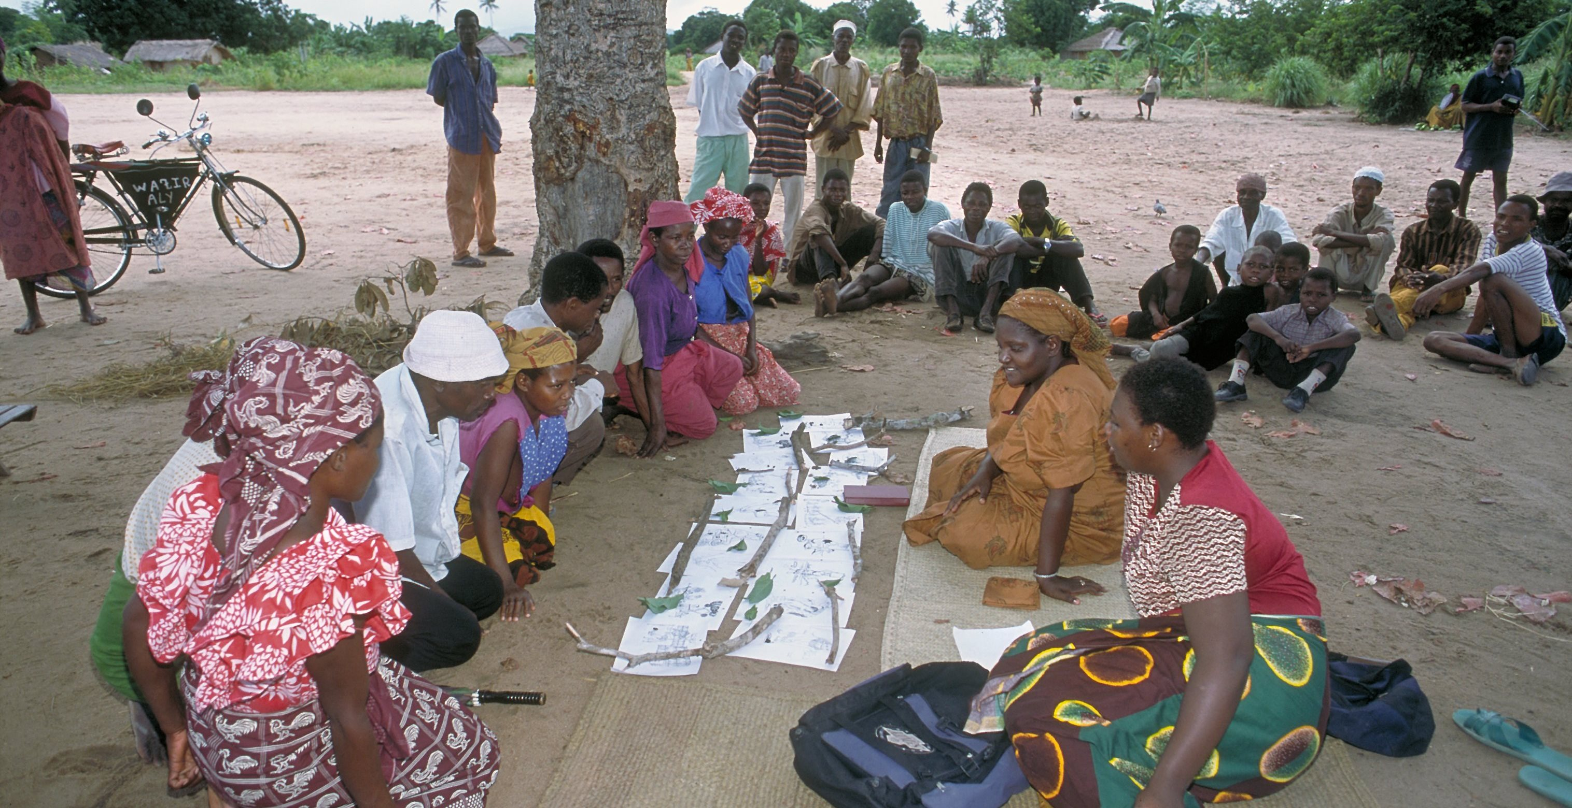
Community Group Engagement
Changing norms to improve sexual and reproductive health.
Notes:
This brief describes the evidence on and experience with community group engagement (CGE) interventions that aim to foster healthy sexual and reproductive health (SRH) behaviors. The distinguishing characteristic of CGE interventions from other social and behavior change (SBC) interventions is that they work with and through community groups to influence individual behaviors and/or social norms rather than shifting behavior by targeting individuals alone.
Photo credit: Save the Children, 2022
REVISED: 3/23

Slide 2
Overview
What is a HIP?
HIP Categories
Partnership
Introduction to the High Impact Practices (HIPs)
PART
PART
Background
Theory of Change
What challenges can this HIP help address?
Evidence of Impact
Community Group Engagement
Implementation Tips
Priority Research Questions
Tools & Resources
Extra Slides
Notes:
Thank you for using this slide deck! This is a product derived from the HIP brief to assist you in presenting to a variety of audiences. Instructions and additional resources are included in the notes of each slide for your convenience. There is a wealth of information and resources in the “Notes” section of each slide.
This presentation is divided in three parts: an Introduction to the High Impact Practices (HIPs) in Family Planning, Community Group Engagement, and Extra Slides.
The logo for your organization or ministry may be added to these slides. The web addresses provided in the “Notes” section of each slide can be copied and pasted into your web browser.

Slide 3
High Impact Practices in Family Planning (HIPs) are…
Evidence-based family planning practices
Vetted by experts against specific criteria
Documented in an easy-to-use format
Notes:
High Impact Practices (HIPs) are a set of evidence-based family planning practices vetted by experts against specific criteria and documented in an easy-to-use format.
The High Impact Practices in Family Planning (HIPs) were first created in 2010 after a survey of FP stakeholders revealed little consensus for “what works” in international FP programming. A small group of leaders in FP were brought together with the task of identifying a short list of HIPs that if implemented at scale would help countries address the unmet need for FP and thereby increase national contraceptive prevalence.
HIPs are identified based on demonstrated magnitude of impact on contraceptive use and potential application in a wide range of settings. Consideration is also given to other relevant outcome measures including unintended pregnancy, fertility, or one of the primary proximate determinants of fertility (delay of marriage, birth spacing, or breast feeding). Evidence of replicability, scalability, sustainability, and cost-effectiveness are also considered.
For more information, please copy and paste this link into your web browser to see this video: https://www.youtube.com/watch?v=N6V0gfl-V3k&ab_channel=KnowledgeSUCCESS
A 2-pager overview of the HIPs is available in an online and a downloadable PDF format here (copy and paste this link into your web browser): https://www.fphighimpactpractices.org/high-impact-practices-in-family-planning-list/

Slide 4
HIPs address the full spectrum of FP programming
Enabling Environment
Service Delivery
Social and Behavioral Change
PART
Address systemic barriers that affect an individual’s ability to access family planning information & services. 8 briefs
Improve the availability, accessibility, acceptability, and quality of family planning services. 8 briefs
Influence knowledge, beliefs, behaviors, and social norms associated with family planning.
7 briefs
Enhancements
Approaches used in conjunction with HIPs to maximize the impact of HIP implementation or increase the reach. 4 briefs
Notes:
There are three categories of HIPs: Enabling Environment, Service Delivery and Social and Behavioral Change. Community Group Engagement is a Social and Behavior Change HIP. This information came from the HIP List (copy and paste this link into your web browser): https://www.fphighimpactpractices.org/high-impact-practices-in-family-planning-list/
A HIP Enhancement is a tool or approach that is not a standalone practice, but it is often used in conjunction with HIPs to maximize the impact of HIP implementation or increase the reach and access for specific audiences. The intended purpose and impact of enhancements are focused and, therefore the evidence-based and impact of an enhancement is subjected to different standards than a HIP.
For more information about the HIP Categories and Enhancements, please copy and paste this link into your web browser: https://www.fphighimpactpractices.org/high-impact-practices-in-family-planning-list/
Here are a few examples of HIPs from each category:
Service Delivery:
Immediate Postpartum Family Planning
Mobile Outreach Services
Postabortion Family Planning
Enabling Environment:
Domestic Public Financing
Educating Girls
Supply Chain Management
Social and Behavior Change:
Community Group Engagement
Digital Health for SBC
Mass Media
Enhancements:
Digital Health for Systems
Adolescent-Responsive Contraceptive Services
Family Planning Vouchers
All HIPs are Available in English, Spanish, French, and Portuguese.

Slide 5
HIP Partnership
The Technical Advisory Group (TAG) is made up of 25 experts in family planning, including representatives from the co-sponsors.
The Co-sponsors include the following organizations:
Notes:
The High Impact Practices in Family Planning (HIPs) are supported by over 65 organizations. These organizations play a vital role in developing, reviewing, disseminating, and implementing HIPs in family planning.
The HIPs partnership includes various structures to ensure HIP products are developed, kept up to date, and disseminated widely. These include:
Co-sponsors – Serve as the secretariat for the HIPs.
Partners – Contribute to key HIP products and endorse the HIPs.
Technical Advisory Group – Ensure high technical quality of key HIP products and approve HIP brief and SPG concepts for development.
P&D Team – Support the production and dissemination (P&D) of HIP products.
Technical Expert Groups – Write new HIP briefs and ensure they are up-to-date.
For more information about the HIP Partnership, please copy and paste this link into your web browser: https://www.fphighimpactpractices.org/partnership-structure/

Slide 6
High Impact Practice
Engage and mobilize communities in group dialogue and action to promote healthy sexual relationships.
Notes:
This brief describes the evidence on and experience with community group engagement (CGE) interventions that aim to foster healthy sexual and reproductive health (SRH) behaviors. The distinguishing characteristic of CGE interventions from other social and behavior change (SBC) interventions is that they work with and through community groups to influence individual behaviors and/or social norms rather than shifting behavior by targeting individuals alone.

Slide 7
Background
Community group engagement (CGE) interventions work with and through community groups to influence individual behaviors and/or social norms rather than shifting behavior by targeting individuals alone.
Community group engagement activities typically follow a defined process to identify and respond to perceived local drivers of and barriers to sexual and reproductive health.
Notes:
Community group engagement (CGE) interventions work with and through community groups to influence individual behaviors and/or social norms rather than shifting behavior by targeting individuals alone.
Community group engagement activities typically follow a defined process to identify and respond to perceived local drivers of and barriers to sexual and reproductive health.
Activities may include mapping exercises, social network approaches, exploratory games, dramas, case studies, prioritization exercises, and coalition-building, to name a few.
Although activities may be facilitated by outsiders, such as NGO staff, public servants, or extension workers, they rely on active participation of local community groups and members to catalyze change.
For more information, please copy and paste this link into your web browser to reference the “Background” section on the HIP brief: https://www.fphighimpactpractices.org/briefs/community-group-engagement/

Slide 8
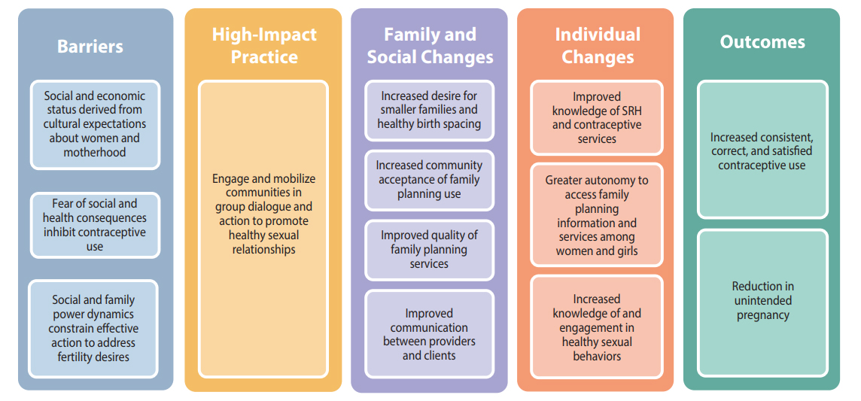
Theory of
Change
BACKGROUND
Notes:
View Figure 1 in the HIP brief (copy and paste this link into your web browser): https://www.fphighimpactpractices.org/briefs/community-group-engagement/

Slide 9
What challenges can this HIP help address?
Women and girls derive social and economic status by conforming to cultural expectations about womanhood and motherhood.
Studies show that CGE can improve both men’s and women’s SRH knowledge.
Notes:
Women and girls derive social and economic status by conforming to cultural expectations about womanhood and motherhood.
Gender norms that idealize sexual ignorance for girls and sexual prowess for boys are found globally.
For women and girls, these norms contribute to early marriage, social isolation, lack of power, limited mobility, and pressures to prove fertility by becoming pregnant early and often, and are reinforced through family and community.
Studies show that CGE can improve both men’s and women’s SRH knowledge.
Limited knowledge and understanding of contraception and reproduction contribute to fear of the potential social and health consequences of using family planning.

Slide 10
What challenges can this HIP help address?
Community group engagement can improve women’s decision-making power.
Community group engagement likely influences change at the community, family, and individual levels by building capacity within the community.
Notes:
Community group engagement can improve women’s decision-making power.
Women’s ability to make and act on decisions is linked to contraceptive use.
Decision-making autonomy and ready access to or control over cash is critical to accessing contraceptive services.
Studies confirm that CGE can promote equitable gender norms and couple decision-making, and reduce acceptance of intimate partner violence.
Community group engagement likely influences change at the community, family, and individual levels by building capacity within the community.
Individuals from communities that worked together to address health problems were over twice as likely to be currently using a modern contraceptive method than individuals from communities that did not work together to address health problems.

Slide 11
Evidence of Impact
Community group engagement is associated with higher levels of contraceptive use.
Community group engagement may be a critical component of comprehensive adolescent SRH programming.
Community group engagement has been implemented in other health areas at scale and cost-effectively.
Notes:
Community group engagement is associated with higher levels of contraceptive use.
Studies using multivariate analysis of this combined approach have been conducted in Benin, Ghana, Nigeria, and Senegal.
All four of these studies reported an increase in modern contraceptive use or a decline in fertility rates after two to three years of program implementation.
Community group engagement may be a critical component of comprehensive adolescent SRH programming.
Community group engagement can facilitate dialogue with influential individuals to identify and clarify values around adolescent marriage and childbearing and to address norms, myths, and misconceptions about adolescent sexuality.
Community group engagement has been implemented in other health areas at scale and cost-effectively.
Evidence for application of CGE in maternal and child health programs, however, demonstrates that this approach can lead to “cost-effective sustained transformation to improve critical health behaviors.”
Community group engagement is a promising practice.
A promising practice has limited evidence, with more information needed to fully document implementation experience and impact. The advisory group recommends that such promising interventions be promoted widely, provided they are implemented within the context of research and are carefully evaluated in terms of both impact and process.

Slide 12
Implementation Tips
Communication for social change should be empowering, horizontal (versus top-down), and biased toward local content and ownership, and it should give a voice to previously unheard community members.
Community group engagement approaches may give marginalized groups a stronger collective voice and agency to affect health and social change for themselves, within their families, and across the larger community.
Notes:
Communication for social change should be empowering, horizontal (versus top-down), and biased toward local content and ownership, and it should give a voice to previously unheard community members.
Community group engagement approaches may give marginalized groups a stronger collective voice and agency to affect health and social change for themselves, within their families, and across the larger community.
Once local stakeholders and community members articulate and explore these dynamics, they are better equipped to develop and carry out contextually relevant strategies that enable social support for changing norms and improving SRH practices.

Slide 13
Implementation Tips
Layer and connect SBC approaches.
Experts believe CGE works best when implementers create linkages and feedback mechanisms between multiple SBC approaches working to achieve the same aim.
SBC health strategies that work at multiple levels and that use multiple channels likely have greater coverage and increase impact.

Slide 14
Thank You
Continue to the extra slides or access the HIP brief for more information.

Slide 15
Extra Slides
Implementation Tips
Priority Research Questions
Tools & Resources
Notes:
We have put together a collection of implementation tips for Community Group Engagement in case you have additional time in your meeting. Further information about these tips can be found in the HIP brief.
References from the literature on this HIP can be found here (copy and paste this link into your web browser): https://www.fphighimpactpractices.org/briefs/community-group-engagement/

Slide 16
Implementation Tips
Communities should be their own change agents.
With increased capacity to identify and address problems that affect them and their community, these groups can tackle other issues as they arise.

Slide 17
Implementation Tips
Emphasis should shift from persuasion and information transmission from outside technical experts to dialogue, debate, and negotiation on issues that resonate with community members.
Communities often benefit from flexibility to identify and implement their own localized responses.
Notes:
Emphasis should shift from persuasion and information transmission from outside technical experts to dialogue, debate, and negotiation on issues that resonate with community members.
Community group engagement facilitates a process through which communities identify root causes to problems and craft approaches to addressing these causes.
Once the goal is clear, communities often benefit from flexibility to identify and implement their own localized responses.
Such flexibility on the part of programs is likely to increase local ownership, capacity, and commitment to achieve and sustain the community’s desired results.

Slide 18
Implementation Tips
Reach young people, especially out-of-school youth.
A 2009 review of adolescent programming for SRH from the World Health Organization concluded that out-of-school SRH education sessions allow for more open, participatory discussions compared with in-school education.

Slide 19
Implementation Tips
Build on existing platforms whenever possible.
Community group engagement interventions should assess the extent to which existing community platforms and groups include active participation of marginalized and/or affected populations.
Using existing social infrastructure—both formal and informal— encourages sustainability and improves the possibility of effective replication and scale-up.

Slide 20
Implementation Tips
Define monitoring and quality assurance mechanisms.
As with other program approaches, implementation monitoring is necessary to ensure effective programming.

Slide 21
Implementation Tips
Ensure political and resource commitment to CGE approaches.
Community group engagement approaches often take ministries of health out of their comfort zone, which may lead them to deprioritize this intervention during scale-up, especially in the context of staff and resource shortages.
High-quality data, as well as human interest stories from a diverse set of stakeholders who have been engaged from the beginning, can help build commitment.

Slide 22
Priority Research Questions
Do CGE interventions influence key family planning outcomes among specific adolescent population groups, such as very young, married, or unmarried adolescents?
How is CGE implemented at scale and what are the associated costs?
What level/dose and coverage of CGE are sufficient to achieve sustained change in social norms and family planning behaviors?

Slide 23
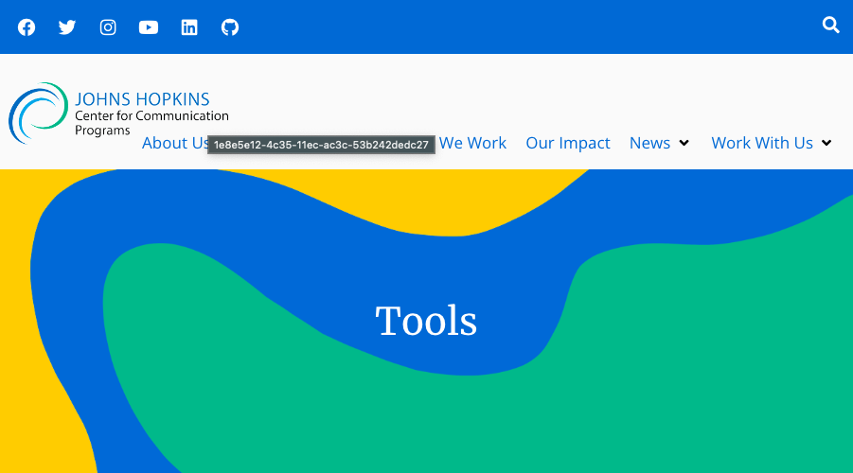
Tools & Resources
How to Mobilize Communities for Health and Social Change
Notes:
How to Mobilize Communities for Health and Social Change provides step-by-step guidance on how to use CGE to influence positive health behaviors. Available from: https://sbccimplementationkits.org/demandrmnch/ikitresources/how-to-mobilize-communities-for-health-and-social-change-2/

Slide 24
fphighimpactpractices.org
Notes:
Subscribe to the HIPs Newsletter here (copy and paste this link into your web browser): https://mailchi.mp/76703a3652c9/hips-newsletter-sign-up
Please visit the five areas of our website to learn more about the HIPs:
HIP Products (copy and paste this link into your web browser): https://www.fphighimpactpractices.org/hip-products/
Resources (copy and paste this link into your web browser): https://www.fphighimpactpractices.org/resources/
Engage (copy and paste this link into your web browser): https://www.fphighimpactpractices.org/engage-with-the-hips/
Overview (copy and paste this link into your web browser): https://www.fphighimpactpractices.org/overview/
About Us (copy and paste this link into your web browser): https://www.fphighimpactpractices.org/partnership-structure/

