Slide 1



Comprehensive Policy Processes
The agreements that outline health goals and the actions to realize them.
Notes:
Policies are often developed without adequate attention to the range of actions necessary to achieve the goals of the policy. When this happens, a policy remains a mere document. The actions necessary for policy success are collectively referred to in this brief as comprehensive policy development, implementation, and monitoring, or more succinctly as a comprehensive policy process.
Photo credit: Images of Empowerment
REVISED: 4/23

Slide 2
Overview
What is a HIP?
HIP Categories
Partnership
Introduction to the High Impact Practices (HIPs)
PART
PART
Background
What challenges can this HIP help address?
Evidence of Impact
Implementation Measurement
Comprehensive Policy Processes
Implementation Tips
Priority Research Questions
Tools & Resources
Extra Slides
Notes:
Thank you for using this slide deck! This is a product derived from the HIP brief to assist you in presenting to a variety of audiences. Instructions and additional resources are included in the notes of each slide for your convenience. There is a wealth of information and resources in the “Notes” section of each slide.
This presentation is divided in three parts: an Introduction to the High Impact Practices (HIPs) in Family Planning, Comprehensive Policy Processes, and Extra Slides.
The logo for your organization or ministry may be added to these slides. The web addresses provided in the “Notes” section of each slide can be copied and pasted into your web browser.

Slide 3



High Impact Practices in Family Planning (HIPs) are…
Evidence-based family planning practices
Vetted by experts against specific criteria
Documented in an easy-to-use format
Notes:
High Impact Practices (HIPs) are a set of evidence-based family planning practices vetted by experts against specific criteria and documented in an easy-to-use format.
The High Impact Practices in Family Planning (HIPs) were first created in 2010 after a survey of FP stakeholders revealed little consensus for “what works” in international FP programming. A small group of leaders in FP were brought together with the task of identifying a short list of HIPs that if implemented at scale would help countries address the unmet need for FP and thereby increase national contraceptive prevalence.
HIPs are identified based on demonstrated magnitude of impact on contraceptive use and potential application in a wide range of settings. Consideration is also given to other relevant outcome measures including unintended pregnancy, fertility, or one of the primary proximate determinants of fertility (delay of marriage, birth spacing, or breast feeding). Evidence of replicability, scalability, sustainability, and cost-effectiveness are also considered.
For more information, please copy and paste this link into your web browser to see this video: https://www.youtube.com/watch?v=N6V0gfl-V3k&ab_channel=KnowledgeSUCCESS
A 2-pager overview of the HIPs is available in an online and a downloadable PDF format here (copy and paste this link into your web browser): https://www.fphighimpactpractices.org/high-impact-practices-in-family-planning-list/

Slide 4
HIPs address the full spectrum of FP programming
Enabling Environment
Service Delivery
Social and Behavioral Change
PART
Address systemic barriers that affect an individual’s ability to access family planning information & services. 8 briefs
Improve the availability, accessibility, acceptability, and quality of family planning services. 8 briefs
Influence knowledge, beliefs, behaviors, and social norms associated with family planning.
7 briefs
Enhancements
Approaches used in conjunction with HIPs to maximize the impact of HIP implementation or increase the reach. 4 briefs
Notes:
There are three categories of HIPs: Enabling Environment, Service Delivery and Social and Behavioral Change. Comprehensive Policy Processes is an Enabling Environment HIP. This information came from the HIP List (copy and paste this link into your web browser): https://www.fphighimpactpractices.org/high-impact-practices-in-family-planning-list/
A HIP Enhancement is a tool or approach that is not a standalone practice, but it is often used in conjunction with HIPs to maximize the impact of HIP implementation or increase the reach and access for specific audiences. The intended purpose and impact of enhancements are focused and, therefore the evidence-based and impact of an enhancement is subjected to different standards than a HIP.
For more information about the HIP Categories and Enhancements, please copy and paste this link into your web browser: https://www.fphighimpactpractices.org/high-impact-practices-in-family-planning-list/
Here are a few examples of HIPs from each category:
Service Delivery:
Immediate Postpartum Family Planning
Mobile Outreach Services
Postabortion Family Planning
Enabling Environment:
Domestic Public Financing
Educating Girls
Supply Chain Management
Social and Behavior Change:
Community Group Engagement
Digital Health for SBC
Mass Media
Enhancements:
Digital Health for Systems
Adolescent-Responsive Contraceptive Services
Family Planning Vouchers
All HIPs are Available in English, Spanish, French, and Portuguese.

Slide 5
HIP Partnership
The Technical Advisory Group (TAG) is made up of 25 experts in family planning, including representatives from the co-sponsors.
The Co-sponsors include the following organizations:
Notes:
The High Impact Practices in Family Planning (HIPs) are supported by over 65 organizations. These organizations play a vital role in developing, reviewing, disseminating, and implementing HIPs in family planning.
The HIPs partnership includes various structures to ensure HIP products are developed, kept up to date, and disseminated widely. These include:
Co-sponsors – Serve as the secretariat for the HIPs.
Partners – Contribute to key HIP products and endorse the HIPs.
Technical Advisory Group – Ensure high technical quality of key HIP products and approve HIP brief and SPG concepts for development.
P&D Team – Support the production and dissemination (P&D) of HIP products.
Technical Expert Groups – Write new HIP briefs and ensure they are up-to-date.
For more information about the HIP Partnership, please copy and paste this link into your web browser: https://www.fphighimpactpractices.org/partnership-structure/

Slide 6
High Impact Practice
Comprehensively develop, implement, and monitor policies to support high-quality family planning at scale.
Notes:
Policies are often developed without adequate attention to the range of actions necessary to achieve the goals of the policy. When this happens, a policy remains a mere document. The actions necessary for policy success are collectively referred to in this brief as comprehensive policy development, implementation, and monitoring, or more succinctly as a comprehensive policy process.

Slide 7
Background
The development, implementation, and monitoring of policies supportive of rights-based family planning is essential in creating an enabling environment for and guiding the provision of high-quality family planning programs and services.
For instance, national family planning programs are often enshrined in reproductive health policies that codify reproductive health as a right, establish goals and objectives, and outline what systems should be developed and what programs and services should be implemented to meet those goals and objectives.
Notes:
The development, implementation, and monitoring of policies supportive of rights-based family planning is essential in creating an enabling environment for and guiding the provision of high-quality family planning programs and services.
For instance, national family planning programs are often enshrined in reproductive health policies that codify reproductive health as a right, establish goals and objectives, and outline what systems should be developed and what programs and services should be implemented to meet those goals and objectives.
The application of a comprehensive policy process usually falls along a spectrum between “inadequate” and “strong,” with some stages and actions well addressed and others not, or partially so.
For more information, please copy and paste this link into your web browser to reference the “Background” section on the HIP brief: https://www.fphighimpactpractices.org/briefs/policy/

Slide 8
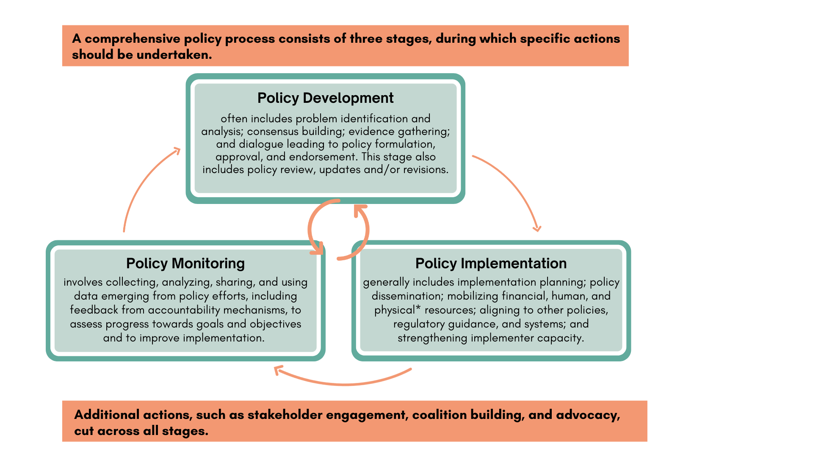
Comprehensive Policy Process
Notes:
Comprehensive policy development, implementation, and monitoring involves attention to all three policy stages and the specific actions of each stage. The visual representation of this practice (Figure 1) draws from several policy implementation frameworks.
While depicted as a cycle, it is often an iterative process, with multiple stages and actions happening at once. For instance, planning for policy monitoring should begin when the policy is still in development.
The application of a comprehensive policy process usually falls along a spectrum between “inadequate” and “strong,” with some stages and actions well addressed and others not, or partially so.
For instance, conclusions from a study on the scale-up of a youth-friendly service delivery model in Ethiopia were that “despite a conducive policy environment, supportive stakeholders, favorable environment, and financial support for trainings, statistically significant increases in long-acting reversible contraceptive uptake occurred at only 2 of the 8 health centers.” This limited success was attributed primarily to lack of broader financial resources and operational barriers within the health system.
View Figure 1 in the HIP brief (copy and paste this link into your web browser): https://www.fphighimpactpractices.org/briefs/policy/

Slide 9
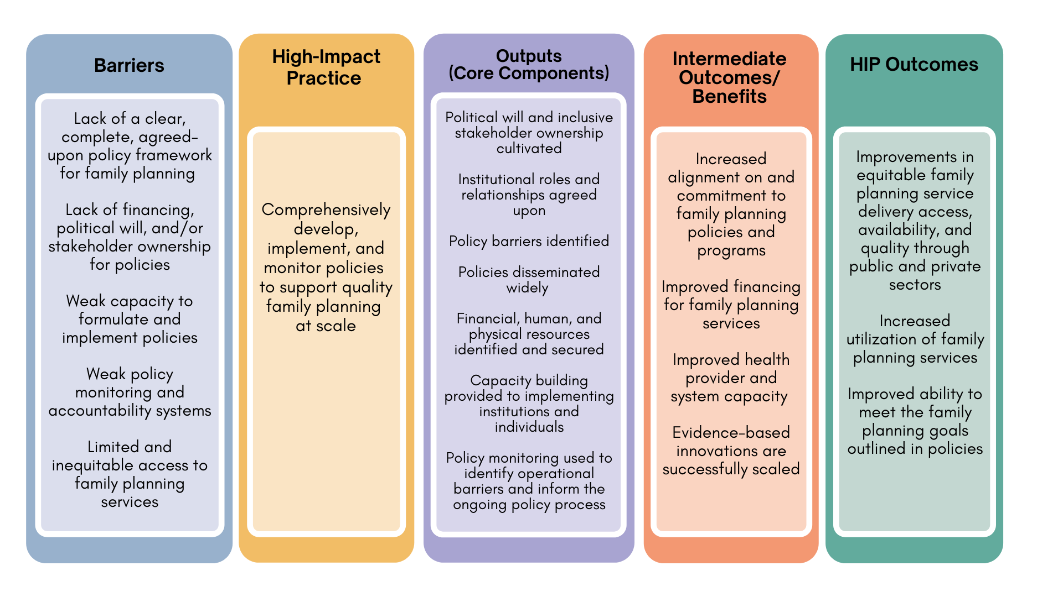
Theory of
Change
BACKGROUND
Notes:
View Figure 2 in the HIP brief (copy and paste this link into your web browser): https://www.fphighimpactpractices.org/briefs/policy/

Slide 10
What challenges can this HIP help address?
Inattention to human rights and inequitable access to care can be addressed through comprehensive policy processes.
Policy efforts that lack attention to the full range of actions within a comprehensive policy process are less likely to result in improvements in family planning outcomes.
Evolving evidence and changing contexts can leave programs and services out-of-date.
Despite ample evidence, proven best practices are not consistently scaled and sustained.
Notes:
Inattention to human rights and inequitable access to care can be addressed through comprehensive policy processes.
Policies play an important role in ensuring equitable access and a rights-based approach to voluntary family planning for all people, especially those that have been historically underserved.
Rights-based policies, when effectively implemented, support the obligations that governments make when ratifying international human rights treaties and articulate political commitment to ensuring rights and equity.
Policy efforts that lack attention to the full range of actions within a comprehensive policy process are less likely to result in improvements in family planning outcomes.
For example, a qualitative review of obstacles to advance women’s health in Mozambique found that “participants unanimously argued that women’s health is already sufficiently prioritized in national health policies and strategies (…); the problem, rather, is the implementation and execution of existing (…) policies and programs.”
Evolving evidence and changing contexts can leave programs and services out-of-date.
Use of a comprehensive policy process, including regular policy review and updates, can support safe, efficient, and quality services as new evidence, practices, and contraceptive methods emerge.
Despite ample evidence, proven best practices are not consistently scaled and sustained.
Several studies describing the scale-up of new practices have highlighted the importance of comprehensive policy development, implementation, and monitoring.

Slide 11
Evidence of Impact:
Guinea
  Guinea has included postabortion care (PAC) (a proven HIP) within several policies and guidelines since it was piloted in 1998.
    A study with data collected in 2014 assessed provision of contraception as part of PAC services and found that more than 95% of PAC clients were counseled on family planning and 73% of clients voluntarily left the facility with a method.
Notes:
Guinea has included postabortion care (PAC) (a proven HIP) within several policies and guidelines since it was piloted in 1998.
A study with data collected in 2014 assessed provision of contraception as part of PAC services and found that more than 95% of PAC clients were counseled on family planning and 73% of clients voluntarily left the facility with a method.
Based on stakeholder interviews, the study authors attribute these high rates of coverage and uptake to the comprehensive inclusion of the practice within national policies, standards, guidelines, and other tools; engagement of champions within and beyond the Ministry of Health to advocate for PAC and the financial resources to support PAC implementation; and roll-out of provider training on clinical PAC guidelines and standards.

Slide 12
Evidence of Impact:
Guinea (cont.)
  Study authors attribute these high rates of coverage and uptake to the comprehensive inclusion of the practice within national policies, standards, guidelines, and other tools; engagement of champions within and beyond the Ministry of Health to advocate for PAC and the financial resources to support PAC implementation; and roll-out of provider training on clinical PAC guidelines and standards.
Notes:
Guinea has included postabortion care (PAC) (a proven HIP) within several policies and guidelines since it was piloted in 1998.
A study with data collected in 2014 assessed provision of contraception as part of PAC services and found that more than 95% of PAC clients were counseled on family planning and 73% of clients voluntarily left the facility with a method.
Based on stakeholder interviews, the study authors attribute these high rates of coverage and uptake to the comprehensive inclusion of the practice within national policies, standards, guidelines, and other tools; engagement of champions within and beyond the Ministry of Health to advocate for PAC and the financial resources to support PAC implementation; and roll-out of provider training on clinical PAC guidelines and standards.

Slide 13

Implementation Measurement
Extent to which policies are up-to-date and harmonized across the health system, e.g., in training curricula, supervision tools, supply and logistics management systems, monitoring systems, and budgets.
Annual budget expenditures to support policy implementation.
Percentage/number of facilities or implementation sites that have the financial, human, and physical resources available to implement the policy.

Slide 14
Thank You
Continue to the extra slides or access the HIP brief for more information.

Slide 15
Extra Slides
Implementation Tips
Priority Research Questions
Tools & Resources
Notes:
We have put together a collection of implementation tips for Comprehensive Policy Processes, in case you have additional time in your meeting. Further information about these tips can be found in the HIP brief.
References from the literature on this HIP can be found here (copy and paste this link into your web browser): https://www.fphighimpactpractices.org/briefs/policy/

Slide 16

Implementation Tips
Across all stages of a comprehensive policy process:
Create inclusive dialogues that address concerns and prevent resistance.
Build and sustain active coalitions to support the policy process.
Establish political will and commitment.
Notes:
Across all stages of a comprehensive policy process:
Create inclusive dialogues that address concerns and prevent resistance.
Resistance to a policy can be a barrier to the success of the policy.
Build and sustain active coalitions to support the policy process.
Collaborative partnerships that build on the relative strengths of a range of stakeholders can facilitate policy implementation.
Establish political will and commitment.
Ownership of a policy has been cited as a key determinant of policy outcomes.
Identifying and asking champions to lead aspects of the comprehensive policy process can help build ownership and commitment. See also the HIP brief on Galvanizing Political Commitment. (https://www.fphighimpactpractices.org/briefs/galvanizing-commitment/)
For more information about Comprehensive Policy Processes, please copy and paste this link into your web browser to visit the HIP Brief: https://www.fphighimpactpractices.org/briefs/policy/

Slide 17
Implementation Tips
During policy development:
Consider the policy environment and how it may be continually evolving.
Design policies with implementation and monitoring in mind.
Plan for both regular updates and unanticipated changes to the policy.
Notes:
During policy development:
Consider the policy environment and how it may be continually evolving.
When engaging in a policy change process, advocates should learn how policy decisions are made, what approvals will be needed, and what the timeline might be.
Design policies with implementation and monitoring in mind.
Policies should address the root causes of agreed-upon problems; be realistic in relation to available resources; and be explicit about roles and expectations.
If a new practice or program is included in the policy, it should be evidence-based, feasible at scale, and tailored to the context. See also the HIP Strategic Planning Guide on Creating Equitable Access to High-Quality Family Planning (https://www.fphighimpactpractices.org/guides/creating-equitable-access-to-high-quality-family-planning-information-and-services/).
Plan for both regular updates and unanticipated changes to the policy.
A comprehensive policy process includes a timeline and plan to regularly review the policy against monitoring data and emerging evidence and changing context, as well as to make updates as needed.
For more information about Comprehensive Policy Processes, please copy and paste this link into your web browser to visit the HIP Brief: https://www.fphighimpactpractices.org/briefs/policy/

Slide 18
Implementation Tips
During policy implementation:
Consider the extent to which policy implementation should be centralized.
Harmonize policies and systems across levels and domains.
Reflect resource needs and realities and develop strategies to act on them.
Disseminate policies widely, through all levels of the health system and to stakeholders.
Notes:
During policy implementation:
Consider the extent to which policy implementation should be centralized.
Policies that are implemented in a top-down manner are often specific directives, while bottom-up policy approaches are often more complex and expansive, such as primary health care policies.
The amount of ambiguity in the policy and level of contention elicited by the policy, as well as the extent to which decision-making powers have been devolved to subnational units, should be considered in determining whether policy implementation should be top-down and/or bottom-up.
Harmonize policies and systems across levels and domains.
As a policy is being developed and monitored, mapping of other relevant policies, systems, and tools should be done to determine if the policy is in alignment and if not, where changes will need to be made.
Reflect resource needs and realities and develop strategies to act on them.
The lack of financial resources is a common reason why policies are not implemented or do not meet their goals.
A costing exercise should be done during the policy development stage, and reviewed during implementation and monitoring, to confirm that policies have realistic budget estimates.
Disseminate policies widely, through all levels of the health system and to stakeholders.
Frontline implementers must be aware of policies, have access to them in the appropriate language(s), and have support to follow them.
In addition, policy information disseminated to the media and civil society organizations can create awareness at the community level, which is essential to social accountability for policy implementation.
For more information about Comprehensive Policy Processes, please copy and paste this link into your web browser to visit the HIP Brief: https://www.fphighimpactpractices.org/briefs/policy/

Slide 19
Implementation Tips
During policy monitoring:
Strengthen monitoring and evaluation of the policy and its implementation.
Strengthen accountability mechanisms.
Notes:
During policy monitoring:
Strengthen monitoring and evaluation of the policy and its implementation.
Policy monitoring should assess implementation milestones across the health systems and scan for operational barriers and areas in which policy implementation may be stalled. A list of illustrative indicators for assessing policy efforts to support family planning programs can be found in the 2013 HIP Policy Brief (https://www.fphighimpactpractices.org/previous-brief-versions).
Strengthen accountability mechanisms.
Accountability mechanisms support transparent communication between community members and health system actors, including policy makers. More information can be found in the 2013 HIP Policy Brief (https://www.fphighimpactpractices.org/previous-brief-versions).
For more information about Comprehensive Policy Processes, please copy and paste this link into your web browser to visit the HIP Brief: https://www.fphighimpactpractices.org/briefs/policy/

Slide 20
Priority Research Questions
What is the relative importance of specific aspects or actions within a comprehensive policy process for achieving family planning related goals and meeting users’ needs?
Can utilization of a comprehensive policy process from the earliest stages of policy creation accelerate the timeline for achieving the goals outlined in the policy?
How can comprehensively developing, implementing, and monitoring policies be used to increase equity in terms of access to services by diverse populations?
Notes:
These research questions, reviewed by the HIP technical advisory group, reflect the prioritized gaps in the evidence base specific to the topics reviewed in this brief and focus on the HIP criteria.

Slide 21


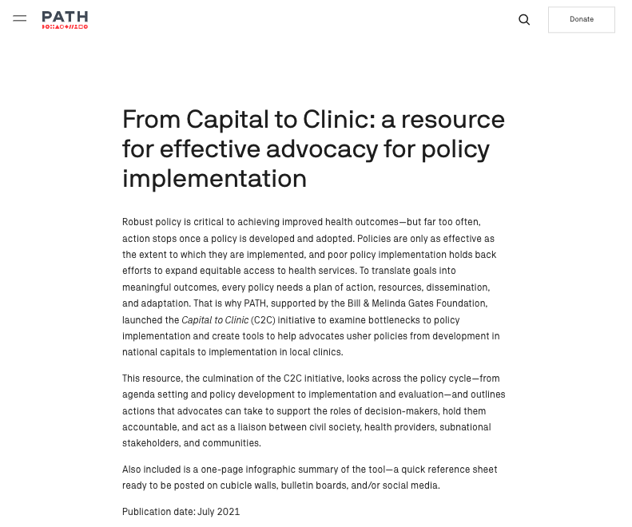

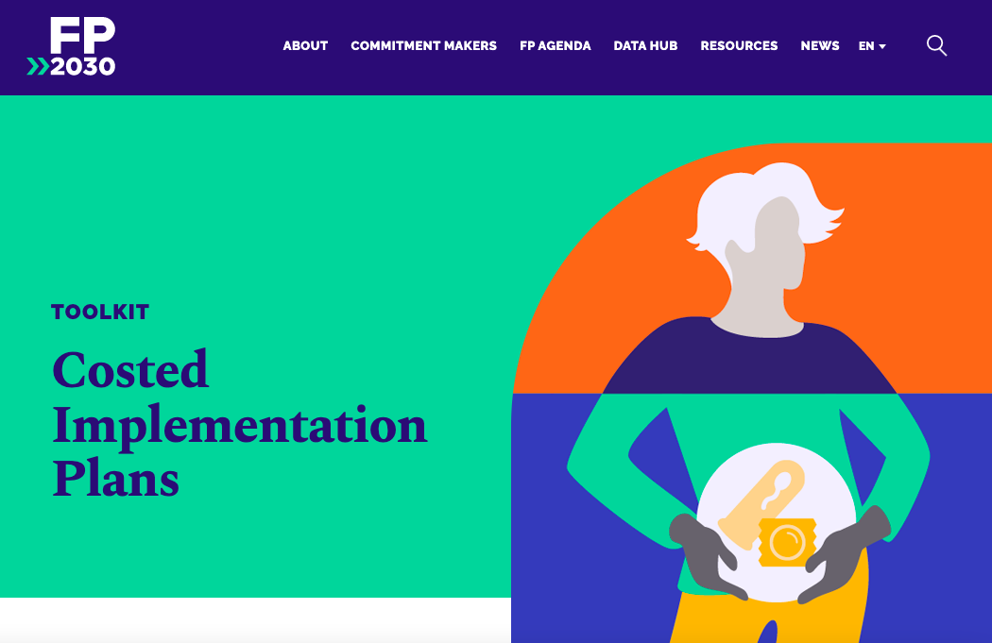
Tools & Resources
Sexual and Reproductive Health and Rights Policy Portal
From Capital to Clinic: A Resource for Effective Advocacy for Policy Implementation
Taking the Pulse of Policy: The Policy Implementation Assessment Tool
The Costed Implementation Plan Resource Kit
Notes:
Sexual and Reproductive Health and Rights Policy Portal. Available from: https://platform.who.int/data/sexual-and-reproductive-health-and-rights
From Capital to Clinic: A Resource for Effective Advocacy for Policy Implementation. Available from: https://www.path.org/resources/capital-clinic-resource-effective-advocacy-policy-implementation/
Taking the Pulse of Policy: The Policy Implementation Assessment Tool. Available from: http://www.healthpolicyplus.com/archive/browsehpi.cfm?get=1565
The Costed Implementation Plan Resource Kit: Tools and Guidance to Develop and Execute Multi-Year Family Planning Plans. Available from: https://fp2030.org/cip

Slide 22
fphighimpactpractices.org
Notes:
Subscribe to the HIPs Newsletter here (copy and paste this link into your web browser): https://mailchi.mp/76703a3652c9/hips-newsletter-sign-up
Please visit the five areas of our website to learn more about the HIPs:
HIP Products (copy and paste this link into your web browser): https://www.fphighimpactpractices.org/hip-products/
Resources (copy and paste this link into your web browser): https://www.fphighimpactpractices.org/resources/
Engage (copy and paste this link into your web browser): https://www.fphighimpactpractices.org/engage-with-the-hips/
Overview (copy and paste this link into your web browser): https://www.fphighimpactpractices.org/overview/
About Us (copy and paste this link into your web browser): https://www.fphighimpactpractices.org/partnership-structure/

