Slide 1
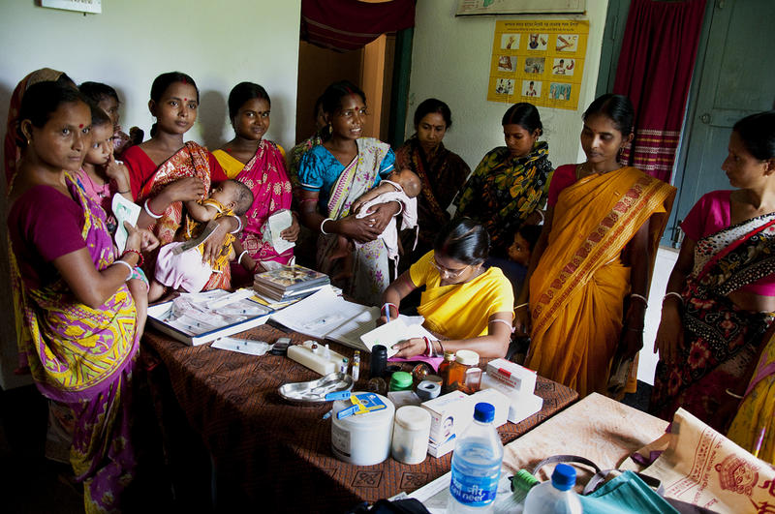
Family Planning and Immunization Integration
Reaching postpartum women with family planning services.
Notes:
This HIP Brief focuses on integration of family planning with immunization during the extended postpartum period, which is the one-year period after delivery. Additional opportunities beyond this can be identified in vaccination schedules for the second year of life and beyond.
Photo credit: Sandipan Majumdar, Courtesy of Photoshare
REVISED: 4/23

Slide 2
Overview
What is a HIP?
HIP Categories
Partnership
Introduction to the High Impact Practices (HIPs)
PART
PART
Background
Theory of Change
Why is this practice important?
What is the Impact?
Recommended Indicators
Family Planning and Immunization Integration
Implementation Tips
Priority Research Questions
Tools & Resources
Extra Slides
Notes:
Thank you for using this slide deck! This is a product derived from the HIP brief to assist you in presenting to a variety of audiences. Instructions and additional resources are included in the notes of each slide for your convenience. There is a wealth of information and resources in the “Notes” section of each slide.
This presentation is divided in three parts: an Introduction to the High Impact Practices (HIPs) in Family Planning, Family Planning and Immunization Integration, and Extra Slides.
The logo for your organization or ministry may be added to these slides. The web addresses provided in the “Notes” section of each slide can be copied and pasted into your web browser.

Slide 3
High Impact Practices in Family Planning (HIPs) are…
Evidence-based family planning practices
Vetted by experts against specific criteria
Documented in an easy-to-use format
Notes:
High Impact Practices (HIPs) are a set of evidence-based family planning practices vetted by experts against specific criteria and documented in an easy-to-use format.
The High Impact Practices in Family Planning (HIPs) were first created in 2010 after a survey of FP stakeholders revealed little consensus for “what works” in international FP programming. A small group of leaders in FP were brought together with the task of identifying a short list of HIPs that if implemented at scale would help countries address the unmet need for FP and thereby increase national contraceptive prevalence.
HIPs are identified based on demonstrated magnitude of impact on contraceptive use and potential application in a wide range of settings. Consideration is also given to other relevant outcome measures including unintended pregnancy, fertility, or one of the primary proximate determinants of fertility (delay of marriage, birth spacing, or breast feeding). Evidence of replicability, scalability, sustainability, and cost-effectiveness are also considered.
For more information, please copy and paste this link into your web browser to see this video: https://www.youtube.com/watch?v=N6V0gfl-V3k&ab_channel=KnowledgeSUCCESS
A 2-pager overview of the HIPs is available in an online and a downloadable PDF format here (copy and paste this link into your web browser): https://www.fphighimpactpractices.org/high-impact-practices-in-family-planning-list/

Slide 4
HIPs address the full spectrum of FP programming
Enabling Environment
Service Delivery
Social and Behavioral Change
PART
Address systemic barriers that affect an individual’s ability to access family planning information & services. 8 briefs
Improve the availability, accessibility, acceptability, and quality of family planning services. 8 briefs
Influence knowledge, beliefs, behaviors, and social norms associated with family planning.
7 briefs
Enhancements
Approaches used in conjunction with HIPs to maximize the impact of HIP implementation or increase the reach. 4 briefs
Notes:
There are three categories of HIPs: Enabling Environment, Service Delivery and Social and Behavioral Change. Family Planning and Immunization Integration is a Service Delivery HIP. This information came from the HIP List (copy and paste this link into your web browser): https://www.fphighimpactpractices.org/high-impact-practices-in-family-planning-list/
A HIP Enhancement is a tool or approach that is not a standalone practice, but it is often used in conjunction with HIPs to maximize the impact of HIP implementation or increase the reach and access for specific audiences. The intended purpose and impact of enhancements are focused and, therefore the evidence-based and impact of an enhancement is subjected to different standards than a HIP.
For more information about the HIP Categories and Enhancements, please copy and paste this link into your web browser: https://www.fphighimpactpractices.org/high-impact-practices-in-family-planning-list/
Here are a few examples of HIPs from each category:
Service Delivery:
Immediate Postpartum Family Planning
Mobile Outreach Services
Postabortion Family Planning
Enabling Environment:
Domestic Public Financing
Educating Girls
Supply Chain Management
Social and Behavior Change:
Community Group Engagement
Digital Health for SBC
Mass Media
Enhancements:
Digital Health for Systems
Adolescent-Responsive Contraceptive Services
Family Planning Vouchers
All HIPs are Available in English, Spanish, French, and Portuguese.

Slide 5
HIP Partnership
The Technical Advisory Group (TAG) is made up of 25 experts in family planning, including representatives from the co-sponsors.
The Co-sponsors include the following organizations:
Notes:
The High Impact Practices in Family Planning (HIPs) are supported by over 65 organizations. These organizations play a vital role in developing, reviewing, disseminating, and implementing HIPs in family planning.
The HIPs partnership includes various structures to ensure HIP products are developed, kept up to date, and disseminated widely. These include:
Co-sponsors – Serve as the secretariat for the HIPs.
Partners – Contribute to key HIP products and endorse the HIPs.
Technical Advisory Group – Ensure high technical quality of key HIP products and approve HIP brief and SPG concepts for development.
P&D Team – Support the production and dissemination (P&D) of HIP products.
Technical Expert Groups – Write new HIP briefs and ensure they are up-to-date.
For more information about the HIP Partnership, please copy and paste this link into your web browser: https://www.fphighimpactpractices.org/partnership-structure/

Slide 6
High Impact Practice
Offer family planning information and services proactively to women in the extended postpartum period during routine child immunization contacts. The extended postpartum period is defined as the 12 months following a birth.
Notes:
This HIP Brief focuses on integration of family planning with immunization during the extended postpartum period, which is the one-year period after delivery. Additional opportunities beyond this can be identified in vaccination schedules for the second year of life and beyond.
For more information about Service Delivery HIPs, please copy and paste this link into your web browser to visit this matrix of tools developed by IBP/WHO: https://www.fphighimpactpractices.org/ibp-who-matrix/
These tools can be used in conjunction with Service Delivery HIPs.
Available in online and downloadable PDF format.
Did you know that we have a webinar recording and downloadable PDF presentation about this HIP? Please copy and paste this link into your web browser to visit: https://www.fphighimpactpractices.org/family-planning-and-immunization-integration-reaching-postpartum-women-with-fp-services-webinar/
This webinar contains recent implementation successes in several country contexts.
Presenters include:
Kathryn Mimno, FP & Immunization Integration Working Group (moderator)
Shawn Malarcher, USAID
Nyapu D. Taylor, Jhpiego, Liberia
Riaz Mobaracaly, Pathfinder International, Mozambique
Rebecca Fields, JSI

Slide 7
Background
Improving uptake of postpartum family planning (PPFP) can enhance the health of women, infants, and children.
Closely spaced births (less than 18 to 24 months apart) are associated with increased maternal, newborn, and child morbidity and mortality including preterm birth, low birth weight, and increased neonatal and under age 5 death.
Notes:
Despite the significant benefits of the use of voluntary family planning to save lives and improve health outcomes, a large proportion of women in the extended postpartum period may not access contraception as suggested by the fact that birth-to-pregnancy intervals in 50% or more of pregnancies in many low- and middle-income countries are too short (less than 23 months).² Given this, it is crucial to take advantage of every health care contact with pregnant and postpartum women to offer family planning information, counseling, and services.
Promising “high-impact practices” (HIPs): http://www.fphighimpactpractices.org/hip-development/
For more information, please copy and paste this link into your web browser to reference the “Background” section on the HIP brief: https://www.fphighimpactpractices.org/briefs/family-planning-and-immunization-integration/

Slide 8
Background
There are multiple touch points through the repeated visits needed to follow the recommended vaccination schedule during the first year of an infant’s life.
Integration offers benefits such as mitigating constraints related to transportation costs and time while also reducing the burden on the overall health system and, potentially, on individual workloads.
Notes:
For more information, please copy and paste this link into your web browser to reference the “Background” section on the HIP brief: https://www.fphighimpactpractices.org/briefs/family-planning-and-immunization-integration/

Slide 9
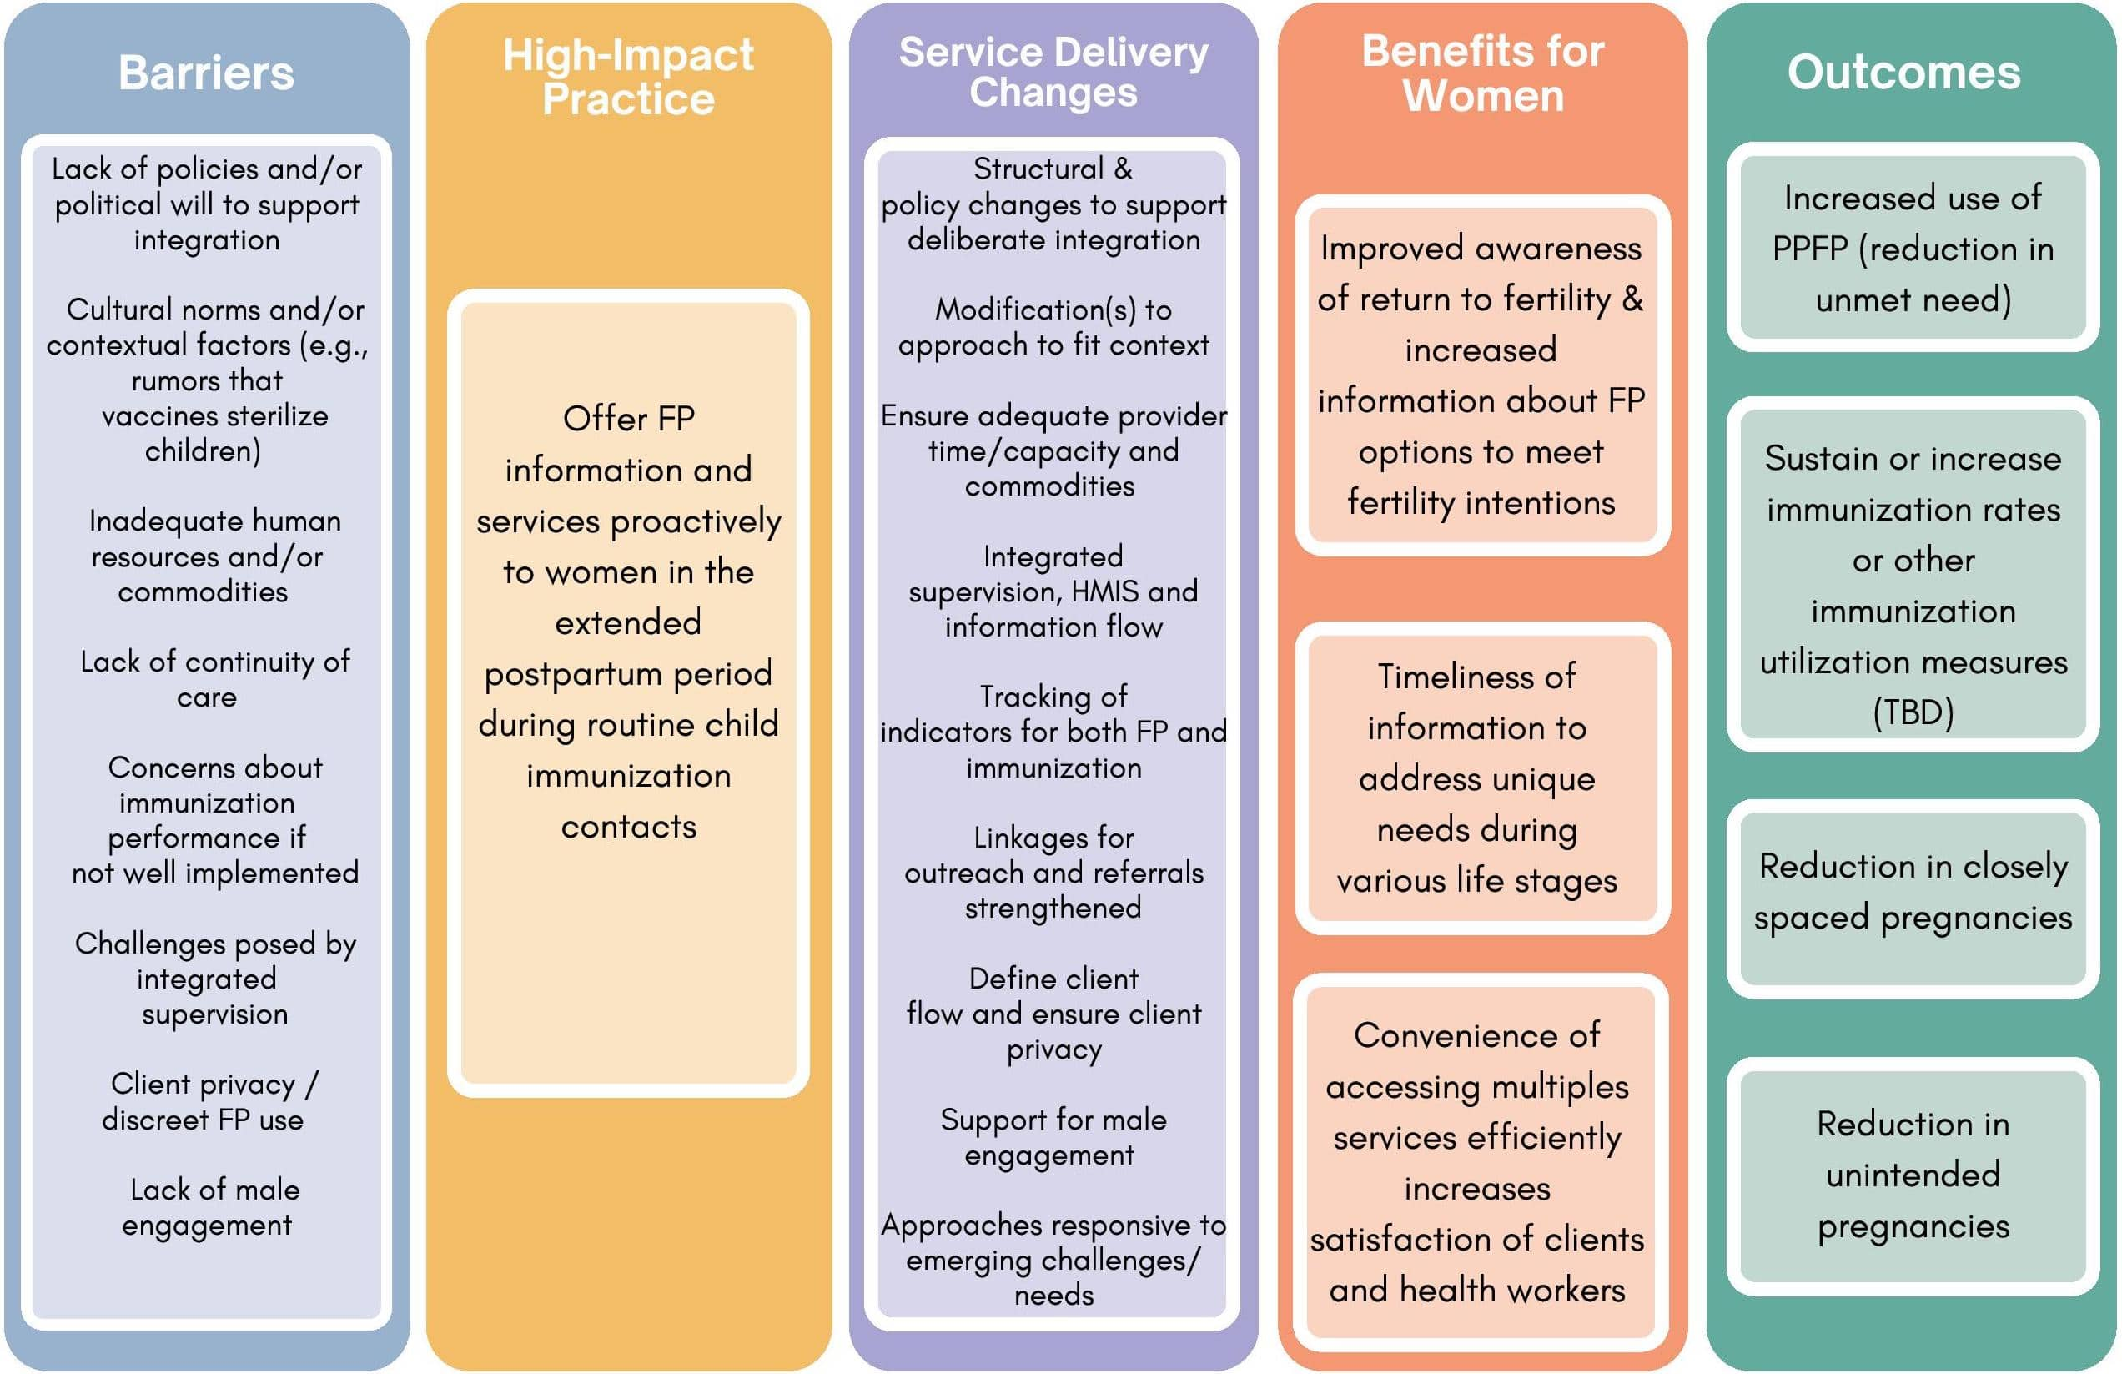
Theory of
Change
BACKGROUND
Notes:
View Figure 1 in the HIP brief (copy and paste this link into your web browser): https://www.fphighimpactpractices.org/briefs/family-planning-and-immunization-integration/

Slide 10
Why is this practice important?
The broad reach and high use of immunization services reflects an ideal opportunity to reach large numbers of postpartum women with family planning.
Child immunization services involve multiple timely contacts with mothers during the first year postpartum.
Evidence suggests that an integrated model is largely acceptable to clients and service providers without having a negative impact on immunization uptake.
Notes:
The broad reach and high use of immunization services reflects an ideal opportunity to reach large numbers of postpartum women with family planning.
Immunization services are a cornerstone of the primary health care system, reaching more people than any other health service globally.
Child immunization services involve multiple timely contacts with mothers during the first year postpartum.
The WHO recommended schedule for the first year of life includes vaccinations at birth, 6 weeks, 10 weeks, 14 weeks, and 9 months, providing opportunity through multiple contacts with the mother to offer family planning.
Evidence suggests that an integrated model is largely acceptable to clients and service providers without having a negative impact on immunization uptake.
A study in Malawi found substantial perceived benefits associated with family planning and immunization integration among providers and clients, including time-savings for both groups, and perceptions of improved health among women and young children.
Most clients reported that an integrated approach allowed them to access the two services in one day at the same place, unlike in the past.

Slide 11
What is the impact?
There are three service delivery models that have proven successful in integrated family planning with routine immunization services:
Combined service provision
Combined service provision plus referral
Single service provision plus referral
Notes:
Combined service provision
This model entails the availability of co-located, same-day family planning services during routine immunization visits.
This approach may involve group talks, individualized screening, or brief motivational messages given with the immunization service that link the two services.
Combined service provision plus referral
This model entails the availability of co-located, same-day or follow-up family planning services for methods available at the site during routine immunization visits plus the provision of offsite referrals for methods not available at the facility.
In this model the service provision may also happen in the community (outside of health facilities), helping to address access barriers by bringing services closer to clients.
Single service provision plus referral
This model, which involves offsite referrals or referrals requiring a follow-up visit at the same location, may be most appropriate where co-located, same-day services are not feasible.
For more information on the service delivery models, view Figure 3 in the HIP brief (copy and paste this link into your web browser): https://www.fphighimpactpractices.org/briefs/family-planning-and-immunization-integration/

Slide 12
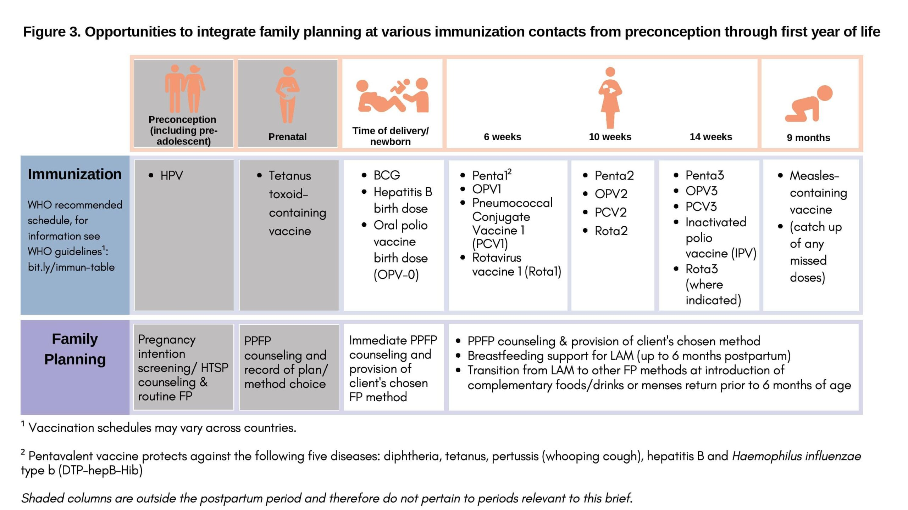
Opportunities to integrate family planning at various immunization contacts from preconception through the
first year of life
Notes:
Figure 3 highlights some opportunities to integrate family planning and immunization at various contacts.
View Figure 3 in the HIP brief (copy and paste this link into your web browser): https://www.fphighimpactpractices.org/briefs/family-planning-and-immunization-integration/

Slide 13
What is the impact?
Rwanda: Intervention included family planning group education to women attending immunization services, a family planning brochure, individual family planning screening by an immunization provider or another provider while the child was being immunized, and referral to co-located family planning services. The program provided home-based family planning counseling to married women. This led to:
Increase in family planning uptake and modern contraceptive use.
No negative impact on uptake or utilization of immunization services.
Notes:
Family Planning and Immunization Integration HIP brief contains highlights from intervention studies in Egypt, Liberia, Malawi, Nepal, Rwanda, Togo, Ghana, and Zambia. For more information, please copy and paste this link into your web browser: https://www.fphighimpactpractices.org/briefs/family-planning-and-immunization-integration/
Family Planning and Immunization Integration is a promising practice.
A promising practice has limited evidence, with more information needed to fully document implementation experience and impact. The advisory group recommends that such promising interventions be promoted widely, provided they are implemented within the context of research and are carefully evaluated in terms of both impact and process.

Slide 14
Recommended Indicators
Number/percent of service delivery points that integrate family planning services during immunization visits disaggregated by health facility or outreach service delivery point.
Number/percent of women attending routine immunization services who follow through on a family planning referral from a vaccinator.
Notes:
Number/percent of service delivery points that integrate family planning services during immunization visits disaggregated by health facility or outreach service delivery point. (Family planning services should include provision of contraceptive services and methods that goes beyond merely providing family planning information).
Number/percent of women attending routine immunization services who follow through on a family planning referral from a vaccinator.

Slide 15
Thank You
Continue to the extra slides or access the HIP brief for more information.
Notes:
For more information, please copy and paste this link into your web browser to visit this webpage with a recording of the webinar on Family Planning and Immunization Integration and a downloadable PDF version of the presentation: https://www.fphighimpactpractices.org/briefs/family-planning-and-immunization-integration/

Slide 16
Extra Slides
Implementation Tips
Priority Research Questions
Tools & Resources
Notes:
We have put together a collection of implementation tips for Family Planning and Immunization Integration, in case you have additional time in your meeting. Further information about these tips can be found in the HIP brief.
References from the literature on this HIP can be found here (copy and paste this link into your web browser): https://www.fphighimpactpractices.org/briefs/family-planning-and-immunization-integration/

Slide 17
Implementation Tips
Program Design
Conductive formative research prior to designing the integrated approach.
Design integrated services with systems in mind.
Design integrated services to avoid negatively affecting immunization.
Notes:
Program Design
Conductive formative research prior to designing the integrated approach.
This is critical to ensure a service delivery model that addresses contextual factors (e.g., gender norms and beliefs around postpartum abstinence, PPFP, privacy, and client preferences).
It is also key to designing effective communication tools to enhance service quality.
Design integrated services with systems in mind.
Design integrated services to avoid negatively affecting immunization.
Integration of immunization into family planning services can benefit immunization programs by providing additional opportunities to reach zero-dose and under-immunized infants, children, and communities.

Slide 18
Implementation Tips
Program Design (cont.)
Consider additional integration of family planning and immunization services with other health services to holistically address client needs.
Notes:
Program Design (cont.)
Consider additional integration of family planning and immunization services with other health services to holistically address client needs.
Integrating in immunization visits may be even more effective at encouraging PPFP use by 12 months postpartum if PPFP is discussed during pregnancy and/or at the time of birth. Thus, it is important to consider implementing family planning and immunization integration concurrently with immediate PPFP when possible.

Slide 19
Implementation Tips
Program Implementation
Do not integrate family planning services into mass vaccination campaigns.
Keep family planning messages simple and reinforce provider communication skills via training, job aids, and on-site mentoring for vaccinators.
Consider systematic screening.
Notes:
Program Implementation
Do not integrate family planning services into mass vaccination campaigns.
These campaigns often occur episodically, are often chaotic in nature, are highly donor-dependent, and typically disease-specific.
Family planning provision requires ongoing services, including counseling to address side effects, method switching (if desired), resupply of methods, and other follow-up.
Keep family planning messages simple and reinforce provider communication skills via training, job aids, and on-site mentoring for vaccinators.
To gain the skills and confidence to provide family planning information or conduct screening or referrals, vaccinators should receive training, on-site coaching, and user-friendly job tools and job aids.
Consider systematic screening.
Systematic screening is an evidence-based approach to comprehensively assess clients’ needs in a single visit using a standardized checklist.
Evidence indicates that systematic screening helps to increase family planning uptake when used at facilities and communities.

Slide 20
Implementation Tips
Program Implementation (cont.)
Establish straightforward referral systems that facilitate client access to family planning services.
Assess the acceptability of integrated services in open air or outreach sites.
Ensure a clearly defined client flow to provide both services within a specified window of time during outreach services.
Ensure outreach service are well staffed.
Notes:
Program Implementation (cont.)
Establish straightforward referral systems that facilitate client access to family planning services.
Same-day referrals may increase convenience for some clients, but others may prefer to return on a different day out of privacy concerns or because they want to discuss family planning with their partner.
When offering same-day services, encourage providers to confirm that mothers receive both family planning and immunization through simple measures such as jointly comparing registers for specific periods on a regular basis.
Assess the acceptability of integrated services in open air or outreach sites.
In some contexts, integrated service in the open may not be acceptable due to community norms and privacy concerns.
Ensure a clearly defined client flow to provide both services within a specified window of time during outreach services.
Ensure outreach service are well staffed.
Increase the number of providers on anticipated busy days such as market days to avoid having long wait times.

Slide 21
Implementation Tips
Program monitoring, evaluation, and adaptation
Tailor integrated services to address client needs using an iterative, data-based, team-driven process.
Monitor integration’s impact on both family planning and immunization services and outcomes.
Notes:
Program monitoring, evaluation, and adaptation
Tailor integrated services to address client needs using an iterative, data-based, team-driven process.
Tailoring services requires a dynamic, data-driven, team-based process that should be centered on information/data gathered from various sources including routine monitoring and evaluation, supportive supervision, input from clients, community leaders, and staff from different departments and cadres.
Monitor integration’s impact on both family planning and immunization services and outcomes.
Ongoing monitoring and supportive supervision can uncover additional constraints to integration of services.

Slide 22
Priority Research Questions
What are feasible and validated indicators to routinely monitor the integration of family planning and immunization without creating extra workload for health care providers and other staff?
Does integration lead to cost savings or other efficiencies in terms of organization of care or deployment of staff resources in various settings?
Notes:
These research questions, reviewed by the HIP technical advisory group, reflect the prioritized gaps in the evidence base specific to the topics reviewed in this brief and focus on the HIP criteria.

Slide 23
Priority Research Questions
What are some key considerations to make family planning and immunization integrated services responsive to adolescent needs (e.g., to address the specific needs of adolescents and youth who are first-time parents)?
What integration models are more effective in different contexts? How is the success or failure of integrated service delivery affected by contextual factors within the service setting and community?
Notes:
These research questions, reviewed by the HIP technical advisory group, reflect the prioritized gaps in the evidence base specific to the topics reviewed in this brief and focus on the HIP criteria.

Slide 24
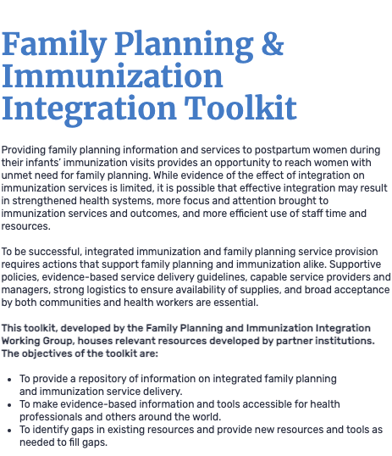
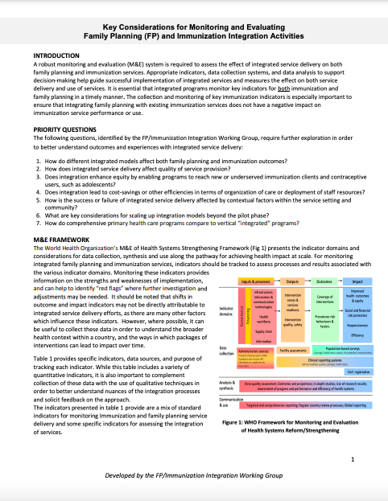
Tools & Resources
Key Considerations for Monitoring and Evaluating Family Planning and Immunization Integration Activities
Family Planning and Immunization Integration Toolkit
Notes:
Family Planning and Immunization Integration Toolkit. Available from: https://toolkits.knowledgesuccess.org/toolkits/family-planning-immunization-integration
Key Considerations for Monitoring and Evaluating Family Planning (FP) and Immunization Integration Activities. Available from: https://toolkits.knowledgesuccess.org/sites/default/files/FP%20Immunization%20Monitoring%20and%20Evaluation%20Briefer_0.pdf

Slide 25
fphighimpactpractices.org
Notes:
Subscribe to the HIPs Newsletter here (copy and paste this link into your web browser): https://mailchi.mp/76703a3652c9/hips-newsletter-sign-up
Please visit the five areas of our website to learn more about the HIPs:
HIP Products (copy and paste this link into your web browser): https://www.fphighimpactpractices.org/hip-products/
Resources (copy and paste this link into your web browser): https://www.fphighimpactpractices.org/resources/
Engage (copy and paste this link into your web browser): https://www.fphighimpactpractices.org/engage-with-the-hips/
Overview (copy and paste this link into your web browser): https://www.fphighimpactpractices.org/overview/
About Us (copy and paste this link into your web browser): https://www.fphighimpactpractices.org/partnership-structure/

