Slide 1
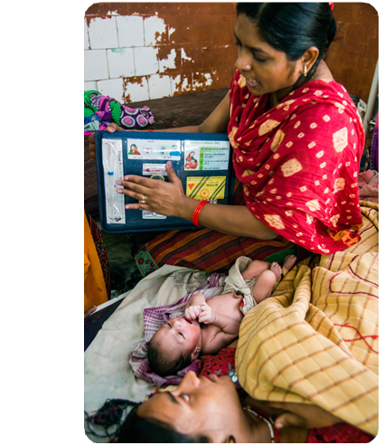
Immediate Postpartum Family Planning
A key component of childbirth care.
Notes:
This brief summarizes the evidence and provides implementation tips for proactively offering family planning as part of care during and immediately after childbirth, often referred to as the immediate postpartum period.
Photo credit: Bill and Melinda Gates Foundation
REVISED: 4/23

Slide 2
Overview
What is a HIP?
HIP Categories
Partnership
Introduction to the High Impact Practices (HIPs)
PART
PART
Immediate Postpartum Family Planning
Background
Theory of Change
Why is this practice important?
What is the impact?
Extra Slides
Implementation Tips
Tools & Resources
Notes:
Thank you for using this slide deck! This is a product derived from the HIP brief to assist you in presenting to a variety of audiences. Instructions and additional resources are included in the notes of each slide for your convenience. There is a wealth of information and resources in the “Notes” section of each slide.
This presentation is divided in three parts: an Introduction to the High Impact Practices (HIPs) in Family Planning, Immediate Postpartum Family Planning, and Extra Slides.
The logo for your organization or ministry may be added to these slides. The web addresses provided in the “Notes” section of each slide can be copied and pasted into your web browser.

Slide 3
High Impact Practices in Family Planning (HIPs) are…
Evidence-based family planning practices
Vetted by experts against specific criteria
Documented in an easy-to-use format
Notes:
High Impact Practices (HIPs) are a set of evidence-based family planning practices vetted by experts against specific criteria and documented in an easy-to-use format.
The High Impact Practices in Family Planning (HIPs) were first created in 2010 after a survey of FP stakeholders revealed little consensus for “what works” in international FP programming. A small group of leaders in FP were brought together with the task of identifying a short list of HIPs that if implemented at scale would help countries address the unmet need for FP and thereby increase national contraceptive prevalence.
HIPs are identified based on demonstrated magnitude of impact on contraceptive use and potential application in a wide range of settings. Consideration is also given to other relevant outcome measures including unintended pregnancy, fertility, or one of the primary proximate determinants of fertility (delay of marriage, birth spacing, or breast feeding). Evidence of replicability, scalability, sustainability, and cost-effectiveness are also considered.
For more information, please copy and paste this link into your web browser to see this video: https://www.youtube.com/watch?v=N6V0gfl-V3k&ab_channel=KnowledgeSUCCESS
A 2-pager overview of the HIPs is available in an online and a downloadable PDF format here (copy and paste this link into your web browser): https://www.fphighimpactpractices.org/high-impact-practices-in-family-planning-list/

Slide 4
HIPs address the full spectrum of FP programming
Enabling Environment
Service Delivery
Social and Behavioral Change
PART
Address systemic barriers that affect an individual’s ability to access family planning information & services. 8 briefs
Improve the availability, accessibility, acceptability, and quality of family planning services. 8 briefs
Influence knowledge, beliefs, behaviors, and social norms associated with family planning.
7 briefs
Enhancements
Approaches used in conjunction with HIPs to maximize the impact of HIP implementation or increase the reach. 4 briefs
Notes:
There are three categories of HIPs: Enabling Environment, Service Delivery and Social and Behavioral Change. Immediate Postpartum Family Planning is a Service Delivery HIP. This information came from the HIP List (copy and paste this link into your web browser): https://www.fphighimpactpractices.org/high-impact-practices-in-family-planning-list/
A HIP Enhancement is a tool or approach that is not a standalone practice, but it is often used in conjunction with HIPs to maximize the impact of HIP implementation or increase the reach and access for specific audiences. The intended purpose and impact of enhancements are focused and, therefore the evidence-based and impact of an enhancement is subjected to different standards than a HIP.
For more information about the HIP Categories and Enhancements, please copy and paste this link into your web browser: https://www.fphighimpactpractices.org/high-impact-practices-in-family-planning-list/
Here are a few examples of HIPs from each category:
Service Delivery:
Immediate Postpartum Family Planning
Mobile Outreach Services
Postabortion Family Planning
Enabling Environment:
Domestic Public Financing
Educating Girls
Supply Chain Management
Social and Behavior Change:
Community Group Engagement
Digital Health for SBC
Mass Media
Enhancements:
Digital Health for Systems
Adolescent-Responsive Contraceptive Services
Family Planning Vouchers
All HIPs are Available in English, Spanish, French, and Portuguese.

Slide 5
HIP Partnership
The Technical Advisory Group (TAG) is made up of 25 experts in family planning, including representatives from the co-sponsors.
The Co-sponsors include the following organizations:
Notes:
The High Impact Practices in Family Planning (HIPs) are supported by over 65 organizations. These organizations play a vital role in developing, reviewing, disseminating, and implementing HIPs in family planning.
The HIPs partnership includes various structures to ensure HIP products are developed, kept up to date, and disseminated widely. These include:
Co-sponsors – Serve as the secretariat for the HIPs.
Partners – Contribute to key HIP products and endorse the HIPs.
Technical Advisory Group – Ensure high technical quality of key HIP products and approve HIP brief and SPG concepts for development.
P&D Team – Support the production and dissemination (P&D) of HIP products.
Technical Expert Groups – Write new HIP briefs and ensure they are up-to-date.
For more information about the HIP Partnership, please copy and paste this link into your web browser: https://www.fphighimpactpractices.org/partnership-structure/

Slide 6
High Impact Practice
Offer contraceptive counseling and services as part of facility-based childbirth care prior to discharge from the health facility.
Notes:
This brief summarizes the evidence and provides implementation tips for proactively offering family planning as part of care during and immediately after childbirth, often referred to as the immediate postpartum period.
For more information about Service Delivery HIPs, please copy and paste this link into your web browser to visit this matrix of tools developed by IBP/WHO: https://www.fphighimpactpractices.org/ibp-who-matrix/
These tools can be used in conjunction with Service Delivery HIPs.
Available in online and downloadable PDF format.
Did you know that we have a webinar recording and downloadable PDF presentation about this HIP? Please copy and paste this link into your web browser to visit: https://www.fphighimpactpractices.org/immediate-postpartum-family-planning-a-key-component-of-childbirth-care-webinar/
This webinar contains recent implementation successes in several country contexts.
Presenters include:
Michael Mwiti, Jhpiego Kenya
Saswati Das, Jhpiego India
Mario Festin, WHO
Riaz Mobaracaly, Pathfinder International, Mozambique
Laura Raney, Senior Advisor, FP2020 (Moderator)

Slide 7
Background
Offering modern contraception services as part of care provided during childbirth increases postpartum contraceptive use and is likely to reduce both unintended pregnancies and pregnancies that are too closely spaced.
The WHO recommends that women receive information on family planning and the health and social benefits of birth spacing during antenatal care, immediately after birth, and during postpartum and well-baby care, including immunization and growth monitoring.
Notes:
Offering modern contraception services as part of care provided during childbirth increases postpartum contraceptive use and is likely to reduce both unintended pregnancies and pregnancies that are too closely spaced.
After a live birth, the recommended interval before attempting the next pregnancy is at least 24 months, based on a consultation convened by the World Health Organization (WHO), in order to reduce the risk of adverse maternal, perinatal, and infant outcomes.
There are many reasons why women do not use effective contraception during the postpartum period, such as sociocultural and gender norms that guide postnatal practices, timing of return to menses and sexual activity, breastfeeding practices and misconceptions of conditions for lactational amenorrhea, and lack of access to contraceptive services.
The WHO recommends that women receive information on family planning and the health and social benefits of birth spacing during antenatal care, immediately after birth, and during postpartum and well-baby care, including immunization and growth monitoring.
Each visit to a health professional offers a unique opportunity to screen for, counsel, and offer family planning services.
Yet each opportunity requires deliberate attention to organize services, update policies and provider practices, and mobilize resources for successful implementation.
For more information, please copy and paste this link into your web browser to reference the “Background” section on the HIP brief: https://www.fphighimpactpractices.org/briefs/immediate-postpartum-family-planning/

Slide 8
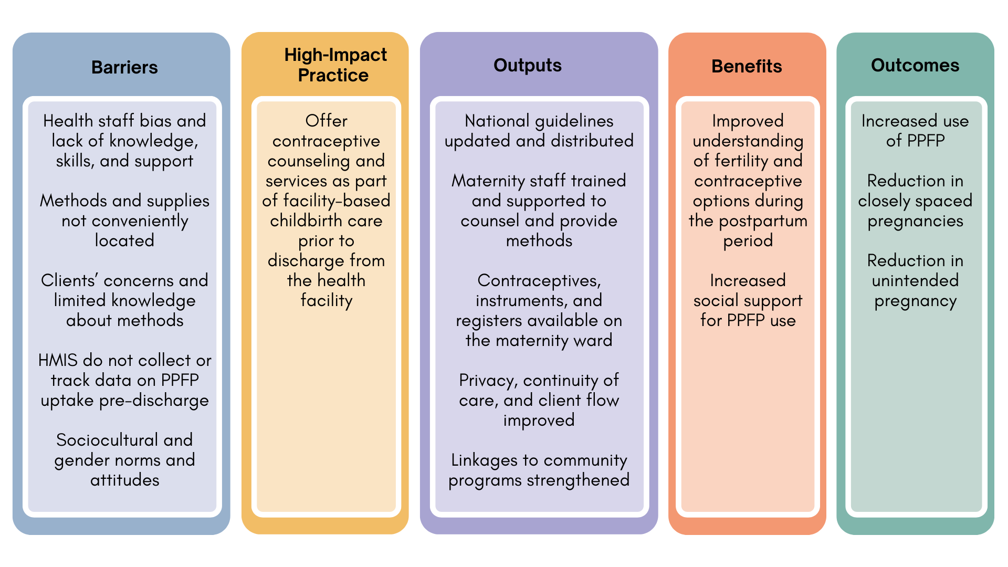
Theory of
Change
BACKGROUND
Notes:
View Figure 1 in the HIP brief (copy and paste this link into your web browser): https://www.fphighimpactpractices.org/briefs/immediate-postpartum-family-planning/

Slide 9
Why is this practice important?
Providing family planning counseling as part of childbirth care raises awareness of the importance of birth spacing and postpartum contraceptive options.
An increasing number of women and their partners can be reached through facility-based childbirth services.
Women have more contraceptive options during the immediate postpartum period.
Notes:
Providing family planning counseling as part of childbirth care raises awareness of the importance of birth spacing and postpartum contraceptive options.
Providers, women, and their support networks cite concerns about contraceptive side effects, especially related to effects of hormonal contraceptives on breast milk and the child’s health as reasons to avoid contraception during the postpartum period.
In settings where women seek care well before active labor or in communities where women are able to recuperate in a facility after birth, family planning counseling can be incorporated into care around the preparation for childbirth and/or immediately thereafter; these approaches are considered acceptable to both providers and clients.
An increasing number of women and their partners can be reached through facility-based childbirth services.
Globally, 4 of 5 births take place with the assistance of a skilled birth attendant, and increasingly these births are taking place in health facilities.
As countries continue to strengthen facility-based childbirth care, this will be an increasingly important platform to reach women and their partners with family planning services.
Women have more contraceptive options during the immediate postpartum period.
Immediately after birth, women may choose from a wide variety of contraceptives including hormonal and non-hormonal, long- and short-acting, and permanent methods.

Slide 10
What is the impact?
Offering modern contraception as part of childbirth services increases postpartum contraceptive use.
Multiple counseling sessions during the course of a pregnancy contributed to higher postpartum family planning uptake.
Training nurses and midwives in immediate postpartum IUD (PPIUD) insertion was particularly successful, achieving increased PPIUD uptake with few complications, expulsions, and removals in countries such as India, Nepal, Sri Lanka, and Tanzania.
Notes:
Offering modern contraception as part of childbirth services increases postpartum contraceptive use.
Multiple counseling sessions during the course of a pregnancy contributed to higher postpartum family planning uptake.
Training nurses and midwives in immediate postpartum IUD (PPIUD) insertion was particularly successful, achieving increased PPIUD uptake with few complications, expulsions, and removals in countries like India, Nepal, Sri Lanka, and Tanzania.
In a major Indian hospital, PPIUD uptake increased from 2.3% to 49.0% over 2 years with 99.5% of 2,626 vaginal insertions performed by trained nurses.

Slide 11
Implementation Tips
Invest in good documentation and monitoring to help ensure voluntarism and informed choice.
When counseling is provided during antenatal care, method choice should be indicated on the client’s record, whether it be a woman-held card or a facility chart.
This documentation facilitates communication across providers who are caring for the same client and ensures continuity of care.

Slide 12
Implementation Tips
Update national service delivery guidelines and clarify the role of service providers.
Guidelines as well as job descriptions should clearly articulate that all antenatal and maternity care providers have a role in postpartum family planning, and that it is not just the responsibility of a few trained provider(s).

Slide 13
Thank You
Continue to the extra slides or access the HIP brief for more information.
Notes:
For more information, please copy and paste this link into your web browser to visit this webpage with a recording of the webinar on Immediate Postpartum Family Planning and a downloadable PDF version of the presentation: https://www.fphighimpactpractices.org/briefs/immediate-postpartum-family-planning/

Slide 14
Extra Slides
Implementation Tips
Tools & Resources
Notes:
We have put together a collection of implementation tips for Immediate Postpartum Family Planning, in case you have additional time in your meeting. Further information about these tips can be found in the HIP brief.
References from the literature on this HIP can be found here (copy and paste this link into your web browser): https://www.fphighimpactpractices.org/briefs/immediate-postpartum-family-planning/

Slide 15
Implementation Tips
Include humanitarian crisis settings.
When offering implants and IUDs with balanced counseling and competent services, these methods quickly achieve popularity in unstable settings where women and families may be uprooted at a moment’s notice.

Slide 16
Implementation Tips
Conduct formative assessments to guide social and behavior change strategies.
Understanding barriers to PPFP uptake and tailoring programmatic approaches to address those barriers can improve uptake.

Slide 17
Implementation Tips
Consider home visits if targeting postpartum family planning adoption among first-time, young parents.
Programs targeting young married women and adolescents have found value in using home visits or community group engagement.
Notes:
Consider home visits if targeting postpartum family planning adoption among first-time, young parents.
Programs targeting young married women and adolescents have found value in using home visits or community group engagement.
These programs documented the need to carefully test strategies for approaching and counseling young married women, as well as their partners and senior women in the household.
Community Group Engagement: https://www.fphighimpactpractices.org/briefs/community-group-engagement/

Slide 18
Implementation Tips
Offer the broadest range of contraceptive methods possible and make them available prior to maternity discharge.
Institutions that demonstrate marked improvements in postpartum contraceptive uptake did so by expanding the method mix and by focusing on method adoption during the pre-discharge period.

Slide 19
Implementation Tips
Consider leveraging antenatal care visits to educate clients on contraception.
While the effect of including family planning counseling as part of antenatal care on increased postpartum family planning uptake is unclear, doing so may allow women to fully explore their intentions and to make an informed decision about contraception before delivery.

Slide 20
Implementation Tips
Engage men.
In many cultures male partners exert considerable influence on uptake and continuation of immediate postpartum family planning.
Men’s involvement during and after pregnancy can reduce the occurrence of postpartum depression and improve use of maternal health services, such as skilled birth attendance and postnatal care.
Notes:
Engage men.
In many cultures male partners exert considerable influence on uptake and continuation of immediate postpartum family planning.
Men’s involvement during and after pregnancy can reduce the occurrence of postpartum depression and improve use of maternal health services, such as skilled birth attendance and postnatal care.
Inequitable gender norms have a powerful effect on women’s ability to make and act on decisions about birth spacing and limiting.
Providing men and women the opportunity to engage in family planning discussions as part of maternity care—together or separately—can directly address these inequitable norms and create space for joint decision making for effective use of family planning.

Slide 21
Implementation Tips
Plan for contraceptive uptake later during the postpartum period.
In Rwanda, the postpartum family planning counseling session is an opportunity to make a plan for returning to a facility for postnatal care and immunization and for obtaining a postpartum family planning method at that time.
Notes:
For more information about Family Planning and Immunization Integration, please copy and paste this link into your web browser to visit the related HIP brief: https://www.fphighimpactpractices.org/briefs/family-planning-and-immunization-integration/

Slide 22
Implementation Tips
Ensure adequate staff, equipment, and supplies, and if possible ensure their availability 24 hours a day, 7 days a week.
Ensuring systematic postpartum family planning counseling may entail making postpartum family planning– trained providers available on call at night or on weekends.
In addition, conducting whole-site orientations helps ensure that even staff who have not been trained or do not possess a clinical background can support postpartum family planning.

Slide 23
Implementation Tips
Encourage facility leadership and adjust management practices based on facility size.
Larger facilities may require more intensive engagement of staff than smaller facilities to achieve similar output.
Problem-solving strategies, as part of leadership, management, or quality improvement approaches, help staff address barriers as they arise.

Slide 24
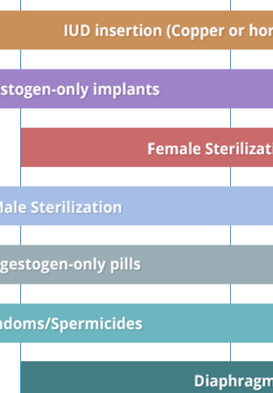
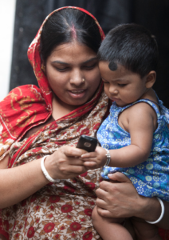
Tools & Resources
Compendium of WHO Recommendations for Postpartum Family Planning
Postpartum Family Planning (PPFP) Toolkit
Case Study: Bangladesh: Behavioral Maintenance and Follow-Up
Notes:
Compendium of WHO Recommendations for Postpartum Family Planning is a web-based tool that integrates core WHO guidance to guide women through their family planning decision-making during the first year postpartum. Available from: https://postpartumfp.srhr.org/
Postpartum Family Planning (PPFP) Toolkit provides a comprehensive collection of best practices and evidence-based tools and documents on PPFP. Available from: https://toolkits.knowledgesuccess.org/toolkits/ppfp
Service Communication Case Study: Bangladesh: Behavioral Maintenance and Follow-Up is an example of a project that has successfully used social and behavior change communication via mHealth to communicate important information about pregnancy and the first year of a child’s life, including PPFP, to expecting and new mothers and their families. Available from: https://sbccimplementationkits.org/service-communication/case-studies/case-study-behavioral-maintenance-and-follow-up-in-bangladesh/
Bonus resource: Use of the WHO Guidelines & Tools alongside service delivery High Impact Practices in family planning. The tool focuses on Service Delivery HIPs and selected WHO Guidelines related to family planning service delivery. The tool is intended to be a quick reference for program managers designing or implementing family planning programs. The tool can be used to help improve implementation of HIPs by illustrating how to incorporate WHO evidence-based guidelines and/or can be used to support advocacy efforts for HIPs by linking them with globally recognized and credible WHO Guidelines. Please copy and paste this link into your web browser to visit:
https://www.fphighimpactpractices.org/ibp-who-matrix/

Slide 25
fphighimpactpractices.org
Notes:
Subscribe to the HIPs Newsletter here (copy and paste this link into your web browser): https://mailchi.mp/76703a3652c9/hips-newsletter-sign-up
Please visit the five areas of our website to learn more about the HIPs:
HIP Products (copy and paste this link into your web browser): https://www.fphighimpactpractices.org/hip-products/
Resources (copy and paste this link into your web browser): https://www.fphighimpactpractices.org/resources/
Engage (copy and paste this link into your web browser): https://www.fphighimpactpractices.org/engage-with-the-hips/
Overview (copy and paste this link into your web browser): https://www.fphighimpactpractices.org/overview/
About Us (copy and paste this link into your web browser): https://www.fphighimpactpractices.org/partnership-structure/

