Slide 1



Leading and Managing
For rights-based family planning programs.
Notes:
This brief focuses on leadership and management for creating an enabling family planning environment. Leadership and management are essential elements for successful, rights-based family planning programs and can help ensure resources are used effectively to achieve results.
For more information about these topics, please copy and paste the following links into your web browser to see the related HIP products: https://www.fphighimpactpractices.org/briefs/family-planning-high-impact-practices-list/
Photo credit: © 2013 SC4CCM/JSI, Courtesy of Photoshare
REVISED: 2/23

Slide 2
Overview
What is a HIP?
HIP Categories
Partnership
Introduction to the High Impact Practices (HIPs)
PART
PART
Background
Theory of change
Why is this practice important?
What is the impact?
Implementation Measurement
Leading and Managing
Implementation Tips
Priority Research Questions
Tools and Resources
Extra Slides
Notes:
Thank you for using this slide deck! This is a product derived from the HIP brief to assist you in presenting to a variety of audiences. Instructions and additional resources are included in the notes of each slide for your convenience. There is a wealth of information and resources in the “Notes” section of each slide.
This presentation is divided in three parts: an Introduction to the High Impact Practices (HIPs) in Family Planning, Leading and Managing, and Extra Slides.
The logo for your organization or ministry may be added to these slides. The web addresses provided in the “Notes” section of each slide can be copied and pasted into your web browser.

Slide 3



High Impact Practices in Family Planning (HIPs) are…
Evidence-based family planning practices
Vetted by experts against specific criteria
Documented in an easy-to-use format
Notes:
High Impact Practices (HIPs) are a set of evidence-based family planning practices vetted by experts against specific criteria and documented in an easy-to-use format.
The High Impact Practices in Family Planning (HIPs) were first created in 2010 after a survey of FP stakeholders revealed little consensus for “what works” in international FP programming. A small group of leaders in FP were brought together with the task of identifying a short list of HIPs that if implemented at scale would help countries address the unmet need for FP and thereby increase national contraceptive prevalence.
HIPs are identified based on demonstrated magnitude of impact on contraceptive use and potential application in a wide range of settings. Consideration is also given to other relevant outcome measures including unintended pregnancy, fertility, or one of the primary proximate determinants of fertility (delay of marriage, birth spacing, or breast feeding). Evidence of replicability, scalability, sustainability, and cost-effectiveness are also considered.
For more information, please copy and paste this link into your web browser to see this video: https://www.youtube.com/watch?v=N6V0gfl-V3k&ab_channel=KnowledgeSUCCESS
A 2-pager overview of the HIPs is available in an online and a downloadable PDF format here (copy and paste this link into your web browser): https://www.fphighimpactpractices.org/high-impact-practices-in-family-planning-list/

Slide 4
HIPs address the full spectrum of FP programming
Enabling Environment
Service Delivery
Social and Behavioral Change
PART
Address systemic barriers that affect an individual’s ability to access family planning information & services. 8 briefs
Improve the availability, accessibility, acceptability, and quality of family planning services. 8 briefs
Influence knowledge, beliefs, behaviors, and social norms associated with family planning.
7 briefs
Enhancements
Approaches used in conjunction with HIPs to maximize the impact of HIP implementation or increase the reach. 4 briefs
Notes:
There are three categories of HIPs: Enabling Environment, Service Delivery and Social and Behavioral Change. Leading and managing is an Enabling Environment HIP. This information came from the HIP List (copy and paste this link into your web browser): https://www.fphighimpactpractices.org/high-impact-practices-in-family-planning-list/
A HIP Enhancement is a tool or approach that is not a standalone practice, but it is often used in conjunction with HIPs to maximize the impact of HIP implementation or increase the reach and access for specific audiences. The intended purpose and impact of enhancements are focused and, therefore the evidence-based and impact of an enhancement is subjected to different standards than a HIP.
For more information about the HIP Categories and Enhancements, please copy and paste this link into your web browser: https://www.fphighimpactpractices.org/high-impact-practices-in-family-planning-list/
Here are a few examples of HIPs from each category:
Service Delivery:
Immediate Postpartum Family Planning
Mobile Outreach Services
Postabortion Family Planning
Enabling Environment:
Domestic Public Financing
Educating Girls
Supply Chain Management
Social and Behavior Change:
Community Group Engagement
Digital Health for SBC
Mass Media
Enhancements:
Digital Health for Systems
Adolescent-Responsive Contraceptive Services
Family Planning Vouchers
All HIPs are Available in English, Spanish, French, and Portuguese.

Slide 5
HIP Partnership
The Technical Advisory Group (TAG) is made up of 25 experts in family planning, including representatives from the co-sponsors.
The Co-sponsors include the following organizations:
Notes:
The High Impact Practices in Family Planning (HIPs) are supported by over 65 organizations. These organizations play a vital role in developing, reviewing, disseminating, and implementing HIPs in family planning.
The HIPs partnership includes various structures to ensure HIP products are developed, kept up to date, and disseminated widely. These include:
Co-sponsors – Serve as the secretariat for the HIPs.
Partners – Contribute to key HIP products and endorse the HIPs.
Technical Advisory Group – Ensure high technical quality of key HIP products and approve HIP brief and SPG concepts for development.
P&D Team – Support the production and dissemination (P&D) of HIP products.
Technical Expert Groups – Write new HIP briefs and ensure they are up-to-date.
For more information about the HIP Partnership, please copy and paste this link into your web browser: https://www.fphighimpactpractices.org/partnership-structure/

Slide 6
High Impact Practice
Strengthen capacity for leading and managing for excellence in family planning programs.
Notes:
This brief focuses on leadership and management for creating an enabling family planning environment. Leadership and management are essential elements for successful, rights-based family planning programs and can help ensure resources are used effectively to achieve results.

Slide 7
Background
Strengthening leadership and management practices:
Leads to improved health outcomes.
Applies to all staff at all levels of the health system.
Addresses diversity, equity, and inclusion by making programs and systems more responsive and effective at reaching the unreached.
Notes:
Since there are no universally accepted definitions of leadership and management, it is helpful to think about the behaviors and practices that comprise effective leadership and management.
Strengthening capacity for leading and managing involves improving the ability of individuals to effectively engage in these practices.
Strengthening leadership and management practices applies to all staff at all levels of the health system from the health facility to supply chain management, and from district to global levels.
Strengthening leadership and management capacity is critical to the performance of other HIPs and family planning programmatic interventions and should therefore be integrated when implementing any of these practices in order to realize their full potential.
Enabling environment overview: https://www.fphighimpactpractices.org/briefs/enabling-environment-overview/
Supply chain management: https://www.fphighimpactpractices.org/briefs/supply-chain-management/
For more information, please copy and paste this link into your web browser to reference the “Background” section on the HIP brief: https://www.fphighimpactpractices.org/briefs/leaders-and-managers/

Slide 8
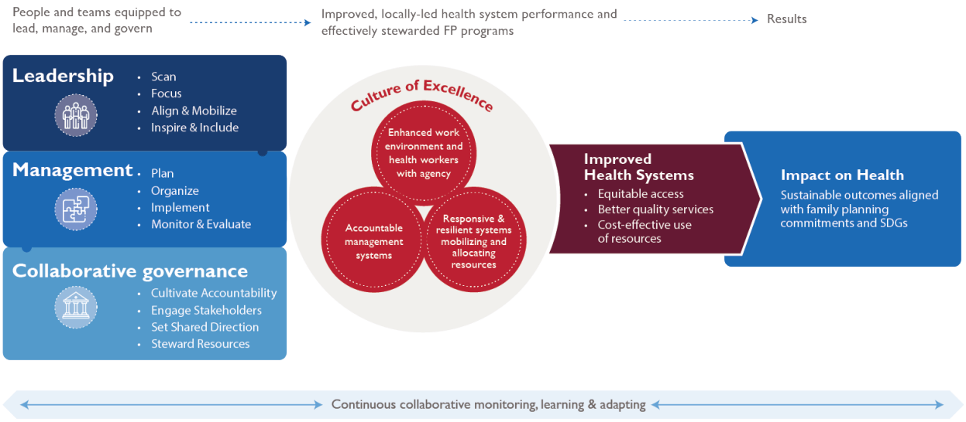
Background
Notes:
View Figure 1 in the HIP brief (copy and paste this link into your web browser): https://www.fphighimpactpractices.org/briefs/leaders-and-managers/
For more information, please copy and paste this link into your web browser to reference the “Background” section on the HIP brief: https://www.fphighimpactpractices.org/briefs/leaders-and-managers/

Slide 9
Background
Practices for Effective Leadership
Leadership | Management
Scanning | Planning
Focusing | Organizing
Aligning and mobilizing | Implementing
Inspiring and including | Monitoring and evaluation
Notes:
Leadership
Scanning: assessing internal and external environment to identify critical challenges and opportunities for growth.
Focusing: setting priorities that make it possible to move toward goals and objectives.
Aligning and mobilizing: uniting staff, partners, communities, and other stakeholders to understand the program’s goals and commit resources.
Inspiring and including: creating an enabling and positive environment, in which everyone wants to put in their best effort.
Management
Planning: setting goals and objectives, developing annual and multi-year plans, and anticipating and reducing risks.
Organizing: acquiring and allocating human, financial, and technical resources and establishing systems and processes to facilitate the work.
Implementing: coordinating multiple activities and managing change to complete tasks in a timely and high-quality manner.
Monitoring and evaluation: setting up processes to track activities against plans and to assess performance of those activities; learning and adapting the program based on results.
For more information, please copy and paste this link into your web browser to reference the “Background” section on the HIP brief: https://www.fphighimpactpractices.org/briefs/leaders-and-managers/

Slide 10
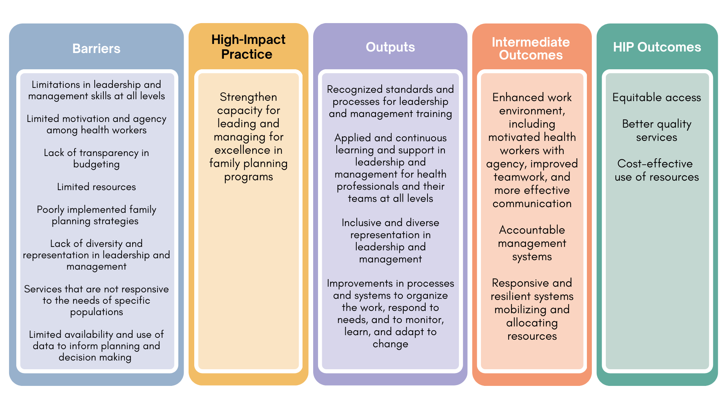
Theory of
Change
BACKGROUND
Notes:
View Figure 2 in the HIP brief (copy and paste this link into your web browser): https://www.fphighimpactpractices.org/briefs/leaders-and-managers/

Slide 11
Why is this practice important?
Improved work environment enhances health worker motivation and agency.
Improved management systems lead to better healthcare performance.
Improved capacity for programs to respond to changing community needs and to effectively scale up.
Notes:
Improved work environment enhances health worker motivation and agency.
In family planning programs, provider-level barriers to positive health outcomes include a lack of knowledge and skills among providers about contraceptive methods, low health worker motivation to provide family planning, long wait times for clients to receive services, and disrespectful treatment of clients.
Many of these issues can be addressed with adequate leadership and management practices to help motivate staff and improve the quality of services, such as recognizing the need for additional staff training, supportive supervision of providers, staff recognition, job aids, and improving logistics systems.
Health workers repeatedly report poor leadership and management by their managers or supervisors as a key factor in their lack of motivation, according to a systematic review of health worker motivation.
Having a strong organizational mission is another motivating factor for health workers, which can be achieved with strong leadership and vision.
Improved management systems lead to better healthcare performance.
While trained clinically, physicians and nurses often lack skills in human resource distribution, resource allocation, and recruitment, resulting in poorly managed health facilities.
There is a need for health care professionals to be equipped with leadership and management skills to carry out the “efficient handling of scarce resources in conditions of uncertainty.”
Improved capacity for programs to respond to changing community needs and to effectively scale up.
While political leadership can help facilitate resources and commitment, leadership and management at the implementation level is equally critical and will ultimately drive the successful scale-up of health interventions.

Slide 12
What is the impact?
Models can describe the effects of leadership and management practices using intermediate indicators, such as change in work climates, improved organizational management, or improved capacity to mobilize and allocate resources. These changes can lead to impact such as:
  More equitable access to services
  Better quality services
  More efficient and cost-effective use of resources
Notes:
Demonstrating a direct causal impact between strengthening capacity for leading and managing and health service outputs and health outcomes is an ongoing challenge.
Models can describe the effects of leadership and management practices using intermediate indicators, such as change in work climates, improved organizational management, or improved capacity to mobilize and allocate resources. These changes may then lead to impact described as: 1) more equitable access to services; 2) better quality services; and 3) more efficient and cost-effective use of resources. This in turn is expected to lead to improved, sustainable health outcomes.
View Figure 1 in the HIP brief (copy and paste this link into your web browser): https://www.fphighimpactpractices.org/briefs/leaders-and-managers/

Slide 13

Implementation Measurement
Proportion of preservice health professional education curricula that include leadership and management content.
Proportion of persons in leadership positions that have formal training in management in health.
Proportion of organizations/facilities/districts that report performance improvements as a result of strengthening capacity in leadership and management.
Proportion of facility, district health management teams, or other administrative units that have developed a monitoring plan, including annual work objectives and performance measures related to family planning.
Representation among leadership and management that reflects diversity and equity.
Notes:
Proportion of preservice health professional education curricula that include leadership and management content.
Proportion of persons in leadership positions that have formal training in management in health.
Proportion of organizations/facilities/districts that report performance improvements as a result of strengthening capacity in leadership and management (performance improvements can include changes in work climate, management systems, health service delivery, quality of care, utilization of services, etc.).
Proportion of facility, district health management teams, or other administrative units that have developed a monitoring plan, including annual work objectives and performance measures related to family planning.
Representation among leadership and management that reflects diversity and equity (adapt based on local contexts, e.g. proportion female, youth, etc.).

Slide 14
Thank You
Continue to the extra slides or access the HIP brief for more information.

Slide 15
Extra Slides
Implementation Tips
Priority Research Questions
Tools and Resources
Notes:
We have put together a collection of implementation tips for Leading and Managing in case you have additional time in your meeting. Further information about these tips can be found in the HIP brief.
References from the literature on this HIP can be found here (copy and paste this link into your web browser): https://www.fphighimpactpractices.org/briefs/leaders-and-managers/

Slide 16

Implementation Tips
Use mentoring and coaching approaches for ongoing support to leaders and managers.
Create standards and certification for leadership and management roles.
Train teams that work together through applied learning and collaborative learning approaches.
Notes:
As an overarching top, programs aimed to strengthen leadership and management capacity should be designed with sustainability of the intervention in mind, e.g., by incorporating into preservice training, creating standards, and using applied learning approaches.
Applied learning is the most effective way to gain practical skills in leadership and management, yielding skill retention rates of up to 75% compared with 5–10% from only reading or lectures.
Using applied-learning approaches with teams working together in real workplace settings has more positive results than sending individuals to off-site leadership and management trainings in which the curriculum is not necessarily directly applicable to their work.
For more information about Leading and Managing, please copy and paste this link into your web browser to visit the HIP Leading and Managing: https://www.fphighimpactpractices.org/briefs/leaders-and-managers/

Slide 17
Implementation Tips
Include leadership and management capacity strengthening in preservice and in-service training.
Connect leaders and managers to a larger community of practice that shares common goals for family planning.
Improve leadership and management skills at multiple levels of the health system for greater impact.
Notes:
Leadership and management training has been incorporated into medical and nursing school curricula in multiple countries.
In Uganda, in addition to receiving clinical training, students are trained on human resources management, finance, logistics, and leadership.
Social accountability initiatives can strengthen the capacity of community members and civil society to help hold facilities and decision makers accountable.
For more information about Social Accountability, please copy and paste this link into your web browser to visit the related HIP brief: http://www.fphighimpactpractices.org/briefs/social-accountability/
For more information about Leading and Managing, please copy and paste this link into your web browser to visit the HIP Leading and Managing: https://www.fphighimpactpractices.org/briefs/leaders-and-managers/

Slide 18
Implementation Tips
Address inequities and imbalances of power in leadership and management, e.g., along gender, age, and racial lines.
New leadership and management skills are needed for changing times and to deal with future challenges.
Notes:
Leadership and management training initiatives should make a concerted effort to identify and cultivate more diverse leaders and create specific trainings for marginalized populations.
For more information about Leading and Managing, please copy and paste this link into your web browser to visit the HIP Leading and Managing: https://www.fphighimpactpractices.org/briefs/leaders-and-managers/

Slide 19
Priority Research Questions
What are the costs and benefits of different approaches to strengthening leadership and management?
What approaches to strengthening leadership and management lead to sustainable improvements in family planning outcomes?
How can family planning interventions feasibly and effectively incorporate approaches to strengthen leadership and management capacity?
Notes:
These research questions, reviewed by the HIP technical advisory group, reflect the prioritized gaps in the evidence base specific to the topics reviewed in this brief and focus on the HIP criteria.

Slide 20

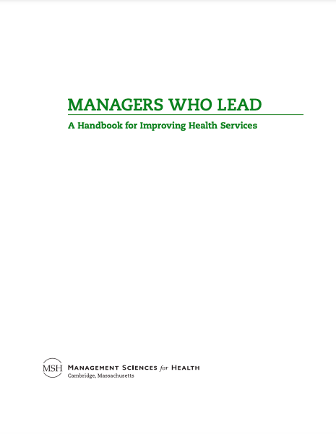
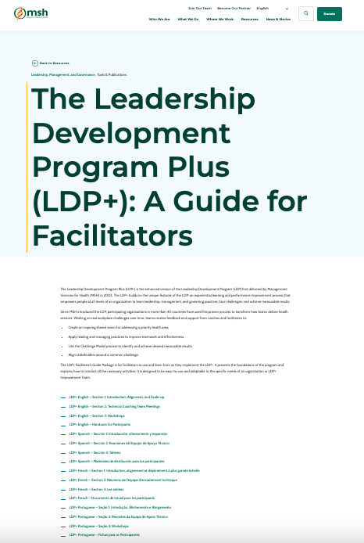
Tools & Resources
Managers Who Lead: A Handbook for Improving Health Services
Leadership Development Program Plus (LDP+): A Guide for Facilitators
Notes:
Managers Who Lead: A Handbook for Improving Health Services. Provides managers with practical guidelines and approaches for leading teams to identify and find solutions for their challenges. Staff at any level of the health system can use this to improve their ability to lead and manage well. Available from: https://msh.org/resources/managers-who-lead-a-handbook-for-improving-health-services/
Leadership Development Program Plus (LDP+): A Guide for Facilitators. LDP+ is an experiential learning and performance improvement process that empowers people at all levels of an organization to learn leadership, management, and governing practices; face challenges; and achieve measurable results. Available in English, Spanish, French, and Portuguese. Available from: https://msh.org/resources/the-leadership-development-program-plus-ldp-a-guide-for-facilitators/

Slide 21
fphighimpactpractices.org
Notes:
Subscribe to the HIPs Newsletter here (copy and paste this link into your web browser): https://mailchi.mp/76703a3652c9/hips-newsletter-sign-up
Please visit the five areas of our website to learn more about the HIPs:
HIP Products (copy and paste this link into your web browser): https://www.fphighimpactpractices.org/hip-products/
Resources (copy and paste this link into your web browser): https://www.fphighimpactpractices.org/resources/
Engage (copy and paste this link into your web browser): https://www.fphighimpactpractices.org/engage-with-the-hips/
Overview (copy and paste this link into your web browser): https://www.fphighimpactpractices.org/overview/
About Us (copy and paste this link into your web browser): https://www.fphighimpactpractices.org/partnership-structure/

