Slide 1
Mass Media
Reaching audiences far and wide with messages to support healthy reproductive behaviors.
Notes:
This brief describes the evidence on and experience with mass media programming in family planning. The distinguishing characteristic of mass media programs, relative to other social and behavior change (SBC) interventions, is that they reach a large audience—often national in scope—with consistent, high-quality messages, primarily through TV and radio (e.g., public service announcements or advertisements, talk shows, or serial dramas).
Photo credit: Akintunde Akinleye/NURHI, Courtesy of Photoshare
REVISED: 3/23

Slide 2
Overview
What is a HIP?
HIP Categories
Partnership
Introduction to the High Impact Practices (HIPs)
PART
PART
Background
Theory of Change
What challenges can this HIP help address?
Evidence of Impact
Mass Media
Extra Slides
Implementation Tips
Tools & Resources
Notes:
Thank you for using this slide deck! This is a product derived from the HIP brief to assist you in presenting to a variety of audiences. Instructions and additional resources are included in the notes of each slide for your convenience. There is a wealth of information and resources in the “Notes” section of each slide.
This presentation is divided in three parts: an Introduction to the High Impact Practices (HIPs) in Family Planning, Mass Media, and Extra Slides.
The logo for your organization or ministry may be added to these slides. The web addresses provided in the “Notes” section of each slide can be copied and pasted into your web browser.

Slide 3
High Impact Practices in Family Planning (HIPs) are…
Evidence-based family planning practices
Vetted by experts against specific criteria
Documented in an easy-to-use format
Notes:
High Impact Practices (HIPs) are a set of evidence-based family planning practices vetted by experts against specific criteria and documented in an easy-to-use format.
The High Impact Practices in Family Planning (HIPs) were first created in 2010 after a survey of FP stakeholders revealed little consensus for “what works” in international FP programming. A small group of leaders in FP were brought together with the task of identifying a short list of HIPs that if implemented at scale would help countries address the unmet need for FP and thereby increase national contraceptive prevalence.
HIPs are identified based on demonstrated magnitude of impact on contraceptive use and potential application in a wide range of settings. Consideration is also given to other relevant outcome measures including unintended pregnancy, fertility, or one of the primary proximate determinants of fertility (delay of marriage, birth spacing, or breast feeding). Evidence of replicability, scalability, sustainability, and cost-effectiveness are also considered.
For more information, please copy and paste this link into your web browser to see this video: https://www.youtube.com/watch?v=N6V0gfl-V3k&ab_channel=KnowledgeSUCCESS
A 2-pager overview of the HIPs is available in an online and a downloadable PDF format here (copy and paste this link into your web browser): https://www.fphighimpactpractices.org/high-impact-practices-in-family-planning-list/

Slide 4
HIPs address the full spectrum of FP programming
Enabling Environment
Service Delivery
Social and Behavioral Change
PART
Address systemic barriers that affect an individual’s ability to access family planning information & services. 8 briefs
Improve the availability, accessibility, acceptability, and quality of family planning services. 8 briefs
Influence knowledge, beliefs, behaviors, and social norms associated with family planning.
7 briefs
Enhancements
Approaches used in conjunction with HIPs to maximize the impact of HIP implementation or increase the reach. 4 briefs
Notes:
There are three categories of HIPs: Enabling Environment, Service Delivery and Social and Behavioral Change. Mass Media is a Social and Behavior Change HIP. This information came from the HIP List (copy and paste this link into your web browser): https://www.fphighimpactpractices.org/high-impact-practices-in-family-planning-list/
A HIP Enhancement is a tool or approach that is not a standalone practice, but it is often used in conjunction with HIPs to maximize the impact of HIP implementation or increase the reach and access for specific audiences. The intended purpose and impact of enhancements are focused and, therefore the evidence-based and impact of an enhancement is subjected to different standards than a HIP.
For more information about the HIP Categories and Enhancements, please copy and paste this link into your web browser: https://www.fphighimpactpractices.org/high-impact-practices-in-family-planning-list/
Here are a few examples of HIPs from each category:
Service Delivery:
Immediate Postpartum Family Planning
Mobile Outreach Services
Postabortion Family Planning
Enabling Environment:
Domestic Public Financing
Educating Girls
Supply Chain Management
Social and Behavior Change:
Community Group Engagement
Digital Health for SBC
Mass Media
Enhancements:
Digital Health for Systems
Adolescent-Responsive Contraceptive Services
Family Planning Vouchers
All HIPs are Available in English, Spanish, French, and Portuguese.

Slide 5
HIP Partnership
The Technical Advisory Group (TAG) is made up of 25 experts in family planning, including representatives from the co-sponsors.
The Co-sponsors include the following organizations:
Notes:
The High Impact Practices in Family Planning (HIPs) are supported by over 65 organizations. These organizations play a vital role in developing, reviewing, disseminating, and implementing HIPs in family planning.
The HIPs partnership includes various structures to ensure HIP products are developed, kept up to date, and disseminated widely. These include:
Co-sponsors – Serve as the secretariat for the HIPs.
Partners – Contribute to key HIP products and endorse the HIPs.
Technical Advisory Group – Ensure high technical quality of key HIP products and approve HIP brief and SPG concepts for development.
P&D Team – Support the production and dissemination (P&D) of HIP products.
Technical Expert Groups – Write new HIP briefs and ensure they are up-to-date.
For more information about the HIP Partnership, please copy and paste this link into your web browser: https://www.fphighimpactpractices.org/partnership-structure/

Slide 6
High Impact Practice
Use mass media channels to support healthy reproductive behaviors.
Notes:
This brief describes the evidence on and experience with mass media programming in family planning. The distinguishing characteristic of mass media programs, relative to other social and behavior change (SBC) interventions, is that they reach a large audience—often national in scope—with consistent, high-quality messages, primarily through TV and radio (e.g., public service announcements or advertisements, talk shows, or serial dramas).

Slide 7
Background
Mass media programs reach a large audience – often national in scope – with consistent high-quality messages, primarily through TV and radio. Some mass media programs also use ancillary print materials.
Mass media programming in reproductive health can influence individual behaviors by providing accurate information, building self-efficacy, and promoting attitudes and social norms that support healthy reproductive behaviors.
Notes:
Mass media programs reach a large audience – often national in scope – with consistent high-quality messages, primarily through TV and radio. Some mass media programs also use ancillary print materials.
Mass media programming in reproductive health can influence individual behaviors by providing accurate information, building self-efficacy, and promoting attitudes and social norms that support healthy reproductive behaviors.
Mass media programming can be designed to overcome lack of knowledge about fertility and contraception, correct misperceptions about one’s risk for unintended pregnancy, allay concerns about side effects of contraceptive methods, increase self-efficacy or confidence to take action, and/or change perceived norms that discourage family planning and contraceptive use.
Mass media should be linked with other SBC approaches, such as interpersonal communication or community group engagement, and/or investments in service delivery improvement for greater impact.
For more information, please copy and paste this link into your web browser to reference the “Background” section on the HIP brief: https://www.fphighimpactpractices.org/briefs/mass-media/

Slide 8
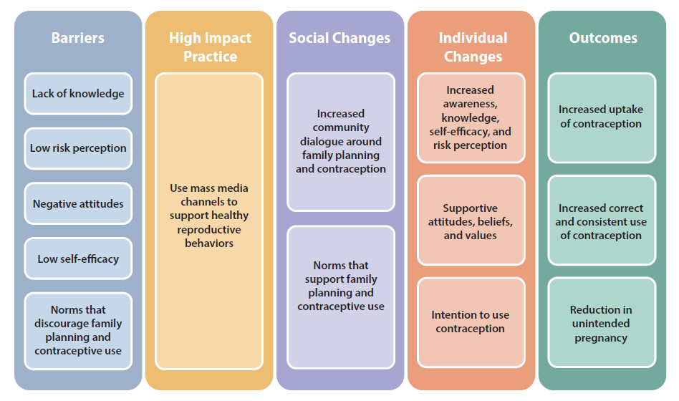
Theory of
Change
BACKGROUND
Notes:
View Figure 1 in the HIP brief (copy and paste this link into your web browser): https://www.fphighimpactpractices.org/briefs/mass-media/

Slide 9
Which challenges can this HIP help address?
Mass media programming contributes to improving sexual and reproductive health knowledge and increasing self-efficacy in support of healthy reproductive behaviors.
Mass media can influence attitudes, beliefs, and expectations that support healthy reproductive behaviors.
Mass media can shift norms and increase social support for healthy reproductive behaviors.
Notes:
Mass media programming contributes to improving sexual and reproductive health knowledge and increasing self-efficacy in support of healthy reproductive behaviors.
Exposure to mass media content was associated with higher levels of knowledge and/or positive attitudes about contraception.
Studies in Tanzania and Uganda have shown that exposure to well-designed mass media programming can improve self-efficacy for contraceptive use.
Mass media can influence attitudes, beliefs, and expectations that support healthy reproductive behaviors.
Method-specific beliefs and outcome expectations may stem from misinformation about methods, as well as cultural or gender norms.
In Nigeria, individuals exposed to mass media programming exhibited more positive attitudes and outcome expectations, as well as greater communication about and advocacy for family planning, compared with those unexposed.
Mass media can shift norms and increase social support for healthy reproductive behaviors.
Norms around family size and composition, such as preference for a large family or for at least one son, may contribute to higher ideal family sizes and non-use of contraception.
Gender norms also influence sexual and reproductive health behaviors.
For example, some gender norms idealize sexual ignorance for girls and limit girls’ and women’s decision making about their own health.

Slide 10
Evidence of Impact
Mass media interventions contribute to increased contraceptive use.
Studies reporting odds ratios found that those exposed to mass media were 25% to 2 times more likely to use modern contraception than those not exposed.
In Bangladesh, for example, married male and female TV viewers of reproductive age increased contraceptive use by a percentage point increase of 10.5.
Notes:
Mass media interventions contribute to increased contraceptive use.
Studies reporting odds ratios found that those exposed to mass media were 25% to 2 times more likely to use modern contraception than those not exposed.
Based on studies that included demographic information on the study population, mass media programs were more likely to reach individuals with higher socioeconomic status, younger age, lower parity, and urban residence.
View Table 1 in the HIP brief (copy and paste this link into your web browser): https://www.fphighimpactpractices.org/briefs/mass-media/

Slide 11
Implementation Tips
Invest in formative research to support development of focused messaging and to inform channel selection, program format, and broadcast schedules.
High-quality formative research serves to reinforce the legitimacy and importance of mass media programming for donors and host country governments.
Implementers must consider how best to present findings to the creative professionals responsible for developing the brand, campaign, show concept, scripts, and other media outputs.
Notes:
Invest in formative research to support development of focused messaging and to inform channel selection, program format, and broadcast schedules.
High-quality formative research serves to reinforce the legitimacy and importance of mass media programming for donors and host country governments.
Once formative research has been conducted, implementers must consider how best to present findings to the creative professionals responsible for developing the brand, campaign, show concept, scripts, and other media outputs.
Typically a creative brief is developed through interactive workshops, allowing creative professionals to understand the data and translate it into key program elements.

Slide 12
Implementation Tips
Partner with local creative professionals to create culturally specific programming.
Evidence suggests that mass media is most effective when it closely parallels the lived reality of target audiences.
Using local language(s) to ensure deep understanding of content by priority audiences may be more effective than relying upon a market language or other regional lingua franca.
Notes:
Partner with local creative professionals to create culturally specific programming.
Evidence suggests that mass media is most effective when it closely parallels the lived reality of target audiences.
Using local language(s) to ensure deep understanding of content by priority audiences may be more effective than relying upon a market language or other regional lingua franca.
Some implementers have chosen to address this need by developing creative concepts, scripts, or script “briefs” at the national level, then engaging state-level, regional, or provincial groups to develop and record them for the local context.

Slide 13
Thank You
Continue to the extra slides or access the HIP brief for more information.

Slide 14
Extra Slides
Implementation Tips
Tools & Resources
Notes:
We have put together a collection of implementation tips for Mass Media, in case you have additional time in your meeting. Further information about these tips can be found in the HIP brief.
References from the literature on this HIP can be found here (copy and paste this link into your web browser): https://www.fphighimpactpractices.org/briefs/mass-media/

Slide 15
Implementation Tips
Consider the nature of priority behaviors when selecting a format.
Some evidence suggests that one-time or periodic behaviors may be more amenable to change via mass media than habitual behaviors.
In considering whether to invest in mass media and what format to use, implementers and donors should review the nature of the behaviors to be addressed and what is known about their drivers in the local context.
Notes:
Consider the nature of priority behaviors when selecting a format.
Some evidence suggests that one-time or periodic behaviors (e.g., immunization, antenatal care) may be more amenable to change via mass media than habitual behaviors (e.g., exercise, dietary habits, and feeding practices).
In considering whether to invest in mass media and what format to use, implementers and donors should review the nature of the behaviors to be addressed and what is known about their drivers in the local context.

Slide 16
Implementation Tips
Promote audience engagement and interaction.
Engaging audiences and provoking discussion are not only expected in today’s communication environment, they are essential to achieving normative change.
With the rise of mobile phones and social media, there are now new opportunities to solicit feedback from audience members and/or encourage discussion of media content among peers.

Slide 17
Implementation Tips
Ensure sufficient reach and frequency of exposure among priority audiences.
In designing mass media interventions, implementers must consider what communication channels, radio or TV stations or networks, broadcast schedule, and program format will best enable them to reach priority audiences.

Slide 18
Implementation Tips
Use pretesting, monitoring, and other mechanisms to allow for continued validation, revision, and development of mass media content.
Mass media outputs should be tested for comprehension, appeal, and effectiveness at several points during their development.
Across all pretesting and monitoring activities, implementers should ensure that media content does not unintentionally reinforce social inequities or harmful norms.
Notes:
Use pretesting, monitoring, and other mechanisms to allow for continued validation, revision, and development of mass media content.
Mass media outputs should be tested for comprehension, appeal, and effectiveness at several points during their development, including the early concept phase and following production of initial drafts, storyboards, or pilot episodes.
Monitoring of mass media should include not only measures of reach among priority audiences but also message recall and intended behavior change.
Tools such as media omnibus surveys, available in many countries, can enable implementers to gather this information on a routine basis at relatively low cost
Across all pretesting and monitoring activities, implementers should ensure that media content does not unintentionally reinforce social inequities or harmful norms.

Slide 19
Implementation Tips
When possible, plan for evaluation that measures behavioral outcomes and allows for cost-benefit analysis.
Evaluations of mass media programming, should measure changes to behavioral outcomes and not only intermediary factors such as knowledge and attitudes.
Evaluations should also include measures of costs and benefits to support strategic selection of channels and approaches in future programming.

Slide 20
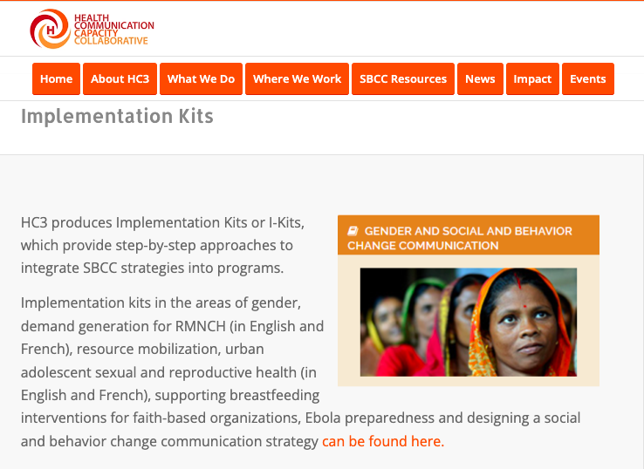
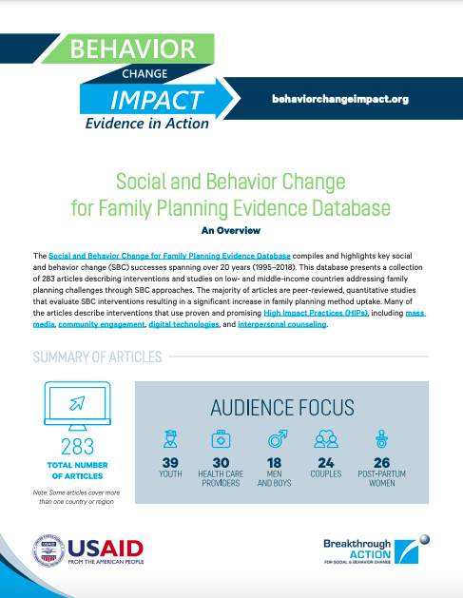
Tools & Resources
HC3 Implementation Kits
HC3 Family Planning Evidence Database
Notes:
Mass Media: The Evidence Base provides mass media campaign examples and makes the case for investment in quality mass media based on outcome modeling. Available from: http://www.who.int/woman_child_accountability/ierg/reports/2012_15S_MassMediaEvidenceBase.pdf
HC3 Implementation Kits provide step-by-step approaches and tools, including how-to guides, campaign spotlights, and implementation guides, to integrate SBC strategies into programs. Available from: https://healthcommcapacity.org/i-kits-sbccimplementationkits/
HC3 Family Planning Evidence Database presents a collection of 249 articles describing interventions or studies that address family planning challenges through SBC approaches. Available from: https://healthcommcapacity.org/family-planning-evidence-database/

Slide 21
fphighimpactpractices.org
Notes:
Subscribe to the HIPs Newsletter here (copy and paste this link into your web browser): https://mailchi.mp/76703a3652c9/hips-newsletter-sign-up
Please visit the five areas of our website to learn more about the HIPs:
HIP Products (copy and paste this link into your web browser): https://www.fphighimpactpractices.org/hip-products/
Resources (copy and paste this link into your web browser): https://www.fphighimpactpractices.org/resources/
Engage (copy and paste this link into your web browser): https://www.fphighimpactpractices.org/engage-with-the-hips/
Overview (copy and paste this link into your web browser): https://www.fphighimpactpractices.org/overview/
About Us (copy and paste this link into your web browser): https://www.fphighimpactpractices.org/partnership-structure/

