Slide 1
Promoting Healthy Couples’ Communication
To improve reproductive health outcomes.
Notes:
This brief focuses on improving healthy couples’ communication to improve reproductive health outcomes.
Photo credit: Deidre Schoo, Columbia University School of Public Health
REVISED: 2/23

Slide 2
Overview
What is a HIP?
HIP Categories
Partnership
Introduction to the High Impact Practices (HIPs)
PART
PART
Background
Theory of Change
Why is this practice important?
Evidence of Impact
Measurement and Indicators
Implementation Tips
Promoting Healthy Couples’ Communication
Extra Slides
Implementation Tips, continued
Tools and Resources
Notes:
Thank you for using this slide deck! This is a product derived from the HIP brief to assist you in presenting to a variety of audiences. Instructions and additional resources are included in the notes of each slide for your convenience. There is a wealth of information and resources in the “Notes” section of each slide.
This presentation is divided in three parts: an Introduction to the High Impact Practices (HIPs) in Family Planning, Promoting Healthy Couples’ Communication, and Extra Slides.
The logo for your organization or ministry may be added to these slides. The web addresses provided in the “Notes” section of each slide can be copied and pasted into your web browser.

Slide 3
High Impact Practices in Family Planning (HIPs) are…
Evidence-based family planning practices
Vetted by experts against specific criteria
Documented in an easy-to-use format
Notes:
High Impact Practices (HIPs) are a set of evidence-based family planning practices vetted by experts against specific criteria and documented in an easy-to-use format.
The High Impact Practices in Family Planning (HIPs) were first created in 2010 after a survey of FP stakeholders revealed little consensus for “what works” in international FP programming. A small group of leaders in FP were brought together with the task of identifying a short list of HIPs that if implemented at scale would help countries address the unmet need for FP and thereby increase national contraceptive prevalence.
HIPs are identified based on demonstrated magnitude of impact on contraceptive use and potential application in a wide range of settings. Consideration is also given to other relevant outcome measures including unintended pregnancy, fertility, or one of the primary proximate determinants of fertility (delay of marriage, birth spacing, or breast feeding). Evidence of replicability, scalability, sustainability, and cost-effectiveness are also considered.
For more information, please copy and paste this link into your web browser to see this video: https://www.youtube.com/watch?v=N6V0gfl-V3k&ab_channel=KnowledgeSUCCESS
A 2-pager overview of the HIPs is available in an online and a downloadable PDF format here (copy and paste this link into your web browser): https://www.fphighimpactpractices.org/high-impact-practices-in-family-planning-list/

Slide 4
HIPs address the full spectrum of FP programming
Enabling Environment
Service Delivery
Social and Behavioral Change
PART
Address systemic barriers that affect an individual’s ability to access family planning information & services. 8 briefs
Improve the availability, accessibility, acceptability, and quality of family planning services. 8 briefs
Influence knowledge, beliefs, behaviors, and social norms associated with family planning.
7 briefs
Enhancements
Approaches used in conjunction with HIPs to maximize the impact of HIP implementation or increase the reach. 4 briefs
Notes:
There are three categories of HIPs: Enabling Environment, Service Delivery and Social and Behavioral Change. Promoting healthy couples’ communication is a Social and Behavior Change HIP. This information came from the HIP List (copy and paste this link into your web browser): https://www.fphighimpactpractices.org/high-impact-practices-in-family-planning-list/
A HIP Enhancement is a tool or approach that is not a standalone practice, but it is often used in conjunction with HIPs to maximize the impact of HIP implementation or increase the reach and access for specific audiences. The intended purpose and impact of enhancements are focused and, therefore the evidence-based and impact of an enhancement is subjected to different standards than a HIP.
For more information about the HIP Categories and Enhancements, please copy and paste this link into your web browser: https://www.fphighimpactpractices.org/high-impact-practices-in-family-planning-list/
Here are a few examples of HIPs from each category:
Service Delivery:
Immediate Postpartum Family Planning
Mobile Outreach Services
Postabortion Family Planning
Enabling Environment:
Domestic Public Financing
Educating Girls
Supply Chain Management
Social and Behavior Change:
Community Group Engagement
Digital Health for SBC
Mass Media
Enhancements:
Digital Health for Systems
Adolescent-Responsive Contraceptive Services
Family Planning Vouchers
All HIPs are Available in English, Spanish, French, and Portuguese.

Slide 5
HIP Partnership
The Technical Advisory Group (TAG) is made up of 25 experts in family planning, including representatives from the co-sponsors.
The Co-sponsors include the following organizations:
Notes:
The High Impact Practices in Family Planning (HIPs) are supported by over 65 organizations. These organizations play a vital role in developing, reviewing, disseminating, and implementing HIPs in family planning.
The HIPs partnership includes various structures to ensure HIP products are developed, kept up to date, and disseminated widely. These include:
Co-sponsors – Serve as the secretariat for the HIPs.
Partners – Contribute to key HIP products and endorse the HIPs.
Technical Advisory Group – Ensure high technical quality of key HIP products and approve HIP brief and SPG concepts for development.
P&D Team – Support the production and dissemination (P&D) of HIP products.
Technical Expert Groups – Write new HIP briefs and ensure they are up-to-date.
For more information about the HIP Partnership, please copy and paste this link into your web browser: https://www.fphighimpactpractices.org/partnership-structure/

Slide 6
High Impact Practice
Implement interventions demonstrated to encourage couples to discuss family planning/reproductive health and make equitable, joint decision to reach fertility intentions.
Notes:
This brief focuses on improving healthy couples’ communication to improve reproductive health outcomes.

Slide 7
Background
Couples’ Communication:
A form of interpersonal communication that entails the exchange or sharing of information, thoughts, ideas, intentions, and feelings between sexual partners.
It is critical to ensure that “all couples and individuals have the basic right to decide freely and responsibly the number and spacing of their children.”
Notes:
Several studies show a positive association between couples discussing their fertility intentions with joint decision making on whether or when to have children.
Supporting healthy couples’ communication can increase the uptake of modern contraceptive use while meeting the HIP principle of “gender equality,” or “endeavor[ing] to be inclusive of women and men by removing barriers to their active engagement and decision-making, recognizing the role of family planning in supporting more equitable power dynamics and healthy relations.”
Recently, there has been attention to power related to sexual decision making and healthy sexual relationships (e.g., consent, bodily autonomy, pleasure), with a need to “better support couples in building practical skills to increase intimacy and communication.”
Access to modern contraceptive methods and reproductive autonomy are fundamental human rights. Individuals must be able to access contraception as their individual right. Involvement of the male partner should not prevent women from choosing contraception free from the influence of a male partner.
For more information, please copy and paste this link into your web browser to reference the “Background” section on the HIP brief: https://www.fphighimpactpractices.org/briefs/couple-communication/

Slide 8
Background
Couples’ Communication is influenced by:
Policies
Attitudes
Values
Culture
Social and gender norms
Individual’s immediate environment
Notes:
For more information, please copy and paste this link into your web browser to reference the “Background” section on the HIP brief: https://www.fphighimpactpractices.org/briefs/couple-communication/

Slide 9
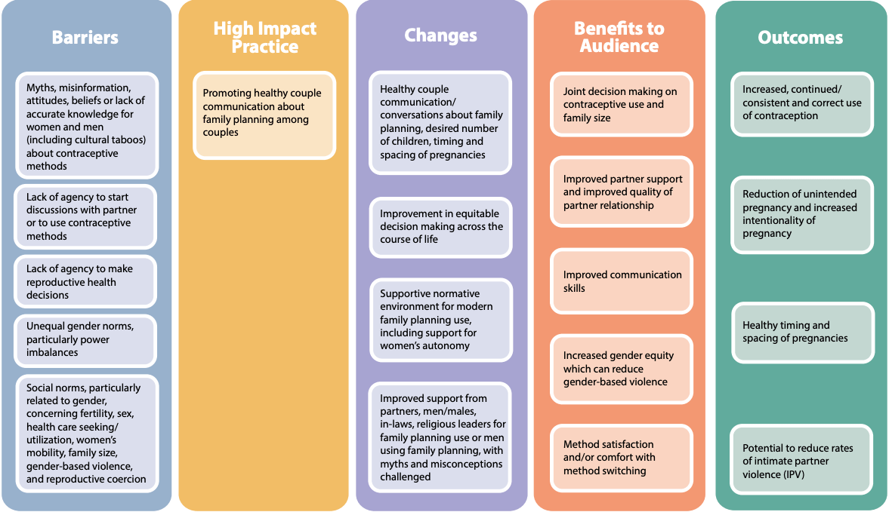
Theory of
Change
BACKGROUND
Notes:
View Figure 1 in the HIP brief (copy and paste this link into your web browser): https://www.fphighimpactpractices.org/briefs/couple-communication/

Slide 10
Why is this practice important?
All couples can benefit from improved couples’ communication.
Healthy couples’ communication can increase uptake of modern contraception and help couples achieve their fertility intentions.
Promoting healthy couples’ communication can also impact gender equality.
Notes:
All couples can benefit from improved couples’ communication.
A study found that couples counseling on contraception helped male partners “realize that spacing pregnancies is directly related to the overall health and financial security of their family,” as well as leading to overall improvements in a marital relationship.
The needs of men and women do not have to be pitted against each other, but can be seen as complementary.
Healthy couples’ communication can increase uptake of modern contraception and help couples achieve their fertility intentions.
Joint couple-level fertility desires are important for contraceptive use.
Promoting healthy couples’ communication can also impact gender equality.
Men may find it challenging to access accurate contraceptive information as most services are geared to women.
Couples’ communication about contraception may help to bridge this gap as women share family planning information they may know and as couples become open to going to family planning services together.

Slide 11
Evidence of Impact
Successful social behavior change (SBC) efforts to improve healthy couples’ communication that have also resulted in uptake of modern contraception have been documented through: counseling sessions with couples, reaching men through trained peer educators, participatory small group discussions, mass media, TV advertisements, serial radio dramas and trained staff.
Notes:
The Promoting Healthy Couples’ Communication HIP brief contains highlights from intervention studies in India, Malawi, Nigeria, Kenya, and El Salvador. For more information, please copy and paste this link into your web browser: https://www.fphighimpactpractices.org/briefs/couple-communication/

Slide 12
Evidence of Impact:
India
The CHARM intervention entailed family planning and gender equity counseling sessions for men and couples. Trained male village health care providers delivered the sessions.
Women in the intervention group were more likely to report contraceptive communication at 9-month follow-up compared to the control group.
Women in the intervention group were more likely to report modern contraceptive use at 9 and 18-month follow-up compared to the control group.
Notes:
The Promoting Healthy Couples’ Communication HIP brief contains highlights from intervention studies in India, Malawi, Nigeria, Kenya, and El Salvador. For more information, please copy and paste this link into your web browser: https://www.fphighimpactpractices.org/briefs/couple-communication/
Intervention: The CHARM intervention entailed three family planning and gender equity (FP+GE) counseling sessions for men and couples. Trained male village health care providers delivered the counseling sessions.
Women in the intervention group were more likely to report contraceptive communication at 9-month follow-up compared to the control group.
Women in the intervention group were more likely to report modern contraceptive use at 9 and 18-month follow-up compared to the control group.
Women in the intervention group were less likely to report sexual intimate partner violence (IPV) at 18-month follow-up. Men in the intervention group were less likely than those in the control to report attitudes accepting of sexual and physical IPV at 18-month follow-up.
View Table 1 in the HIP brief (copy and paste this link into your web browser): https://www.fphighimpactpractices.org/briefs/couple-communication/

Slide 13
Measurement and Indicators
High Impact Practice
Number or percentage of intended audience who reported seeing family planning messages promoting communication among couples about family planning in the past 3 months by channel (e.g. social media, television, radio, community meetings).
Changes
Number or percentage of intended audience who discussed contraceptive use with their partner in the past 3 months.
Benefits to Audience
Percentage of women who state that use of modern contraception is their decision or a joint decision with their partner.
Notes:
These are illustrative indicators based on the Theory of Change that can be collected from a variety of data sources such as routine monitoring systems, remote mobile-based surveys, or household surveys such as PMA (https://www.pmadata.org/) and DHS (https:// dhsprogram.com/).

Slide 14
Implementation Tips
Address gender and power dynamics, including gender-based violence (GBV).
Use a a gender-synchronized approach to ensure that interventions are mutually reinforcing.
Direct engagement in problem solving can help to strengthen couples’ communication.
Notes:
Address gender and power dynamics, including gender-based violence (GBV).
Use a a gender-synchronized approach to ensure that interventions are mutually reinforcing.
A gender-synchronized approach is defined as working with both sexes in a mutually reinforcing way, to challenge restrictive gender norms, catalyzing the achievement of gender equality.
Direct engagement in problem solving can help to strengthen couples’ communication.

Slide 15
Implementation Tips
Search out existing platforms and spaces where boys and men can access information about sex, sexual relationships, reproductive health, and family planning information and services.
Working with existing groups can be a more efficient and sustainable way to reach men and boys.
Discussions around family planning should focus on family well-being plus family size and not just methods.

Slide 16
Thank You
Continue to the extra slides or access the HIP brief for more information.

Slide 17
Extra Slides
Implementation Tips
Tools and Resources
Notes:
We have put together a collection of implementation tips for Promoting Healthy Couples’ Communication in case you have additional time in your meeting. Further information about these tips can be found in the HIP brief.
References from the literature on this HIP can be found here (copy and paste this link into your web browser): https://www.fphighimpactpractices.org/briefs/couple-communication/

Slide 18
Implementation Tips
Ensure that interventions “do not harm” to undermine women’s autonomy.
A key lesson learned was that attention to gender and power dynamics is critical.
It is critical to ensure that in the context of promoting healthy couples’ communication, each person can individually access reproductive health information and services as well as services related to GBV as needed.
Notes:
Ensure that interventions “do not harm” to undermine women’s autonomy.
A key lesson learned was that attention to gender and power dynamics is critical.
An intervention to increase male involvement in family planning and couples counseling in Zimbabwe used media messages to reach men.
The messages in the campaign used football images and analogies, with wives as teammates, service providers as coaches, and small families as the goal. Twice as many men as women heard the ads.
The analysis indicates that “respondents were 1.6 times more likely to use a modern family planning method if they were exposed to at least three components of the multimedia campaign. Both men and women reported increased discussion with spouses about family planning.
However, the campaign, while increasing couples’ communication resulting in uptake of modern contraception, also resulted in a significant increase in men believing that they alone should take responsibility for choosing a method, getting family planning information, and going to a clinic to seek family planning services, reducing women’s autonomy and increasing gender inequality.
In certain studies, some women who reported experiencing gender based violence (GBV) from their husbands were more likely to use contraception without informing their husbands.
There are numerous reports of both women and men accessing modern contraceptive methods in secret or using clandestine methods such as injectables or intrauterine devices, fearing either coercion, disapproval, abandonment, or GBV from their partner.
It is critical to ensure that in the context of promoting healthy couples’ communication, each person can individually access reproductive health information and services as well as services related to GBV as needed.

Slide 19
Implementation Tips
Norms of masculinity should be addressed.
The decision-making power of a husband can significantly reduce women’s likelihood of using contraceptives, as harmful norms of masculinity in certain contexts may lead men to demonstrate their virility by fathering numerous children.
When possible, it is important to incorporate discussions of sexual pleasure in the context of sex and contraception.

Slide 20
Implementation Tips
Find creative and culturally appropriate ways to address women’s and men’s skills and perceived self-efficacy to communicate with their partners effectively.
Individuals may need to learn and/or practice new skills before attempting to communicate with a partner.
Programs may need to provide safe spaces for women to practice skills and possible prompts within a same sex group of trusted peers.
Notes:
Find creative and culturally appropriate ways to address women’s and men’s skills and perceived self-efficacy to communicate with their partners effectively.
Individuals may need to learn and/or practice new skills before attempting to communicate with a partner Need to have confidence that they can communicate without fear of conflict and/or other risks.
They need to have confidence that they can communicate without fear of conflict and/or other risks.
Programs may need to provide safe spaces for women to practice skills and possible prompts within a same sex group of trusted peers.

Slide 21
Implementation Tips
Consider and plan for the special requirements and challenges of couples counseling sessions.
Contraception may be a taboo subject, and auditory and visual privacy are essential for the couples who agree to joint counseling.

Slide 22
Implementation Tips
Provide opportunities and job aids for those who offer health and family planning services.
Pre-service and in-service training for providers as well as simple counseling tools/aids/ checklists/apps can make counseling easier.
Policies that ensure that women who want their partners to accompany them to counseling sessions may invite them to do so are important and may facilitate healthy couples’ communication.

Slide 23
Implementation Tips
Identify and provide opportunities for respected couples in the community to model and talk about their healthy communication habits.
SBC programs may help individuals make this assessment by showcasing role model couples and their actions through radio dramas, personal testimonials, and community discussions.

Slide 24
Implementation Tips
Use social networks over time to spread the innovation of healthy couples’ communication through training and other mechanisms.
Media representations of couples communicating should demonstrate the positive impact of healthy couples’ communication.
Notes:
Use social networks over time to spread the innovation of healthy couples’ communication through training and other mechanisms.
Media representations of couples communicating should demonstrate the positive impact of healthy couples’ communication.
Successful SBC programs identify:
How the audience thinks of couples who are communicating about sexual and reproductive healthy and family planning issues.
Opinion leaders in the local network.
Messages that address concerns about healthy couples’ communication.

Slide 25
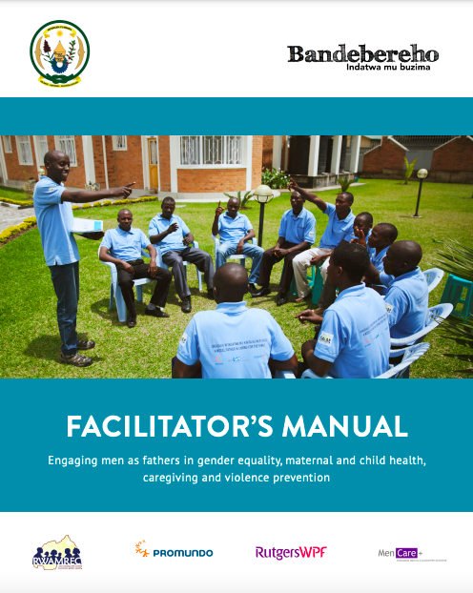
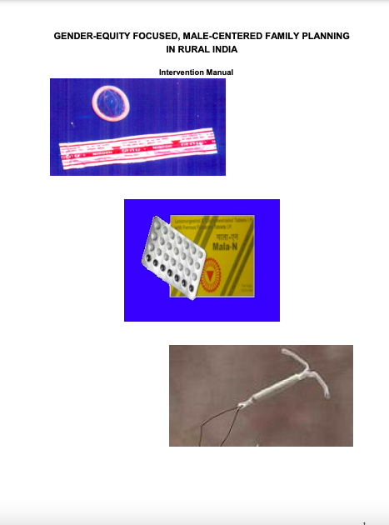
Tools and Resources
Save the Children: Male Motivator Training Curriculum
Bandeberecho Facilitator’s Manual: Engaging men as fathers
UCSD: Charm Manual
Notes:
Save the Children. 2007. Male Motivator Training Curriculum is an approach designed to engage men to break down gender norms leading to male-initiated couples’ communication about family planning. Men who use modern contraception are identified and trained as male motivators and visit other men in the communities to provide information on contraception, plus practice skills to discuss fertility desires with wives. Available from: https://resourcecentre.savethechildren.net/document/male-motivator-training-curriculum-malawi/
Rwanda Men’s Resource Center, Promundo-US and Rutgers WPF. 2013. Bandeberecho Facilitator’s Manual: Kigali, Rwanda; Washington, DC, USA; Utrecht, the Netherlands is a tool designed for participatory community engagement activities on gender equality, family planning, parenting, violence, and caregiving. Available from: https://men-care.org/wp-content/uploads/2015/08/Bandebereho-Facilitators-Manual-Fathers.pdf
UCSD. CHARM Manual is a manual designed to enhance the knowledge of health care practitioners on ways to address gender issues among young married couples in choosing and exercising their family planning options. Available from: https://geh.ucsd.edu/wp-content/uploads/2021/03/intervention_manual.pdf
Note: If your program is addressing GBV in addition to healthy couples’ communication, there is a wealth of resources that you can consult, such as: https://prevention-collaborative.org; https://www.unwomen.org/en/digital-library/publications/2020/07/respect-women-implementation-package and https://www.whatworks.co.za/

Slide 26
fphighimpactpractices.org
Notes:
Subscribe to the HIPs Newsletter here (copy and paste this link into your web browser): https://mailchi.mp/76703a3652c9/hips-newsletter-sign-up
Please visit the five areas of our website to learn more about the HIPs:
HIP Products (copy and paste this link into your web browser): https://www.fphighimpactpractices.org/hip-products/
Resources (copy and paste this link into your web browser): https://www.fphighimpactpractices.org/resources/
Engage (copy and paste this link into your web browser): https://www.fphighimpactpractices.org/engage-with-the-hips/
Overview (copy and paste this link into your web browser): https://www.fphighimpactpractices.org/overview/
About Us (copy and paste this link into your web browser): https://www.fphighimpactpractices.org/partnership-structure/

