Slide 1
Social Accountability
To improve family planning information and services.
Notes:
This brief focuses on social accountability approaches for family planning that are designed with the following criteria: 1) primarily operate at the subnational level, where the community and health facility intersect; 2) involve a high degree of community influence and control; 3) are largely collaborative in nature rather than confrontational; 4) facilitate community voice and bolster service provider/power holder responsiveness; and 5) are structured, facilitated, and transparent processes that create safe and inclusive space for effective dialogue and negotiation.
Photo credit: Images of Empowerment
REVISED: 2/23

Slide 2
Overview
What is a HIP?
HIP Categories
Partnership
Introduction to the High Impact Practices (HIPs)
PART
Background
Theory of Change
What challenges can this HIP help address?
What is the impact?
Implementation measurement
PART
Social Accountability
Extra Slides
Implementation Tips
Priority Research Questions
Tools & Resources
Notes:
Thank you for using this slide deck! This is a product derived from the HIP brief to assist you in presenting to a variety of audiences. Instructions and additional resources are included in the notes of each slide for your convenience. There is a wealth of information and resources in the “Notes” section of each slide.
This presentation is divided in three parts: an Introduction to the High Impact Practices (HIPs) in Family Planning, Social Accountability, and Extra Slides.
The logo for your organization or ministry may be added to these slides. The web addresses provided in the “Notes” section of each slide can be copied and pasted into your web browser.

Slide 3
High Impact Practices in Family Planning (HIPs) are…
Evidence-based family planning practices
Vetted by experts against specific criteria
Documented in an easy-to-use format
Notes:
High Impact Practices (HIPs) are a set of evidence-based family planning practices vetted by experts against specific criteria and documented in an easy-to-use format.
The High Impact Practices in Family Planning (HIPs) were first created in 2010 after a survey of FP stakeholders revealed little consensus for “what works” in international FP programming. A small group of leaders in FP were brought together with the task of identifying a short list of HIPs that if implemented at scale would help countries address the unmet need for FP and thereby increase national contraceptive prevalence.
HIPs are identified based on demonstrated magnitude of impact on contraceptive use and potential application in a wide range of settings. Consideration is also given to other relevant outcome measures including unintended pregnancy, fertility, or one of the primary proximate determinants of fertility (delay of marriage, birth spacing, or breast feeding). Evidence of replicability, scalability, sustainability, and cost-effectiveness are also considered.
For more information, please copy and paste this link into your web browser to see this video: https://www.youtube.com/watch?v=N6V0gfl-V3k&ab_channel=KnowledgeSUCCESS
A 2-pager overview of the HIPs is available in an online and a downloadable PDF format here (copy and paste this link into your web browser): https://www.fphighimpactpractices.org/high-impact-practices-in-family-planning-list/

Slide 4
HIPs address the full spectrum of FP programming
Enabling Environment
Service Delivery
Social and Behavioral Change
PART
Address systemic barriers that affect an individual’s ability to access family planning information & services. 8 briefs
Improve the availability, accessibility, acceptability, and quality of family planning services. 8 briefs
Influence knowledge, beliefs, behaviors, and social norms associated with family planning.
7 briefs
Enhancements
Approaches used in conjunction with HIPs to maximize the impact of HIP implementation or increase the reach. 4 briefs
Notes:
There are three categories of HIPs: Enabling Environment, Service Delivery and Social and Behavioral Change. Social Accountability is an Enabling Environment HIP. This information came from the HIP List (copy and paste this link into your web browser): https://www.fphighimpactpractices.org/high-impact-practices-in-family-planning-list/
A HIP Enhancement is a tool or approach that is not a standalone practice, but it is often used in conjunction with HIPs to maximize the impact of HIP implementation or increase the reach and access for specific audiences. The intended purpose and impact of enhancements are focused and, therefore the evidence-based and impact of an enhancement is subjected to different standards than a HIP.
For more information about the HIP Categories and Enhancements, please copy and paste this link into your web browser: https://www.fphighimpactpractices.org/high-impact-practices-in-family-planning-list/
Here are a few examples of HIPs from each category:
Service Delivery:
Immediate Postpartum Family Planning
Mobile Outreach Services
Postabortion Family Planning
Enabling Environment:
Domestic Public Financing
Educating Girls
Supply Chain Management
Social and Behavior Change:
Community Group Engagement
Digital Health for SBC
Mass Media
Enhancements:
Digital Health for Systems
Adolescent-Responsive Contraceptive Services
Family Planning Vouchers
All HIPs are Available in English, Spanish, French, and Portuguese.

Slide 5
HIP Partnership
The Technical Advisory Group (TAG) is made up of 25 experts in family planning, including representatives from the co-sponsors.
The Co-sponsors include the following organizations:
Notes:
The High Impact Practices in Family Planning (HIPs) are supported by over 65 organizations. These organizations play a vital role in developing, reviewing, disseminating, and implementing HIPs in family planning.
The HIPs partnership includes various structures to ensure HIP products are developed, kept up to date, and disseminated widely. These include:
Co-sponsors – Serve as the secretariat for the HIPs.
Partners – Contribute to key HIP products and endorse the HIPs.
Technical Advisory Group – Ensure high technical quality of key HIP products and approve HIP brief and SPG concepts for development.
P&D Team – Support the production and dissemination (P&D) of HIP products.
Technical Expert Groups – Write new HIP briefs and ensure they are up-to-date.
For more information about the HIP Partnership, please copy and paste this link into your web browser: https://www.fphighimpactpractices.org/partnership-structure/

Slide 6
High Impact Practice
Engage communities and health sector actors in a collaborative process to jointly identify problems, and to implement and monitor solutions to hold each other accountable for improvements in quality and responsiveness of family planning services.
Notes:
This brief focuses on social accountability approaches for family planning that are designed with the following criteria: 1) primarily operate at the subnational level, where the community and health facility intersect; 2) involve a high degree of community influence and control; 3) are largely collaborative in nature rather than confrontational; 4) facilitate community voice and bolster service provider/power holder responsiveness; and 5) are structured, facilitated, and transparent processes that create safe and inclusive space for effective dialogue and negotiation.

Slide 7
Background
Social accountability:
Collective efforts of individuals and communities (rights holders) to hold service providers, government officials, and other decision makers (duty bearers) to account for the quality, effectiveness, and equitable provision of services.
Can sometimes result in confrontation between different actors given local power dynamics.
Notes:
For more information, please copy and paste this link into your web browser to reference the “Background” section on the HIP brief: https://www.fphighimpactpractices.org/briefs/social-accountability/

Slide 8
Background
The social accountability approach:
A non-governmental organization or local civil society organization initiate conversations with key health system stakeholders.
A series of facilitated discussions with the community members are convened to solicit their concerns; A similar series is held with health providers.
Once all stakeholders have been heard, they together prioritize the issues to tackle and discuss how these issues could be addressed.
Notes:
The social accountability approach:
Often starts with with a non-governmental organization or local civil society organization initiating conversations with key health system stakeholders, during which the benefits of increasing dialogue between the community and health workers is shared and their support and co-ownership garnered.
Next, a series of facilitated discussions with the community members, including key groups (e.g., women, youth, marginalized), are convened to solicit their concerns, discuss barriers to service use, and prioritize areas of most concern.
A similar series of facilitated discussions is held with health providers to give them the opportunity to voice their concerns openly, and to prioritize the biggest problems from their perspective.
Once all stakeholders have had a chance to be fully heard, an interface meeting can be held where each side shares challenges and concerns, and together prioritize the issues to tackle and discuss how these issues could be addressed.
At regular intervals the community and health providers come back together to jointly review progress in an ongoing accountability process.
For more information, please copy and paste this link into your web browser to reference the “Background” section on the HIP brief: https://www.fphighimpactpractices.org/briefs/social-accountability/

Slide 9
Background
Generic and branded tools to facilitate social accountability processes:
Community Score Card (CSC)
Citizen Voice and Action (CVA)
Public hearings
Social audits
Notes:
Community Score Card (CSC)
Is a two-way and ongoing participatory tool for assessment, planning, monitoring and evaluation of services.
The main goal is to positively influence the quality, efficiency and accountability with which services are provided at different levels.
Citizen Voice and Action (CVA)
Is a local level advocacy methodology that transforms the dialogue between communities and government in order to improve services, like health care and education, which impact the daily lives of children and their families.
The goal is to improve the accessibility and quality of public services.
Public Hearings
Social Audits
See Appendix for further descriptions of these approaches: https://www.fphighimpactpractices.org/wp-content/uploads/2022/08/SocialAccountability-Appendix_Aug2022_ENG.pdf
For more information, please copy and paste this link into your web browser to reference the “Background” section on the HIP brief: https://www.fphighimpactpractices.org/briefs/social-accountability/

Slide 10
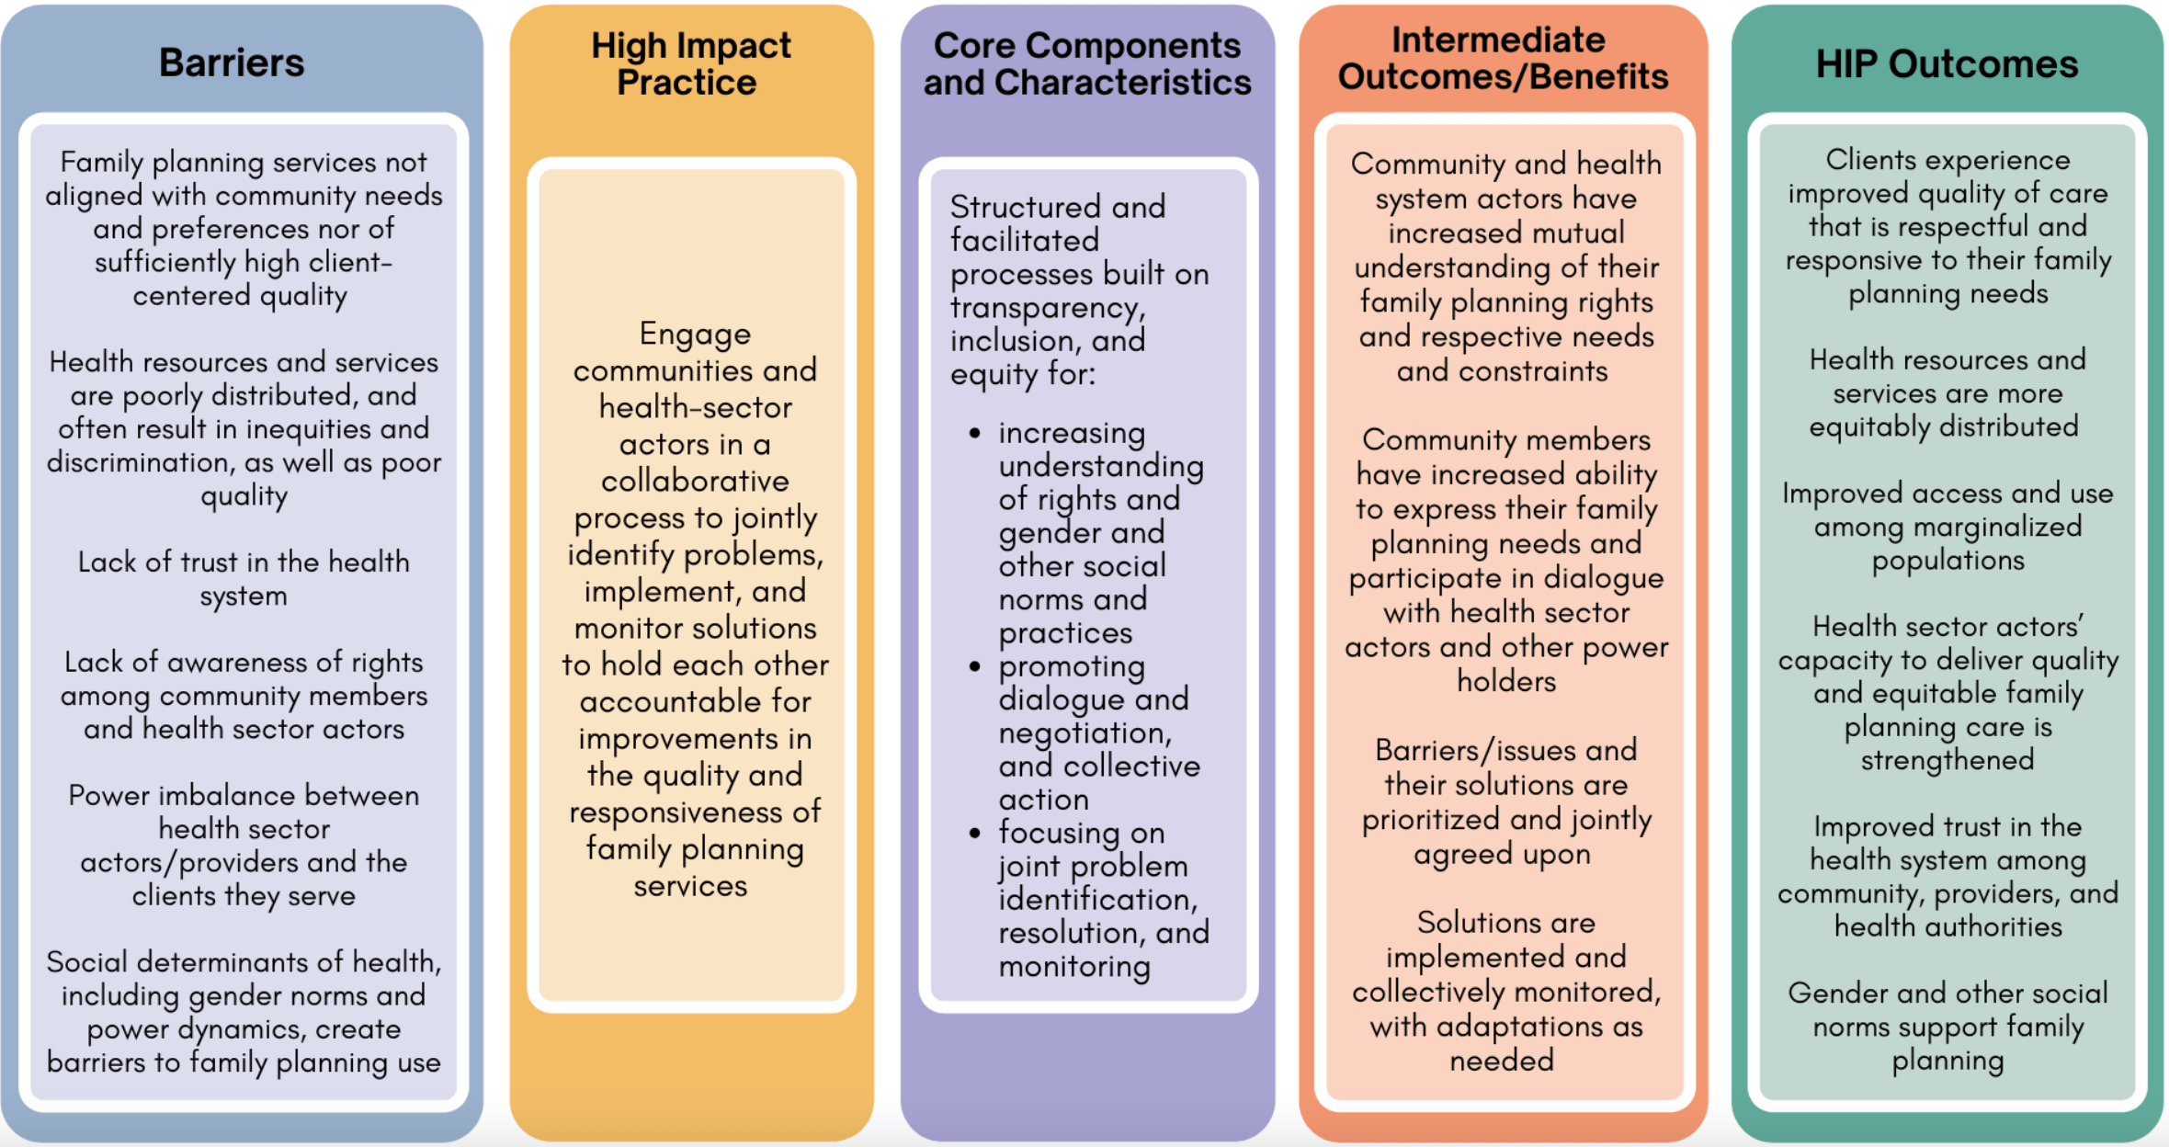
Theory of
Change
BACKGROUND
Notes:
View Figure 1 in the HIP brief (copy and paste this link into your web browser): https://www.fphighimpactpractices.org/briefs/social-accountability/

Slide 11
What Challenges Can This HIP Help Address?
Services not aligned with community needs and preferences can impede service use.
Poor policy implementation and budget allocation to health facilities lead to poor services, inequities, and discrimination.
Lack of trust in the health system discourages people from accessing services.
Notes:
Services not aligned with community needs and preferences can impede service use.
Negative attitudes of providers, and their own resource and technical constraints, can get in the way of providing high-quality services responsive to community needs.
Social accountability can fundamentally change how communities and health system actors approach and address the challenges they face. When structured appropriately, these mechanisms can mitigate distrust and fear amongst stakeholders and evolve to address new and emerging needs, challenges, and issues and increase citizen engagement and community ownership of health services.
In Ghana, use of scorecards to engage multiple stakeholders to improve maternal health services resulted in improved care, in addition to an improved culture of accountability, increased community participation and transparency, and clarified lines of accountability among decision makers.
Poor policy implementation and budget allocation to health facilities lead to poor services, inequities, and discrimination.
Social accountability processes have led to better defined and coordinated policies, budgets, and plans including increased ability of providers and managers to advocate for needs with higher levels of the health system (e.g., state/province or national), and increased allocation and reallocation of resources including for marginalized groups.
Lack of trust in the health system discourages people from accessing services.
The process of sharing information, discussion, and negotiation can transform trust within health systems.
Use of community scorecards in humanitarian settings, has been shown to build trust and increase service utilization.

Slide 12
What Challenges Can This HIP Help Address?
When communities are unaware of their rights and entitlements, or have low self-efficacy to obtain them, they are less likely to demand them from health sector actors.
Social determinants, specifically unequal power dynamics and gender norms, create barriers to family planning use.
Notes:
When communities are aware of their rights and entitlements, or have low self-efficacy to obtain them, they are entitlements, or have low self-efficacy to obtain them, they are less likely to demand them from health sector actors.
Accountability is a cornerstone of ensuring that human rights, including the right to the highest attainable standard of sexual and reproductive health, are upheld.
Social accountability has promoted greater awareness of rights among citizens and health sector actors.
Social determinants, specifically unequal power dynamics and gender norms, create barriers to family planning use.
Social accountability efforts can confront and transform adverse power relationships by providing space for different groups (e.g., women, men, youth, local leaders, and providers, including the most vulnerable in communities) to share issues and to make sure their voices are heard and not drowned out by the more powerful.

Slide 13
What is the Impact?
Social accountability programs can disrupt and realign the governance structures and systems that affect an individual’s ability to access family planning information and services.
Social accountability interventions have made family planning services more responsive to client needs.
Since social accountability is intended to improve client experience, system responsiveness, and equitable access among other factors, evidence of the direct effects on contraceptive use and continuation is more limited.

Slide 14
Implementation Measurement
Percent of community/health facility catchment areas that have functional mechanisms for engaging communities (especially women and marginalized groups) in the design, implementation, and monitoring of family planning service delivery.
Percent of women and/or number of marginalized groups who participate in functional accountability mechanisms that include family planning.
Clients in the catchment area with social accountability mechanisms experience improved quality of care that is respectful and responsive to their family planning needs (e.g., measured from community scorecards).

Slide 15
Thank You
Continue to the extra slides or access the HIP brief for more information.

Slide 16
Extra Slides
Implementation Tips
Priority Research Questions
Tools & Resources
Notes:
We have put together a collection of implementation tips for Social Accountability, in case you have additional time in your meeting. Further information about these tips can be found in the HIP brief.
References from the literature on this HIP can be found here (copy and paste this link into your web browser): https://www.fphighimpactpractices.org/briefs/social-accountability/

Slide 17
What is the Impact?
Malawi
Intervention: CARE Community Score Cards in Malawi lead to:
Health resources and services more equitably distributed, leading to improved access and use among vulnerable populations.
Health sector actors’ capacity to deliver quality and equitable family planning care is strengthened.
Client experienced improved quality of care that is responsive to their needs.

Slide 18
Implementation Tips
Set the stage for a collaborative process.
Securing buy-in and meaningful participation of health system actors is key to success.
Health officials and service providers may fear being attacked and blamed; giving them an opportunity to express their frustrations and vocalize those feelings, as well as assuring them that the process is not about finger-pointing and blame is an important first step.
Notes:
Set the stage for a collaborative process.
Securing buy-in and meaningful participation of health system actors is key to success.
Provide space at the beginning of the process to sensitize different actors on health rights, family planning, responsibilities, and accountability.
This can help ensure everyone has investment in the process, the challenges of different actors (community and health facility staff) are understood, misconceptions are addressed, and there is mutual understanding and respect.
Health officials and service providers may fear being attacked and blamed; giving them an opportunity to express their frustrations and vocalize those feelings, as well as assuring them that the process is not about finger-pointing and blame is an important first step.
Prior to meeting with the frontline health workers, sessions with district-level health officials and managers can focus on how the approach can help solve issues they face (e.g., targeting limited resources, improving health indicators), clarify roles and responsibilities, and facilitate shared ownership of the process.
In some cases, adapting language can help smooth the way, i.e., focusing on improvements in quality, equity, and responsiveness, as opposed to stressing “rights” and “accountability” as key phrases.
Take the time to listen to health providers and analyze with them what the barriers are to providing responsive services, what they would like to see change, and what benefits might come from participation in the process.
Finally, securing buy-in and engagement from community members and health facility staff is a continuous process; lack of participation and motivation will limit the effectiveness of social accountability approaches.

Slide 19
Implementation Tips
Identify the right problems to address.
Working with the community and health system stakeholders to identify and respond to needs they themselves identify is crucial.
Be mindful of, and adapt to, the contextual factors that may limit participation by community members, including literacy, social determinants, gender norms, and power dynamics and trust within the community and between the community and the health facility/system.
Notes:
Identify the right problems to address.
It is important to understand the context when selecting a social accountability approach and tools; tools and approaches used in “one setting may not achieve the same outcomes in a different setting.”
Working with the community and health system stakeholders to identify and respond to needs they themselves identify is crucial.
It is important that interventions are informed by and developed with a diverse range of locally relevant stakeholders from the community and the health facility/system, so that they are tailored to their needs and contexts.
Be mindful of, and adapt to, the contextual factors that may limit participation by community members, including literacy, social determinants (the conditions in which people are born, work, and live), gender norms, and power dynamics and trust within the community and between the community and the health facility/system.

Slide 20
Implementation Tips
A structured and facilitated process built on transparency, inclusion, and equity.
Social accountability processes should be built on raising awareness among health providers and communities about their rights and entitlements.
Notes:
A structured and facilitated process built on transparency, inclusion, and equity.
Social accountability processes should be built on raising awareness among health providers and communities about their rights and entitlements, and standards of client-centered family planning care they should receive, as well as information about the quality and characteristics of services currently available to them.

Slide 21
Implementation Tips
Promote dialogue, negotiation, and collective action.
Ensuring a supportive environment where everyone feels listened to, understood, and not blamed or reproached, can lead to improved service delivery and policy outcomes.
Ensure good and practiced facilitation, which recognizes and seeks to alter the existing power imbalances within the community and between the community and health facility/system.
Notes:
Promote dialogue, negotiation, and collective action.
Ensuring a supportive environment where everyone—from marginalized groups to health workers—feels listened to, understood, and not blamed or reproached, can lead to improved service delivery and policy outcomes.
Ensure good and practiced facilitation, which recognizes and seeks to alter the existing power imbalances within the community and between the community and health facility/system.
Combine activities: combining health education, outreach, civic education, and community dialogue can be beneficial in addressing local gender dynamics, which can affect women and young people’s ability to participate in community sensitization or outreach services.
Ensure communities direct how best their requests and demands are communicated, especially where they fear potential reprisal.
Conduct discussions with specific segments of the population (e.g., women, youth, persons with disabilities) to ensure that marginalized voices are not overpowered by those who are more dominant within the community.
Experienced, well-trained facilitators are essential to managing relationships, and ensuring regular and productive interactions between health facility staff and the community.

Slide 22
Implementation Tips
Sustainability
Effective social accountability approaches can contribute to the increased resilience of the health system even in times of crises.
To be sustainable, communities need to value the social accountability approaches and see their continued utility in addressing their needs.
Notes:
Sustainability
Effective social accountability approaches can contribute to the increased resilience of the health system even in times of crises.
To be sustainable, communities need to value the social accountability approaches and see their continued utility in addressing their needs.

Slide 23
Priority Research Questions
What factors promote the integration, scalability, and sustainability of social accountability processes geared to improving the quality and utilization of family planning services?
How, if at all, can accountability at global, regional, and national levels be aligned with local social accountability initiatives (e.g., community scorecards) for system-wide change in family planning?
Notes:
These research questions, reviewed by the HIP technical advisory group, reflect the prioritized gaps in the evidence base specific to the topics reviewed in this brief and focus on the HIP criteria.

Slide 24
Priority Research Questions
How can social accountability approaches designed to improve family planning outcomes work in settings where there is less community cohesion and less spare time to participate in community activities, e.g., urban areas, countries responding to shocks (e.g., armed conflict, climate- and pandemic-related conflict), pastoralist communities, and areas with internally displaced persons?
How can we best measure increases in trust as an outcome of social accountability initiatives?
Notes:
These research questions, reviewed by the HIP technical advisory group, reflect the prioritized gaps in the evidence base specific to the topics reviewed in this brief and focus on the HIP criteria.

Slide 25
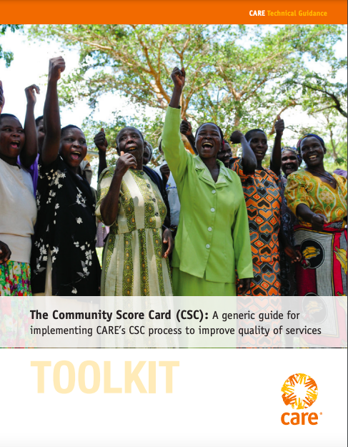
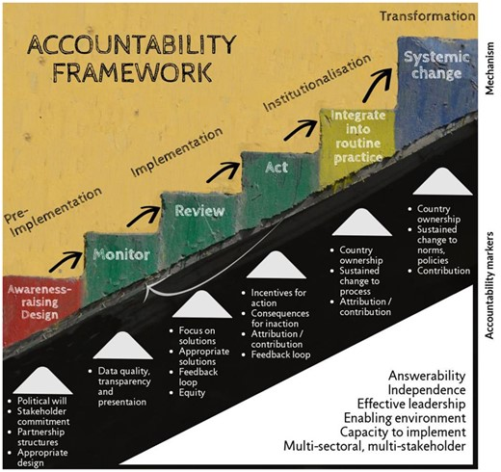
Tools & Resources
Social Accountability Resources and Tools
Citizen Voice and Action Field Guide
Community Score Card (CSC) Implementation Guidance
Accountability Measurement Framework Tool
Notes:
Social Accountability Resources and Tools. USAID. Available from:
https://coregroup.org/resource-library/social-accountability-resources-and-tools/
Citizen Voice and Action Field Guide. World Vision. Available from: https://www.wvi.org/sites/default/files/CVA_Field_Guide_0.pdf
CARE’s Community Score Card© (CSC). CARE. Available from:
https://www.care.org/wp-content/uploads/2020/05/FP-2013-CARE_CommunityScoreCardToolkit.pdf
Community Score Card Implementation Guidance. CARE. Available from:
https://www.care.org/wp-content/uploads/2020/05/FP-2013-CARE_CommunityScoreCardToolkit.pdf
Accountability Measurement Framework Tool. London School of Hygiene and Tropical Medicine. Available from: https://academic.oup.com/heapol/article/35/7/765/5851094

Slide 26
fphighimpactpractices.org
Notes:
Subscribe to the HIPs Newsletter here (copy and paste this link into your web browser): https://mailchi.mp/76703a3652c9/hips-newsletter-sign-up
Please visit the five areas of our website to learn more about the HIPs:
HIP Products (copy and paste this link into your web browser): https://www.fphighimpactpractices.org/hip-products/
Resources (copy and paste this link into your web browser): https://www.fphighimpactpractices.org/resources/
Engage (copy and paste this link into your web browser): https://www.fphighimpactpractices.org/engage-with-the-hips/
Overview (copy and paste this link into your web browser): https://www.fphighimpactpractices.org/overview/
About Us (copy and paste this link into your web browser): https://www.fphighimpactpractices.org/partnership-structure/

