Slide 1
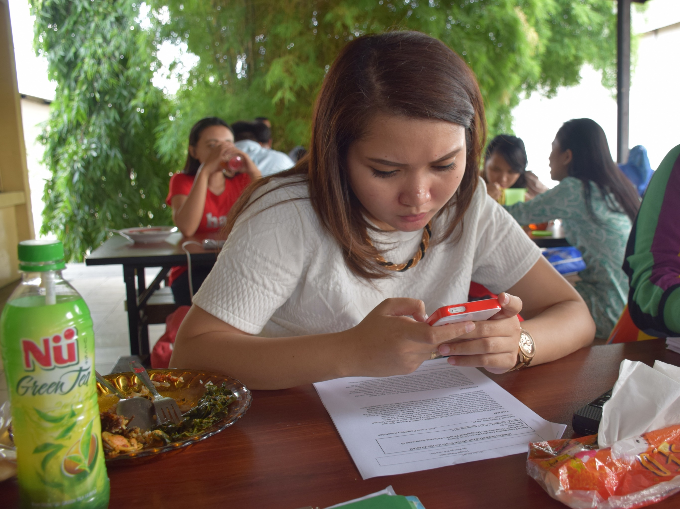
Digital Health for Social and Behavior Change
New technologies, new ways to reach people.
Notes:
Using digital technologies—such as mobile phones, computers, or tablets—to convey information and messages as part of an evidence-based multichannel social and behavior change (SBC) strategy may contribute to promoting, adopting, and maintaining healthy sexual and reproductive behavior. This brief summarizes the current state of evidence in this rapidly changing field.
Photo credit: Radha Rajan, Photoshare 2016
REVISED: 3/23

Slide 2
Overview
What is a HIP?
HIP Categories
Partnership
Introduction to the High Impact Practices (HIPs)
PART
PART
Background
Theory of Change
What challenges can this HIP help address?
Evidence of Impact
Digital Health for Social and Behavior Change
Extra Slides
Implementation Tips
Tools & Resources
Notes:
Thank you for using this slide deck! This is a product derived from the HIP brief to assist you in presenting to a variety of audiences. Instructions and additional resources are included in the notes of each slide for your convenience. There is a wealth of information and resources in the “Notes” section of each slide.
This presentation is divided in three parts: an Introduction to the High Impact Practices (HIPs) in Family Planning, Digital Health for Social and Behavior Change, and Extra Slides.
The logo for your organization or ministry may be added to these slides. The web addresses provided in the “Notes” section of each slide can be copied and pasted into your web browser.

Slide 3
High Impact Practices in Family Planning (HIPs) are…
Evidence-based family planning practices
Vetted by experts against specific criteria
Documented in an easy-to-use format
Notes:
High Impact Practices (HIPs) are a set of evidence-based family planning practices vetted by experts against specific criteria and documented in an easy-to-use format.
The High Impact Practices in Family Planning (HIPs) were first created in 2010 after a survey of FP stakeholders revealed little consensus for “what works” in international FP programming. A small group of leaders in FP were brought together with the task of identifying a short list of HIPs that if implemented at scale would help countries address the unmet need for FP and thereby increase national contraceptive prevalence.
HIPs are identified based on demonstrated magnitude of impact on contraceptive use and potential application in a wide range of settings. Consideration is also given to other relevant outcome measures including unintended pregnancy, fertility, or one of the primary proximate determinants of fertility (delay of marriage, birth spacing, or breast feeding). Evidence of replicability, scalability, sustainability, and cost-effectiveness are also considered.
For more information, please copy and paste this link into your web browser to see this video: https://www.youtube.com/watch?v=N6V0gfl-V3k&ab_channel=KnowledgeSUCCESS
A 2-pager overview of the HIPs is available in an online and a downloadable PDF format here (copy and paste this link into your web browser): https://www.fphighimpactpractices.org/high-impact-practices-in-family-planning-list/

Slide 4
HIPs address the full spectrum of FP programming
Enabling Environment
Service Delivery
Social and Behavioral Change
PART
Address systemic barriers that affect an individual’s ability to access family planning information & services. 8 briefs
Improve the availability, accessibility, acceptability, and quality of family planning services. 8 briefs
Influence knowledge, beliefs, behaviors, and social norms associated with family planning.
7 briefs
Enhancements
Approaches used in conjunction with HIPs to maximize the impact of HIP implementation or increase the reach. 4 briefs
Notes:
There are three categories of HIPs: Enabling Environment, Service Delivery and Social and Behavioral Change. Digital Health for Social and Behavior Change is a Social and Behavior Change HIP. This information came from the HIP List (copy and paste this link into your web browser): https://www.fphighimpactpractices.org/high-impact-practices-in-family-planning-list/
A HIP Enhancement is a tool or approach that is not a standalone practice, but it is often used in conjunction with HIPs to maximize the impact of HIP implementation or increase the reach and access for specific audiences. The intended purpose and impact of enhancements are focused and, therefore the evidence-based and impact of an enhancement is subjected to different standards than a HIP.
For more information about the HIP Categories and Enhancements, please copy and paste this link into your web browser: https://www.fphighimpactpractices.org/high-impact-practices-in-family-planning-list/
Here are a few examples of HIPs from each category:
Service Delivery:
Immediate Postpartum Family Planning
Mobile Outreach Services
Postabortion Family Planning
Enabling Environment:
Domestic Public Financing
Educating Girls
Supply Chain Management
Social and Behavior Change:
Community Group Engagement
Digital Health for SBC
Mass Media
Enhancements:
Digital Health for Systems
Adolescent-Responsive Contraceptive Services
Family Planning Vouchers
All HIPs are Available in English, Spanish, French, and Portuguese.

Slide 5
HIP Partnership
The Technical Advisory Group (TAG) is made up of 25 experts in family planning, including representatives from the co-sponsors.
The Co-sponsors include the following organizations:
Notes:
The High Impact Practices in Family Planning (HIPs) are supported by over 65 organizations. These organizations play a vital role in developing, reviewing, disseminating, and implementing HIPs in family planning.
The HIPs partnership includes various structures to ensure HIP products are developed, kept up to date, and disseminated widely. These include:
Co-sponsors – Serve as the secretariat for the HIPs.
Partners – Contribute to key HIP products and endorse the HIPs.
Technical Advisory Group – Ensure high technical quality of key HIP products and approve HIP brief and SPG concepts for development.
P&D Team – Support the production and dissemination (P&D) of HIP products.
Technical Expert Groups – Write new HIP briefs and ensure they are up-to-date.
For more information about the HIP Partnership, please copy and paste this link into your web browser: https://www.fphighimpactpractices.org/partnership-structure/

Slide 6
High Impact Practice
Use digital technologies to support, maintain, and adopt healthy sexual and reproductive behaviors.
Notes:
Using digital technologies—such as mobile phones, computers, or tablets—to convey information and messages as part of an evidence-based multichannel social and behavior change (SBC) strategy may contribute to promoting, adopting, and maintaining healthy sexual and reproductive behavior. This brief summarizes the current state of evidence in this rapidly changing field.
Did you know that we have a webinar recording and downloadable PDF presentation about this HIP? Please copy and paste this link into your web browser to visit: https://www.fphighimpactpractices.org/digital-health-for-social-and-behavior-change-new-technologies-new-ways-to-reach-people-webinar/
This webinar contains recent implementation successes in several country contexts.
Presenters include:
Peggy D’Adamo, USAID (Moderator)
Trinity Zan, FHI 360
Tara Miller, FHI 360
Caitlin Loeher, Johns Hopkins CCP
Katia Amado, Pathfinder International/Mozambique

Slide 7
Background
Using digital technologies —such as mobile phones, computers, or tablets—to convey information and messages as part of social and behavior change (SBC) strategy may contribute to healthy sexual and reproductive behavior.
Making information available through digital applications may also reduce the time and cost related to seeking or receiving information through more traditional sources, such as print or interpersonal communication.
Notes:
For more information, please copy and paste this link into your web browser to reference the “Background” section on the HIP brief: https://www.fphighimpactpractices.org/briefs/digital-health-sbc/

Slide 8
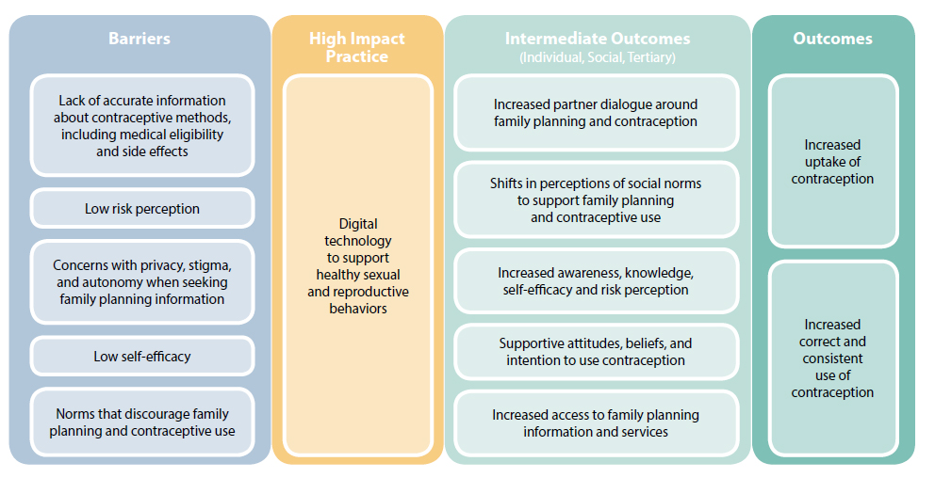
Theory of
Change
BACKGROUND
Notes:
View Figure 1 in the HIP brief (copy and paste this link into your web browser): https://www.fphighimpactpractices.org/briefs/digital-health-sbc/

Slide 9
What challenges can this HIP help address?
Digital technologies for clients contribute to improving sexual and reproductive health knowledge; influencing attitudes, beliefs, and expectations; and increasing self-efficacy in support of healthy reproductive behaviors.
Digital technologies for clients may contribute to shifting norms and increasing social support for healthy reproductive behaviors.
Digital technologies may offer more options to reach young people.
Notes:
Digital technologies for clients contribute to improving sexual and reproductive health knowledge; influencing attitudes, beliefs, and expectations; and increasing self-efficacy in support of healthy reproductive behaviors.
Five out of the six studies that examined changes in sexual and reproductive health knowledge after exposure to digital health applications found a positive effect, including improved knowledge of contraceptive options; fertility awareness; and knowledge of the menstrual cycle, side effects of contraception, and locations of health facilities or where to get condoms.
Digital technologies for clients may contribute to shifting norms and increasing social support for healthy reproductive behaviors.
Digital technologies may offer more options to reach young people.
Digital technology has the potential to provide accurate information to individuals when and where they want it and, with careful attention paid to design, may offer the added benefit of confidentiality, privacy, and anonymity—issues that are critically important to young people.

Slide 10
Evidence of Impact
Example: In Nigeria, participants opted to receive a series of 17 prerecorded interactive voice response (IVR) calls daily or twice a week, which included a drama segment followed by an interactive component where participants could choose to listen to additional information and answer call-related quizzes. This led to:
An increase in modern contraceptive use among the intervention group.
Contraceptive use in the control group remained nearly the same.
Notes:
The Digital Health for Social and Behavior Change HIP brief contains highlights from studies in Cambodia, India, Mozambique, and Nigeria. For more information, please copy and paste this link into your web browser: https://www.fphighimpactpractices.org/briefs/digital-health-sbc/
Nigeria: Participants opted to receive a series of 17 prerecorded interactive voice response calls (IVR) calls daily or twice a week, which included a drama segment (fictional stories related to using family planning methods) followed by an interactive component where participants could choose to listen to additional information and answer call-related quizzes. This led to:
An increase in modern contraceptive use among the intervention group, significantly (from 23% to 37%) while contraceptive use in the control group remained nearly the same (at about 21%).
Digital Health for Social and Behavior Change is a promising practice.
A promising practice has limited evidence, with more information needed to fully document implementation experience and impact. The advisory group recommends that such promising interventions be promoted widely, provided they are implemented within the context of research and are carefully evaluated in terms of both impact and process.

Slide 11
Implementation Tips
Engage with end-users early in the design process to decide on the most appropriate type of technology to use and how best to use it.
It is generally recommended to use technologies with which end-users are already familiar, rather than introducing new types of technologies that require a significant learning curve.
For example, if the target audience owns smartphones, tablets, or computers, then the intervention may focus on building a website or using social media sites like Facebook or Twitter.
Notes:
Engage with end-users in the design process to decide on the most appropriate type of technology to use and how best to use it.
For example, if the target audience predominantly owns basic-feature phones, then the intervention may focus on using SMS or IVR to either “push” content (e.g., a service where you sign up to receive prerecorded voice messages once a week), allow end-users to “pull” content (e.g., a service where you send a message to a short code to request information about a specific topic), or some combination.
If the target audience owns smartphones, tablets, or computers, then the intervention may focus on building a website or using social media sites like Facebook or Twitter.
It is generally recommended to use technologies with which end-users are already familiar, rather than introducing new types of technologies that require a significant learning curve.

Slide 12
Implementation Tips
Determine end-user preferences for format (e.g., text or audio), language, and frequency and dose of messaging.
Different formats have different advantages and appeal to different target audiences.
When “pushing” content directly to individuals, programs must ask potential end-users about the frequency and timing of messages.
Notes:
Determine end-user preferences for format (e.g., text or audio), language, and frequency and dose of messaging.
Interventions using SMS, IVR, hotlines, and online repositories of frequently asked questions are often appreciated for their anonymity and privacy, allowing participants to access the content they need, when they need it—attributes that are particularly attractive to young people.
Different formats have different advantages and appeal to different target audiences.
When “pushing” content directly to individuals, programs must ask potential end-users about the frequency and timing of messages.

Slide 13
Thank You
Continue to the extra slides or access the HIP brief for more information.
Notes:
For more information, please copy and paste this link into your web browser to visit this webpage with a recording of the webinar on Digital Health for Social and Behavior Change and a downloadable PDF version of the presentation: https://www.fphighimpactpractices.org/briefs/digital-health-sbc/

Slide 14
Extra Slides
Implementation Tips
Priority Research Questions
Tools & Resources
Notes:
We have put together a collection of implementation tips for Digital Health, in case you have additional time in your meeting. Further information about these tips can be found in the HIP brief.
References from the literature on this HIP can be found here (copy and paste this link into your web browser): https://www.fphighimpactpractices.org/briefs/digital-health-sbc/

Slide 15
Implementation Tips
Consider how best to protect individual privacy.
While mobile phones can increase an individual’s sense of privacy—for example, offering access to contraceptive information without having to visit a clinic or provider— they may also expose individuals to real or perceived risks that must be considered during the design of any digital health intervention.

Slide 16
Implementation Tips
Understand end-users’ literacy levels and comfort with text-based content.
IVR, hotlines, or image-based content such as graphic stories may be more appropriate for low-literacy individuals than SMS or other text-based content.

Slide 17
Implementation Tips
Test content with potential end-users for comprehension and appropriateness and test the platform for usability.
It is very important to ensure that end-users understand and interpret digital content in the intended ways.

Slide 18
Implementation Tips
Budget accurately, including initial and recurring costs, and project costs at scale.
Though actual costs vary substantially across countries and contexts, cost categories that must be budgeted can include: research, technology development (e.g., software, programming, server), hardware, data (SMS, airtime, data time), staff, and promotion.

Slide 19
Implementation Tips
Weigh the desire to reach end-users, including those most economically marginalized, against budget requirements for implementing digital health applications over the long term.
For programs focused on reaching the most vulnerable populations, it is likely that content will need to remain free or heavily subsidized for the user, and thus other innovative financial models must continue to be explored.

Slide 20
Implementation Tips
Use digital health applications’ built-in feature to support robust monitoring and evaluation.
If designed well, evaluations of digital health interventions can determine their effectiveness, including value for money, as well as impact, though these evaluations may or may not be conducted using only digital data collection methodologies.

Slide 21
Priority Research Questions
Does the use of digital applications (e.g., SMS, IVR, social media) positively impact contraceptive behavior change and social norms? Which platforms (e.g., SMS, IVR, social media) are most effective?
What is the cost, reach, and potential for sustainability of using digital health applications in different contexts?

Slide 22
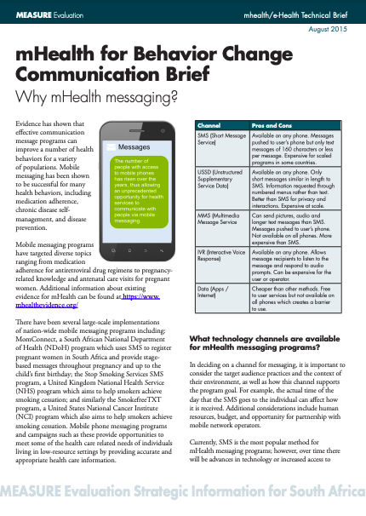
Tools & Resources
mHealth for Behavior Change Communication Brief: Why mHealth Messaging?
Notes:
mHealth for Behavior Change Communication Brief: Why mHealth Messaging? describes the importance of, and different channels for, mHealth messaging, as well as step-by-step guidance for creating an mHealth messaging program. Available from: https://www.measureevaluation.org/resources/publications/fs-15-149

Slide 23
fphighimpactpractices.org
Notes:
Subscribe to the HIPs Newsletter here (copy and paste this link into your web browser): https://mailchi.mp/76703a3652c9/hips-newsletter-sign-up
Please visit the five areas of our website to learn more about the HIPs:
HIP Products (copy and paste this link into your web browser): https://www.fphighimpactpractices.org/hip-products/
Resources (copy and paste this link into your web browser): https://www.fphighimpactpractices.org/resources/
Engage (copy and paste this link into your web browser): https://www.fphighimpactpractices.org/engage-with-the-hips/
Overview (copy and paste this link into your web browser): https://www.fphighimpactpractices.org/overview/
About Us (copy and paste this link into your web browser): https://www.fphighimpactpractices.org/partnership-structure/

